Slide 1
Second level Pretraining
Using domain specific data

Slide 2
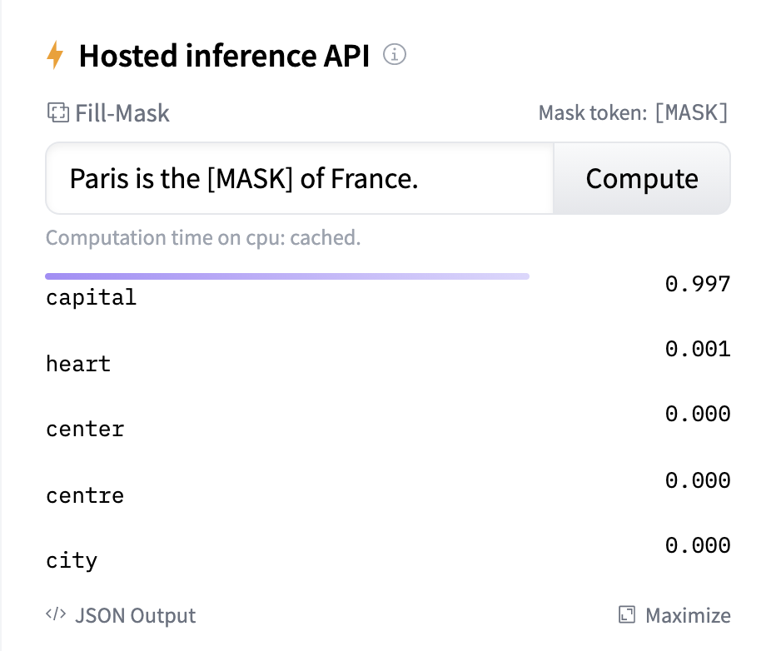
Objective: Masked language Modelling

Slide 3
2nd level Pretraining on domain specific data
Pretrained Model
for eg:
bert-base-uncased
New Pretrained model
Pretraining
(using unlabeled large corpus like Wikipedia)
2nd level Pretraining
(using a smaller Domain specific corpus)
Prediction on sentences containing Masked words
Prediction on sentences with Masked words - (Better Results)

Slide 4
implementation of Domain specific pretraining using youtube subtitles

Slide 5
Scrape Youtube for “tablet review” and get the video ids
(yt-extractor-script repo)
2. Use youtube videos api to fetch details of each video id like title, duration, publish date etc and YouTubeTranscriptApi library to fetch subtitles. Save all these details to “warehouse” DB
(yt-extractor-script repo)
3. Fetch all the subtitles from warehouse DB and pass it through DeepSegment library for meaningful separation of sentences and write them line by line to a text file
(yt-extractor-script repo) ~59K lines
Connect to PAL VPN and use selenium web driver to scrape the video ids from youtube search on “tablet review” to create a video id array
Disconnect from VPN and scrape the video ids again for the same search keyword using youtube search to create another video id array
Remove the duplicates from both the arrays and create a list of unique video ids
4. Filter out the lines containing 10 or less than 10 words per line into a text file
(yt-extractor-script repo) ~28K lines
5. Run the training code from huggingface mlm sample in Azure ML
(google-colab-files repo) ~1.5 hr with 4 GPUs
6. Run the prediction in Azure ML
(google-colab-files repo)

Slide 6
High level Steps involved in Training
Prepare domain specific dataset, preferably line by line
Load bert pretrained model and tokenizer
Tokenize text randomly, masking 15% of the words in a sentence
Train with bert pretrained model and domain specific tokenized dataset
Save the model
Use the new model to make predictions of a masked sentence

Slide 7
yt-extractor-script (github.wdf.sap.corp/sentient-commerce)
youtube-infinite-scroll.py
max-length.py
process_utils.py
subtitle_extractor_extend.py
save_to_warehouse.py
google-colab-files (github.com/eshrinivasan)*
1_run_bert_2ndlevel_trainer.py
2_run_mlm_pred.py
* These files are currently in github since I wanted to run the training in colab/azure without VPN to make the execution faster

Slide 8
Results - obtained using unseen test input
Input: "I happen to be a big fan of tablets especially large [MASK]"
Expected: tablets
Input: "I found it to reform on par with the front facing [MASK]"
Expected: sensors
bert-large-uncased | bert-large-uncased + 4K lines of domain specific data | bert-large-uncased + 28K lines of domain specific data
ones tablets screens displays games tablet devices windows computers screen | screen tablets tablet games screens size windows scale ##s . | ones tablets screens displays games tablet devices windows computers screen
bert-large-uncased | bert-large-uncased + 4K lines of domain specific data | bert-large-uncased + 28K lines of domain specific data
screen display speakers windows camera tablet monitor wall speaker surface | screen display speakers windows camera tablet monitor wall speaker surface | camera cameras view screen display mirror facing monitor eye Side

Slide 9
Results - obtained using unseen test input
Input: "[MASK] is neither too glaring nor dark and the ips panel"
Expected: brightness
Input: "brightness is neither too [MASK] nor dark and the ips panel"
Expected: glaring
bert-large-uncased | bert-large-uncased + 4K lines of domain specific data | bert-large-uncased + 28K lines of domain specific data
it this which that tablet what everything one the light | it this which that tablet what everything one the light | it this which that everything there color brightness what here
bert-large-uncased | bert-large-uncased + 4K lines of domain specific data | bert-large-uncased + 28K lines of domain specific data
bright light dark clear loud high nice good pale white | bright light dark clear loud high nice good pale white | bright light good clear high much loud nice white vivid

Slide 10
RESULTS - obtained using unseen test input
Input: "the only downside to this tablet is the driver [MASK] with Photoshop"
Expected: compatibility
Input: "the sound from the [MASK] is very good for this price range"
Expected: speakers
bert-large-uncased | bert-large-uncased + 4K lines of domain specific data | bert-large-uncased + 28K lines of domain specific data
issues problems issue problem side loaded available crash here itself | issues problems issue problem side loaded available crash here itself | interface issues compatibility installed issue problems experience comes working work
bert-large-uncased | bert-large-uncased + 4K lines of domain specific data | bert-large-uncased + 28K lines of domain specific data
speakers speaker pen tablet box screen camera battery keyboard microphone | speakers speaker pen tablet box screen camera battery keyboard microphone | speakers speaker tablet screen pen phone device box camera driver

Slide 11
Terminologies
BERT is transformers model pretrained on a large corpus of English data in a self-supervised fashion. It is designed to read in both directions at once
Transformers is a deep learning model in which every output element is connected to every input element, and the weightings between them are dynamically calculated based upon their connection
Masked language modelling (MLM) is taking a sentence, the model randomly masks 15% of the words in the input then run the entire masked sentence through the model and has to predict the masked words
Transfer learning means to apply the knowledge that some machine learning model holds (represented by its learned parameters) to a new (but in some way related) task
Fine tuning means taking some machine learning model that has already learned something before (i.e. been trained on some data) and then training that model (i.e. training it some more, possibly on different data)
Pretrained model is a saved network that was previously trained on a large dataset, typically on a large-scale image-classification task. You either use the pretrained model as is or use transfer learning to customize this model to a given task
Notes:
Bidirectional Encoder Representations from Transformers (BERT)

