Slide 1

Q3 2026 Business Review
Northwind Labs, operations and growth
Northwind Labs | Confidential | Q3 2026 Business Review

Slide 2
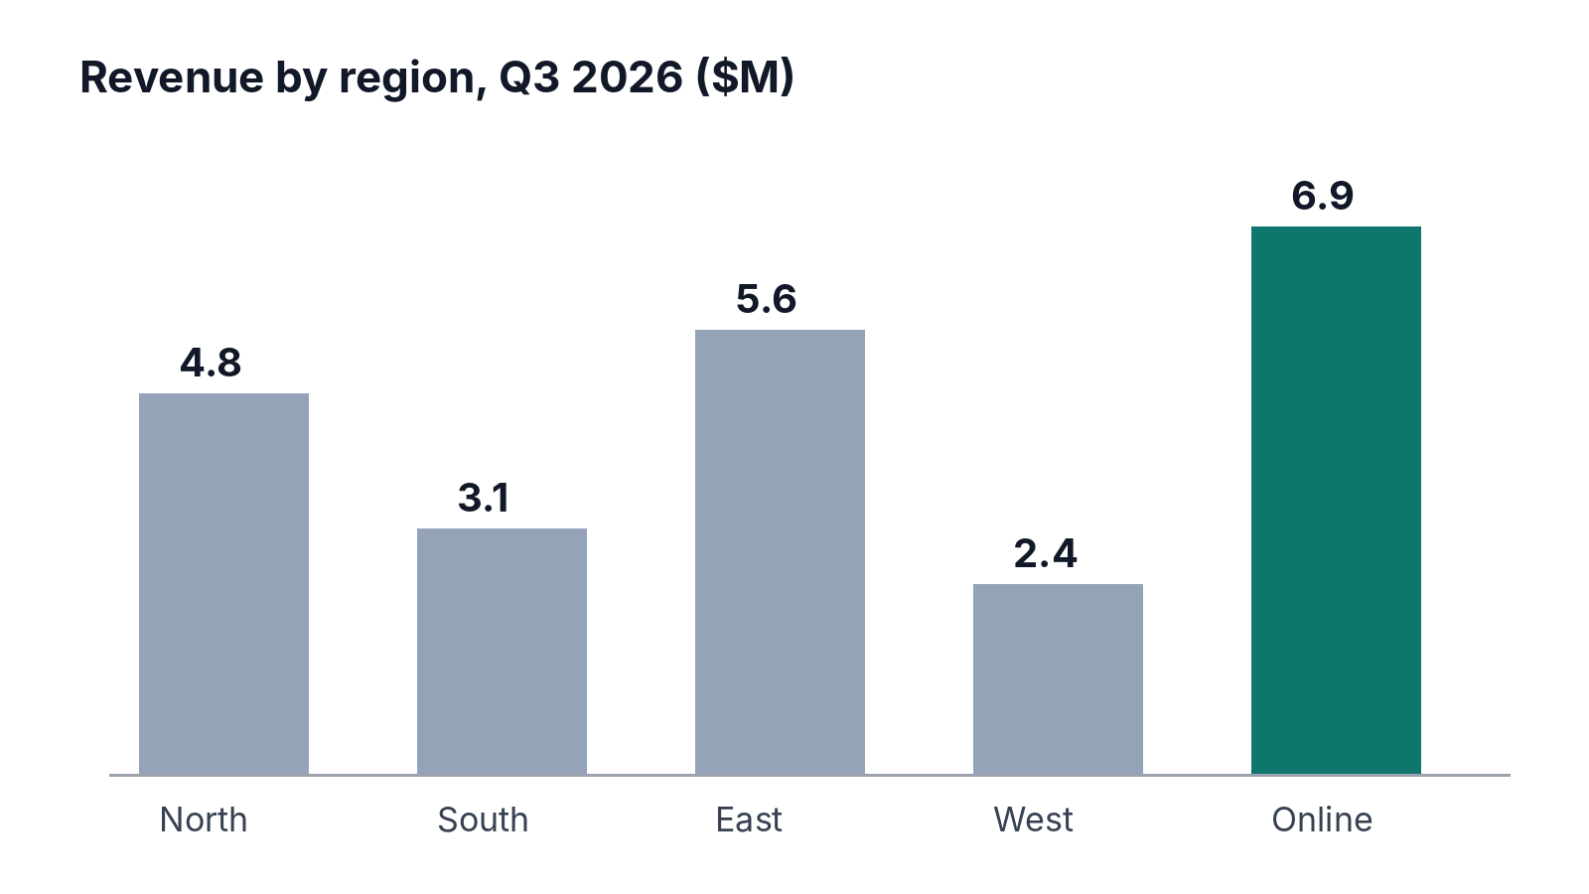
Headline numbers
Revenue reached $22.8M, up 14% on Q2.
Gross margin held at 41%.
Online overtook every region for the first time.
Northwind Labs | Confidential | Q3 2026 Business Review
Notes:
Stress that Online grew 38% while South shrank.

Slide 3
Regional detail
Region | Revenue | vs Q2 | Margin
North | $4.8M | +9% | 43%
South | $3.1M | -4% | 37%
East | $5.6M | +12% | 44%
West | $2.4M | +2% | 35%
Online | $6.9M | +38% | 42%
Northwind Labs | Confidential | Q3 2026 Business Review

Slide 4
Monthly active customers
Growth slowed in September after the price change.
Northwind Labs | Confidential | Q3 2026 Business Review

Slide 5
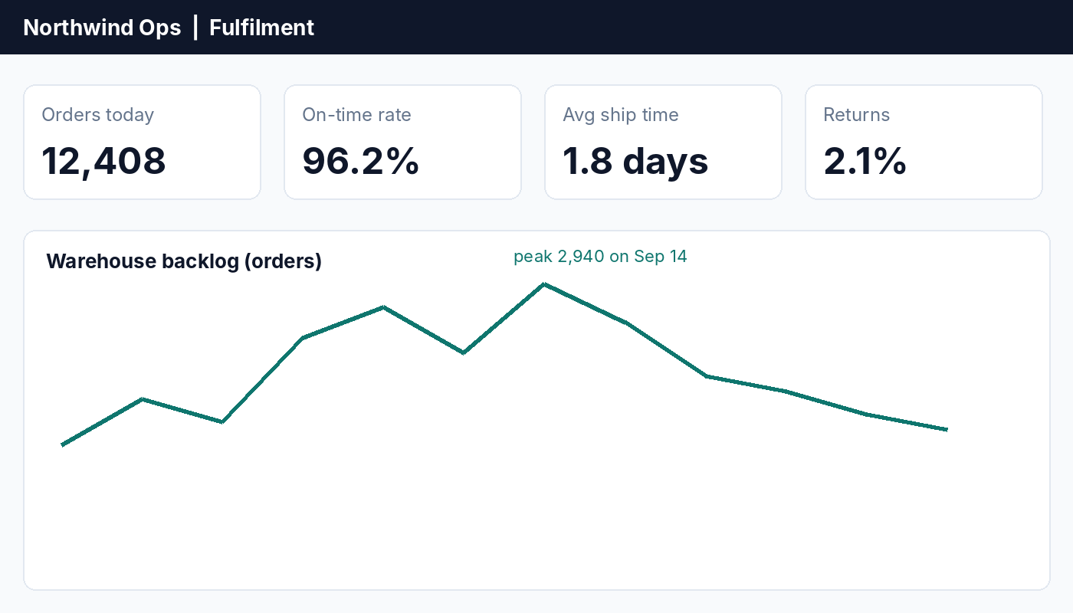
Fulfilment
On-time delivery improved to 96.2%.
Backlog peaked mid-September, then cleared.
Northwind Labs | Confidential | Q3 2026 Business Review

Slide 6

Our team
Hiring: 6 engineers and 4 analysts joined in Q3.
Northwind Labs | Confidential | Q3 2026 Business Review

Slide 7
Q4 priorities
1. Renew the Atlas Freight contract (decision by Oct 20)
2. Launch the loyalty programme in November
3. Cut average ship time below 1.5 days
Northwind Labs | Confidential | Q3 2026 Business Review

Slide 8
Questions
ops@northwind.example
Northwind Labs | Confidential | Q3 2026 Business Review

