Slide 1

RNS INSTITUTE OF TECHNOLOGY
DEPARTMENT OF INFORMATION SCIENCE AND TECHNOLOGY
TOPIC:-
WHOLESALE MANAGEMENT SYSTEM
SUBMITTED TO:-
Mr. R Rajkumar
ISE DEPT
SUBMITTED BY:-
HARSHITH KUMAR V S
(1RN16IS036)
ESHWAR CHANDRA VIDYA SAGAR G. (1RN16IS031)
GUIDE:-
Mrs. Anusha U A
ISE DEPT

Slide 2
ABSTRACT
➧Wholesale management system is developed aim to improve the efficiency
and performance of daily business activity of the wholesaler. The wholesaler did not have any computerized system for now.
➧All the business activity are recorded and documented. A lot of time is consumed during the -process of the business activity. This project will develop a computerized system for helping the wholesaler in processing the daily business activity.
➧Methodology used for developing this project is System Development Life Cycle (SDLC). This project will be focus on sales record management, purchase record management, stock management,customer information management, manufacturer management, staff information management, payment management, stock management, payment and report management.

Slide 3
AGENDA
➧ INTRODUCTION
➧IMPLEMENTATION
➧SCHEMA DIAGRAM
➧ER DIAGRAM
➧ LOGIN FORM
➧RESULT SNAPSHOTS AND QUERIES
➧CONCLUSION AND FUTURE ENHANCEMENTS
➧THANK YOU

Slide 4
INTRODUCTION
Wholesale management system is the process of buying the stock from buyers and the selling to the customers. It acts as the intermediate between the buyers and the sellers. The manager has to buy the stock from the buyers. Managing the details that is regarding the wholesale is not possible to be kept in track through pen and paper mode. It requires the database system where we can store the information of the people involved in the wholesale system management. It can be stored clearly in the database with more precision and can avoid the redundant data.

Slide 5
IMPLEMENTATION
Software requirement
➤Front End Tools: HTML,JavaScript,CSS,PHP
➤Back End Tools: phpmyadmin
➤MySQL database
➤Xampp server
Hardware requirement
➤CPU: Pentium processor
➤RAM: 8GB
➤HDD: 1TB

Slide 6
SCHEMA DIAGRAM
Category
category_id | category_name
Customer_information
customerid | name | address | phone | password
Supplier_info
supplier_id | sname | address | phone
product
product_id | pname | category_id | supplier_id | q_in_stock | unit_price | reorder_level
Transaction_details
transaction_id | product_id | quantity | discount | total_amount | trans_init_date
Payment
transaction_id | amount_paid | mode | transaction_date
Price_list
product_id | usp
Depleted_products
product_id | quantity
Transaction_info
transaction_id | customer_id | trans_init_date

Slide 7
product_id
pname
customer_id
name
1
q_in_stock
address
N
Category
products
Product
unit_price
p_no
customer_id
1
reorder_level
category_id
cate_name
N
N
N
password
1
has
has
has
N
N
transaction_id
Price_list
N
supply
N
Transaction_info
usp
Can have
1
has
tran_init_date
supplier_id
phone
M
amount_paid
Supplier_info
sname
M
Payment
address
Transaction_details
mode
tran_date
quantity
tran_init_date
discount
total_amt
ER Diagram

Slide 8
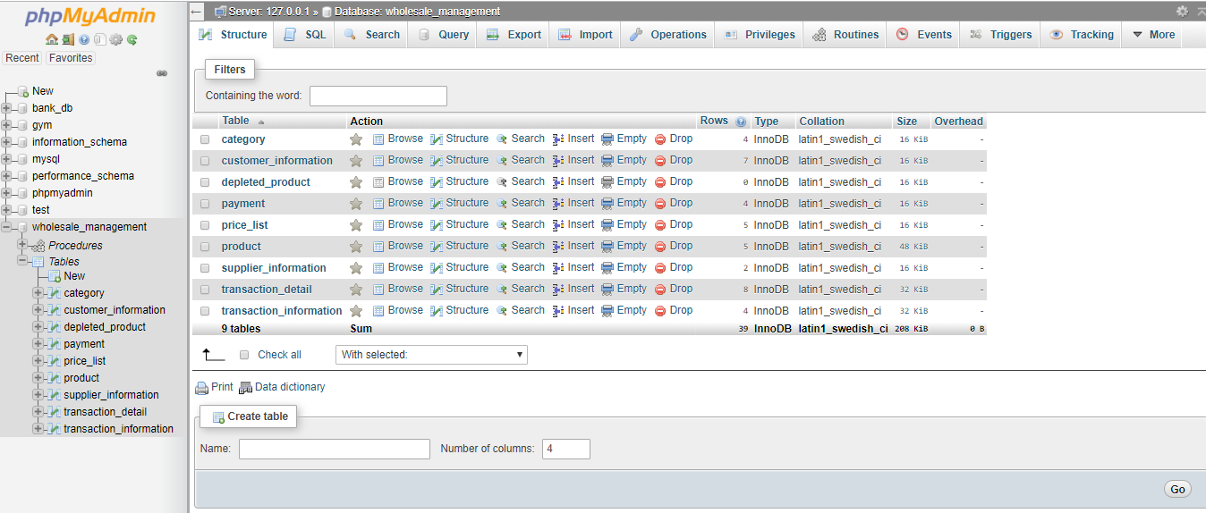
Structur
This figure shows all the tables in the database.

Slide 9

LOGIN FORM
This fig shows login window which allows authenticated user to login

Slide 10
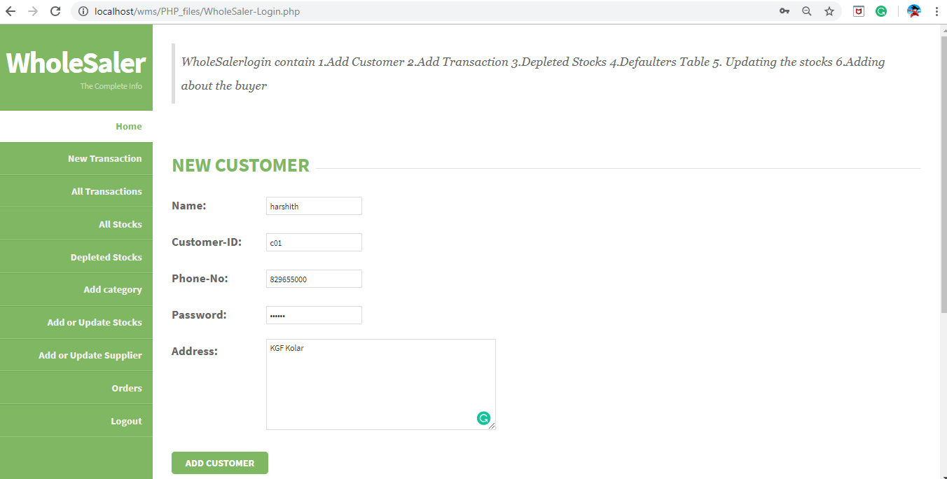
HOME PAGE
This shows the home page of user.Which contains name,customer_id,phone no etc.

Slide 11
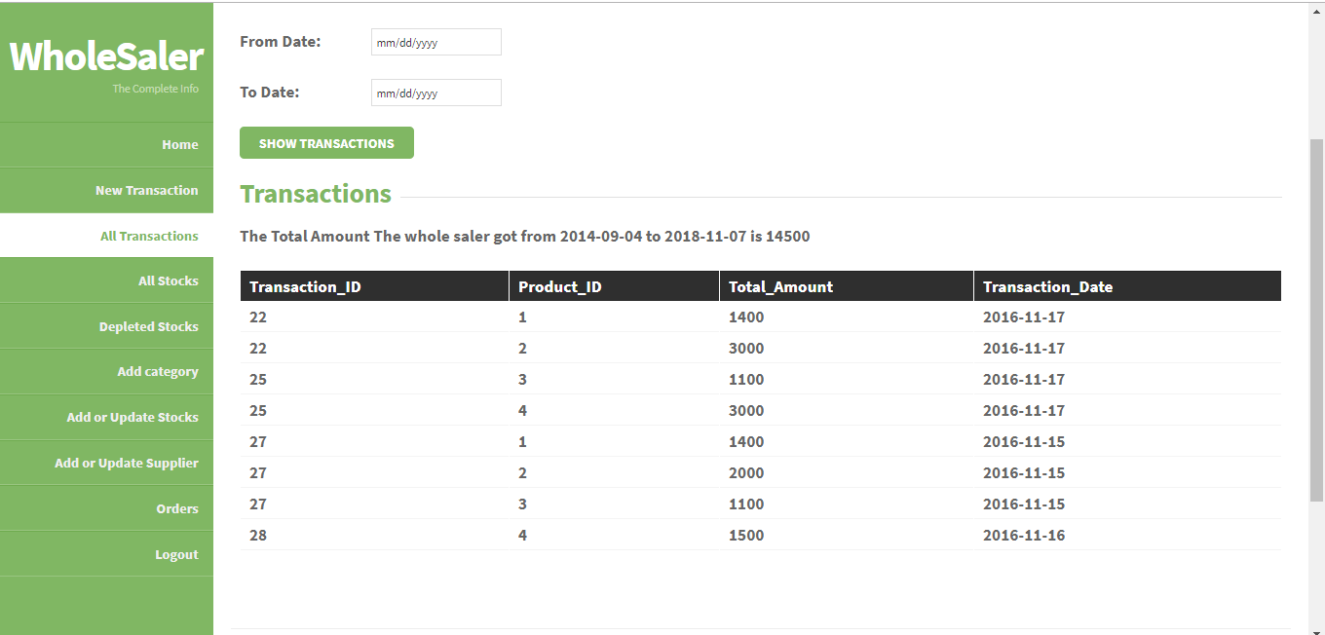
ALL TRANSACTION
This fig shows transactions that has taken place in an interval of time.

Slide 12
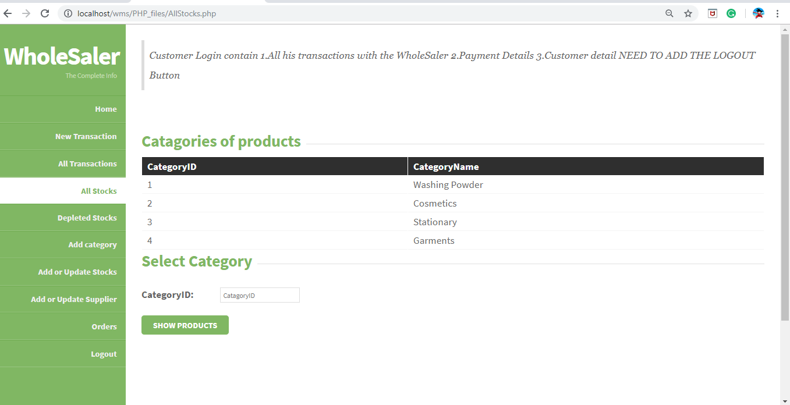
ALL STOCKS
This shows all the products available for sale.

Slide 13
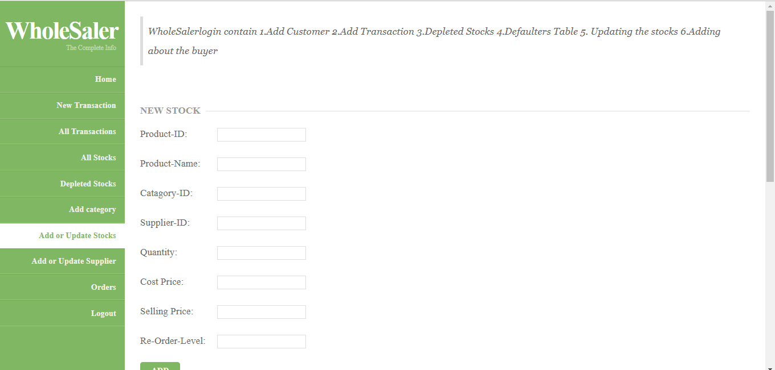
ADD OR UPDATE STOCKS
We can update or add stocks in this window.

Slide 14
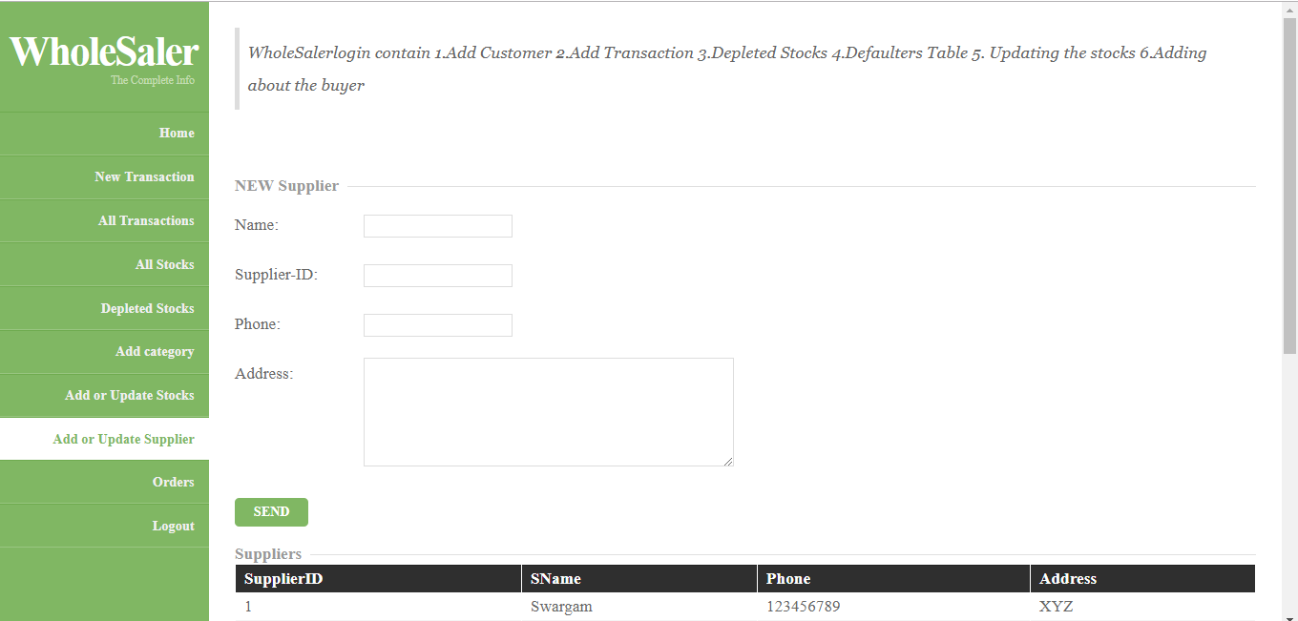
ADD OR UPDATE SUPPLIER
Using this window we can add or update supplier information.

Slide 15
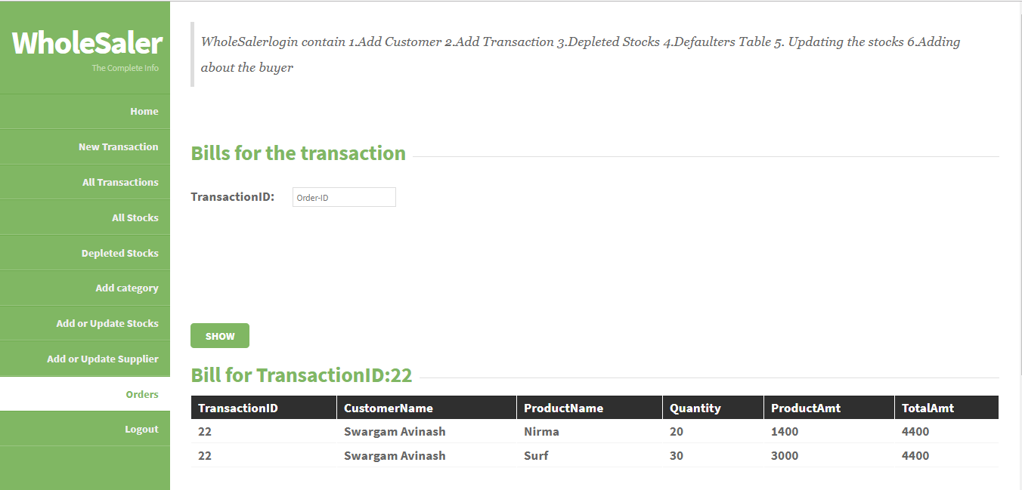
ORDERS
This figure shows all the transactions done by an id.

Slide 16
CONCLUSION AND FUTURE ENHANCEMENTS
Wholesale Management System concluded as below
CONCLUSION
➧The system was mainly designed to reduce the manual work of updating and tracking
and also make it easier for the user .
➧It also provide flexible and powerful reports regarding customer details,transaction
Details andstock details .
FUTURE ENHANCEMENTS
This project can be easily implemented under various situations. Can add new features
when it requires.We can also include online payment services to this project using
some payment applications like Paytm, BHIM,Phonepay etc .

Slide 17
REFERENCES
[1] Ramez Elmasri and Shamkant B. Navathe ,7th Edition Pearson
[2] W3Schools
https:/www.w3schools.com/html/
https:/www.w3schools.com/css/
https:/www.w3schools.com/sql/
https:/www.w3schools.com/php/
[3] Wikipedia

Slide 18
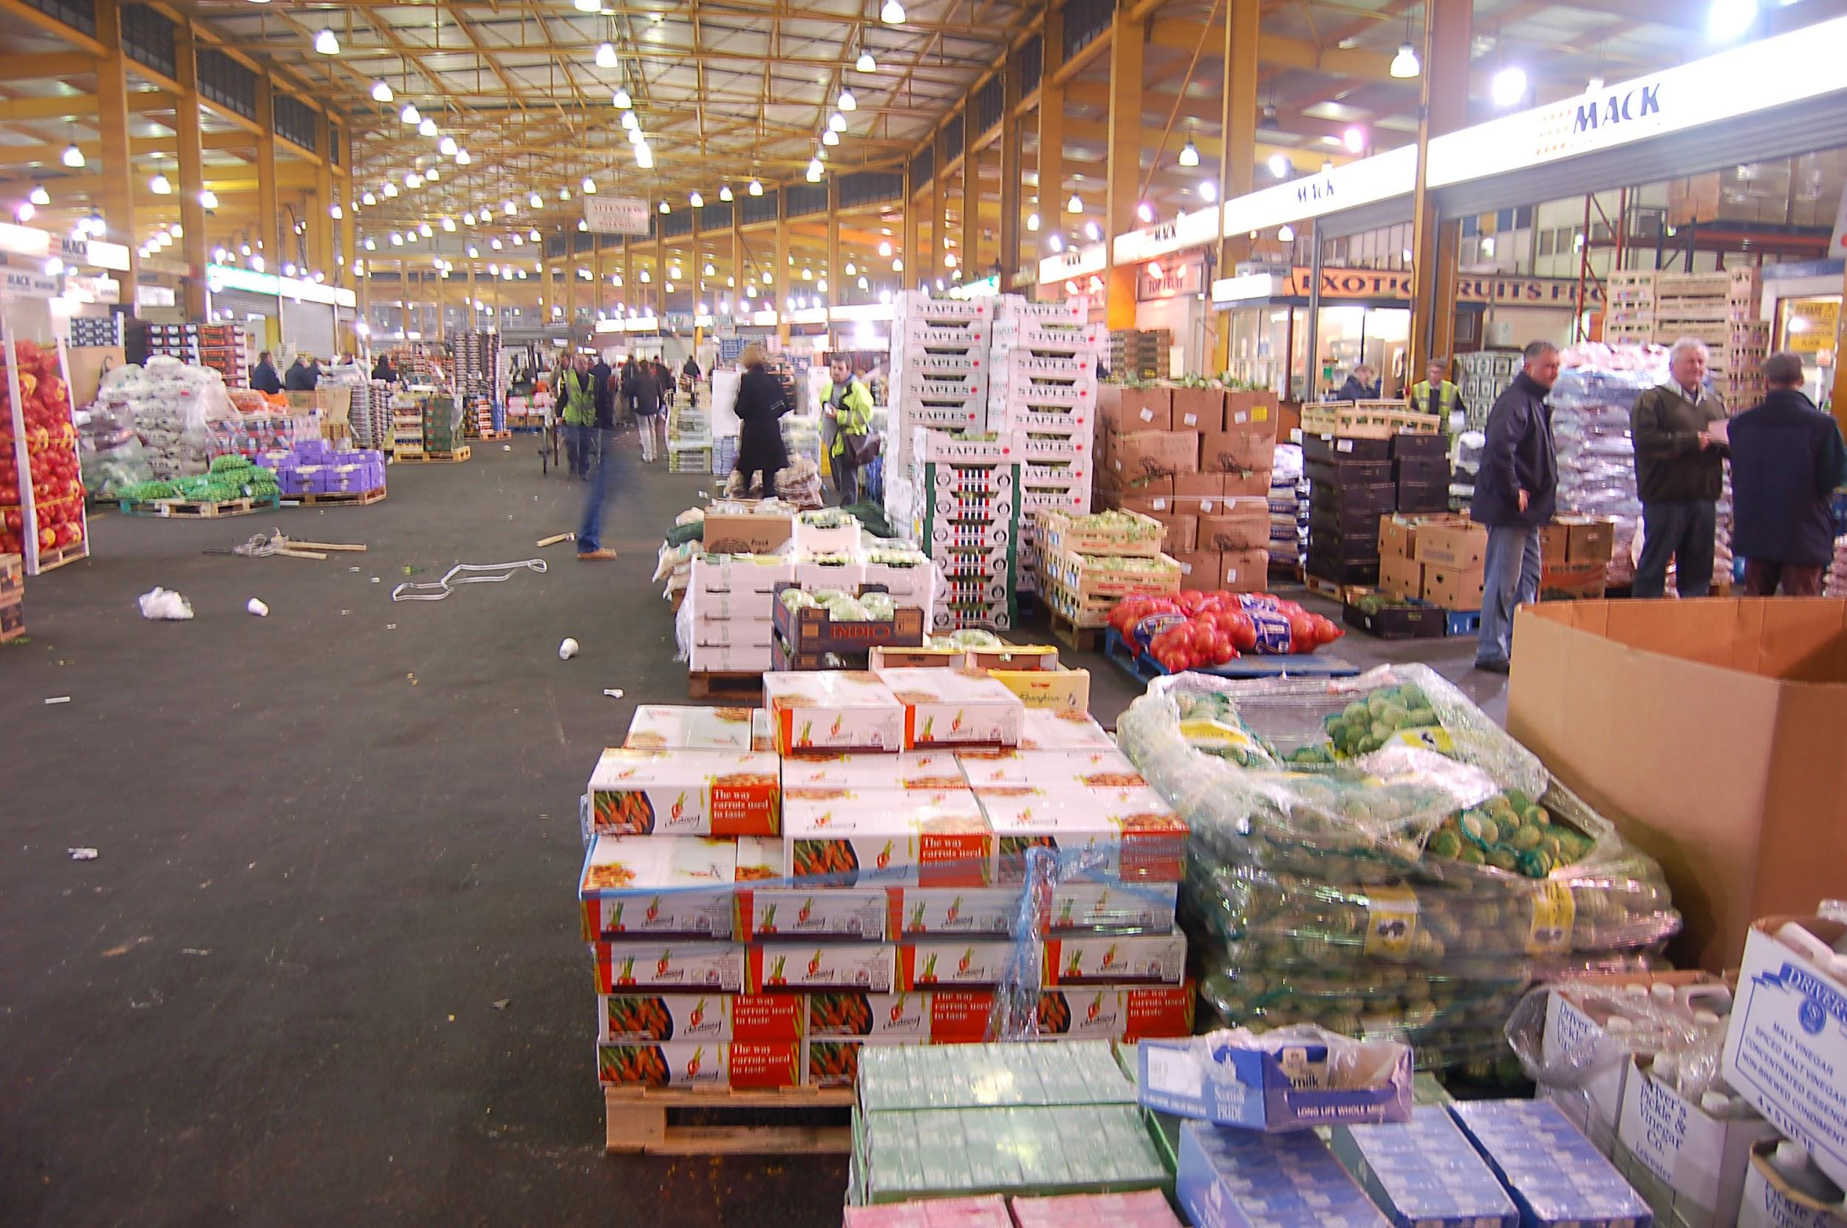
THANK YOU

