Slide 1
CS397 - CAPSTONE PROJECT
Name | R.Eshwar
Roll No | 2101AI25
Supervisor | Dr.Mayank Agarwal

Slide 2
INTRUSION DETECTION SYSTEMS

Slide 3
INTRODUCTION
Intrusion Detection Systems (IDS) are vital cybersecurity tools. They continuously monitor networks and systems for suspicious activity, such as unauthorized access or malware.
Marking an activity suspicious or non - suspicious can be modelled as a pattern recognition problem. Our work is to come up with ML algorithms that can learn the patterns better.

Slide 4
INTRODUCTION (Contd..)
Types of Intrusion Detection Systems :
1.Signature-based Detection : This method compares observed network traffic or system activity to a database of known attack signatures. It is effective in detecting known threats but may miss novel or previously unseen attacks.
2.Anomaly-based Detection : Anomaly detection establishes a baseline of normal behavior for a network or system and flags any deviations from this baseline as potential intrusions. While effective at detecting unknown threats, it can also generate false positives.
3.Hybrid-based Approach : By combining these methods, hybrid-based IDS can achieve greater accuracy and coverage in detecting a wide range of cyber threats. For example, signature-based detection can catch known attacks, while anomaly-based detection can identify unusual behavior indicative of novel threats.

Slide 5
DATASETS FOR TRAINING
NSL-KDD and UNSW-NB15 are datasets commonly used in cybersecurity research and machine learning experiments for evaluating intrusion detection systems (IDS) and related security algorithms.
NSL-KDD (KDD Cup 1999 dataset after feature selection) is a refined version of the original KDD Cup 1999 dataset, which was widely used in early research on intrusion detection. The original KDD Cup 1999 dataset had several limitations, including redundant and irrelevant features, which made it less suitable for modern machine learning techniques.
UNSW-NB15 is a publicly available dataset created by the University of New South Wales (UNSW) in Australia. It was generated from raw network traffic data collected in a controlled lab environment, where various types of attacks were launched against a simulated network.

Slide 6
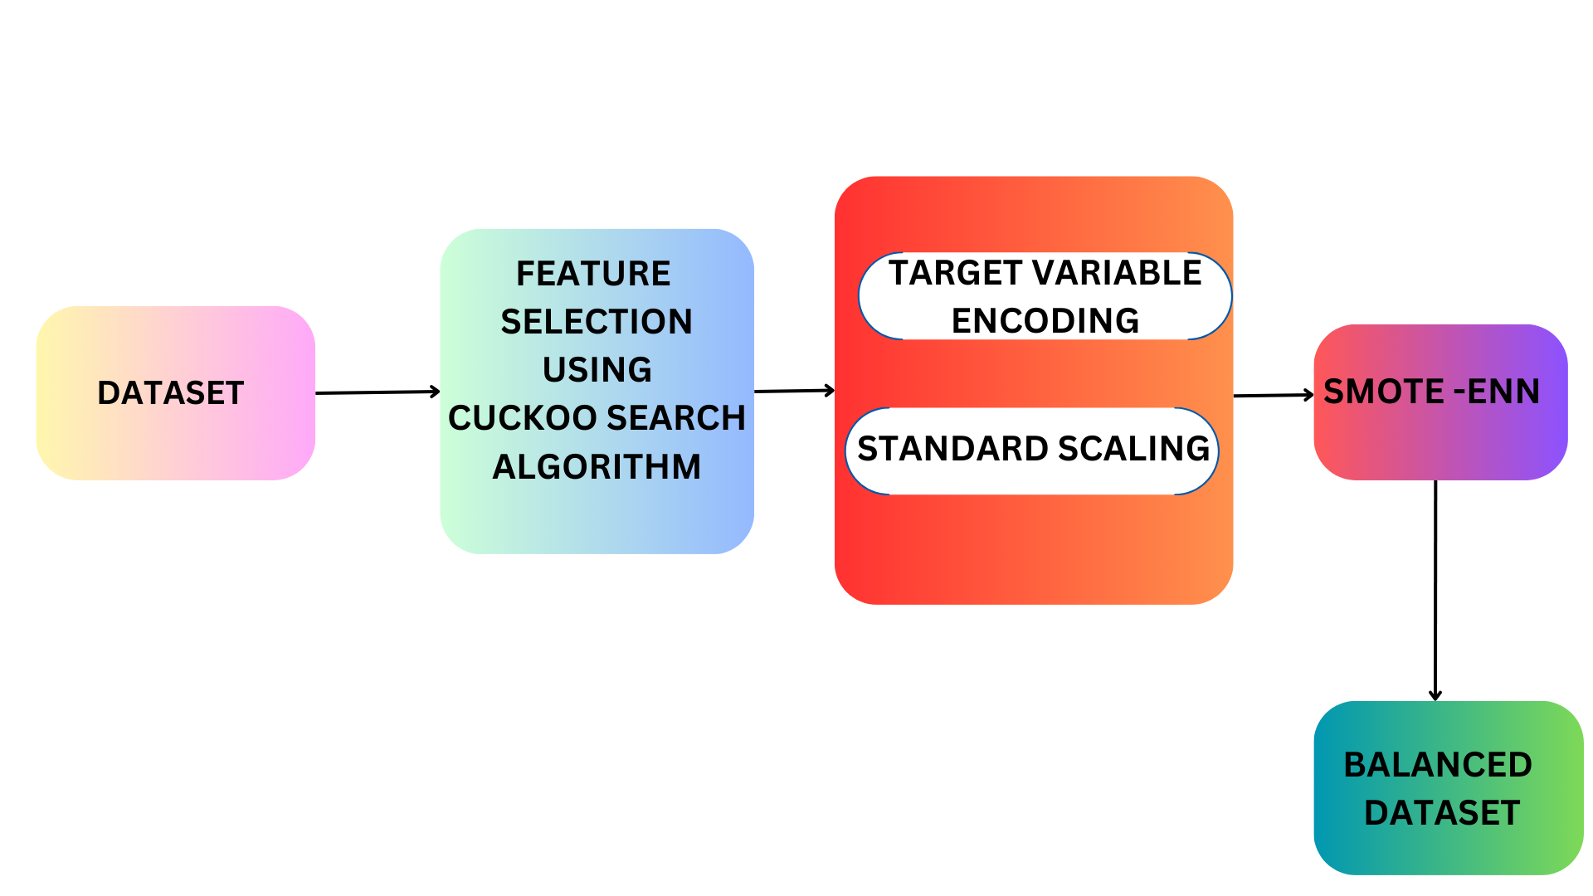
DATASET PREPROCESSING :

Slide 7
CLASSES IN UNSW NB15 DATASET
Fuzzers : Represents normal network traffic without any malicious activity.
Analysis : Represents activities related to analysis or monitoring of the network.
Backdoors : A backdoor in the network, allowing unauthorized access.
DoS : Attacks aimed at disrupting network services
Exploits : Indicates attempts to exploit vulnerabilities in network systems or applications.
Generic : Represents miscellaneous or uncategorized network traffic.
Reconnaissance : Activities where attackers gather information about the target network.
Shellcode : The presence of shellcode, typically used in exploitation attempts.
Worms : Self-replicating malware in the network.

Slide 8
CLASSES IN NSL KDD DATASET
DoS (Denial of Service): Indicates attacks aimed at disrupting network services or making resources unavailable to legitimate users.
Probe: Represents reconnaissance activities where attackers scan or probe the target network to gather information.
R2L (Remote-to-Local): Indicates unauthorized attempts to gain access to a target system from a remote location.
U2R (User-to-Root): Represents attempts to exploit vulnerabilities in the target system to escalate privileges and gain administrative access.

Slide 9

RESULTS : BASELINE COMPARISON FOR UNSW
(* References attached)

Slide 10

RESULTS : BASELINE COMPARISON FOR NSL KDD

Slide 11
REFERENCES
1.Yao, W.; Hu, L.; Hou, Y.; Li, X. A Lightweight Intelligent Network Intrusion Detection System Using One-Class Autoencoder and Ensemble Learning for IoT. Sensors 2023, 23, 4141. https://doi.org/10.3390/s23084141
2.Yin, Y., Jang-Jaccard, J., Xu, W. et al. IGRF-RFE: a hybrid feature selection method for MLP-based network intrusion detection on UNSW-NB15 dataset. J Big Data 10, 15 (2023). https://doi.org/10.1186/s40537-023-00694-8
3.Mambwe Sydney, Kasongo. (2021). An advanced Intrusion Detection System for IoT Based on GA and Tree based Algorithms. IEEE Access. PP. 1-1. 10.1109/ACCESS.2021.3104113.
4.S. Das et al., "Network Intrusion Detection and Comparative Analysis Using Ensemble Machine Learning and Feature Selection," in IEEE Transactions on Network and Service Management, vol. 19, no. 4, pp. 4821-4833, Dec. 2022, doi: 10.1109/TNSM.2021.3138457.

Slide 12
REFERENCES (Contd…)
5.Yao, W.; Hu, L.; Hou, Y.; Li, X. A Lightweight Intelligent Network Intrusion Detection System Using One-Class Autoencoder and Ensemble Learning for IoT. Sensors 2023, 23, 4141. https://doi.org/10.3390/s23084141
6.Hybrid Intrusion Detection using MapReduce based Black Widow Optimized Convolutional Long Short-Term Memory Neural Networks. https://doi.org/10.1016/j.eswa.2022.116545
7.Wang C,Sun Y, Lv S, Wang C, Liu H, Wang B. Intrusion Detection System Based on One-Class Support Vector Machine and Gaussian Mixture Model. Electronics. 2023; 12(4):930.https://doi.org/10.3390/electronics12040930.
8.S. Das, M. Ashrafuzzaman, F. T. Sheldon, and S. Shiva, “Network Intrusion Detection using Natural Language Processing and Ensemble Machine Learning,” 2020, https://doi:10.1109/SSCI47803.2020.9308268.

Slide 13
THANK YOU

