Slide 1

DIGITAL CERTIFICATE
VERIFICATION SYSTEM
BLOCKCHAIN AND CRYPTOCURRENCY - CS577
SSA DESHIK
R ESHWAR
T SAINADH
16th November 2024
2101AI32
2101AI25
2101CS77

Slide 2
OBJECTIVE!
The requirement to quickly validate degree credentials creates new business prospects even as the number of universities, higher education students, and annual graduates rises steadily.
Fake certificates are easily obtained in India. Businesses that hire thousands of new hires invest a lot of money on having applicants' transcripts and educational credentials validated.
This issue can be resolved with a digital certificate that uses blockchain technology.

Slide 3
NEED OF BLOCKCHAIN
Integrity and Transparency
- Each certificate has a unique address on the blockchain and cannot be changed.
Verification of Authenticity
- Blockchain certificates are verified by a transaction containing the certificate's address.
Decentralization
- Blockchain is a decentralized system where no central authority controls it.

Slide 4
ROLES AND FUNCTIONALITIES
Admin Role:
Assigns Ethereum addresses to universities/institutes.
Institute Role:
Creates courses and issues certificates.
Generate student account addresses.
Student Role:
Retrieves and verifies certificates.
Verifier Role:
Checks authenticity via blockchain.

Slide 5
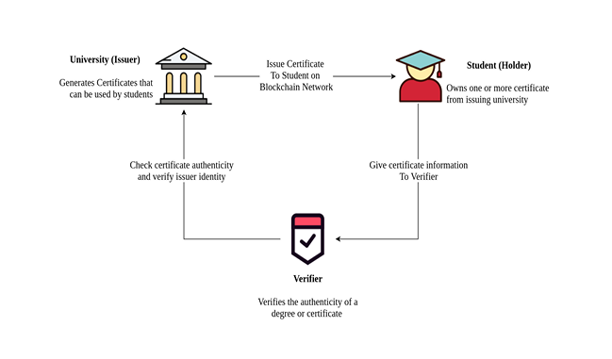
WORKFLOW

Slide 6
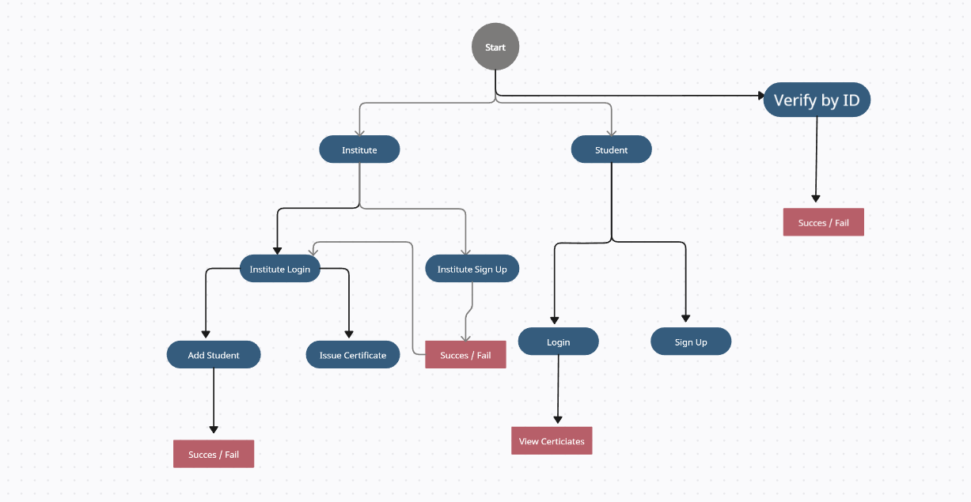
ACTIVITY DIAGRAM

Slide 7
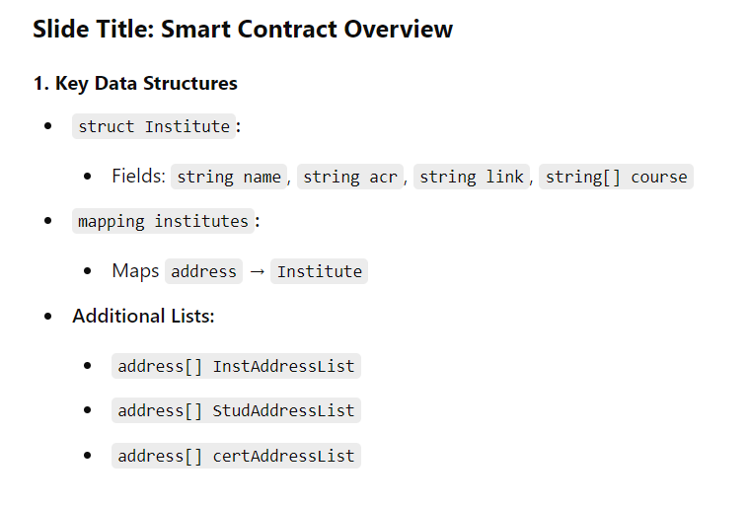
SMART CONTRACT OVERVIEW
struct Institute(string name,string acr,string link,string[] course)
mapping institutes(address => Institute)
address[] InstAddressList, StudAddressList, certAddressList
function addInstitute(Institute), viewInstitute(instAddress), getInstituteName(instAddress), viewAllInstitutes()
mapping students(address => string) // name
function addStudent(studAddress, name), getStudentName(address)
struct Certificate(certAddress, studAddress, instAddress, *)
mapping certificates(address=>Certificate)
function issueCertificate(Certificate), viewCertificate(certAddress), viewStudCertificate(studAddress)

Slide 8
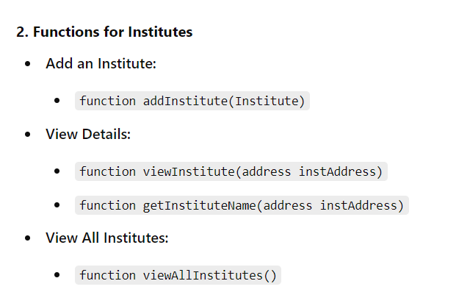
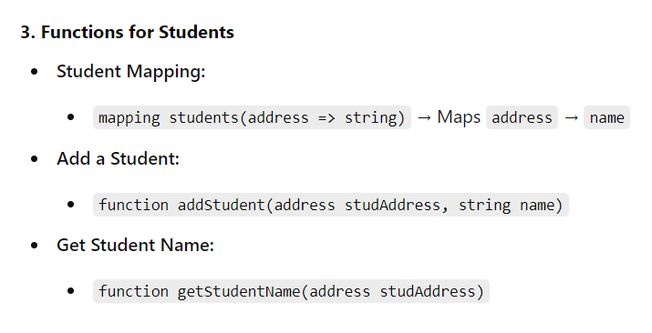
SMART CONTRACT OVERVIEW

Slide 9
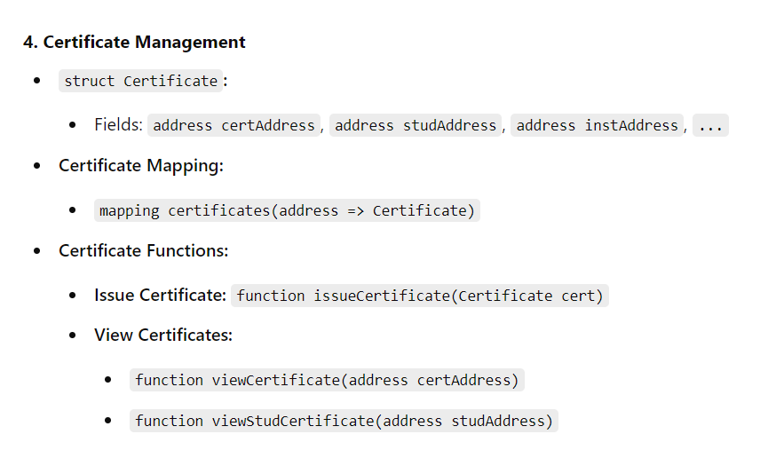
SMART CONTRACT OVERVIEW

Slide 10
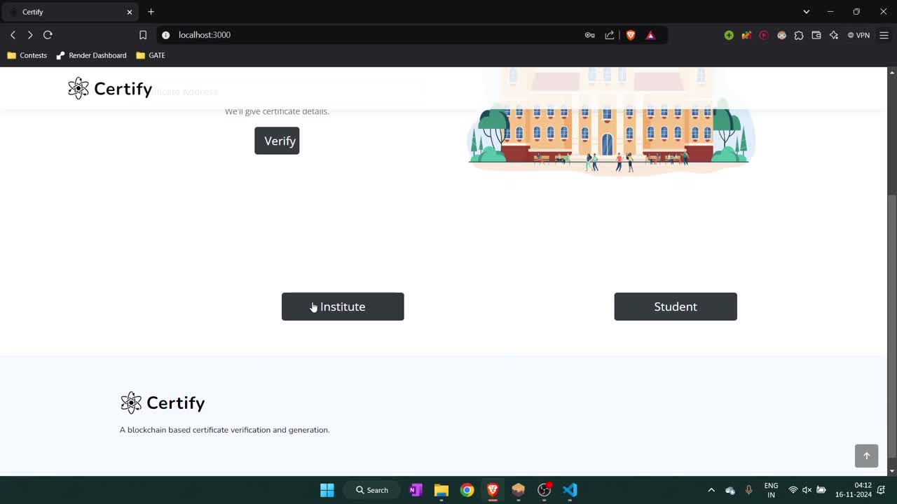
DEMO

Slide 11
TECH STACK USED
Smart Contract: Solidity for backend logic.
Frontend and backend : EJS, Node.js , Express.js
Blockchain: Ethereum network for decentralized storage.
Database : MongoDB
Tools : VS Code , ganache , MongoDB Compass.
Others : truffle, web3, bcrypt.
Find instructions with code here : https://github.com/eshwar0210/Certify

Slide 12
THANK YOU
SSA DESHIK
R ESHWAR
T SAINADH
16 November 2024
2101AI32
2101AI25
2101CS77

