Slide 1
COMPUTER VISION CS385
R.Eshwar
2101AI25

Slide 2
HANDWRITING RECOGNITION
SYSTEM WITH CNN & LSTM

Slide 3
Problem Statement and Objective
Task : To recognize handwritten text and convert it into a machine-readable format.
Objective : To develop a model that accurately interprets and transcribes handwritten text.

Slide 4
METHODOLOGY
Dataset - I.A.M Dataset which contains handwritten english words with labels
Model - A series of convolution layers followed by max pooling for feature extraction
- Bidirectional LSTMs for sequence modelling
- Label encoded layer for calculating loss predicted from LSTM.
Metric - To evaluate the model performance on validation dataset we use
Edit Distance - A standard metric which is a famous dynamic programming problem.
* Minimum no of transformations required to complete transform a string to another.

Slide 5
DATASET
Total of 115320 training samples with labels are available in dataset.
All of the samples are isolated and labelled words.
Split used for train test validation = 0.90 : 0.5 : 0.5
Total unique characters : 78
Max token length of word : 21

Slide 6
IMAGE PRE-PROCESSING
We have to work with rectangular images.
While aspect-unaware resizing square images doesn’t introduce distortion but for rectangular images it isn’t the case.
But resizing images to a uniform size is a requirement for mini-batching.
I have resized them as image_width = 128, image_height = 32
So we need to perform our resizing such that the following criteria are met.
Aspect ratio is preserved.
Content of the images is not affected.

Slide 7
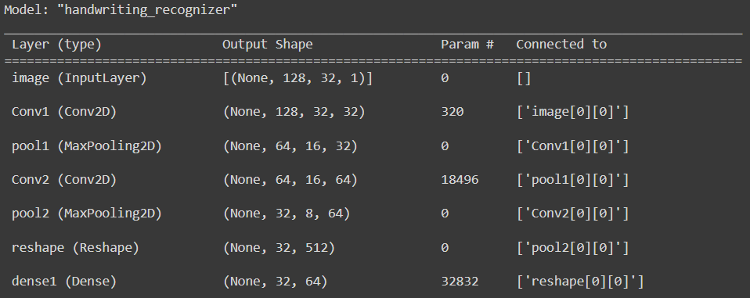
PROPOSED MODEL

Slide 8
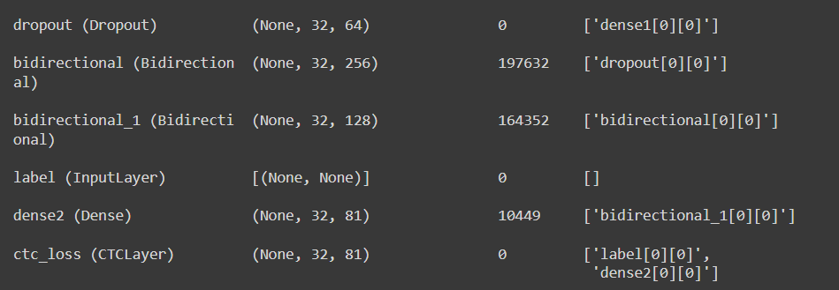
PROPOSED MODEL (Contd..)

Slide 9
PARAMETERS AND OUTPUT SHAPE CALCULATIONS (1)
1.Layer Conv1 uses 32 : (3,3) matrices . So 9 weights in (3,3) matrix + 1 bias parameter.
Total parameters = (3*3*1+1) * 10 = 320.
Same padding is used so input and output shapes match together.
2.Layer Pool1 uses (2,2) matrix. Max has no weights.
Total parameters = 0
Width and height of last layer matrix is halved.
3. Layer Conv2 uses 64 : (3,3) matrices . So 9 weights in (3,3) matrix + 1 bias parameter.
Total parameters = (3*3*32 + 1 )*64 = 18496 [ 32 is last layer channels ].
Same padding is used so input and output shapes match together.

Slide 10
PARAMETERS AND OUTPUT SHAPE CALCULATIONS (2)
4.Layer Pool2 uses 32 : (2,2) matrices. Max has no weights.
Total parameters = 0
Width and height of last layer matrix is halved.
5.Layer reshape : Reshapes the last layer output which is current input.
Total parameters = 0
new_shape = ((image_width // 4), (image_height // 4) * 64).
6.Layer Dense-1 uses 64 units
Total parameters = (512+1)*64 = 32832 parameters.
Width remains same , height of last layer matrix is now 64.

Slide 11
PARAMETERS AND OUTPUT SHAPE CALCULATIONS (3)
7.Layer Dropout uses 0.2 probability to drop some connections.
Total parameters = 0
Output shape is same as input shape.
8.Layer Bidir LSTM uses 128 units and 0.25 probability of dropout.
Total parameters = 2* ((64 * 4 * 128 ) + (128 *4 * 128 ) + 4*128 ) = 197632
4 - Input gate, forget gate , cell state , output gate, 2 for bi-directional .
Output shape is (32,256) 256 is concatenation of outputs from forward & backward 128 units.

Slide 12
PARAMETERS AND OUTPUT SHAPE CALCULATIONS (4)
Parameters=(Input size×4×Units)+(Units×4×Units)+4×Units
9.Layer Bidir LSTM 2 uses 64 units and 0.25 probability of dropout.
Total parameters = 2* ((256 * 4 * 64) + (64 *4 * 64) + 4*64 ) = 164352
4 - Input gate, forget gate , cell state , output gate, 2 for bi-directional .
Output shape (32,128) 128 is concatenation of outputs from forward & backward 64 units.
10.Layer Dense-1 uses 81 units
Total parameters = (128+1)*81 = 10449 parameters.
Width remains same , height of last layer matrix is now 81.

Slide 13
ANALYSIS OF OUTPUT LAYER
OUTPUT LAYER HAS 81 UNITS.
UNIQUE CHARACTERS ARE 79 + 2 SPECIAL TOKENS
EACH UNIT IS INTERPRETED AS PROBABILITY OF CHARACTER FOR CONSIDERATION FOR PREDICTION OF WORD.

Slide 14
METRIC FOR LOSS CALCULATION.
1.The edit distance metric, also known as the Levenshtein distance, is a measure of the similarity between two sequences of items.
2.Definition: The edit distance between two sequences is the minimum number of edits (insertions, deletions, or substitutions) required to transform one sequence into the other.
3.Lower edit distance indicates higher similarity between the predicted and ground truth sequences.
4.A perfect match results in an edit distance of 0.

Slide 15
MODEL TRAINING
Batch size = 64
No of epochs - Tried 10 , 20 , 30 ,40 .
Training time = For 40 epoch it takes around 90 minutes.

Slide 16
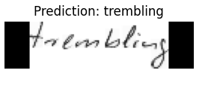
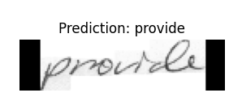
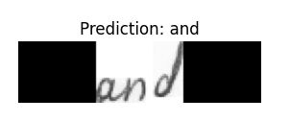
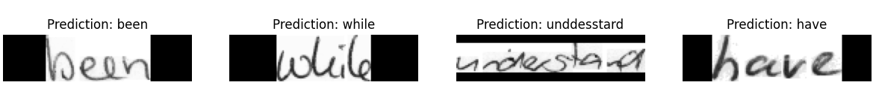
RESULTS ON VALIDATION DATASET

Slide 17
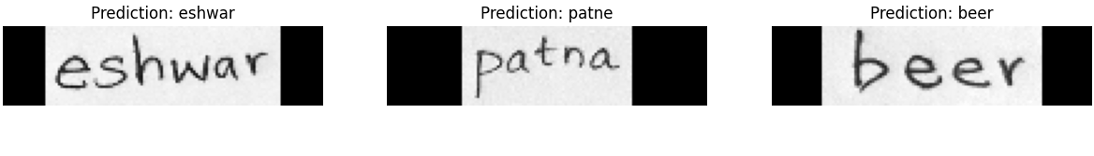
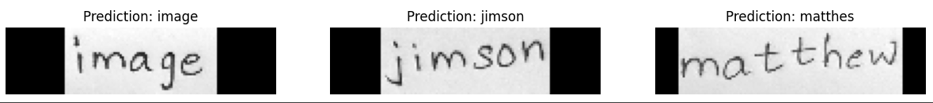
RESULTS ON CUSTOM DATASET

Slide 18
REFERENCES AND LINKS
1.Sequence Modeling With CTC , https://distill.pub/2017/ctc/ .
2.Edit Distance , https://en.wikipedia.org/wiki/Edit_distance .
3.OCR Model , https://keras.io/examples/vision/captcha_ocr/ .
4.IAM Dataset , https://fki.tic.heia-fr.ch/databases/iam-handwriting-database .

Slide 19
THANK YOU

