Slide 1
WOA vs PSO vs GA
Metaheuristic Algorithms for Erasure Code Repair
in Geo-Distributed Storage
Eshwari Khurd | UCI ID: 28722089
EECS 247: Information Storage | UC Irvine
Extending: Xu et al. (2026), Journal of Cloud Computing, 15(3)
github.com/eshwarikhurd/woa-repair-optimization

Slide 2
The GECR Problem — jointly minimize three objectives:
The Problem
Node fails
Cross-DC traffic
Load imbalance
k fragments needed
from multiple DCs
Wide-area links
bandwidth-limited
Some links saturated,
others idle
(1) Repair latency — how fast can we recover?
(2) Repair traffic — how much data do we move?
(3) Load imbalance — are links evenly utilized?
Constructing the optimal repair tree is NP-hard.

Slide 3
Repair Tree Model
Root node = destination (repaired block) Leaf nodes = surviving data providers Intermediate nodes = XOR aggregation (combine before forwarding) Encoded as: array of k paths, each leaf → root
Three objective functions:
fmerge (Eq. 5)
Avg depth of XOR merger nodes. Lower = XOR happens early = less raw data on bottleneck links
fnet-load (Eq. 6)
Std dev of link utilization. Lower = more balanced traffic
fitness = 0.5 × fmerge + 0.5 × fnet-load
repair_traffic
Total hops × block size (MB). Lower = less bandwidth consumed

Slide 4
Three Algorithms — Same Problem
WOA
PSO
GA
Whale Optimization Algorithm
Particle Swarm Optimization
Genetic Algorithm
Mimics humpback whale bubble-net hunting
Each repair tree is a particle with velocity
Evolves a population of repair trees
Contraction & encircling — local search near best
Random search — escape local optima
Spiral update — spiral path refinement
Personal best — memory of own best solution
Global best — pull toward swarm's best
Inertia decay — exploration → exploitation
Tournament selection — pick fittest parents
Crossover — swap sub-paths between parents
Mutation — re-route one leaf via Dijkstra
All three share the same fitness function — comparison isolates algorithmic differences only.

Slide 5
Experimental Setup
41-node US backbone network topology Nodes = data centers | Edges = WAN links Bandwidth sampled uniformly [30,300] Mbps 50 population · 50 iterations · 3 trials per config Metrics: repair latency, traffic, load std dev
Three Experiments:
Exp I: Vary RS code (n,k)
(11,7)(13,9)(14,10)(24,15)
(24,20)(27,13)(28,21)(33,18)
Exp II: Vary bandwidth range
30–90, 30–150, 30–210
30–270, 30–300 Mbps
Exp III: Vary block size
2, 4, 6, 8, 10, 12, 14, 16 MB

Slide 6
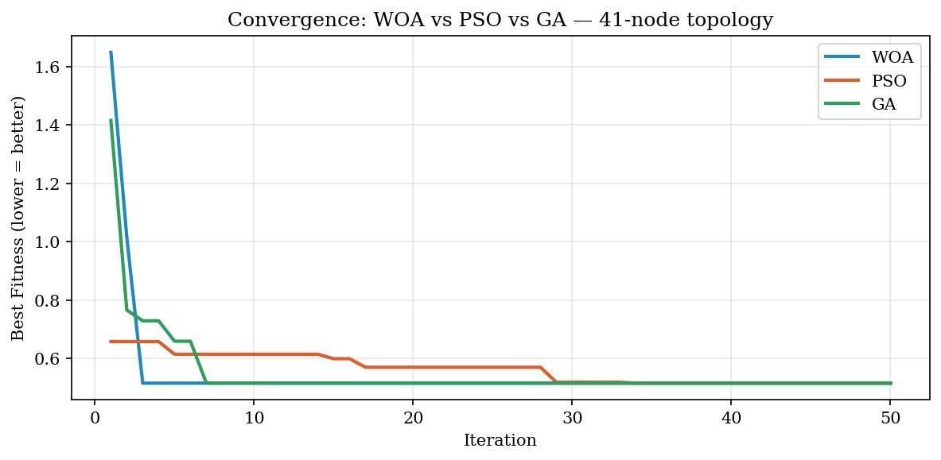
Convergence Analysis
WOA converges by iteration 7 — fastest
GA close behind, stabilizes ~iteration 7
PSO slowest — converges at iteration 28
WOA converges 4× faster than PSO — critical for production repair decisions

Slide 7
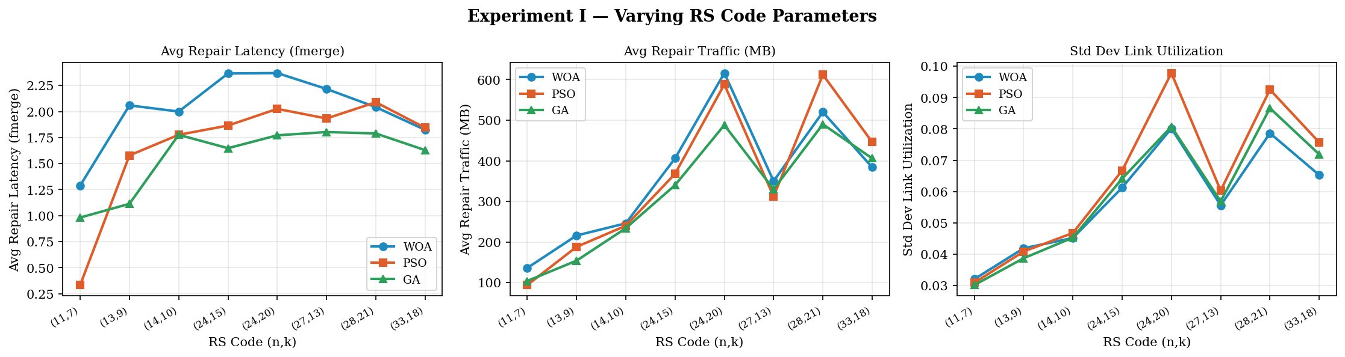
Experiment I — Varying RS Code Parameters (n,k)
Latency: GA wins → produces lowest-latency repair trees Traffic: GA uses least traffic across all configs Load: All three are similar — no single winner

Slide 8
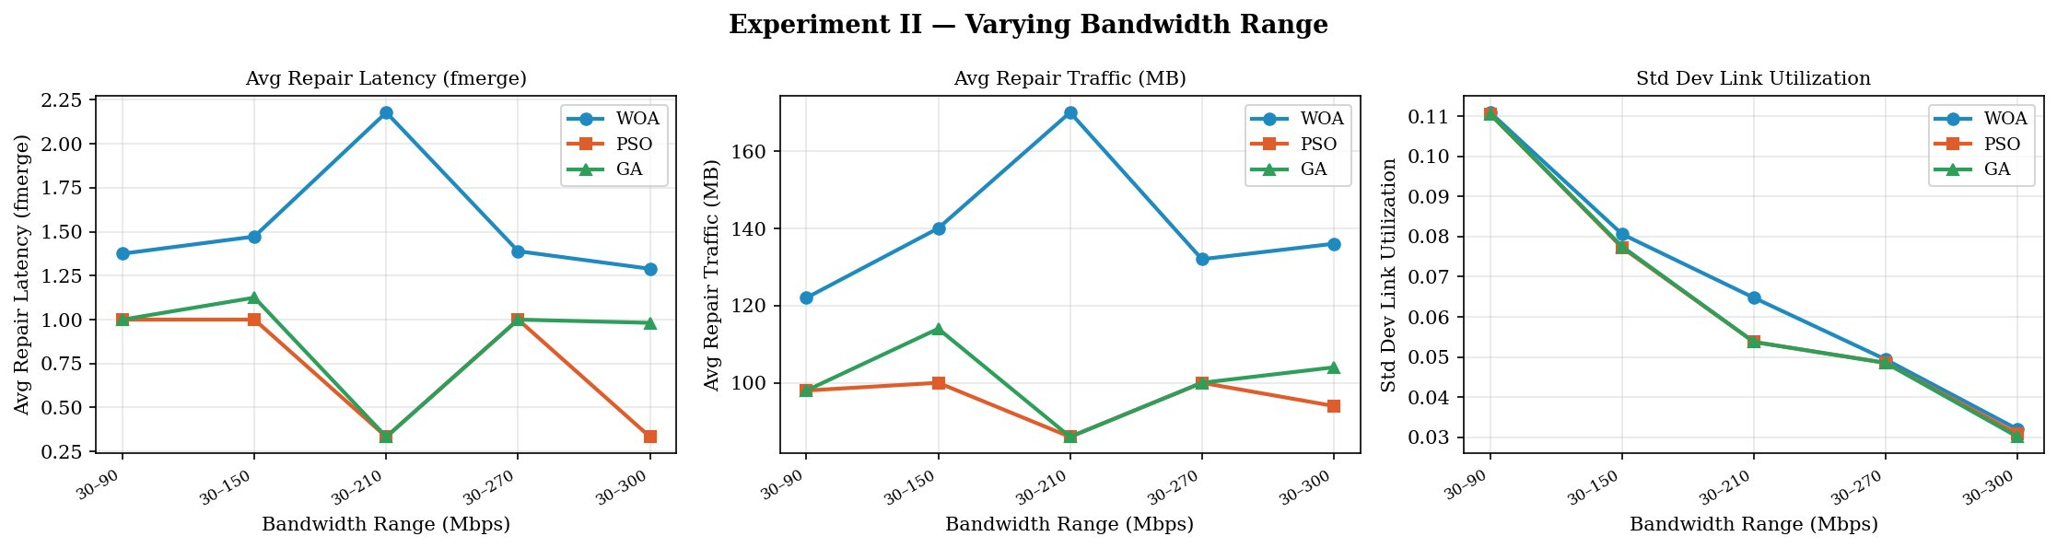
Experiment II — Varying Bandwidth Range
Load std converges to same value at high bandwidth — network stops being the bottleneck PSO + GA nearly identical across all bandwidth configs WOA spikes at 30–210 Mbps — more aggressive routing under mid-range bandwidth

Slide 9
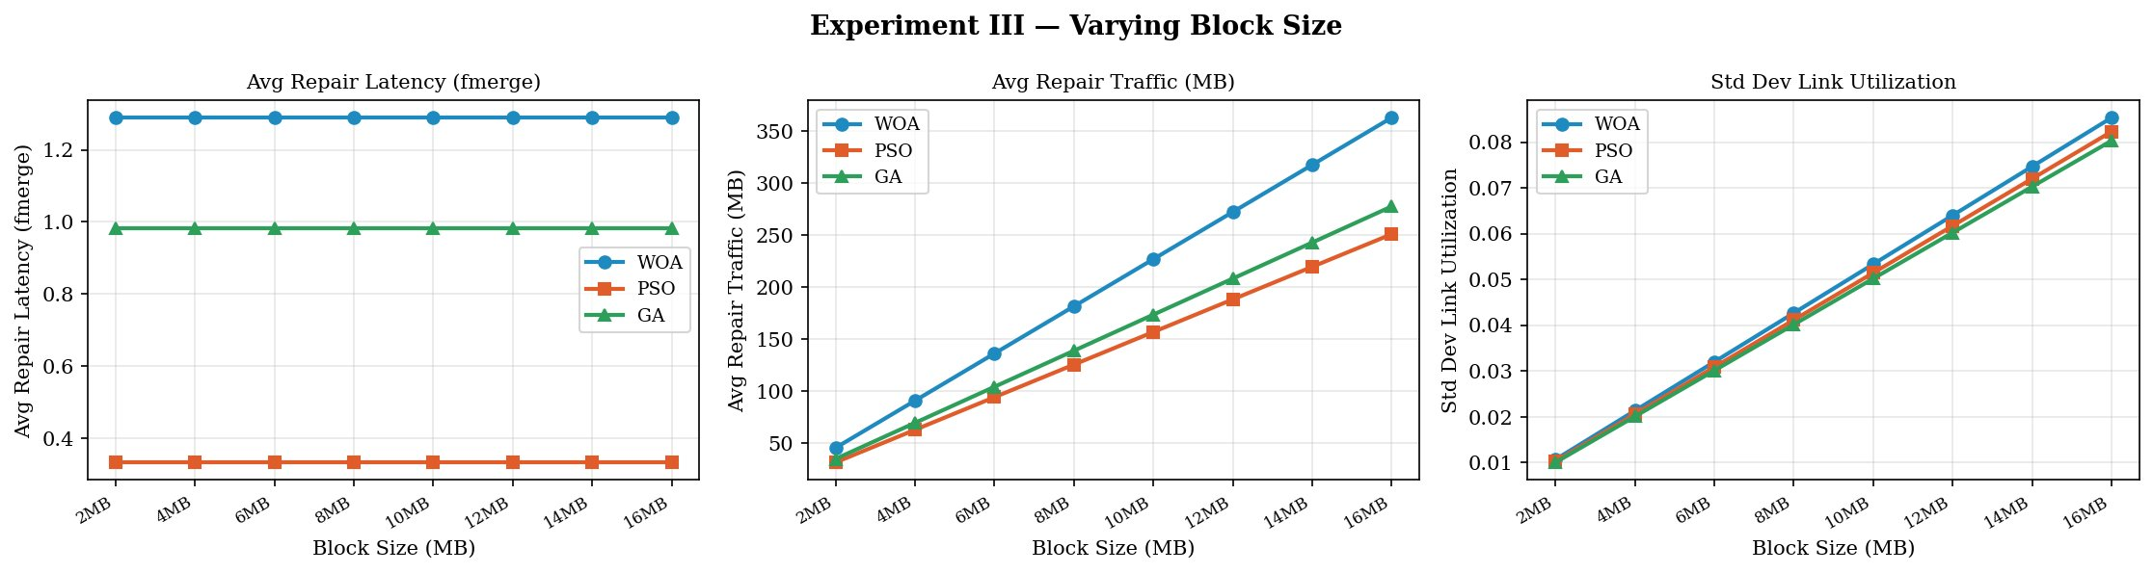
Experiment III — Varying Block Size
Latency flat for all algorithms — block size doesn't change path structure, validates model Traffic scales linearly with block size as expected PSO uses 20–30% less traffic than WOA — finding not covered in original paper

Slide 10
Discussion — Does WOA Win?
WOA strengths
PSO advantages
GA findings
Fastest convergence — iteration 7 vs 28 for PSO
Good for time-critical repair decisions
Balances exploration + exploitation well
20–30% less repair traffic than WOA
Nearly identical load balancing to GA
Competitive when bandwidth is the bottleneck
Lowest repair latency across (n,k) configs
Most traffic-efficient in Exp I
Slowest convergence — trades speed for quality

Slide 11
Conclusions
No single winner — each algorithm has a different strength:
WOA: fastest convergence — best for time-critical decisions PSO: most traffic-efficient — best when bandwidth is constrained GA: lowest repair latency — best for solution quality given time
Original paper's claim is partially validated
WOA's convergence advantage is real. But PSO's traffic efficiency and GA's latency quality
are findings the paper misses by not running this comparison.
Future Work
Dynamic bandwidth model — test robustness under fluctuating links
Scale to 100 iterations × 10 trials for publication-quality results
github.com/eshwarikhurd/woa-repair-optimization | khurde@uci.edu

