Slide 1
D Eswar Reddy
Key Logger Protection
3/21/2024 Annual Review

Slide 2

PROJECT TITLE
Key Logger Protection
3/21/2024 Annual Review

Slide 3


AGENDA
Create a Python key Logger code using pynput module and jsonlibrary
3/21/2024 Annual Review

Slide 4

PROBLEM STATEMENT
Definition of Key Loggers: Software or hardware that records keystrokes.
Threats Posed by Key Loggers:
Unauthorized access to sensitive information (passwords, financial data, etc.).
Identity theft and financial loss.
Corporate espionage.
Prevalence: Increasing incidents in both personal and corporate environments
3/21/2024 Annual Review

Slide 5

PROJECT OVERVIEW
Objective: Develop a robust protection mechanism against key loggers.
Scope:
Detection of key loggers.
Prevention techniques.
User education and awareness
.
Key Components:
Software solutions.
Hardware solutions.
Best practices for users.
3/21/2024 Annual Review

Slide 6

WHO ARE THE END USERS?
Target Audience:
Individual users (general public).
Corporate employees.
IT professionals.
Government and military personnel.
3/21/2024 Annual Review

Slide 7

YOUR SOLUTION AND ITS VALUE PROPOSITION
Solution Overview:
Multi-layered defense strategy.
Combination of detection and prevention techniques.
Proposition:
Real-time monitoring and alerting system.
Use of encryption for keystrokes.
Regular updates and patches.
Unique Selling Points:
High detection accuracy.
Low false positive rate.
Seamless user experience.
3/21/2024 Annual Review

Slide 8

THE WOW IN YOUR SOLUTION
Innovative Features:
AI and machine learning integration for adaptive threat detection.
Behavioral analysis to identify suspicious activities.
User Testimonials:
Case studies or user feedback highlighting effectiveness.
Comparative Advantage:
How your solution outperforms existing products in the market.
3/21/2024 Annual Review
8

Slide 9
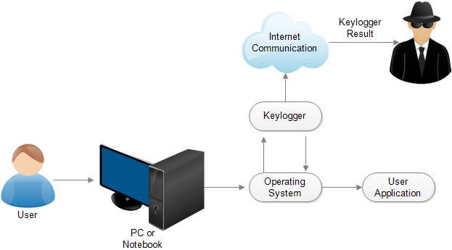
MODELLING
Teams cam add wireframes
3/21/2024 Annual Review
9

Slide 10
RESULTS
After successfully executing the code it creates two different files one is json source file and another one is text document
In json source file it shows what we enter for instance the passwords, credentials .The Text document shoes each & every letter of what we type
3/21/2024 Annual Review
10

Slide 11
Project Link
https://github.com/eshwarreddydoddareddy/D-Eswar-Reddy-.git

