Slide 1



Calorimeter Trigger
Muon Trigger
ECAL
HCAL
HB/HE $μ$HTR
HCAL
HF $μ$HTR
CSC
DT
RPC
oSLB
CuOF
MPC
LB
Mezz
New SC & fan-out
Splitters
New SC & fan-out
Muon Track-Finder Layer
Calorimeter Trigger Layer-1
End cap
Overlap
Barrel
Sorting/Merging Layer
Calorimeter Trigger Layer-2
End cap
Overlap
Barrel
$μ$GMT
Global Trigger
Notes:
Bare

Slide 2
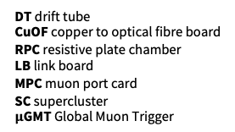
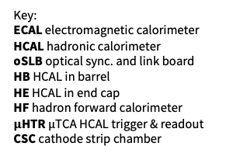
Calorimeter Trigger
Muon Trigger
ECAL
HCAL
HB/HE $μ$HTR
HCAL
HF $μ$HTR
CSC
DT
RPC
oSLB
CuOF
MPC
LB
Mezz
New SC & fan-out
Splitters
New SC & fan-out
Muon Track-Finder Layer
Calorimeter Trigger Layer-1
End cap
Overlap
Barrel
Sorting/Merging Layer
Calorimeter Trigger Layer-2
End cap
Overlap
Barrel
Key:
ECAL electromagnetic calorimeter
HCAL hadronic calorimeter
oSLB optical sync. and link board
HB HCAL in barrel
HE HCAL in end cap
HF hadron forward calorimeter
$μ$HTR $μ$TCA HCAL trigger & readout
CSC cathode strip chamber
$μ$GMT
DT drift tube
CuOF copper to optical fibre board
RPC resistive plate chamber
LB link board
MPC muon port card
SC supercluster
$μ$GMT Global Muon Trigger
Global Trigger
Notes:
Adding a key (order is roughly top-to-bottom)

Slide 3
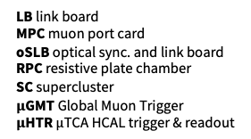
Calorimeter Trigger
Muon Trigger
ECAL
HCAL
HB/HE $μ$HTR
HCAL
HF $μ$HTR
CSC
DT
RPC
oSLB
CuOF
MPC
LB
Mezz
New SC & fan-out
Splitters
New SC & fan-out
Muon Track-Finder Layer
Calorimeter Trigger Layer-1
End cap
Overlap
Barrel
Sorting/Merging Layer
Calorimeter Trigger Layer-2
End cap
Overlap
Barrel
Key:
CSC cathode strip chamber
CuOF copper to optical fibre board
DT drift tube
ECAL electromagnetic calorimeter
HB HCAL in barrel
HCAL hadronic calorimeter
HE HCAL in end cap
HF hadron forward calorimeter
$μ$GMT
LB link board
MPC muon port card
oSLB optical sync. and link board
RPC resistive plate chamber
SC supercluster
$μ$GMT Global Muon Trigger
$μ$HTR $μ$TCA HCAL trigger & readout
Global Trigger
Notes:
Adding a key (order is alphabetical, case insensitive)

