Slide 1

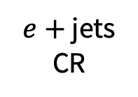

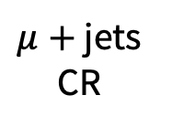
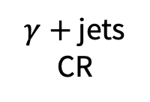

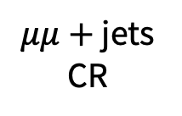
$μ+$ jets CR
$e+$ jets CR
$W\left(→ℓυ\right)/t\overline{t}+$ jets
CR-only fit
QCD sidebands
Signal region
CR-only fit
$Z\left(→υυ\right)+$ jets
$μμ+$ jets CR
$γ+$ jets CR
$ee+$ jets CR

Slide 2

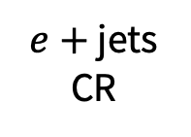

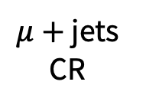
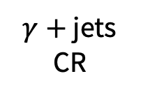


$μ+$ jets CR
$e+$ jets CR
$W\left(→ℓυ\right)/t\overline{t}+$ jets
CR-only fit
QCD sidebands
Signal region
QCD multijet
CR-only fit
$Z\left(→υυ\right)+$ jets
$μμ+$ jets CR
$γ+$ jets CR
$ee+$ jets CR

