Slide 1



Calorimeter Trigger
Muon Trigger
ECAL
HCAL
HB/HE $μ$HTR
HCAL
HF $μ$HTR
CSC
DT
RPC
oSLB
CuOF
MPC
LB
Mezz
New SC & fan-out
Splitters
New SC & fan-out
Muon Track-Finder Layer
Calorimeter Trigger Layer-1
End cap
Overlap
Barrel
Sorting/Merging Layer
Calorimeter Trigger Layer-2
End cap
Overlap
Barrel
$μ$GMT
Global Trigger
Notes:
Bare

Slide 2
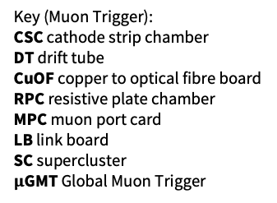
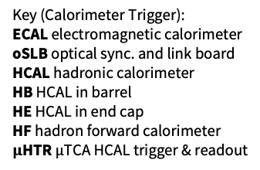
Calorimeter Trigger
Muon Trigger
ECAL
HCAL
HB/HE $μ$HTR
HCAL
HF $μ$HTR
CSC
DT
RPC
oSLB
CuOF
MPC
LB
Mezz
New SC & fan-out
Splitters
New SC & fan-out
Muon Track-Finder Layer
Calorimeter Trigger Layer-1
End cap
Overlap
Barrel
Sorting/Merging Layer
Calorimeter Trigger Layer-2
End cap
Overlap
Barrel
Key (Muon Trigger):
CSC cathode strip chamber
DT drift tube
CuOF copper to optical fibre board
RPC resistive plate chamber
MPC muon port card
LB link board
SC supercluster
$μ$GMT Global Muon Trigger
Key (Calorimeter Trigger):
ECAL electromagnetic calorimeter
oSLB optical sync. and link board
HCAL hadronic calorimeter
HB HCAL in barrel
HE HCAL in end cap
HF hadron forward calorimeter
$μ$HTR $μ$TCA HCAL trigger & readout
$μ$GMT
Global Trigger
Notes:
Adding a key (Calo on the left, Muon on the right, order left-to-right, top-to-bottom)

Slide 3
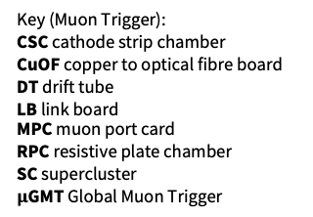
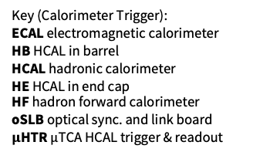
Calorimeter Trigger
Muon Trigger
ECAL
HCAL
HB/HE $μ$HTR
HCAL
HF $μ$HTR
CSC
DT
RPC
oSLB
CuOF
MPC
LB
Mezz
New SC & fan-out
Splitters
New SC & fan-out
Muon Track-Finder Layer
Calorimeter Trigger Layer-1
End cap
Overlap
Barrel
Sorting/Merging Layer
Calorimeter Trigger Layer-2
End cap
Overlap
Barrel
$μ$GMT
Key (Muon Trigger):
CSC cathode strip chamber
CuOF copper to optical fibre board
DT drift tube
LB link board
MPC muon port card
RPC resistive plate chamber
SC supercluster
$μ$GMT Global Muon Trigger
Key (Calorimeter Trigger):
ECAL electromagnetic calorimeter
HB HCAL in barrel
HCAL hadronic calorimeter
HE HCAL in end cap
HF hadron forward calorimeter
oSLB optical sync. and link board
$μ$HTR $μ$TCA HCAL trigger & readout
Global Trigger
Notes:
Adding a key (Calo on the left, Muon on the right, order is alphabetical)

