Slide 1

Programmatic PowerPoint
Capabilities Showcase
Demonstrating python-pptx + API Integrations

Slide 2
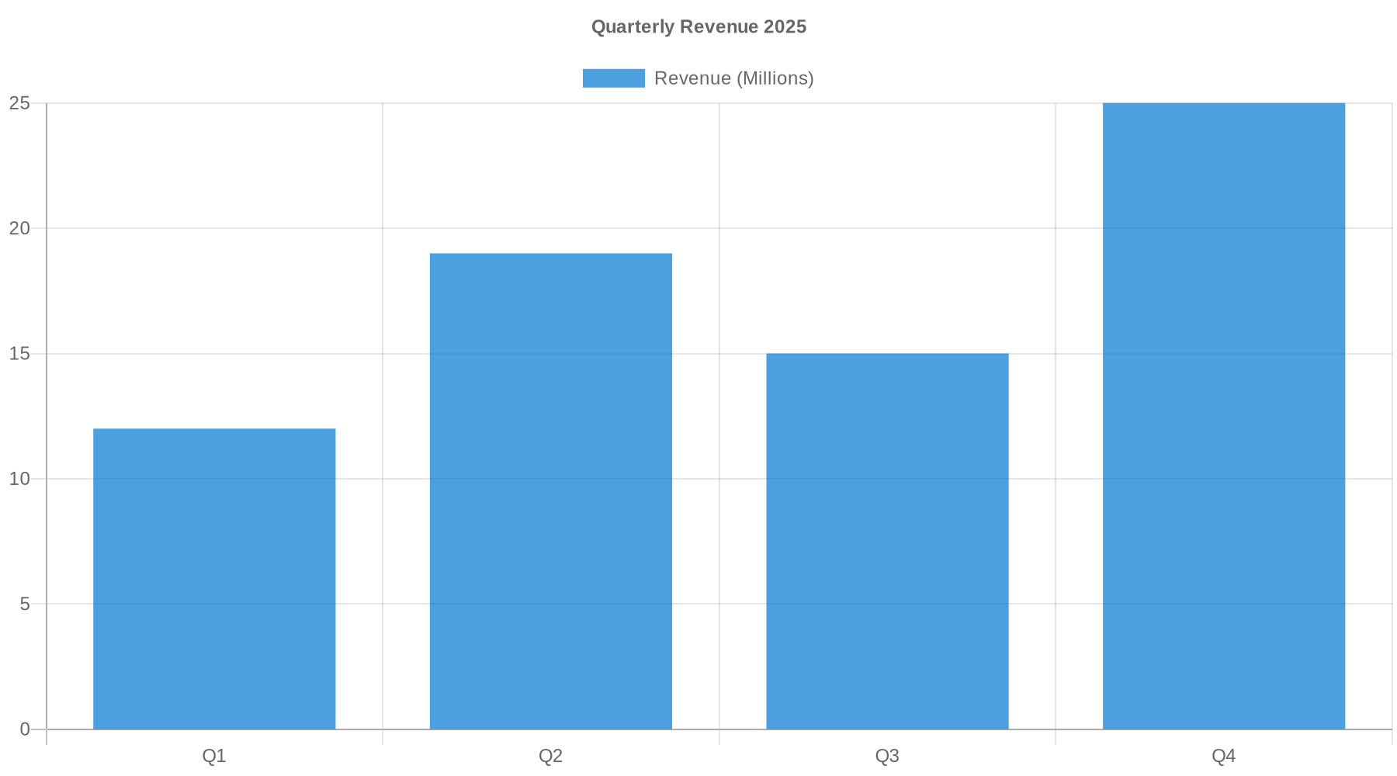
Chart Generation via QuickChart.io

Slide 3
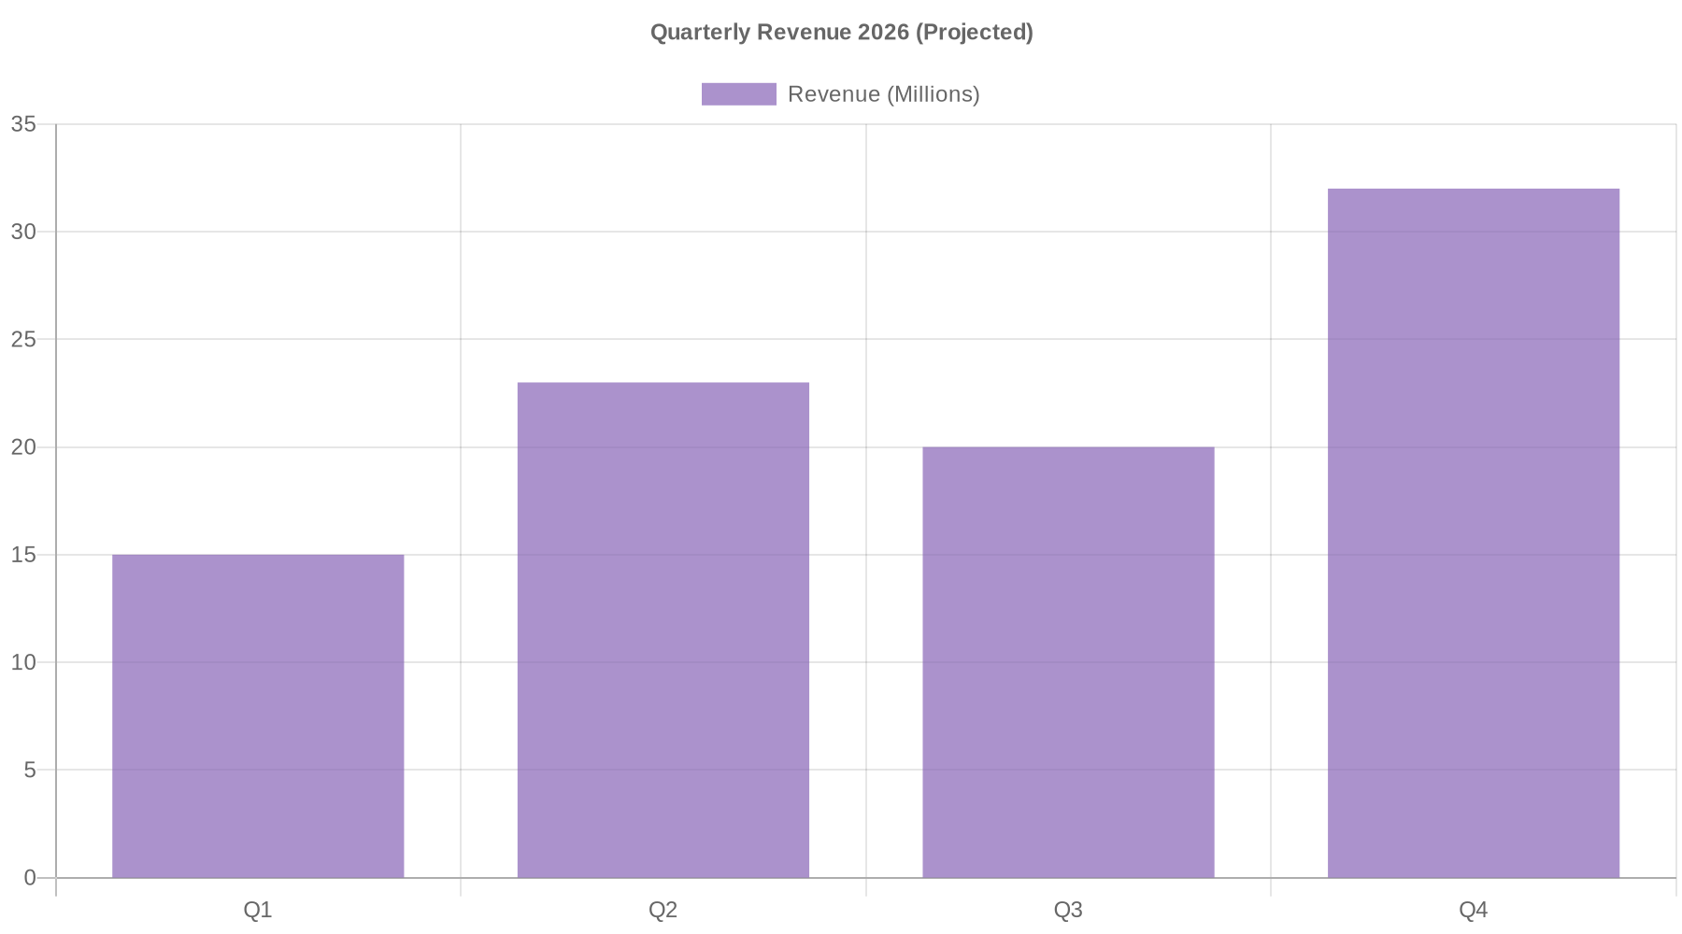
Updated Data (Watch the Morph!)

Slide 4
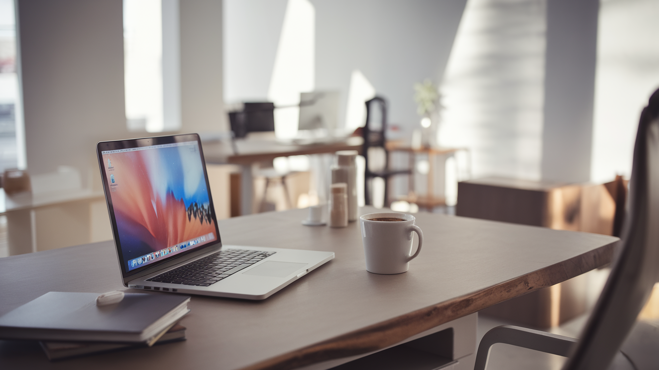
AI-Generated Visuals (Ideogram API)
Prompt: "Modern minimalist office workspace with laptop, coffee, and natural lighting, professional photography, clean aesthetic"

Slide 5
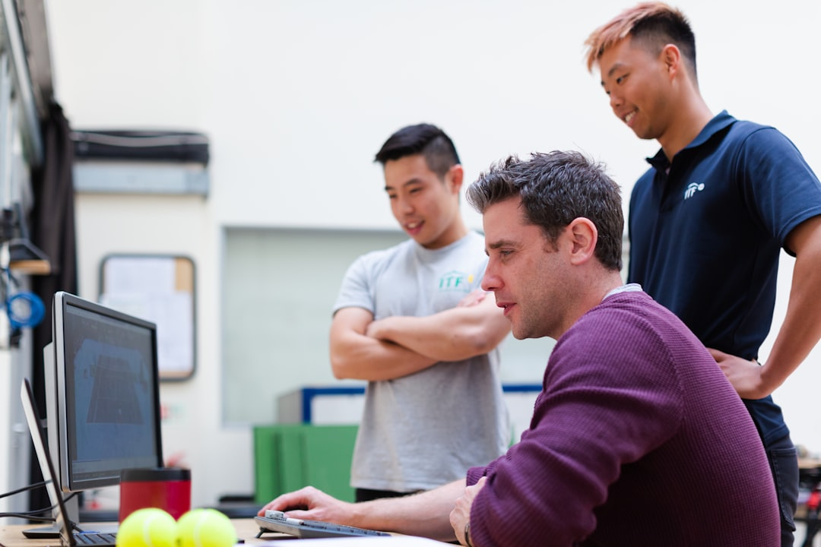
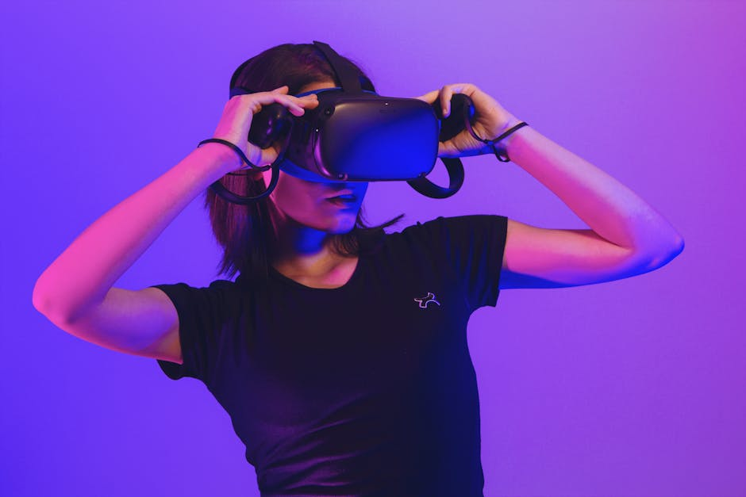
Stock Photography (Unsplash + Pexels)
Unsplash API
Pexels API

Slide 6
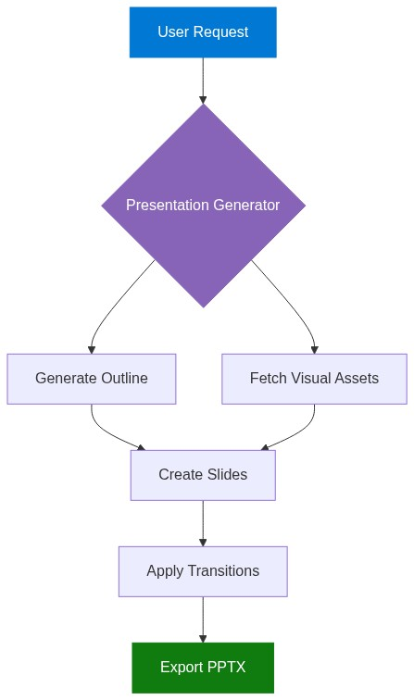
Diagram Generation (Mermaid)

Slide 7






Avatar Generation (DiceBear API)
Alice
Bob
Charlie
Diana
Eve
Frank

Slide 8
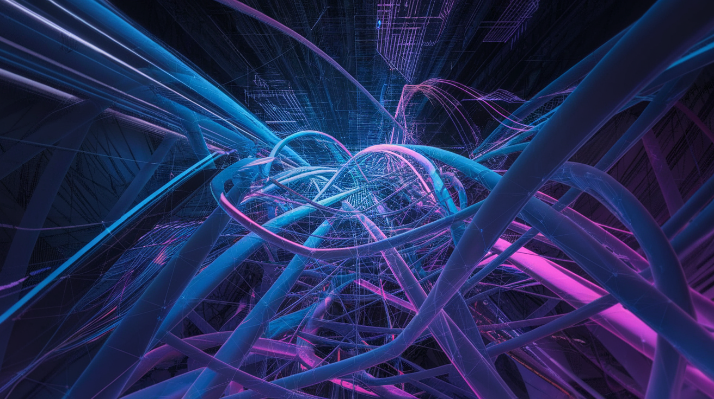
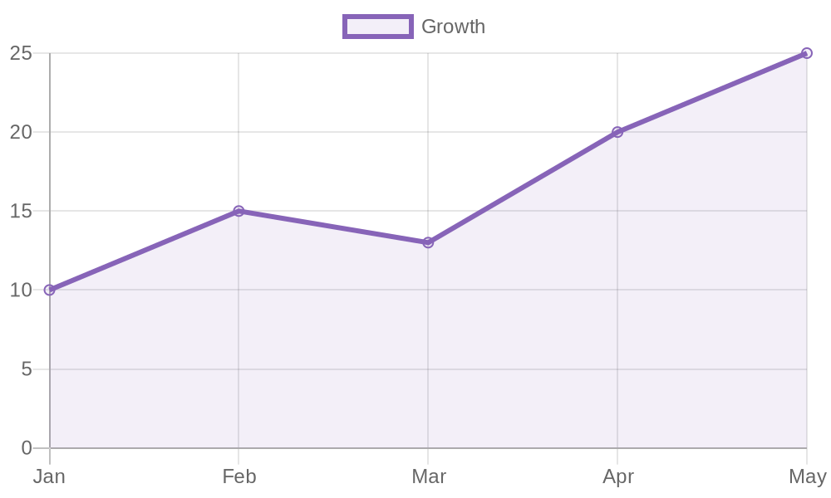
Full Integration: All Capabilities Combined
• AI-Generated Images (Ideogram)
• Dynamic Charts (QuickChart.io)
• Stock Photography (Unsplash/Pexels)
• Diagrams & Flowcharts (Mermaid)
• Custom Avatars (DiceBear)

