Slide 1
Diagramming plugin - RIC-353 hero diagrams
Fareez Ahmed, esimplicity platform team

Slide 2
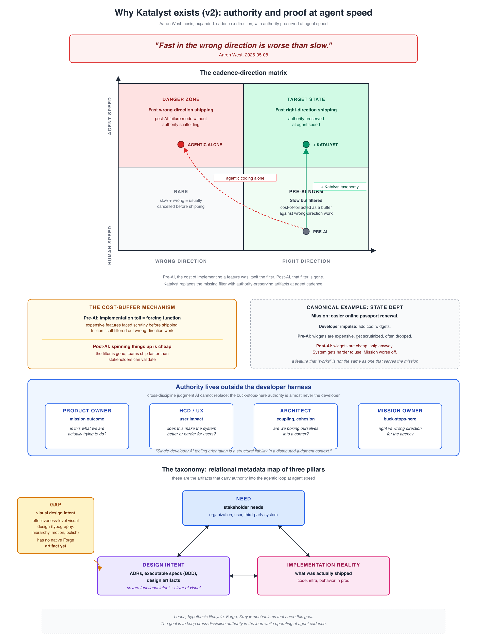
Why Katalyst exists - Aaron's expanded thesis (v2)
Cadence-direction matrix, cost-buffer collapse, authority outside the harness, three taxonomy pillars
Diagramming plugin - RIC-353 hero diagrams · Fareez Ahmed, esimplicity platform team
1 / 4
Notes:
Hand-authored canonical reference for what Katalyst is for. 'Fast in the wrong direction is worse than slow.' The cadence-direction matrix names the danger zone (fast-wrong, agentic alone), the target state (fast-right, Katalyst), the pre-AI slow-but-filtered state, and the post-AI cheap-and-unfiltered state. The pre-AI cost-of-features acted as a buffer that filtered out wrong-direction work; AI removed the cost, the filter is gone, Katalyst's taxonomy replaces it. Authority lives outside the developer harness: Product Owner, HCD/UX, Architect, Mission Owner are sources of authoritative judgment. Three taxonomy pillars: Need, Design Intent, Implementation Reality, with acknowledged GAP that visual design intent has no Forge artifact yet.

Slide 3
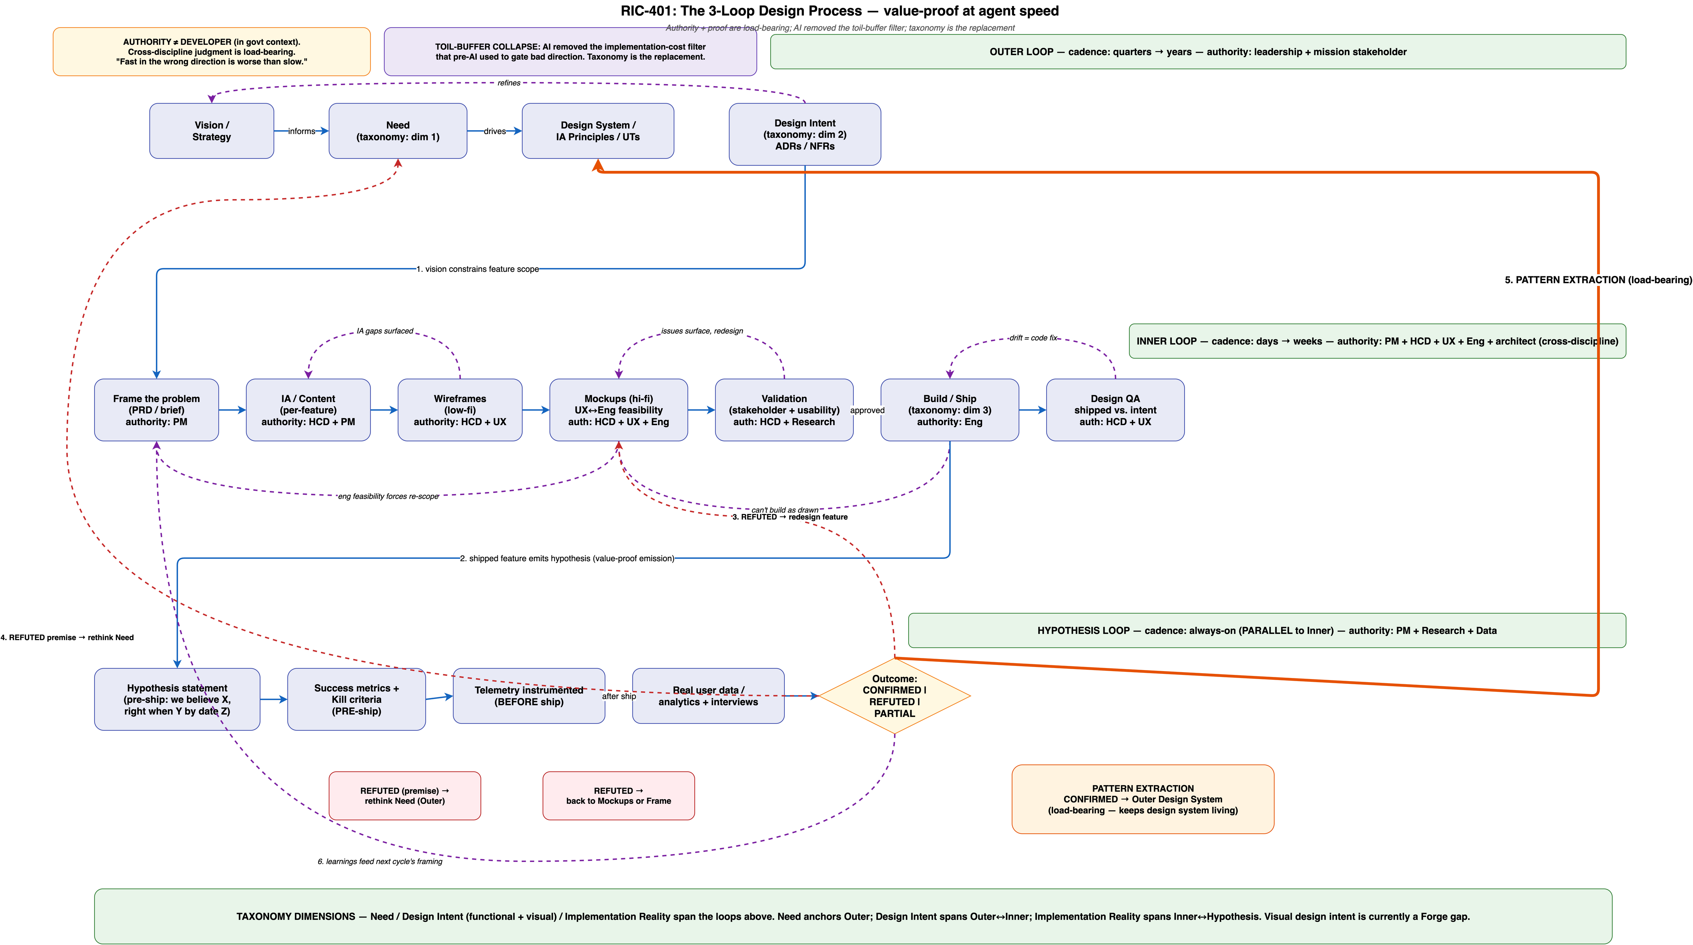
RIC-401 - The 3-loop design process
outer (quarters to years), inner (days to weeks), hypothesis (always-on)
Diagramming plugin - RIC-353 hero diagrams · Fareez Ahmed, esimplicity platform team
2 / 4
Notes:
Three loops, three cadences, three authority sets. Outer loop (cadence: quarters to years; authority: leadership + mission stakeholder): vision to need to design system to design intent. Direction gets set here. Inner loop (cadence: days to weeks; authority: PM + HCD + UX + Eng + architect): frame to IA to wireframes to mockups to validation to build/ship to design QA. The per-feature design iteration. HCD/UX is irreplaceable because AI cannot synthesize visual design intent. Hypothesis loop (cadence: always-on; authority: PM + Research + Data): hypothesis statement to success metrics + kill criteria to telemetry to outcome (CONFIRMED / REFUTED / PARTIAL). Real user data is the only thing that can answer the hypothesis. Pattern extraction flows CONFIRMED outcomes back into the Outer Design System.

Slide 4
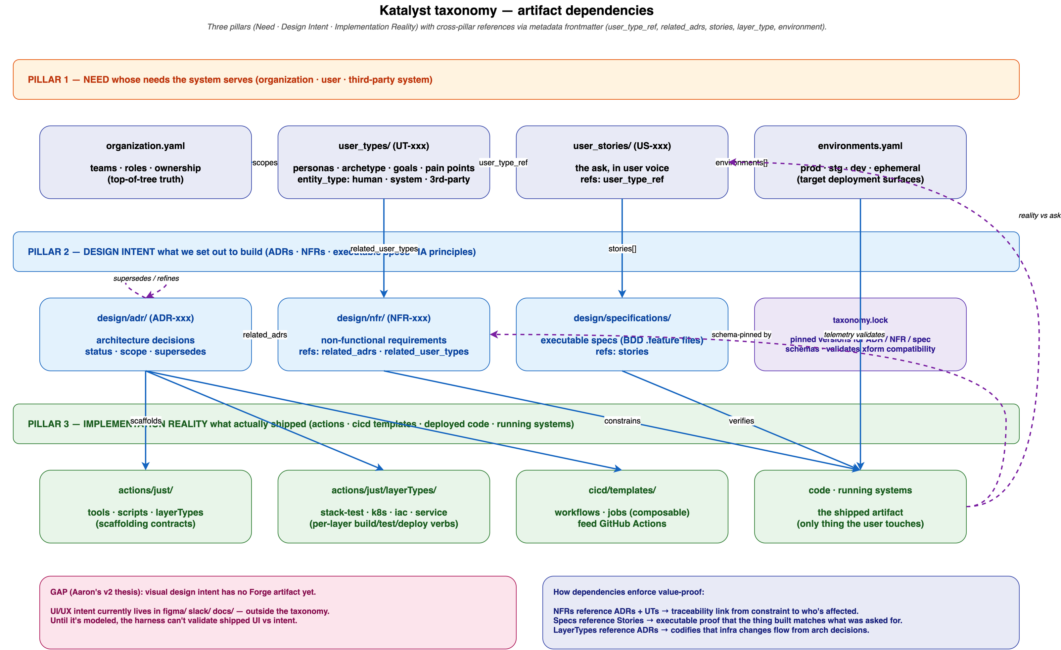
Katalyst taxonomy - artifact dependencies
Three pillars, cross-pillar refs labeled with frontmatter field names
Diagramming plugin - RIC-353 hero diagrams · Fareez Ahmed, esimplicity platform team
3 / 4
Notes:
Dependency graph of artifact types in the Katalyst taxonomy, organized by Aaron's three pillars. NEED lane (orange): organization.yaml, user_types/, user_stories/, environments.yaml. DESIGN INTENT lane (blue): design/adr/, design/nfr/, design/specifications/, taxonomy.lock. IMPLEMENTATION REALITY lane (green): actions/just/, layerTypes/, cicd/templates/, code · running systems. Arrows are labeled with the actual metadata field names that create the link: user_type_ref, related_adrs, related_user_types, stories[], environments[]. Bottom-left callout names the GAP from Aaron's v2 thesis (visual design intent has no Forge artifact yet); bottom-right explains how the dependency graph enforces value-proof traceability at runtime.

Slide 5
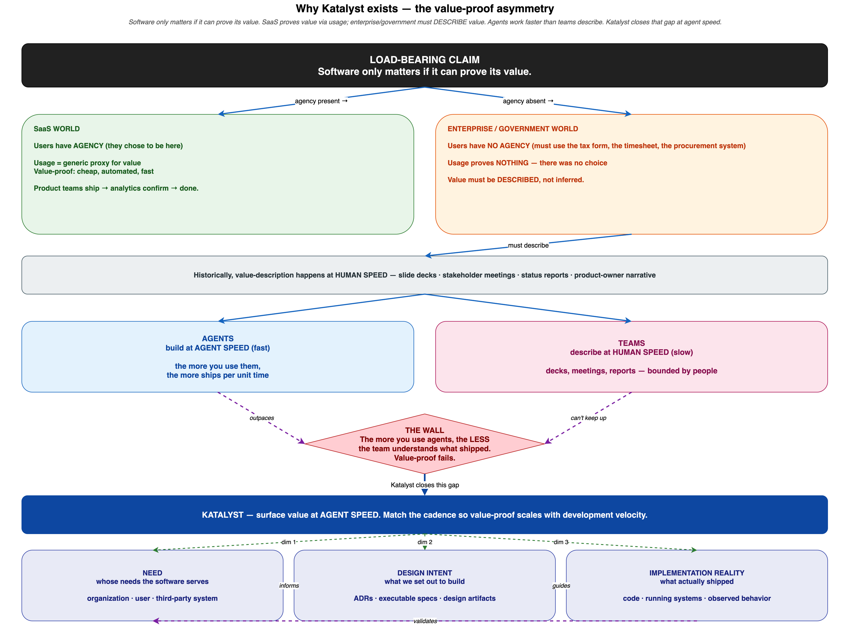
Why Katalyst exists - plugin-rendered v1
Same argument as slide 1, this time generated by the plugin (proof the renderer handles real conceptual content)
Diagramming plugin - RIC-353 hero diagrams · Fareez Ahmed, esimplicity platform team
4 / 4
Notes:
The plugin's take on the same thesis Aaron hand-authored in slide 1. Software only matters if it can prove its value. SaaS proves value via usage because users have AGENCY. Enterprise / government has no agency; usage proves nothing. Value must be DESCRIBED. Historically descriptions happen at human speed; agents work at agent speed; gap widens; value-proof fails. Katalyst surfaces value at agent speed via the three-pillar taxonomy. Simpler than the v2, with the same core argument without the cadence-direction matrix or the cost-buffer framing. Captured here as proof the plugin can render real conceptual content from a structured spec, not just code-derived diagrams.

