Slide 1


Churn Analysis and Prevention
Esis Ramadhan
Traveloka Technical Assessment Test – Part 2

Slide 2


Table of Content
1
Objective
2
Summary Data, Intro to Data
2
3
Initial Analysis
Advance Analysis and Feature Building (might be explained churns characteristics
4
3
5
Modelling
4
Conclusions and Recommendations
6

Slide 3



Objective

Slide 4
Preamble
Objective
Descriptions
Reduce Churn
Overall objective of analysis is to create recommendation and strategy to reduce customer churn and summarize your analysis.
We want to find out behaviour based on transactions data that may or might be related to churns
Understanding User Behaviour
Product Market Fit Checking
Figuring out which product type is fit or not based on churn proportion each product

Slide 5
Summary Data, Intro to Data

Slide 6




Summary Data – Intro to Data
Features
Observation Number
• Profile_id = hashed identity of a customer. One profile id represents one customer [integer 64]
• Primary_sales_product_type = the product identifier [{‘FLIGHT’, ‘HOTEL’, ‘TRAIN’, ‘TRIP’}]
• first_booking_time = is the first time the customer booked a product in primary_sales_product [unix timestamp in milliseconds]
• First_issued_time = is the first time the customer issued a product in primary_sales_product [unix timestamp in milliseconds]
• Last_booking_time = is the last time the customer booked a product in primary_sales_product [unix timestamp in milliseconds]
• Last_issued_time = is the first time the customer issued a product in primary_sales_product [unix timestamp in milliseconds]
• Avg_booking_invoice_amount_idr = avg invoice amount in submitted booking [in IDR]
• Avg_issued_invoice_amount_idr = avg invoice amount in issuance [in IDR]
• Count_booking = total count of bookings of that particular product (from the day they were acquired until now) [integer]
• Count_issued = total count of issuance of that particular product (from the day they were acquired until now) [integer
278 K
Caveat Analysis (already aggregate)
Descriptions
Product
What can we do for analysis?
Characteristics RFM Transactions toward churn/ Retention Behaviour. All three aspects, Recency (How recent), Frequency (count issue, count booking), and monetary (invoice / booking account). Panel Analysis to see retention behaviour and sanity checking toward all finding
Flight
Hotel
What can’t we do for analysis?
Data user level (loyal/normal customer), journey UX (unseen where the advertisement comes from as it only provide transaction data), Fraud Flag, Segment User. our dimension limited to transaction point of view
Train
How long range of timeframe
Timeframe dataset has range interval from 2013 to 2019
Majority year is 2018 based on proportion compared to other years
Trip
Which Year Majority Population ?

Slide 7
Initial Analysis

Slide 8
Initial Analysis – Construct Churns Label and checking successful transaction until issued
Description
Flight Population
136 K | 49%
Only Booked 24%
Explain:
The overall Success transaction until issued payment is about 74%, it is quite good as the proportion success is stil more than 70%
Product Trip(56%) is the most only booked compared to other product that are still more than 70% that means for drop the recorded data row which doesn’t have last issued time
1
Finish Trx 76%
Checking Successful Transactions until Issued
Hotel Population
93 K | 33%
Only Booked 29%
Finish Trx 71%
Overall Population
(278 K)
Train Population
42 K | 15%
Only Booked 22%
Only Booked 26%
Finish Trx 78%
Finish Trx 74%
Trip Population
6,7 K | 2.41%
Only Booked 44%
Finish Trx 56%
2
Churns Label
Customer Churns : Customer who haven’t bought in the last one year from ‘last updated date’ in the dataset
Last updated date : 2019-02-01
Drop row that has transactions only booked
Target days : last updated date – last issued time date, this features is formed to give flag churns label, if target days > 365 then ‘churns’
Notes:
Numpang lewat

Slide 9
Initial Analysis – Proportion Churns (Product Market Fit)
1
Population
2
Proportion (%)
Flight Population
103 K | 50%
Churns 44%
Non Churns 56%
Not Fit
Explain:
The overall churn is about 40%, it is very badly for the company due to many churners, but it doesn't mean all product are badly let it breakdown churners for every product types to find out which product has the most churners
Product Flight(47%) is the most churns followed with Hotel (40%) that means product flight and hotel is not product market fit unlike Train and Trip
Hotel Population
66 K | 32%
Churns 39%
Non Churns 61%
Overall Population
(206 K)
Train Population
32,6 K | 16%
Churns 27%
Churns 40%
Non Churns 73%
Non Churns 60%
Fit
Trip Population
3,7 K | 1.8%
Churns 28%
Non Churns 72%

Slide 10
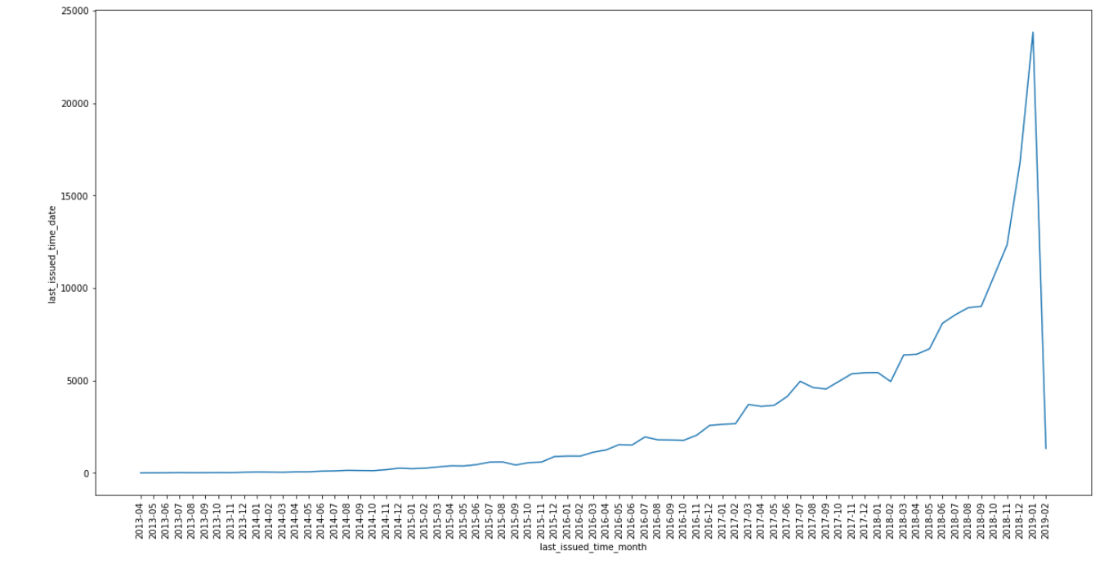
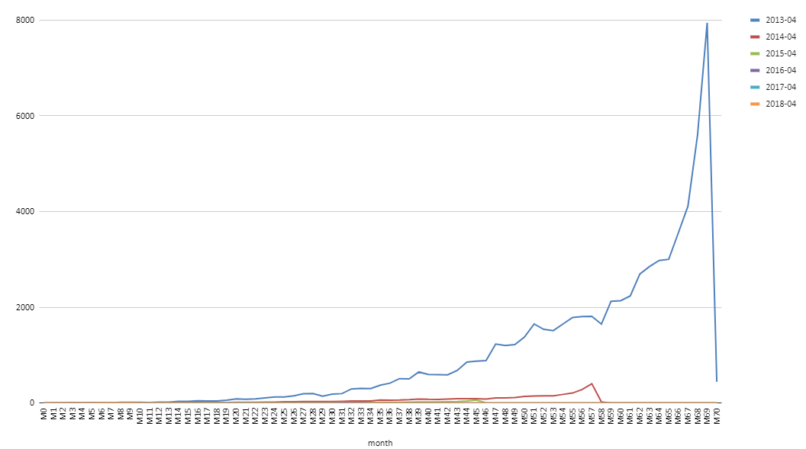
Initial Analysis (Cohort All Product) – Checking definition customer churns is already suitable for Traveloka business that haven’t bought in one last year??
Explain:
Dari hasil cohort analysis terlihat bahwa tidak ada churn yang signifikan dan selalu ada peningkatan di setiap bulan. Titik yang dilingkarin terjadi penurunan tajam dikarenakan kekurangan data di bulan February.
Diperkuat dengan bukti bahwa ada banyak akuisis aktif user yang baru bahkan sampai January 2019 dengan trend yang cenderung naik, hal ini membuktikan kalo bahwa cohort transaksi sehat.
Karena retention masih dalam angka yang sehat, sehingga definisi customer churn yang tidak belanja kurang dari setahun kurang tepat dan bisa dibentuk label churn bulanan.

Slide 11
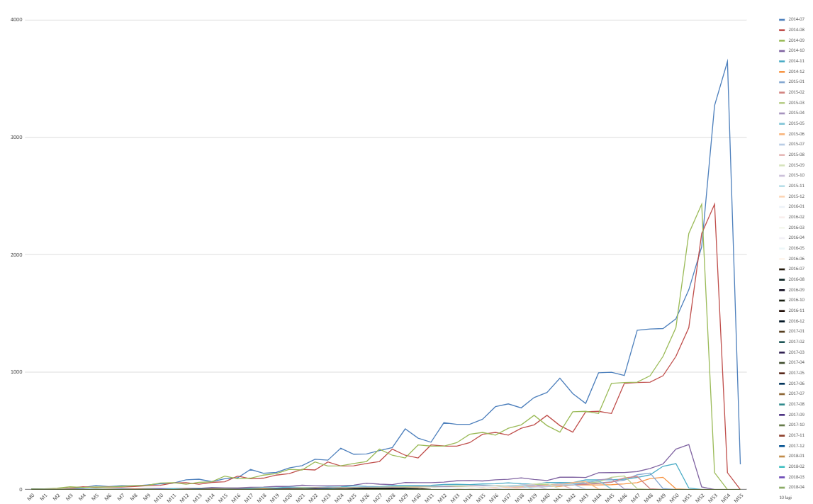
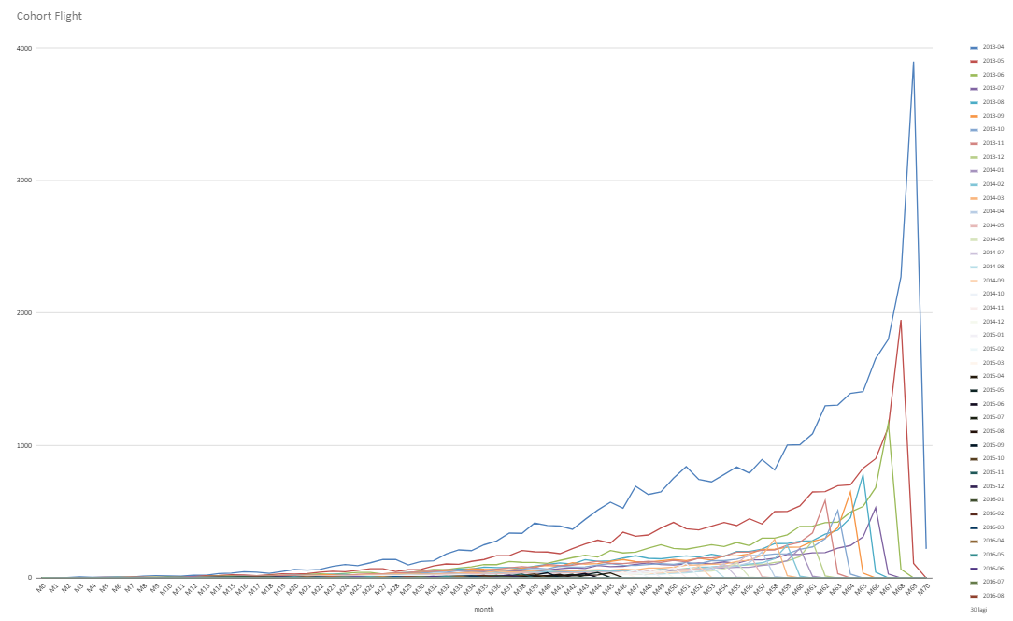
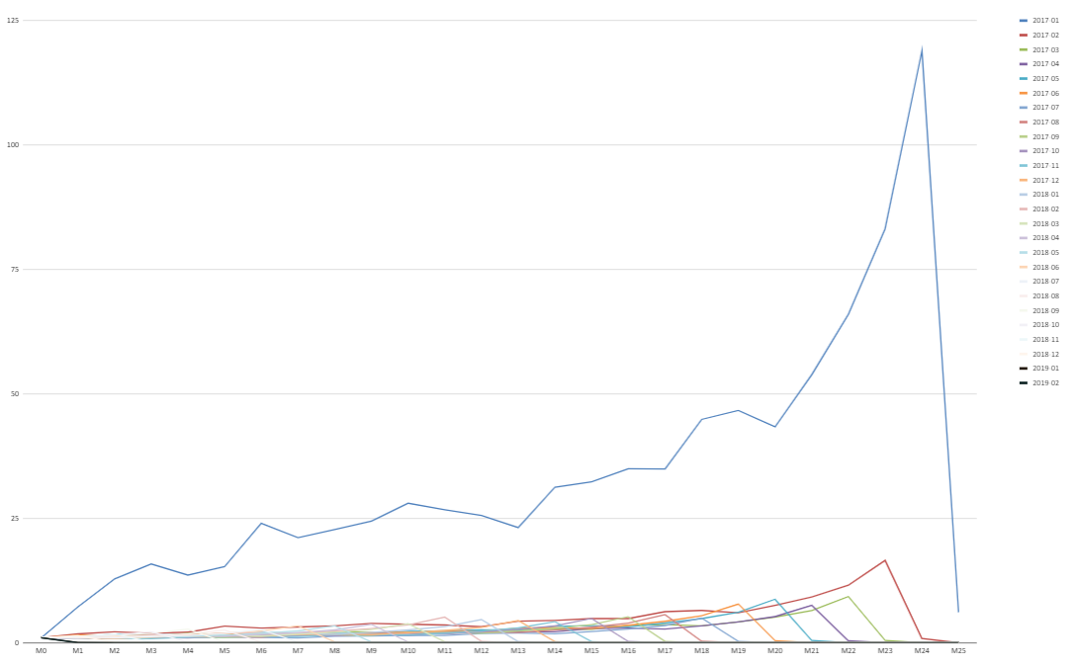
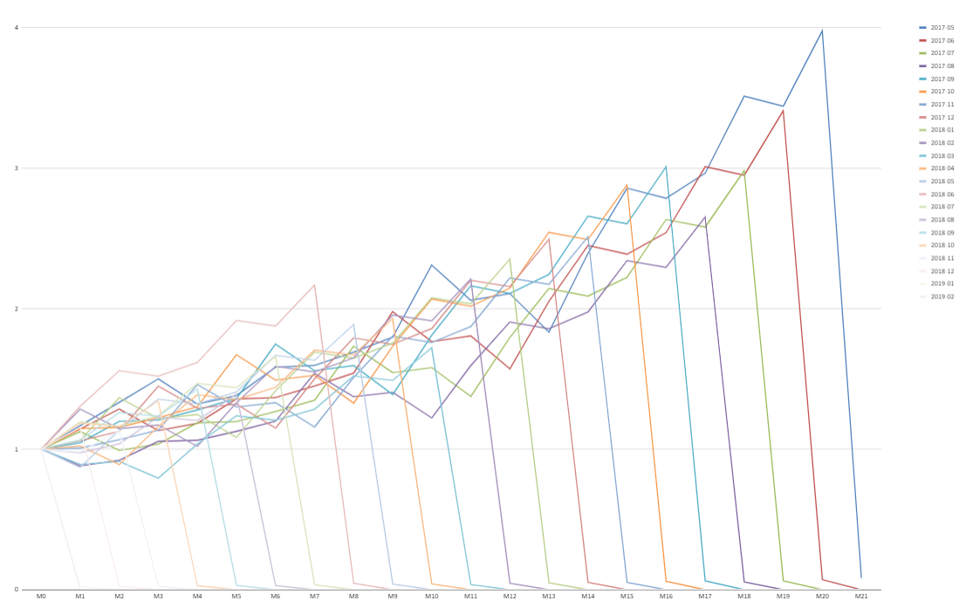
Initial Analysis (Cohort Product) – Checking definition customer churns is already suitable for Traveloka business that haven’t bought in one last year??
Hotel
Flight
Trip
Train
Notes:
Numpang lewat

Slide 12
Advance Analysis and Feature Building

Slide 13
Advanced Analysis and Feature Building – Summary Originial Features
Features
Flight
Hotel
Train
Trip
Total
Unit
Churns
Non-churns
diff(%)
Churns
Non-churns
diff(%)
Churns
Non-churns
diff(%)
Churns
Non-churns
diff(%)
Churns
Non-churns
diff(%)
1,65
0,34
6.9%
1,49
0,33
1.4%
6.9%
7.4%
1.4%
9.5%
9.7%
9.5%
9.7%
Avg booking invoice amount IDR
In Million
9.7%
0,96
0,90
3,70
4,09
6,5
6,9
26%
23%
16%
26%
23%
16%
27%
28%
27%
28%
Avg issued invoice amount IDR
In Million
0,92
1,29
28%
0,48
0,63
0,22
0,27
1,63
2,24
3,26
4,43
66%
62%
61%
66%
68%
61%
25%
68%
Count Booking
In trx
6,0
19,0
68%
5,0
13,0
4,0
12,0
3,0
4,0
18,0
48,0
80%
66%
60%
80%
60%
70%
60%
0%
70%
Count Issued
In trx
3,0
10,0
70%
2,0
5,0
1,0
5,0
1,0
1,0
7,0
21,0
0%
0%
0%
0%
0%
0%
0%
0%
0%
Random_number
In %
0.25
0.25
0%
0.25
0.25
0.25
0.25
0.25
0.25
1
1
Explanation :
After getting information from these table advanced analysis, for example see on ‘random number’ for product FLIGHT 0.25% - 0.25%, it means ‘random number’ doesn’t have special characteristics to churns then drop this features due to potential noise
The Churns Segment Customer tend to have far more lower transactions count than loyal ones, the differences is significance higher about more or less 60%
Delta Average issued invoice amount shows the churners spends money Lower than non churners. Inference is usually customer taking promo are the ones who churns in next cycle

Slide 14
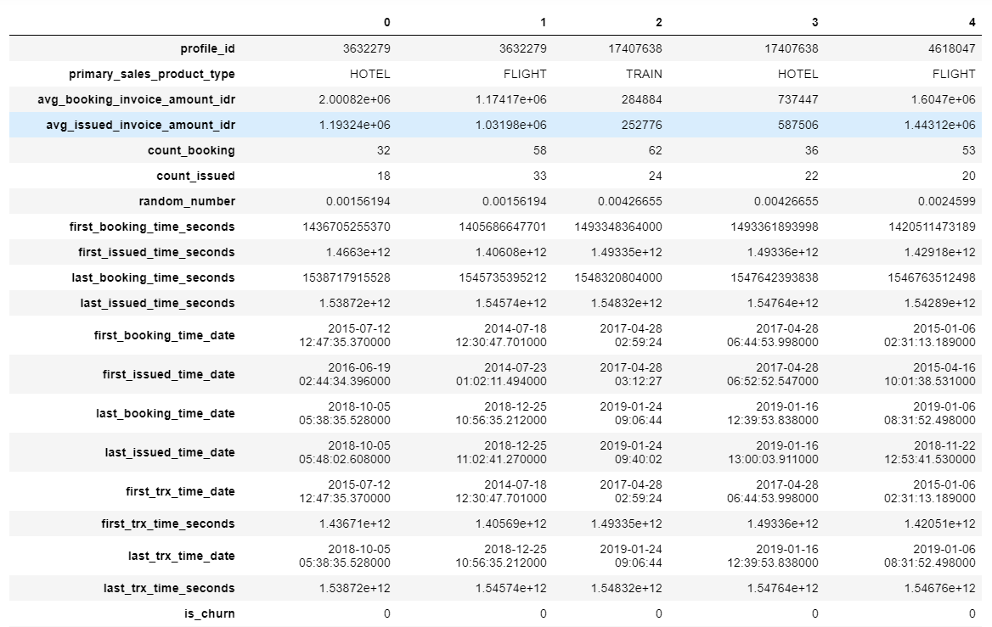
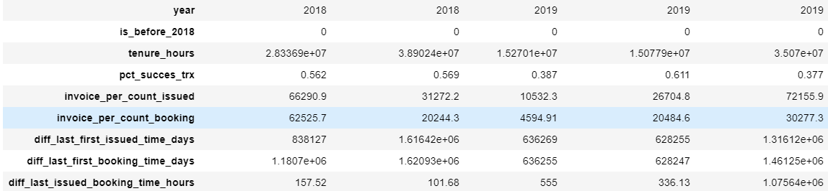
Advanced Analysis and Feature Building – Features Building
1) Tenure hours = last transactions time – first transactions time, I assume this tenure matrix from first time and last time customer bought and might be useful to indicate the churners because my hypothesis customer who left Traveloka usually have small tenure and they only find the promo and one time use
2) Pct success transaction = success transaction rate by dividing count issued with count booking, this features to measure how percentage customer success finishing the payment issued process from booking
3) Invoice per count issued = this features may look average of churn because often to buy expensive product or buying a lot of cheap product
4) Invoice per count booking = this features may look average of churn because often to booked expensive product or booked a lot of cheap product
5) Diff last first issued time days = subtracting last booking time with first booking time to measure how range of time distance from first issued to last issued
6) Diff last first booking time days = subtracting last booking time with first booking time to measure how range of time distance from first booking to last booking
7) Diff last issued booking time hours = subtracting last issued time with last booking time to find out how payment process from check out until end in which it probably indicates the UI/UX is good because the payment process is fast and easy
Notes:
Numpang lewat

Slide 15
Advanced Analysis and Feature Building – Summary New Features
Features
Flight
Hotel
Train
Trip
Total
Unit
Churns
Non-churns
diff(%)
Churns
Non-churns
diff(%)
Churns
Non-churns
diff(%)
Churns
Non-churns
diff(%)
Churns
Non-churns
diff(%)
Tenure
In Hours
3444
11048
68%
2357
8303
71%
694
4533
84%
336
1763
80%
6831
25647
73%
Percentage success transactions
In %
44.2
54.6
28%
35.1
40.9
23%
42.2
45.4
16%
28.7
37.6
27%
40.8
47.8
15%
Invoice per count issued
In Million
0,59
0,53
11%
0,34
0,30
13%
0,17
0,14
18%
1,54
1,85
17%
2,65
2,84
6.7%
Invoice per count booking
In Million
0,84
0,57
46%
0,55
0,31
80%
0,18
0,12
48%
2,52
2,49
1.3%
4,11
3,50
17%
Delta last first issued time
In days
115
379
69%
80
267
70%
36
151
76%
34
56
39%
265
853
69%
Delta last first booking time
In days
143
10,0
69%
98
5,0
71%
29
5,0
84%
14
1,0
80%
284
1068
73%
Delta last issued booking time
In Hours
320
737
56%
319
710
55%
104
474
78%
72
317
77%
815
2238
63%
Explanation :
1. Churns people from traveloka might be because of price indicator even though the differences is only 10%
2. The lower the delta in last first issued item meaning the less frequent this kind of customer doing transactions in Traveloka, it aligned with RFM theory, the more recent transactions, the more customer not churning out
3. There is totally different characteristics between booking and issued count, it shows that more booking doesn’t necessarily leading to the successful transactions, this arise a new hypothesis whether the booking conversion into issuance or transactions done is effective?

Slide 16
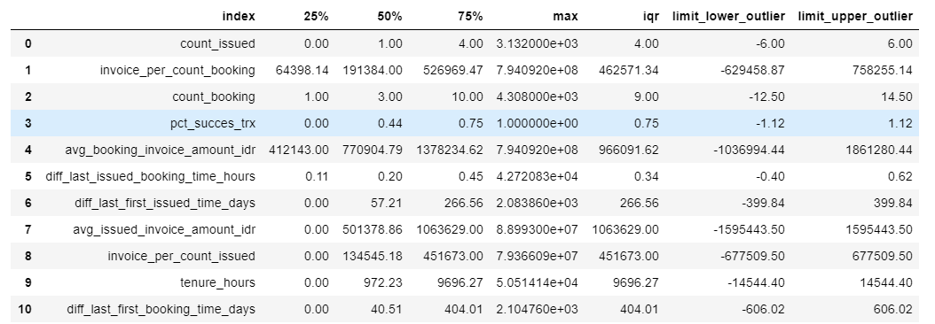
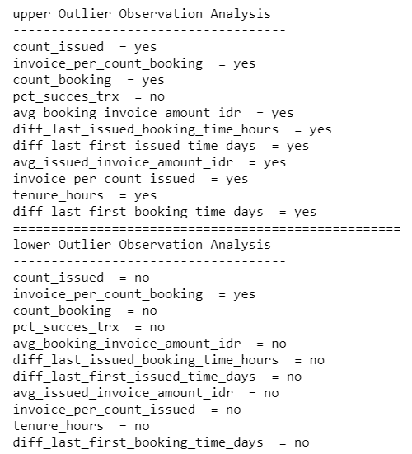

Advanced Analysis and Feature Building – Clustering
The circle on the table marked the limit of lower and upper of dataset to detect outlier
Clustering Processing
Dataset
Perform standardizations is needed because if there are large differences between the ranges of initial variables, those variables with larger ranges will dominate over those with small ranges
Standardized
Marked ‘Yes’ means this features have outlier,
Then for upper outlier data point will be replaced or imputation with limit upper outlier as well as lower outlier data point is replaced with limit lower outlier
Standardize Data
Silhoutte Score
Number cluster
K-means Clustering
Summary
Dataset with segment clustering
Notes:
Numpang lewat

Slide 17

Advanced Analysis and Feature Building – Summary Clustering
1
Product
2
Segment
Segment A (69.5%)
Segment B (30.5%)
52% non-churns 48% churns
80% non-churns 20% churns
Hotel
Hotel
52 % non-churns
48 % churns
83 % non-churns
17 % churns
A
B
Flight
Flight
Train
Train
45 % non-churns
55 % churns
66 % non-churns
34 % churns
77 % non-churns
23 % churns
96 % non-churns
4 % churns
Trip
Trip
72 % non-churns
28 % churns
100 % non-churns
0 % churns
Quality cluster is Weak according to the (Kauffman & rouusseuw, 1991), but 2 cluster Is the biggest silhouette score for this dataset
Silhouette index
0.32
Detail Charasterisctic & Profile for Each Segment and product
Segment

Slide 18
Advanced Analysis and Feature Building – Summary Clustering – All Product
 | Segment A | Segment B
Total Subs (K) | 143.3 ( 69.5 % ) | 62.6 (30.5 %)
Tenure (Hours,000) | 2.3 ( 11% ) | 18.5 (89%)
Diff last first issued time (days) | 67 ( 9% ) | 702 (91%)
Count issued (Transactions) | 2 (10%) | 18 ( 90% )
Invoice per count issued (IDR,000) | 817 ( 86% ) | 128 (14%)
Avg issued invoice amount (IDR,000000) | 1.15 ( 52% ) | 1.03 (48%)
Pct success transaction (%) | 63% | 55%
Total Subs : 206 K
Most Churners Segment
Dominant non churner Segment

Slide 19
Advanced Analysis and Feature Building – Summary Clustering – Flight
 | Segment A | Segment B
Total Subs (K) | 67.8 ( 65 % ) | 35.7 (35 %)
Tenure (Hours,000) | 2.5 ( 11% ) | 20.4 (89%)
Diff last first issued time (days) | 74 ( 8% ) | 774 (92%)
Count issued (Transactions) | 2 (9%) | 21 ( 91% )
Invoice per count issued (IDR,000000) | 1.05 ( 87% ) | 0.15 (13%)
Avg issued invoice amount (IDR,000000) | 1.54 ( 54% ) | 1.32 (46%)
Pct success transaction (%) | 68% | 60%
Total Subs : 103 K
Most Churners Segment
Dominant non churner Segment
Notes:
Numpang lewat

Slide 20
Advanced Analysis and Feature Building – Summary Clustering – Hotel
 | Segment A | Segment B
Total Subs (K) | 46.1 ( 70 % ) | 19.8 (30 %)
Tenure (Hours,000) | 2.3 ( 12% ) | 17.8 (88%)
Diff last first issued time (days) | 64 ( 9% ) | 667 (91%)
Count issued (Transactions) | 2 (13%) | 13 ( 87% )
Invoice per count issued (IDR,000) | 597 ( 83% ) | 117 (17%)
Avg issued invoice amount (IDR,000) | 825 ( 51% ) | 772 (49%)
Pct success transaction (%) | 57% | 43%
Total Subs : 66 K
Most Churners Segment
Dominant non churner Segment
Notes:
Numpang lewat

Slide 21
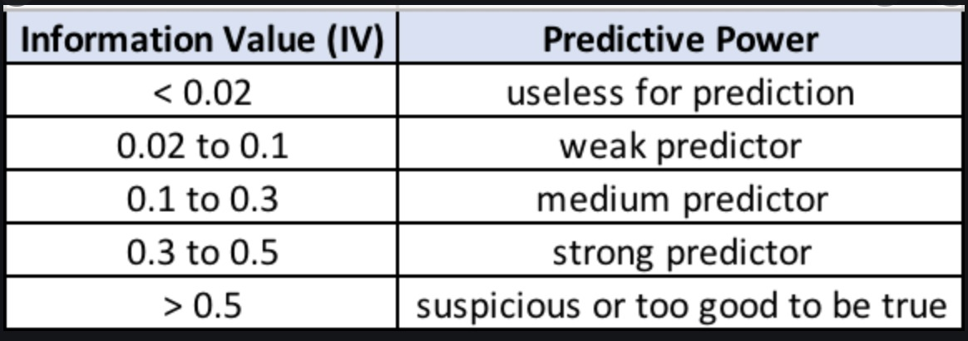
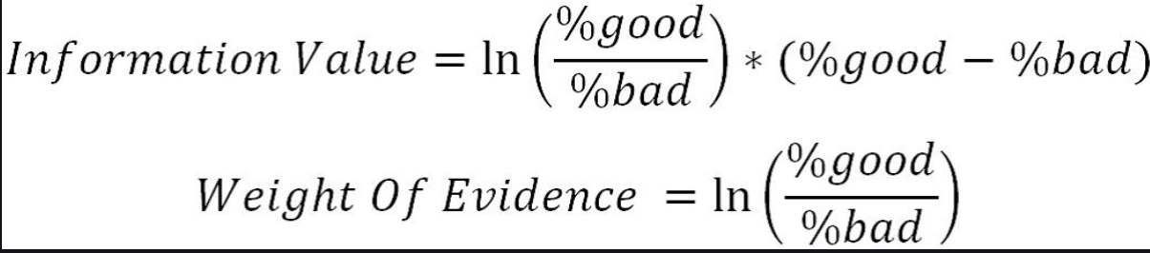
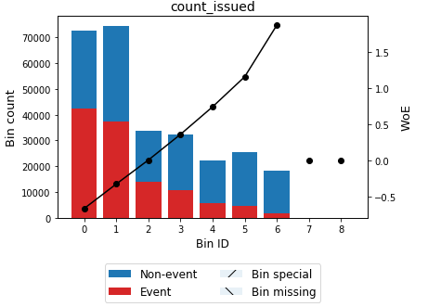
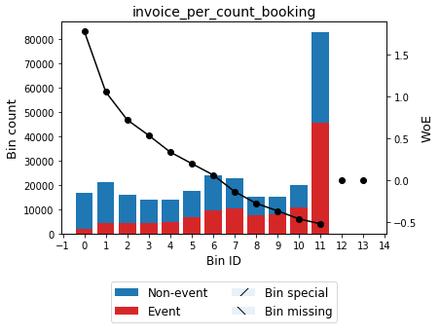
Advanced Analysis and Feature Building – Woe Analysis Features
Weigh of Evidence
Criteria
Total Information Value
Monotonic Ranking/Decaying
Top 5 Strong Features after WOE Analysis
1) tenure_hours = 0.575544
2) diff_last_first_booking_time_days = 0.575544
3) diff_last_first_issued_time_days = 0.521940
4) count_issued = 0.459246
5) count_booking = 0.458151
Notes:
Numpang lewat

Slide 22
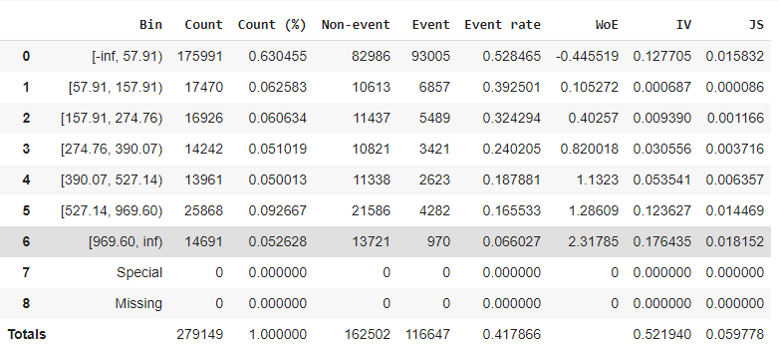
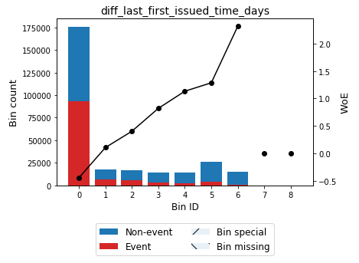
Advanced Analysis and Feature Building – diff last first issued time days - recency
Trave Customer Characteristics doesn’t often do transactions, there is a range of interval around 60 days/2 months each payment transactions
Churn Recommendation should be changed into 60 days/ 2 month, so the treatment (observation starts after customer success issued until periods of time) should be done on 60 days/ 2month range of interval at customer journey transactions, the rest is more loyal
IV = 0.52, Potential features as strong predictor and Monotonic Ranking

Slide 23
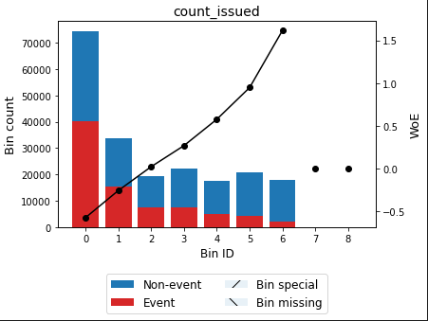
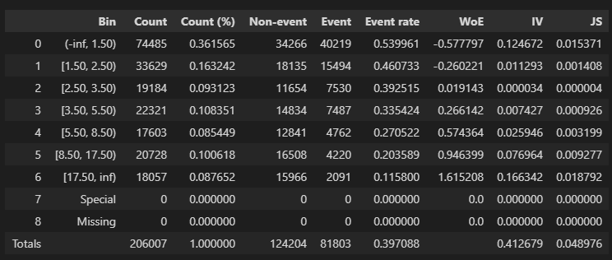
Advanced Analysis and Feature Building – Count Issued Features - Frequency
The less transactions until issued, the more highly people to Churn because these people probably new comer that try to use an app for transactions
IV = 0.41, Potential features as strong predictor and Monotonic Ranking
Notes:
Numpang lewat

Slide 24
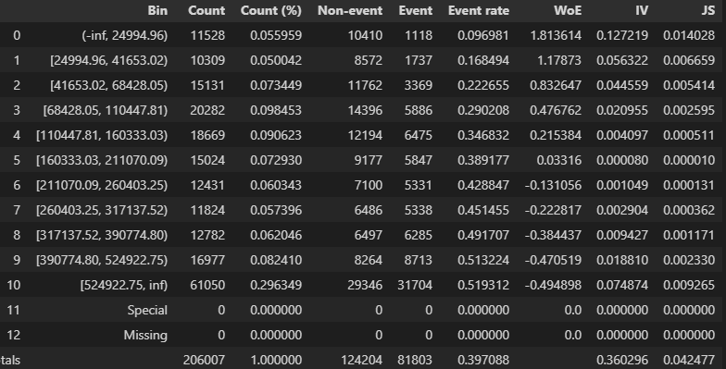
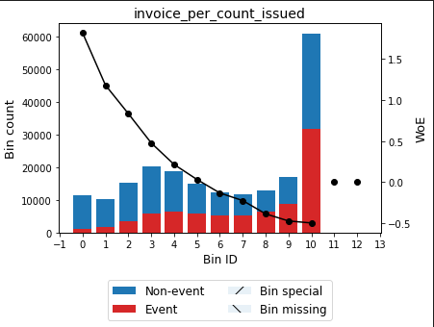
Advanced Analysis and Feature Building – Invoice per Count Issued Features - Monetary
The more expensive invoice per count issued, the more highly people to churn because the natural business behaviour such as Traveloka or OTA, the customer go to holiday maximum twice in a year
IV = 0.36, Potential features as strong predictor and Monotonic Decaying
Notes:
Numpang lewat

Slide 25
Modelling

Slide 26
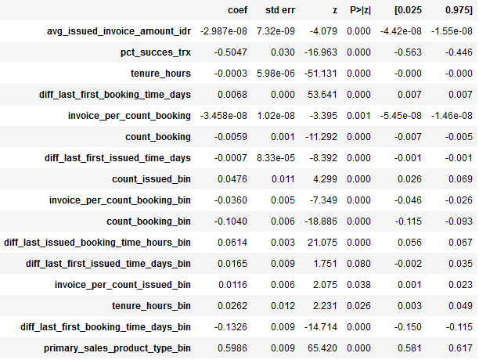
Logit Analysis - Sanity Check
All Signal is OK after sanity checking per each definition (Positive or Negative) Direction
Positive Sign, indicating the higher invoice amount toward churn on the next cohort.
Negative Sign, Indicating the longer the the more longer difference between first booking time to last booking time tend to more loyal customer and have more recent/frequent Traveloka Purchase

Slide 27
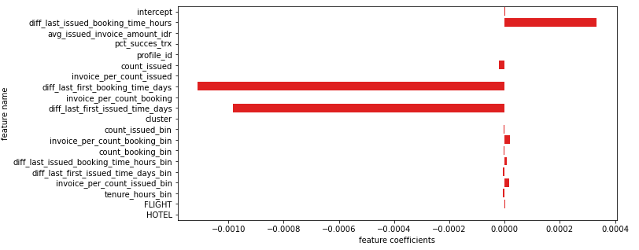
Churn model Coefficient Attributes
Negative Sign, Indicating the longer the distance of first issued to last issued tend to more loyal customer and have more recent/frequent Traveloka Purchase
Positive Sign, indicating the higher invoice amount toward churn on the next cohort.
Notes:
Numpang lewat

Slide 28
Retention Class Modelling
model | auc_train | auc_test | accuracy_train | accuracy_test | precision_train | precision_test | recall_train | recall_test | f1_train | f1_test
Decision Tree | 0.73793 | 0.737924 | 0.676691 | 0.678195 | 0.641381 | 0.645797 | 0.420396 | 0.423954 | 0.420396 | 0.423954
catboost | 0.761648 | 0.759032 | 0.6924 | 0.692685 | 0.624875 | 0.627387 | 0.562755 | 0.561044 | 0.562755 | 0.561044
bagging | 0.763112 | 0.75805 | 0.694057 | 0.691884 | 0.629146 | 0.628265 | 0.558031 | 0.553055 | 0.558031 | 0.553055
Random_Forest | 0.844819 | 0.756391 | 0.761312 | 0.688462 | 0.733358 | 0.629245 | 0.626267 | 0.528784 | 0.626267 | 0.528784
adaboost | 1.0 | 0.735445 | 1.0 | 0.672953 | 1.0 | 0.60678 | 1.0 | 0.506464 | 1.0 | 0.506464
Notes:
Numpang lewat

Slide 29
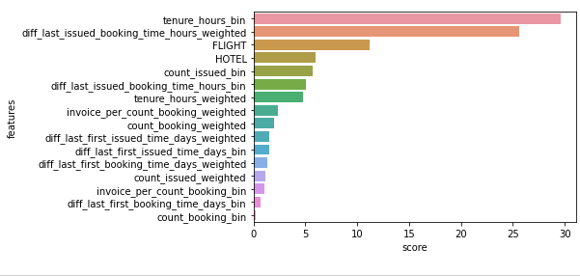
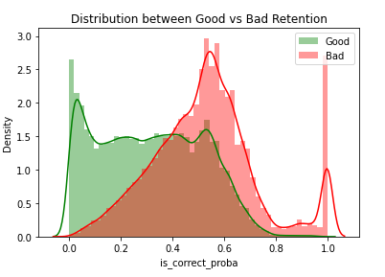
Retention Class Modelling
Our model able to distinct probability churn/no quite good as the higher proba indicating higher composition of churned customers, vice versa.

Slide 30
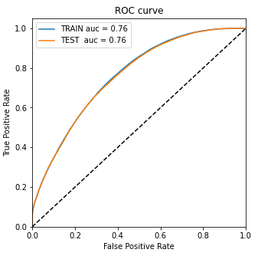
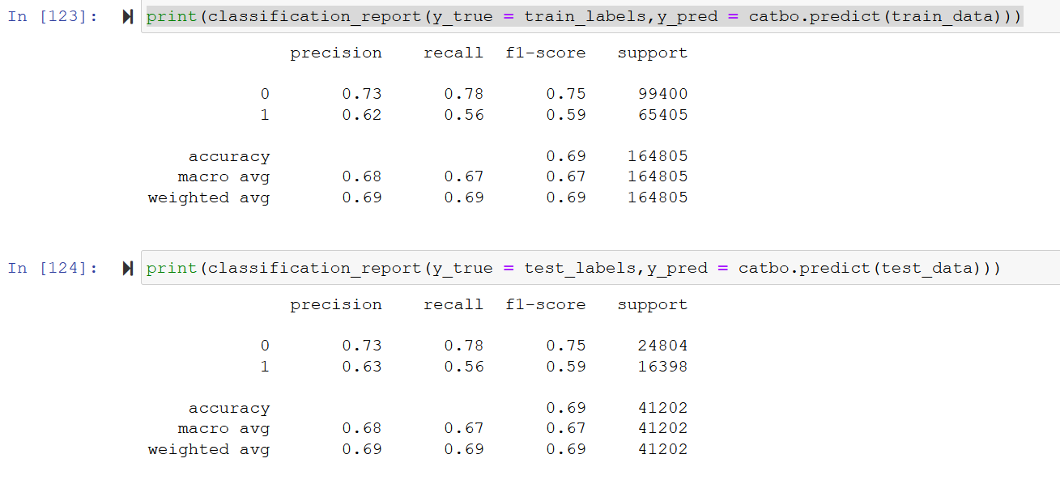
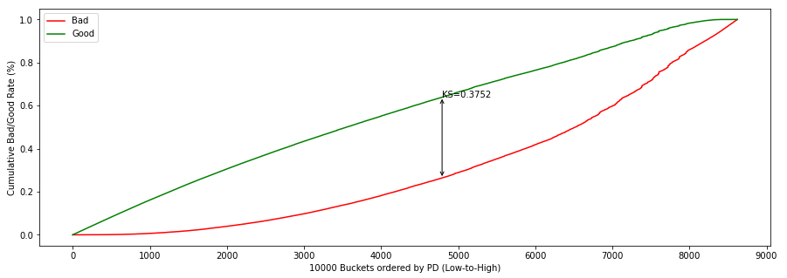
Retention Class Modelling Metrics
AUC : 0.76, quite good toward distinct churn yes/no class. Moreover, stability is immerse as no delta found between randomized Train and Test Population.
Precision-Recall on class 0 is already good, meanwhile on class 1 (churns) can be improved for next cycle
KS of 0.3752 indicating model is quite better in terms of distancing between class churn/no in Population

Slide 31
Strategy Analyst Results – Benefit of using model
Model Scoring
Apply the model on the existing transaction portfolio data
Divide the scoring data into 10 deciles based on the high to low score probability
Classify high, medium, and low default rate of customers based on the decile grouping and average likelihood score for each decile
Example :

Slide 32
Conclusion &

Slide 33
Conclusions
For customer who have diff time between last and first issued <= 2 months, it probably this customer only looks for promo in certain periods of time, in other hand > 2 months is more loyal customer. In other hand from cohort analysis standpoint It is safe to assume retention label can be done in monthly basis because of healthy retention overall throughout the years.
Define churns label not in a year, but in maximum 2 months of periods observation other than that more loyal customer because the natural business behaviour of Traveloka product is rarely transactions in shorter periods or the near future
Performing cluster segment help to determine which target that receive loyalty program or promo program (Mainly segment A product flight and hotel)
There are 10 features have strong predictor to churns , those are tenure hours(0.57), difference last booking time with first booking time (0.57), difference last issued time with first issued time (0.52), count issued (0.45), count booking (0.45), cluster segment (0.45), invoice per count issued (0.42), invoice per count booking (0.36), probability success transactions (0.26), and difference last issued time with last booking time (0.23)
All of these analysis probably could be supported by uncaptured data like payment systems (range of cancelling time, Fee cancellation, using wallet point, profiling data like segment status, etc), UI/UX experiences, and etc

Slide 34
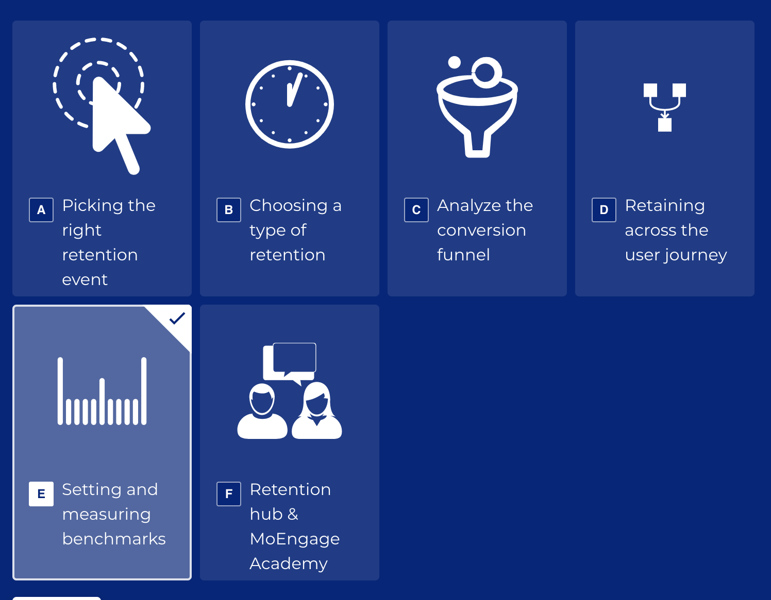
Recommendation of data experiments
It turns out that the invoice issued price does affect to churns, but not enough strong because the Coefficient determination of average invoice is not too strong (based on logistic analysis) and the prices difference only 10% based on (advanced analysis)
Based on logistic analysis on data transactions, it turns out tenure hours does affect to the churns characteristics as to why increasing interactive program is important in order to make customer actively used Traveloka apps
Define Loyalty Index / Score with consideration RFM Standpoint, UX Journeys, Income Capacity, and Customer Awareness Index.
Analysing most drop conversion funnel before churn, set many callbacks procedures like Promo or One-Pay click, and monitor relevant metrics on that funnel (Conversion, Retention Point, LeftOff and Churn Per Cohort)
Re-targerting promo based on probabilitly model above 0.4

Slide 35
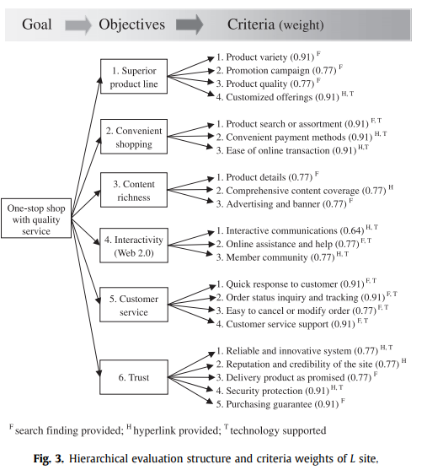
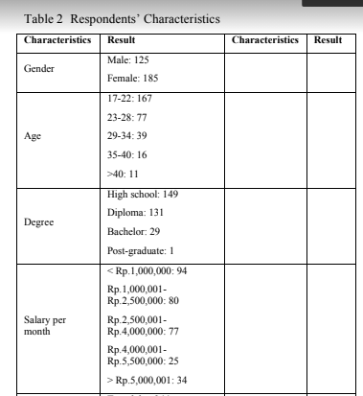
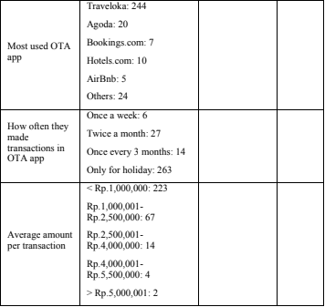
Product Level Recommendations
Based on Paper ‘’Tourism Management 32 (2011) 1463-1473’’ for increasing loyalty customer at online travel agency, instead of giving promo, Customized offering are more effective to increase loyal customer, it can be proven by the research, customized offering (0.91) has more powerful than promotion campaign (0.77) and product quality (0.77)
Based on Paper ‘’Advances Intelligence Systems Research, volume 131 ’’ Characteristics Indonesia users to the Online travel agency apps that shows the most customer who made transactions in online travel agency is only for Holidays, followed by twice a month, and once every 3 months These conditions are same with our data transactions.
Notes:
Numpang lewat

Slide 36
Product Level Recommendations - Glossaries
Phima Ruthia Dwikesumasari. Rizka Miladiah Ervianty. Customer Loyalty Analysis of Online Travel Agency App with Customer Satisfaction As A Mediation Variable. Advances in Intelligent Systems Research, volume 131. International Conference of Organizational Innovation (ICOI 2017). January 2017 DOI: 10.2991/icoi-17.2017.18
Chiou, W.-C., Lin, C.-C., & Perng, C. (2011). A strategic website evaluation of online travel agencies. Tourism Management, 32(6), 1463–1473. doi:10.1016/j.tourman.2010.12.007
De Wit, L.S. (2017). An Analysis of Non-Contractual Churn in the B2B Hotel Industry. Master thesis: Data Science: Business and Governance 2017. ANR: 837191 U-Number: 1255441.
Notes:
Numpang lewat

Slide 37
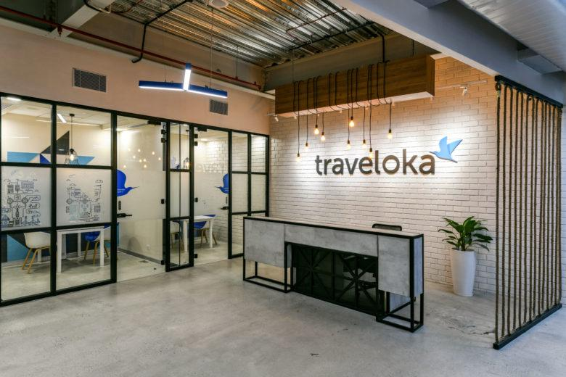
THANK YOU!

