Slide 1
Deploy to Azure Container Registry
Demo 3
by Ehsan Eskandari

Slide 2


Slide 3


Slide 4
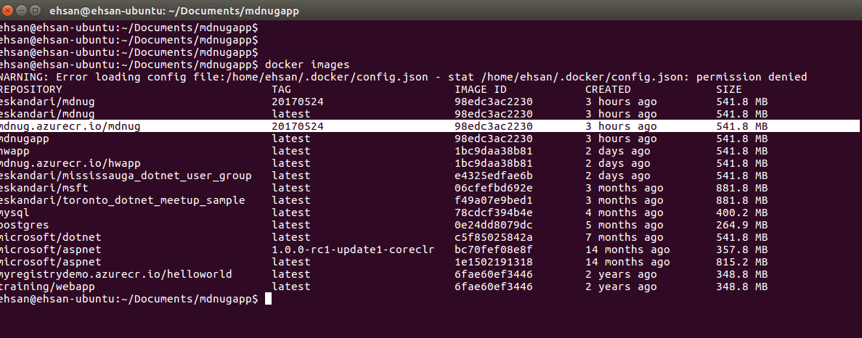

Slide 5


Slide 6


Slide 7
