Slide 1
Push .NET CORE APP to Docker Hub and Azure Container Registry
Ehsan Eskandari

Slide 2
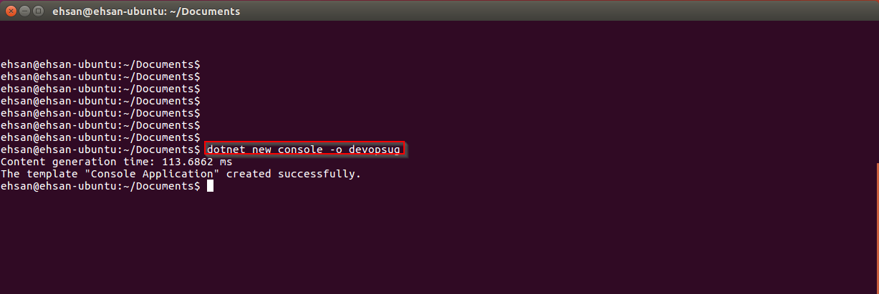

Slide 3


Slide 4


Slide 5


Slide 6
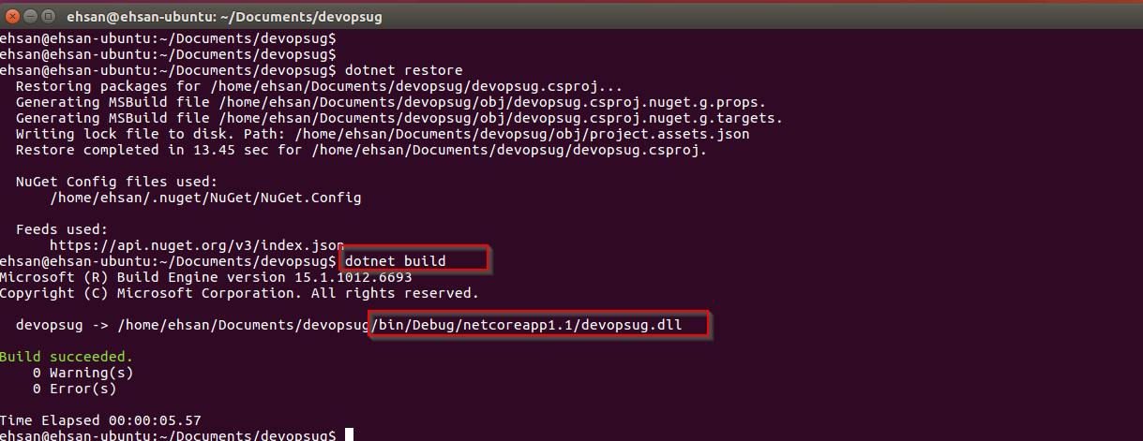

Slide 7
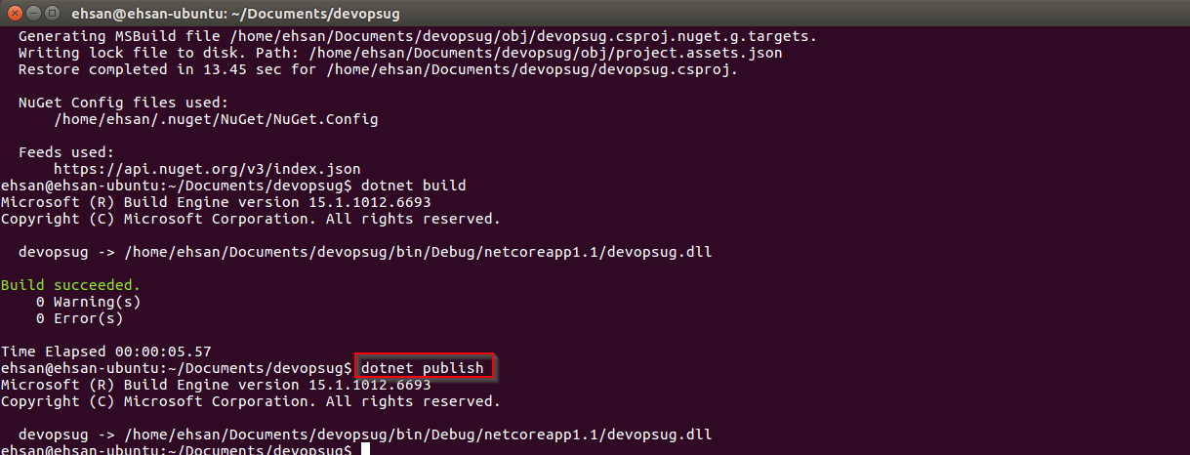

Slide 8
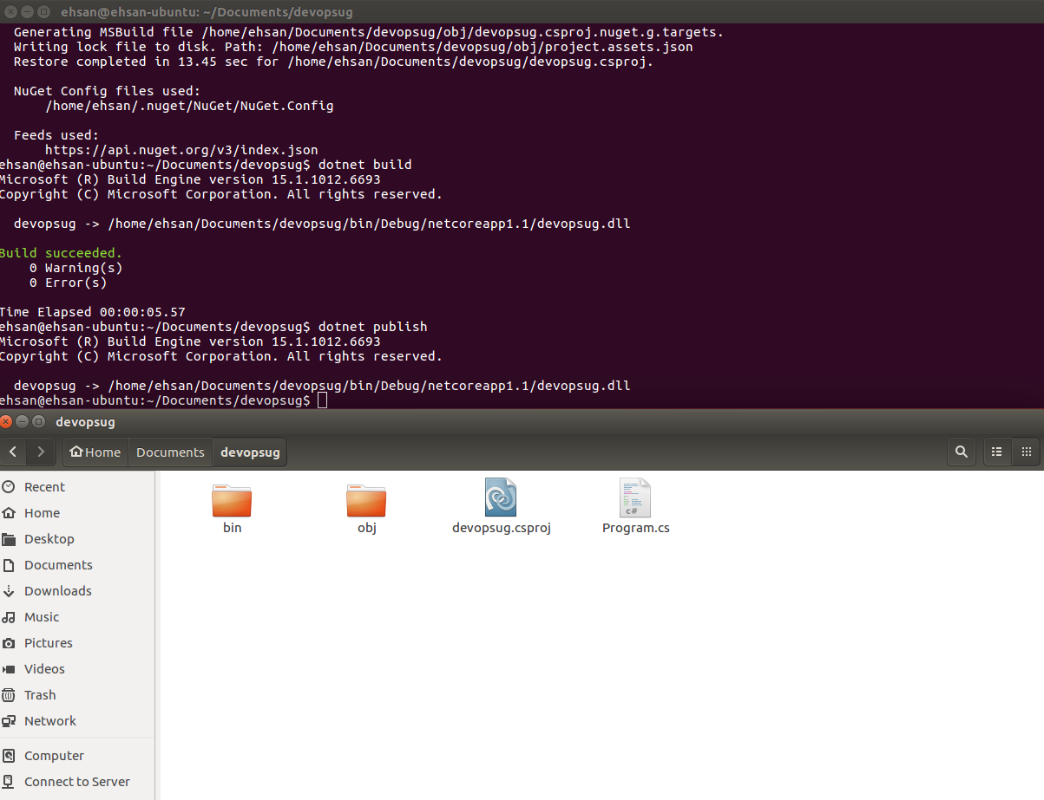

Slide 9
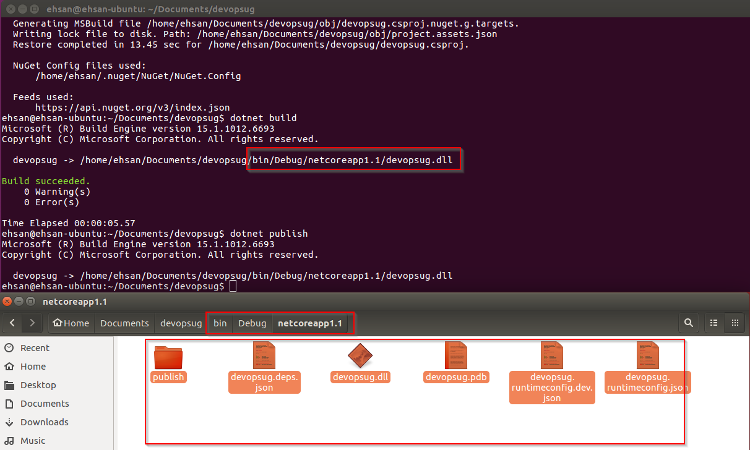

Slide 10
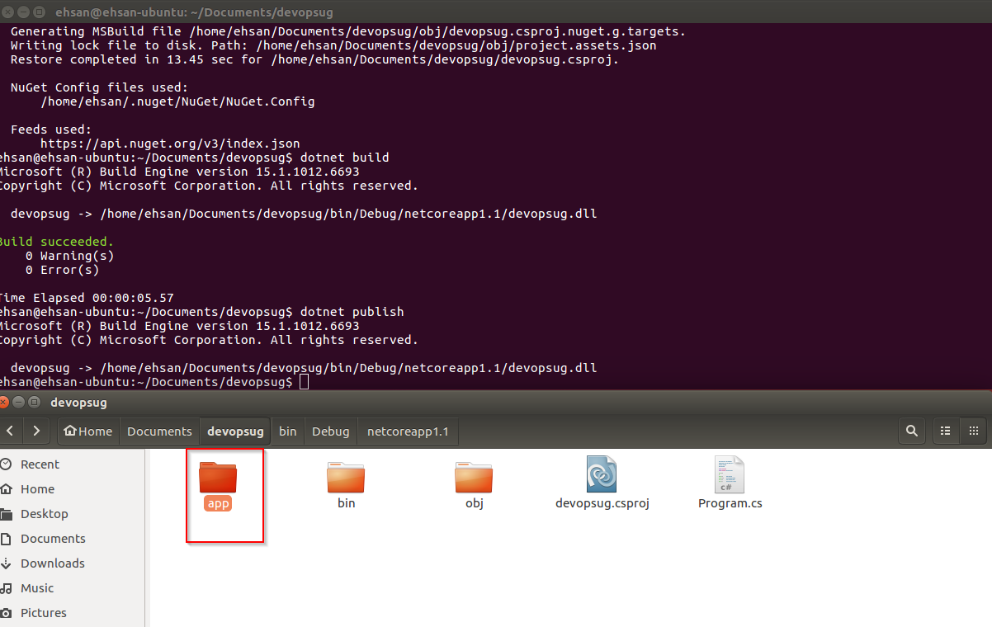

Slide 11
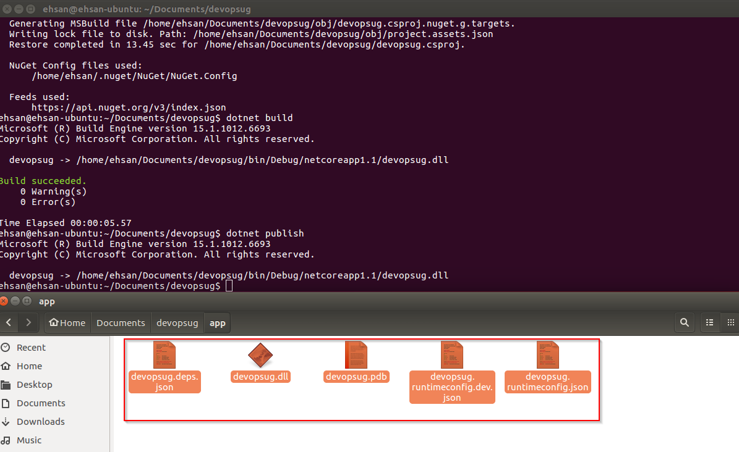

Slide 12
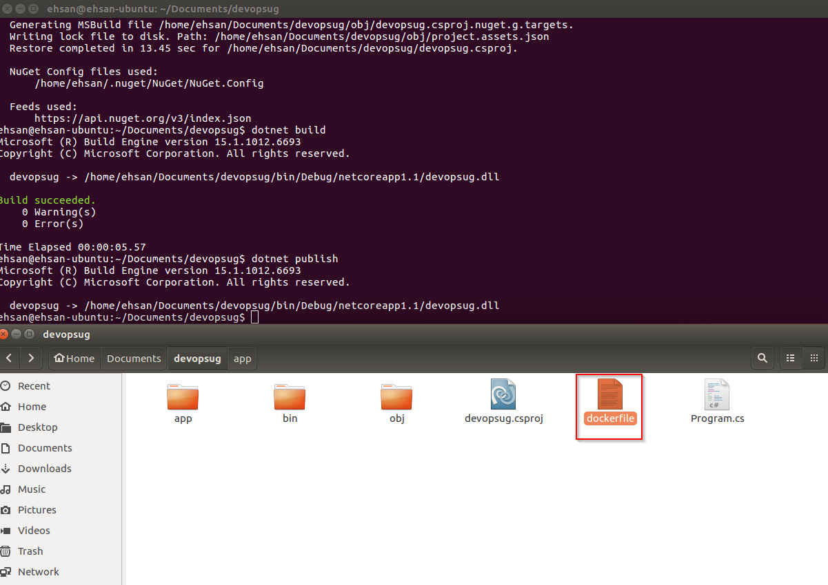

Slide 13
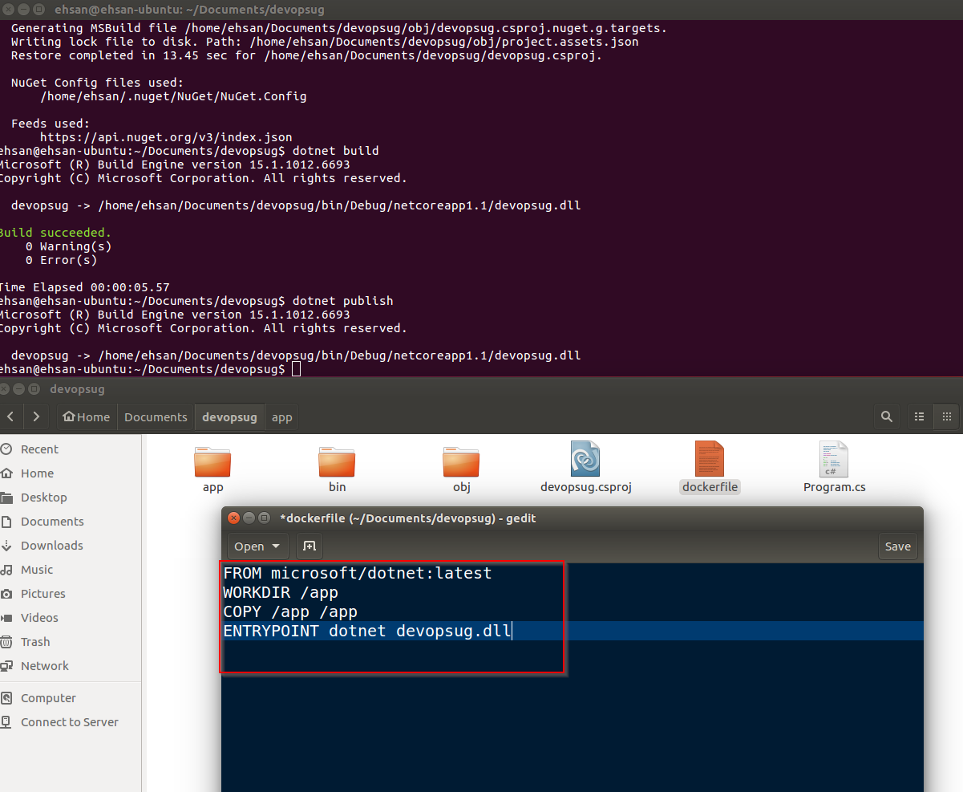

Slide 14
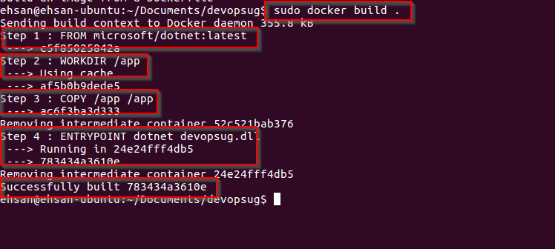

Slide 15


Slide 16
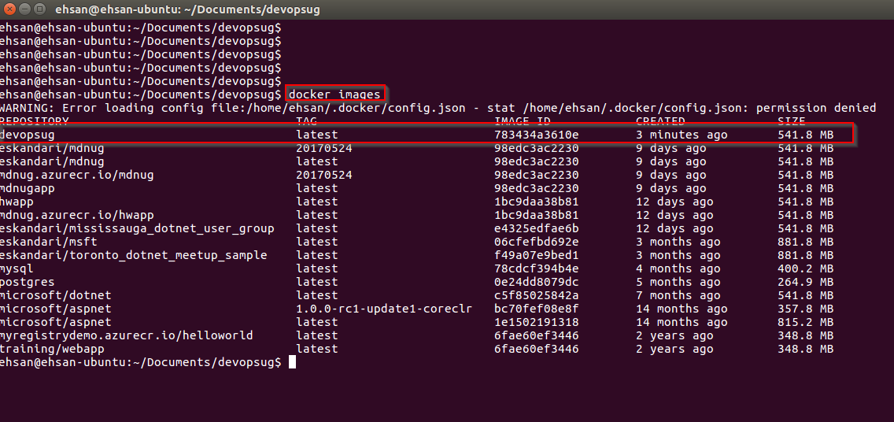

Slide 17
Now, Let’s push this image to docker hub

Slide 18


Slide 19
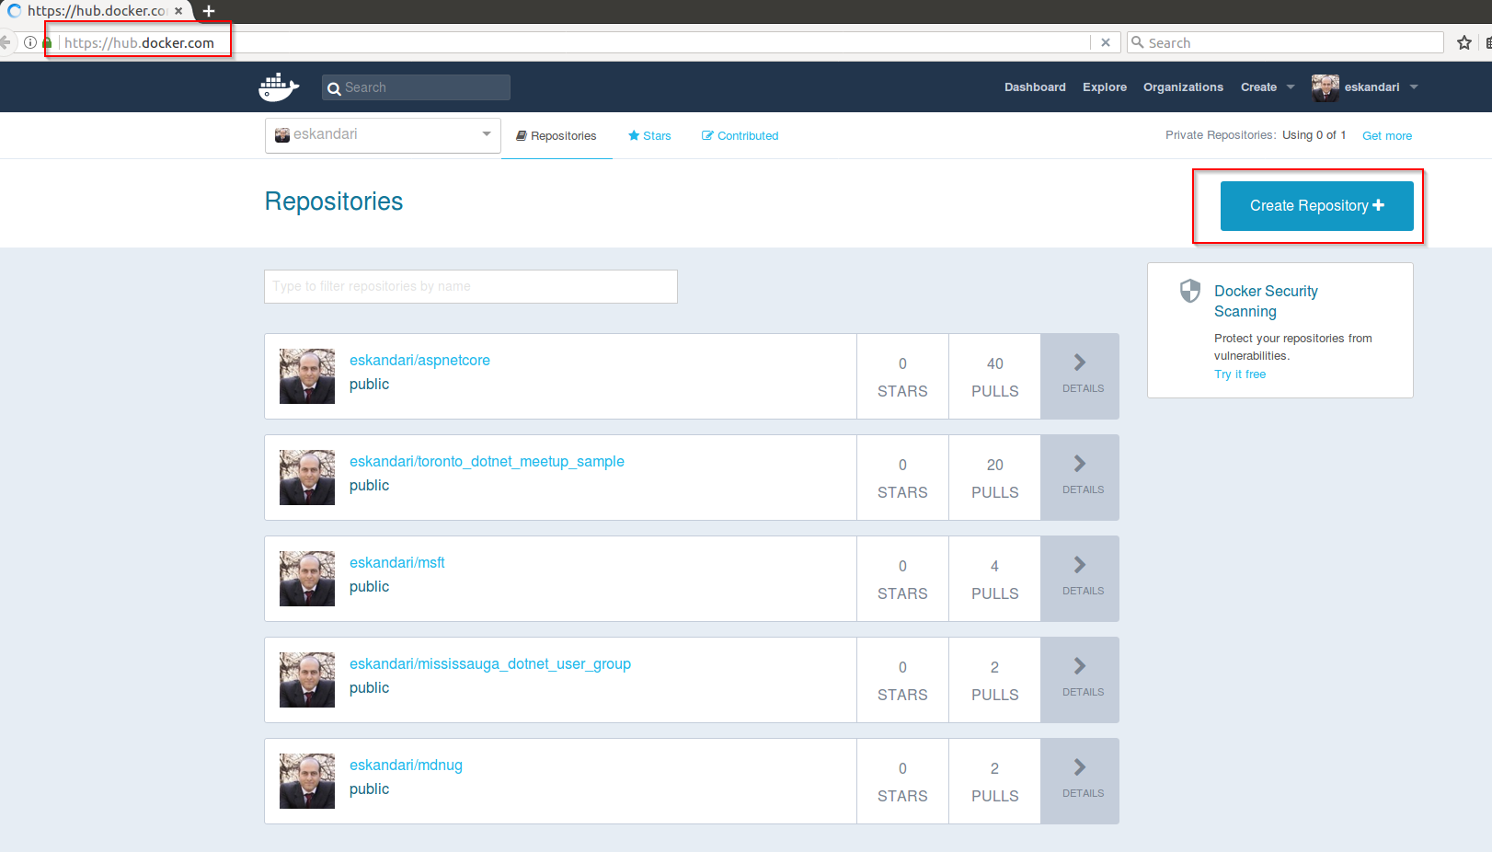

Slide 20
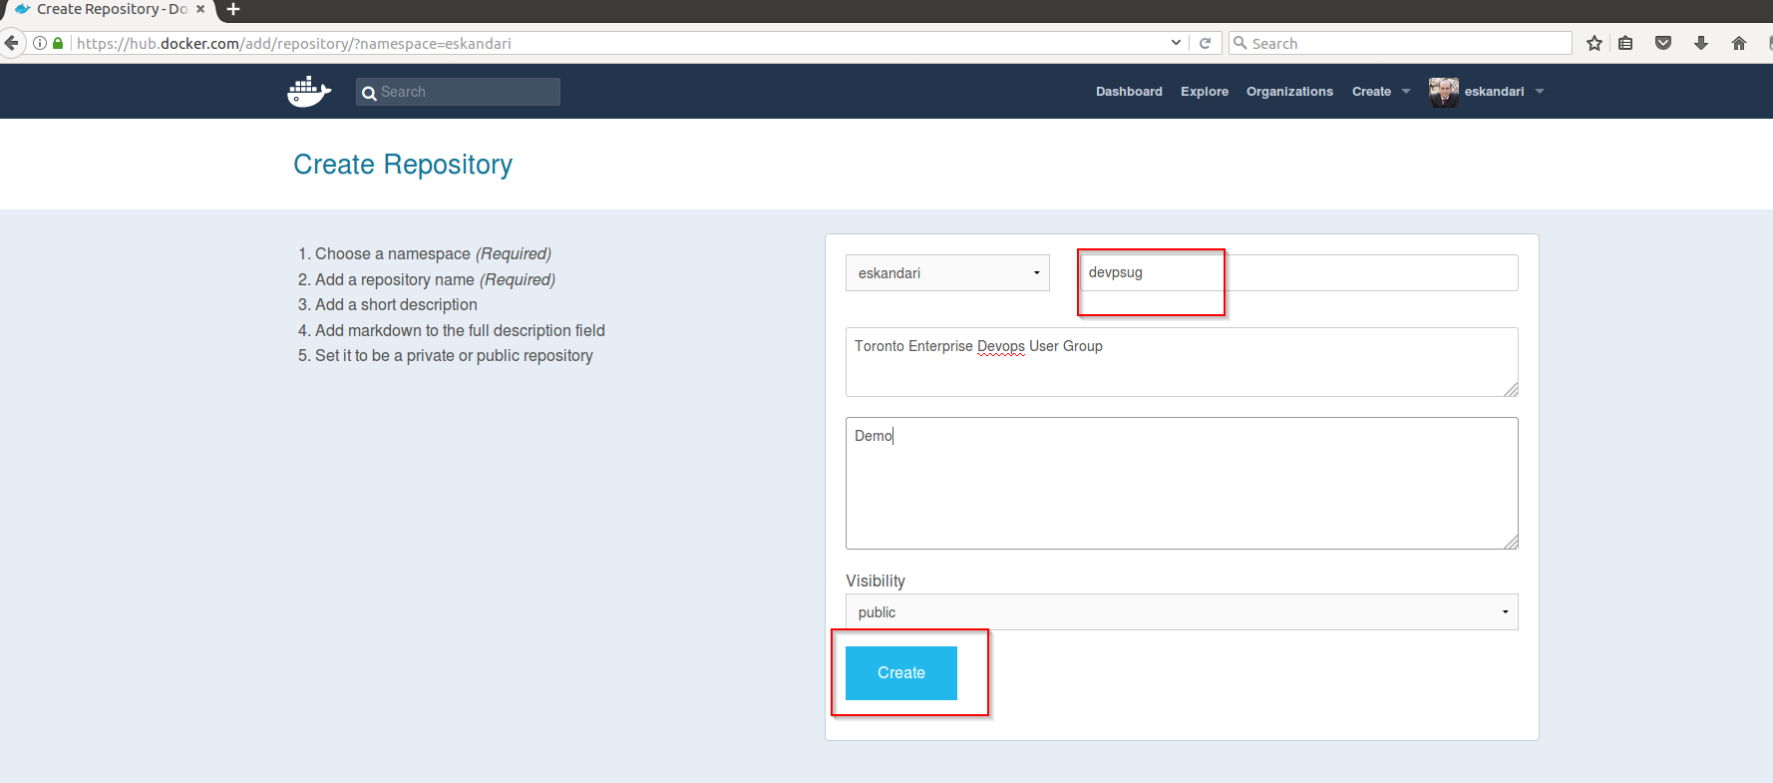

Slide 21
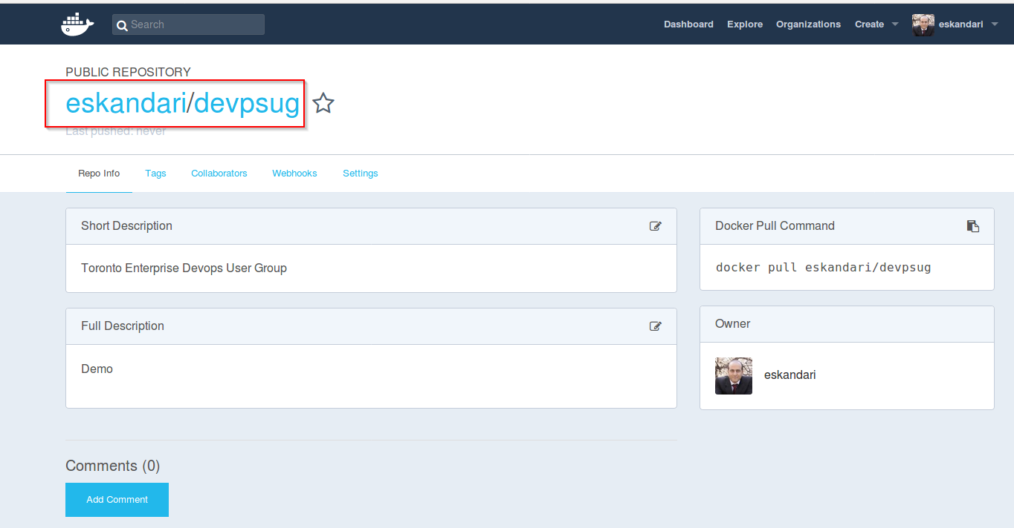

Slide 22


Slide 23
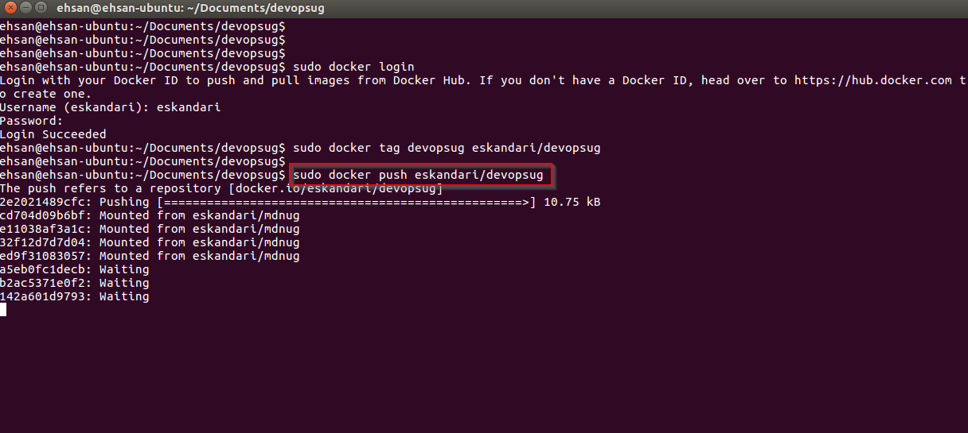

Slide 24
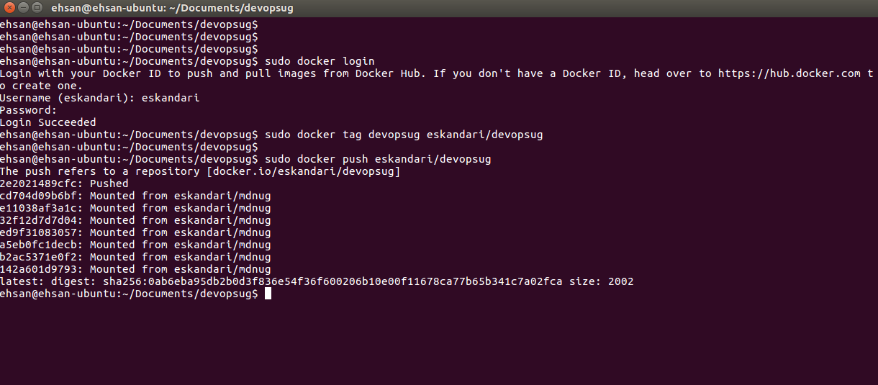

Slide 25


Slide 26


Slide 27
Now let’s push the image to azure container registry

Slide 28


Slide 29
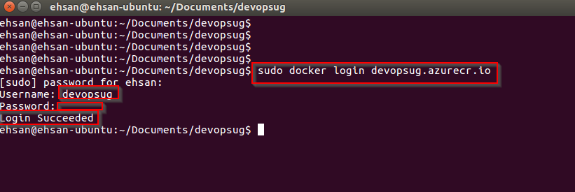

Slide 30


Slide 31
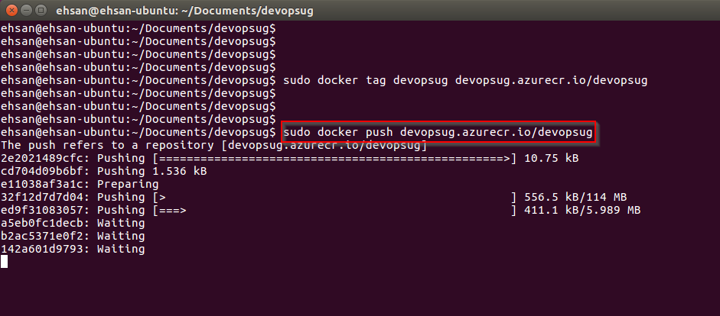

Slide 32
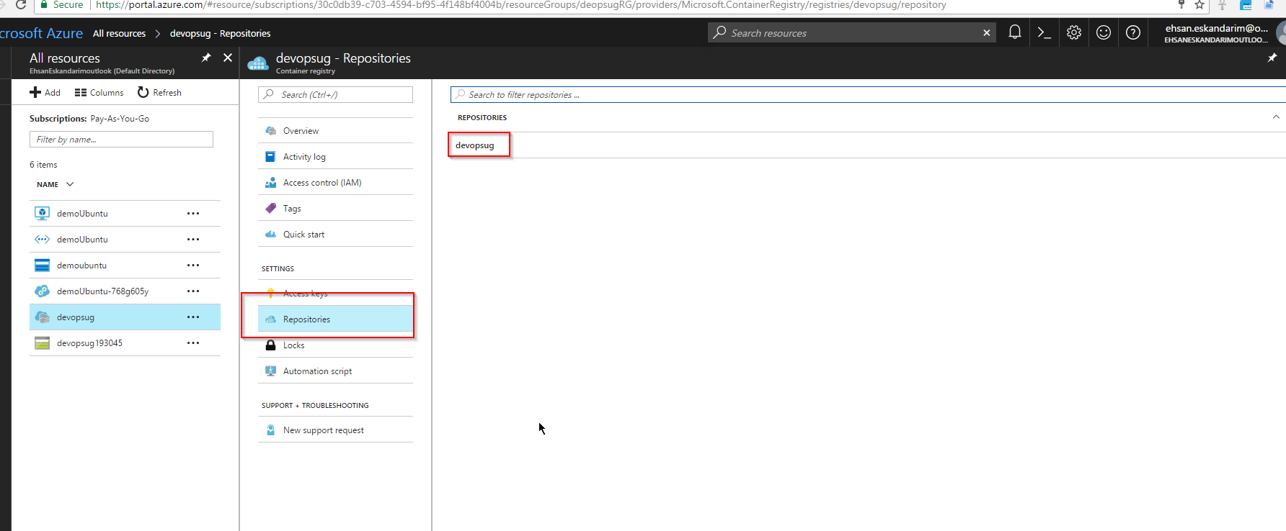

Slide 33
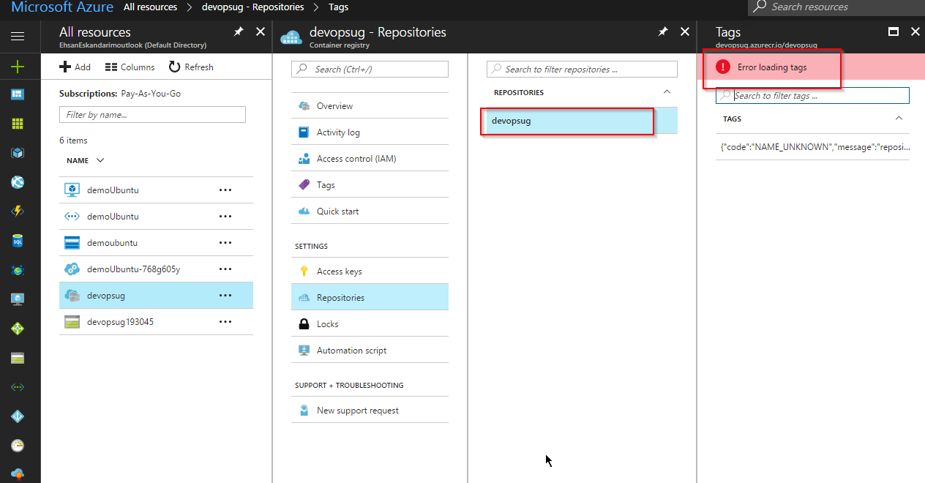

Slide 34
We are getting an error as push is in progress!
After Pushing to ACR

Slide 35


Slide 36
Now let’s pull this image to our Ubuntu machine on Azure

Slide 37
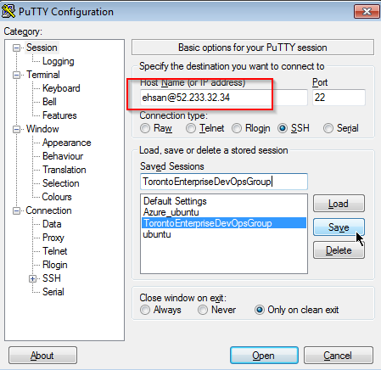

Slide 38
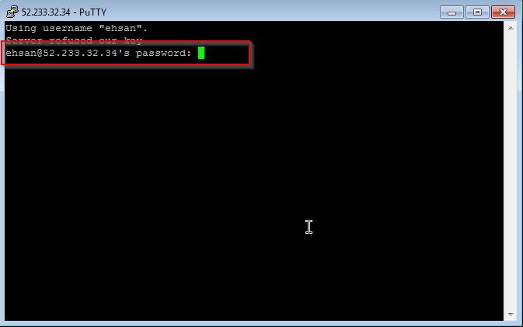

Slide 39


Slide 40


Slide 41
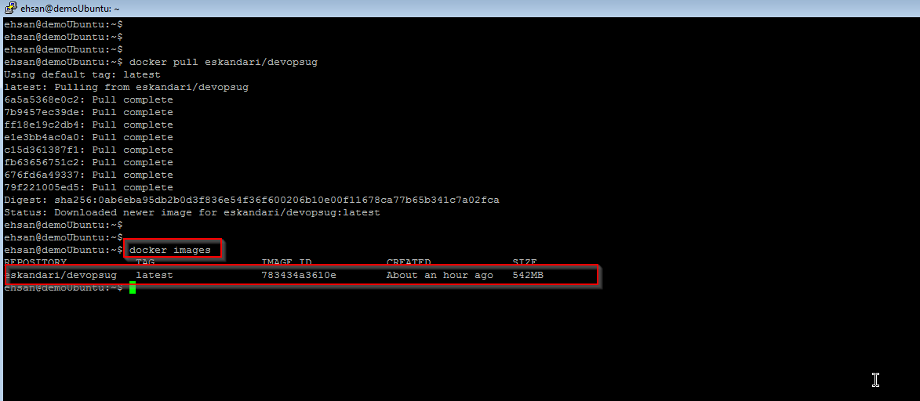

Slide 42
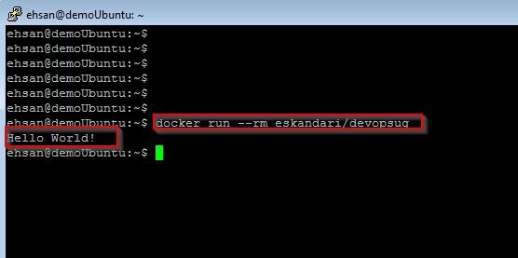

Slide 43
