Slide 1
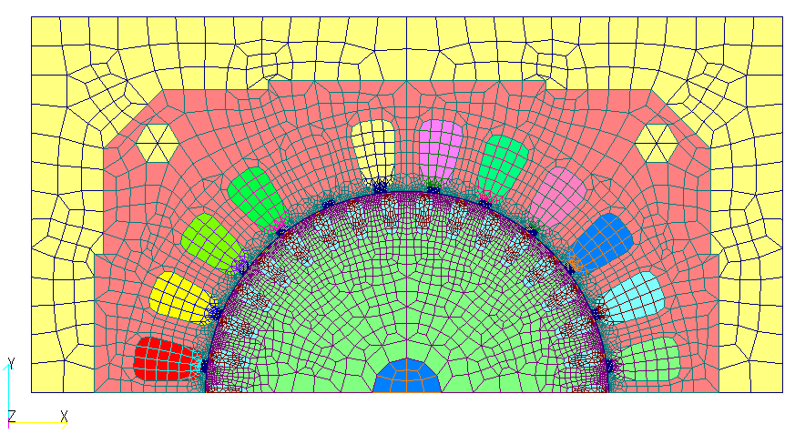
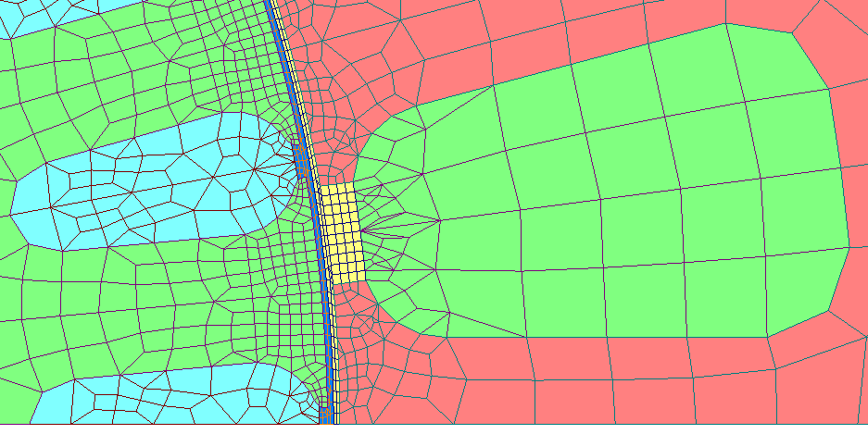
[mm]
6
22
6.5
19
Stator slots = 12
1slots = 180deg/12=15deg
5.2deg
12
0.8
9deg
Rotor slots = 19
1slots = 180deg/19
6.5
0.2
Gap=0.3

