Slide 1
Data management

Slide 2
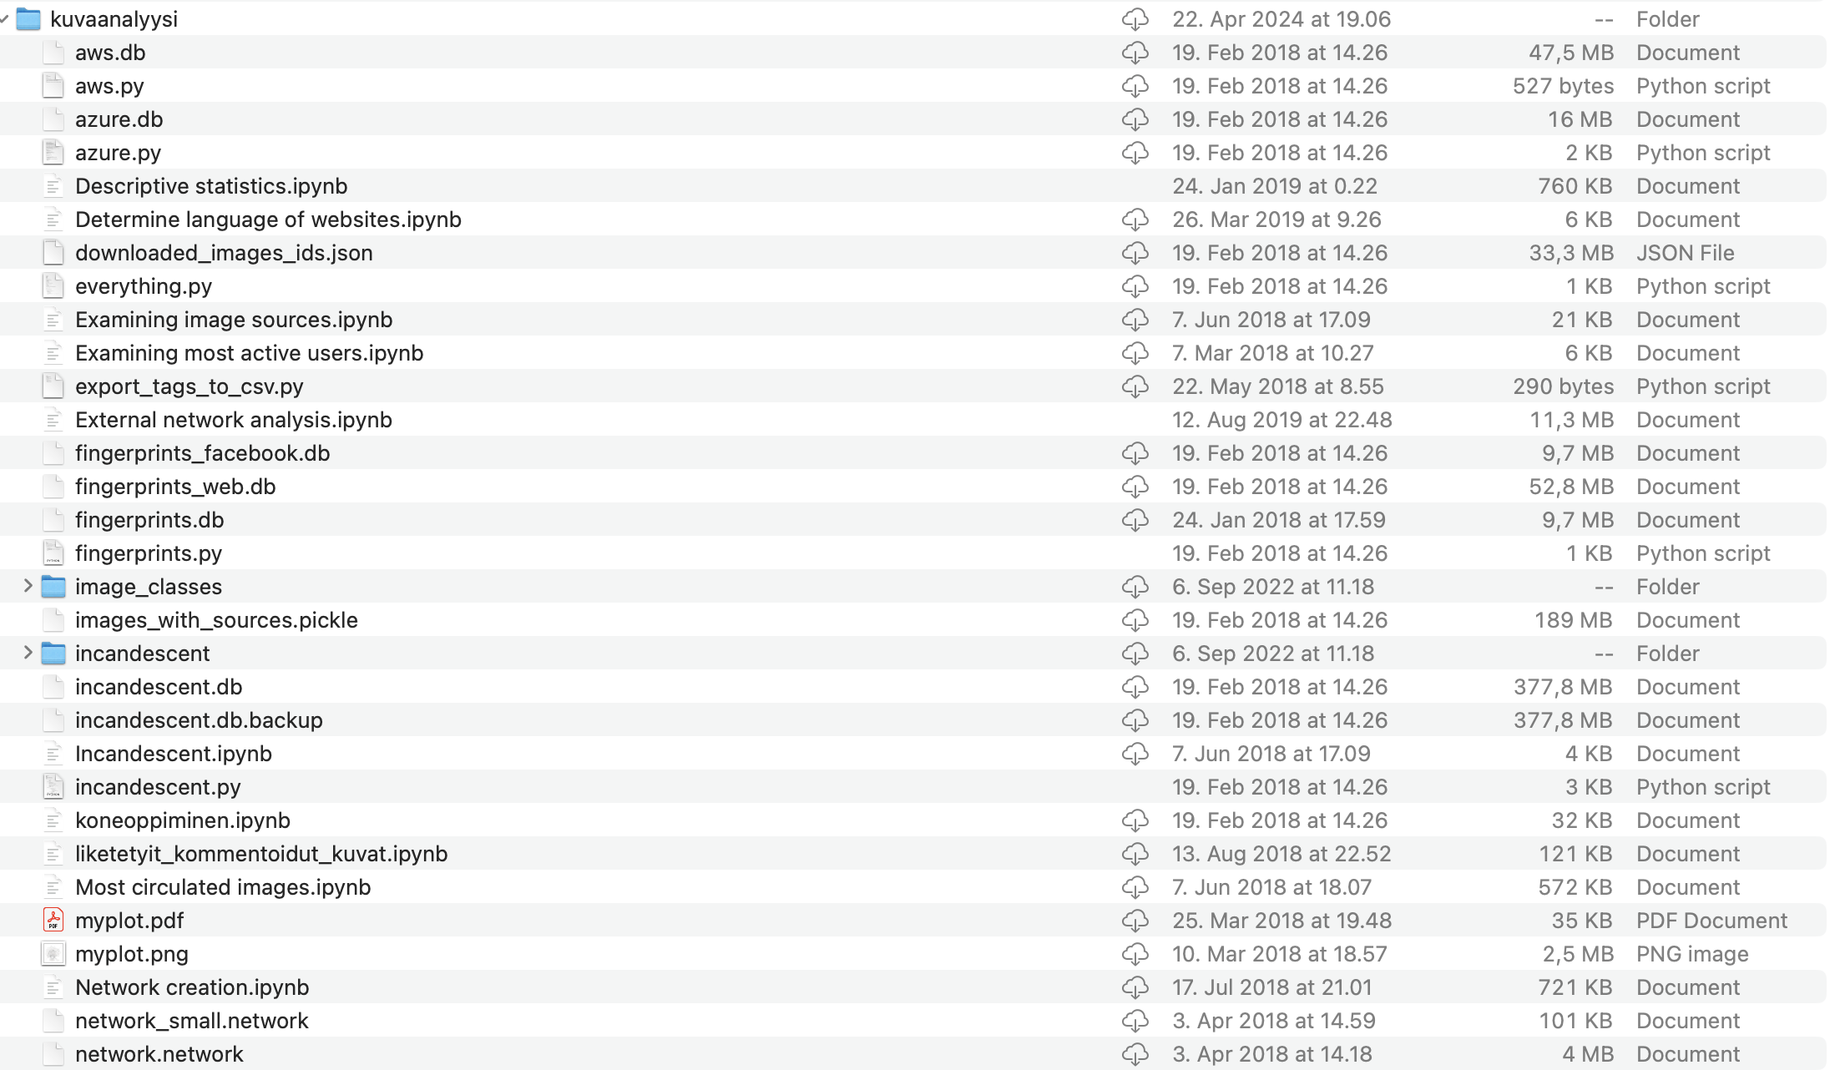
Not like this!

Slide 3
Some hints as well
Always archive the original ‘raw’ data before any cleaning or processing.
Document each processing and wrangling step.
In the end, rerun the processing steps to ensure you have notforgotten anything.

Slide 4
Storage
csv
json
SQL

Slide 5
SQL
Table: People
First name | Last name | Birth year
Matti | Meikäläinen | 2000
Maija | Meikäläinen | 1999
Mikko | Meikäläinen | 2024

Slide 6
SQL
Table: People
First name | Last name | Birth year
Matti | Meikäläinen | 2000
Maija | Meikäläinen | 1999
Mikko | Meikäläinen | 2024
Table: Pets
Name | Kind | Birth year
Matti | Dog | 2020
Maija | Cat | 1999
Mikko | Cat | 2024

Slide 7
SQL
Table: People
ID | First name | Last name | Birth year
1 | Matti | Meikäläinen | 2000
2 | Maija | Meikäläinen | 1999
3 | Mikko | Meikäläinen | 2024
Table: Pets
Name | Kind | Birth year | Owner
Matti | Dog | 2020 | 1
Maija | Cat | 1999 | 2
Mikko | Cat | 2024 | 2

