Slide 1
(Research/Business) ethics
Do no harm
Law and contracts
Privacy law (GDPR)
Coyright law
Elecommunication inference
Digital service act
Terms of service
Privacy policy
Notes:
These are the main legal and ethical pillars in digital data collection. GDPR governs personal data handling.
Copyright protects creative works (text, images, code).
Digital Services Act (DSA) and Terms of Service (ToS) set platform-specific rules.
“Do no harm” applies both to research participants and affected communities.
Ethics is broader than law. Something can be legal but still unethical.

Slide 2
(Research/Business) ethics
Do no harm
Law and contracts
Privacy law (GDPR)
Coyright law
Elecommunication inference
Digital service act
Terms of service
Privacy policy

Slide 3
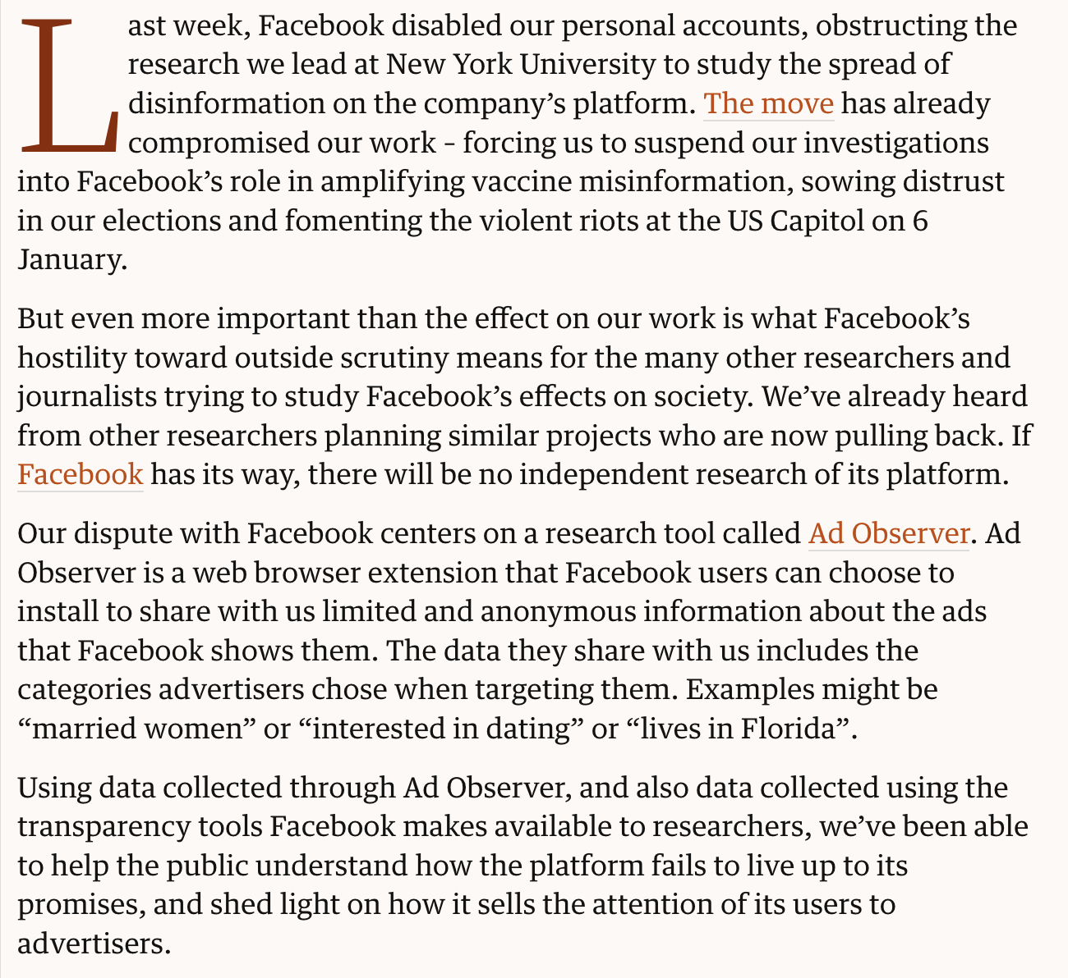
The Guardian 14.8.2021
Notes:
https://www.theguardian.com/technology/2021/aug/14/facebook-research-disinformation-politics
Tension between platform control and academic transparency.
Ad Observer collected user-consented, anonymized ad-targeting data, yet Facebook cited privacy and ToS violations.
Back at our two questions: Who owns platform data? Who gets to decide what is ethical research?

Slide 4
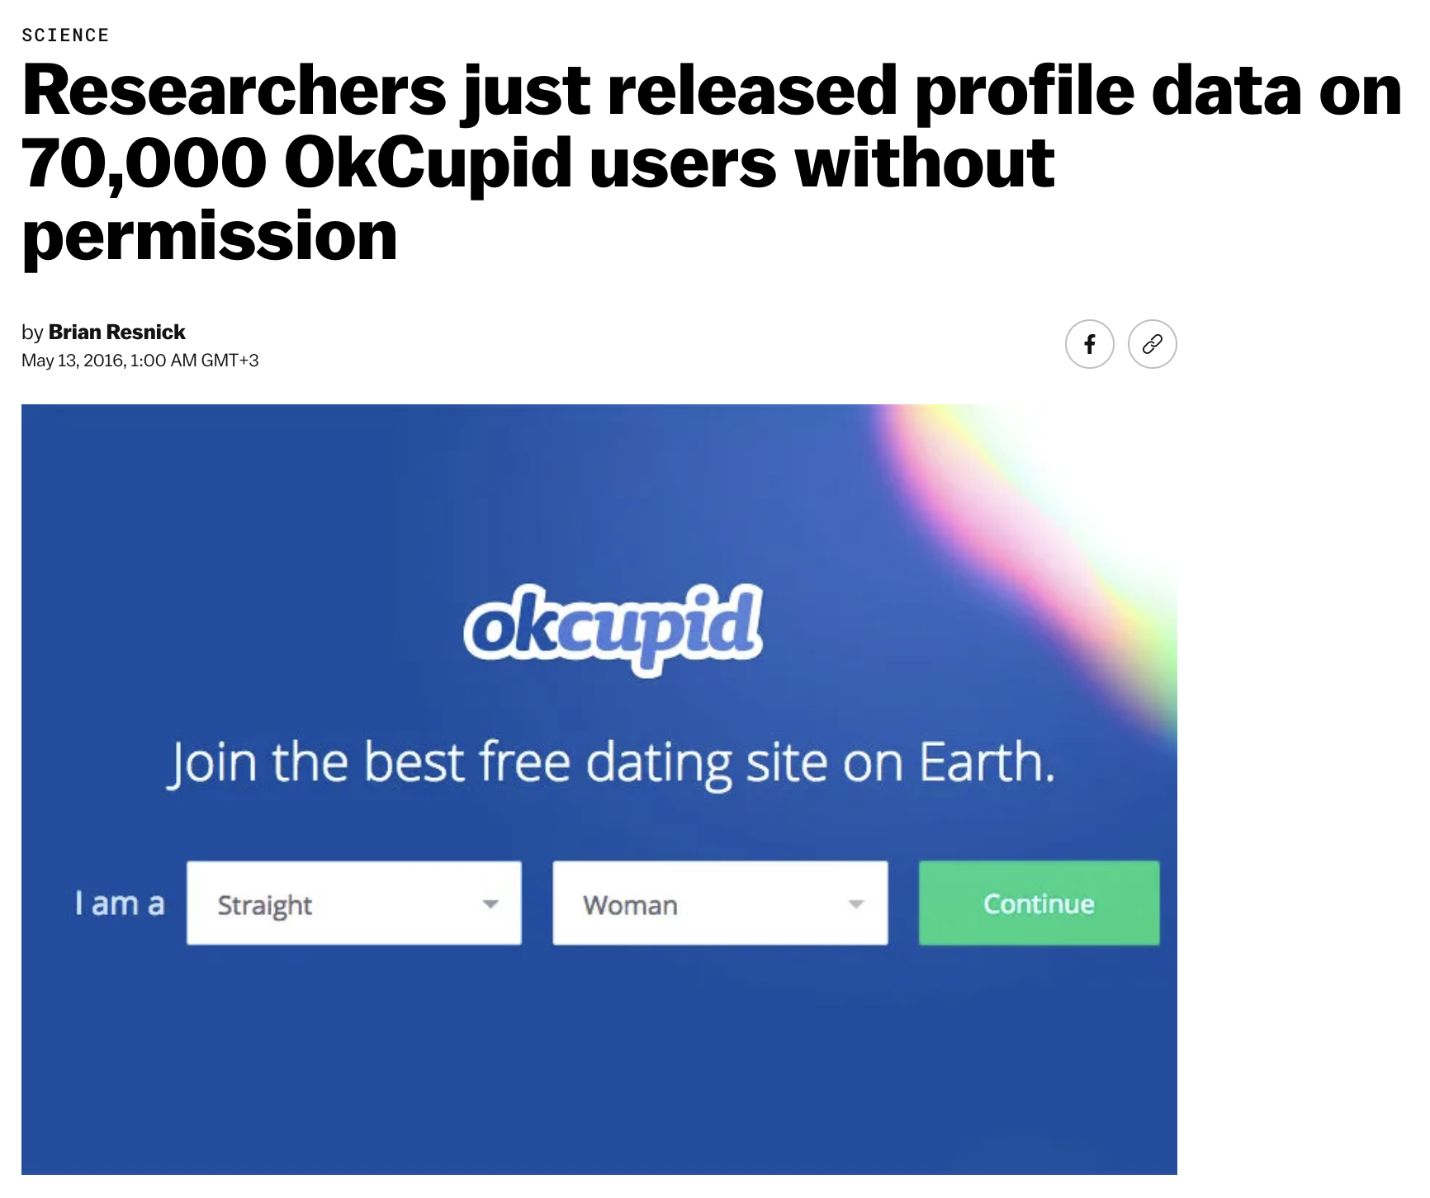
Notes:
https://www.vox.com/2016/5/12/11666116/70000-okcupid-users-data-release
Article about a Danish researcher who publicly released personal data from 70,000 OKCupid users without consent, claiming it was “already public.” Shows the risk of reusing online data without proper consent.
Even “public” data can still be personally identifiable and sensitive.
There is a difference between what’s legally accessible and what’s ethically acceptable.
Always respect context and expectations of privacy when collecting digital data.

Slide 5
Technically feasible
(Research/Business) ethics
Do no harm
Law and contracts
Privacy law (GDPR)
Coyright law
Elecommunication inference
Digital service act
Terms of service
Privacy policy
Notes:
just because something can be done technically doesn’t mean it should be done ethically.
Researchers must balance their capabilities with respect for rights and consent.
Always ask: “Who benefits, who might be harmed, and do participants know what’s happening?”

