Slide 1
Collecting Digital Data for Social Scientists

Slide 2
Learning goals
Students can scrape data from static webpages
Students understand the operation of simple APIs and can pull data from those using GET requests
Students can examine websites to find potential hidden APIs from websites
Students can collect data from online platforms which require OAuth authentication
Students can list other forms of digital data (away from websites and social media content) and describe how it would be collected
Students can explain limitations digital data have
Students can justify the data collection in terms of research ethics and legal perspectives

Slide 3
Evaluation
Weekly assignments, equal weight.
Attendance bonus during weeks [2-6] of lecture. +1/100 point towards the final grade for each week.

Slide 4


Connecting to internet – the basics

Slide 5
Connecting to internet – the basics
REQUEST

Slide 6
Connecting to internet – the basics
REQUEST
RESPONSE

Slide 7
Request
GET
POST
PUT
DELETE
Headers
Parameters
Body (Payload)

Slide 8
Response
Headers
Body

Slide 9
Example

Slide 10
Response formats
Raw text
HTML/XML
JSON
Image
File

Slide 11
JSON
”key”: ”value”,
”another_key”: ”another value”

Slide 12
JSON
{
”example”: 1.6,
”another_example”: false,
”third_example”: ”the end”
}

Slide 13
JSON
[
{
”example”: 1.6,
”another_example”: false,
”third_example”: ”the end”
} ,
{
”example”: 1.6,
”another_example”: false,
”third_example”: ”the end”
}
]

Slide 14
Example

Slide 15
HTML
<!doctype html>
<html>
<head>
<title>Example Domain</title>
<meta charset="utf-8" />
</head>
<body>
<div>
<h1>Example Domain</h1>
<p>This domain is for use in illustrative examples in documents. You may use this domain in literature without prior coordination or asking for permission.</p> <p><a href="https://www.iana.org/domains/example">More information...</a></p> </div>
</body>
</html>

Slide 16
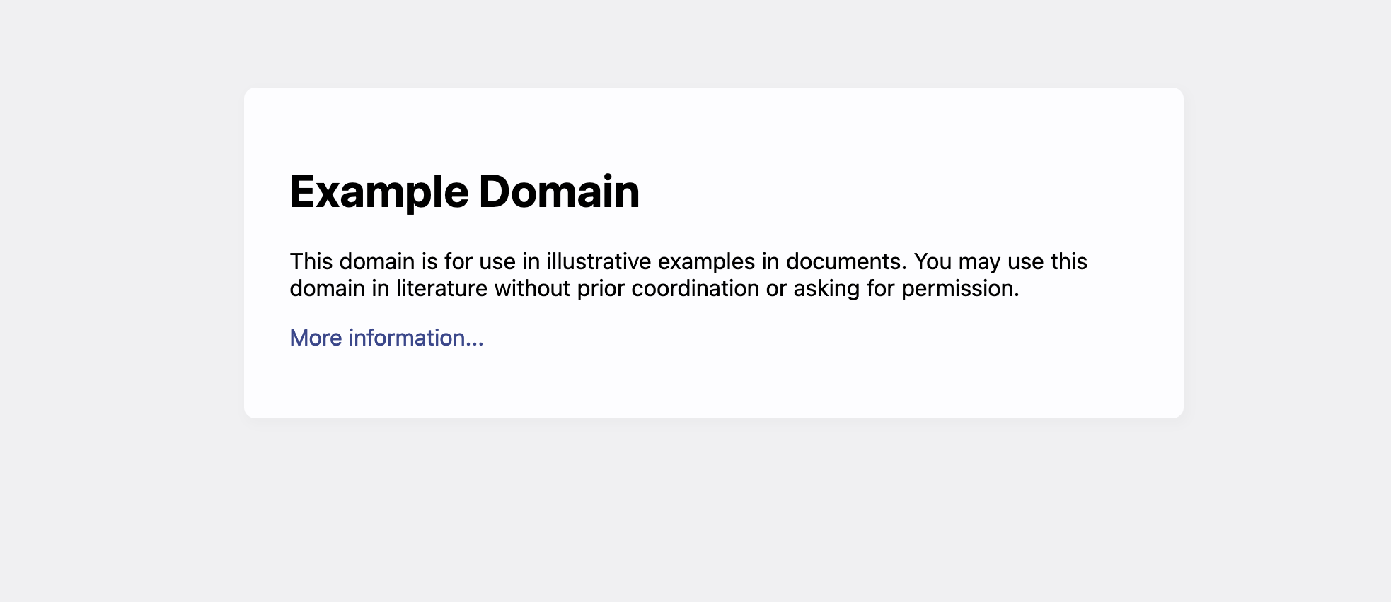

Slide 17
HTML
Metadata header
<!doctype html>
<html>
<head>
<title>Example Domain</title>
<meta charset="utf-8" />
</head>
<body>
<div>
<h1>Example Domain</h1>
<p>This domain is for use in illustrative examples in documents. You may use this domain in literature without prior coordination or asking for permission.</p> <p><a href="https://www.iana.org/domains/example">More information...</a></p> </div>
</body>
</html>
Show header at level 1
Show new paragraph

Slide 18
HTML
<!doctype html>
<html>
<head>
<title>Example Domain</title>
<meta charset="utf-8" />
</head>
<body>
<div>
<h1>Example Domain</h1>
<p>This domain is for use in illustrative examples in documents. You may use this domain in literature without prior coordination or asking for permission.</p> <p><a href="https://www.iana.org/domains/example">More information...</a></p> </div>
</body>
</html>
Show a link

Slide 19
HTML
<a href="https://www.iana.org/domains/example">More information...</a>
Link text
Link attribute “href”

Slide 20
HTML
Children
<div>
<h1>Example Domain</h1>
<p>This domain is for use in illustrative examples in documents. You may use this domain in literature without prior coordination or asking for permission.</p> <p><a href="https://www.iana.org/domains/example">More information...</a></p>
</div>
Parent

Slide 21
HTML
Link
A
Structure
div
span
Strong
ol, ul, li
Media
img
video
audio

Slide 22
Binary files
Images, videos
PDFs, .docx, .xlsx, etc.

Slide 23
Public websites
Gray APIs
Public APIs

