Slide 1
Collecting Digital Data for Social Scientists

Slide 2
Learning goals
Students can scrape data from static webpages
Students understand the operation of simple APIs and can pull data from those using GET requests
Students can examine websites to find potential hidden APIs from websites
Students can collect data from online platforms which require OAuth authentication
Students can list other forms of digital data (away from websites and social media content) and describe how it would be collected
Students can explain limitations digital data have
Students can justify the data collection in terms of research ethics and legal perspectives

Slide 3
Public websites
Gray APIs
Public APIs

Slide 4
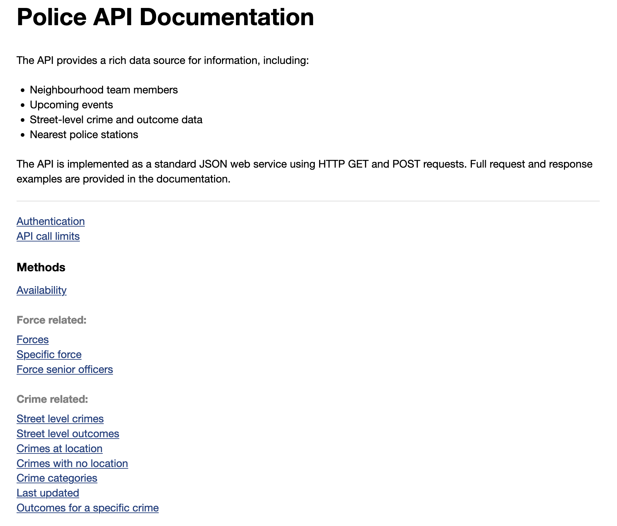
Public unlimited APIs
Public APIs tells how to structure a request to get (often JSON) formualted response.
You can consider this as a form of “grammar” between you and the service.
https://data.police.uk/docs/

Slide 5
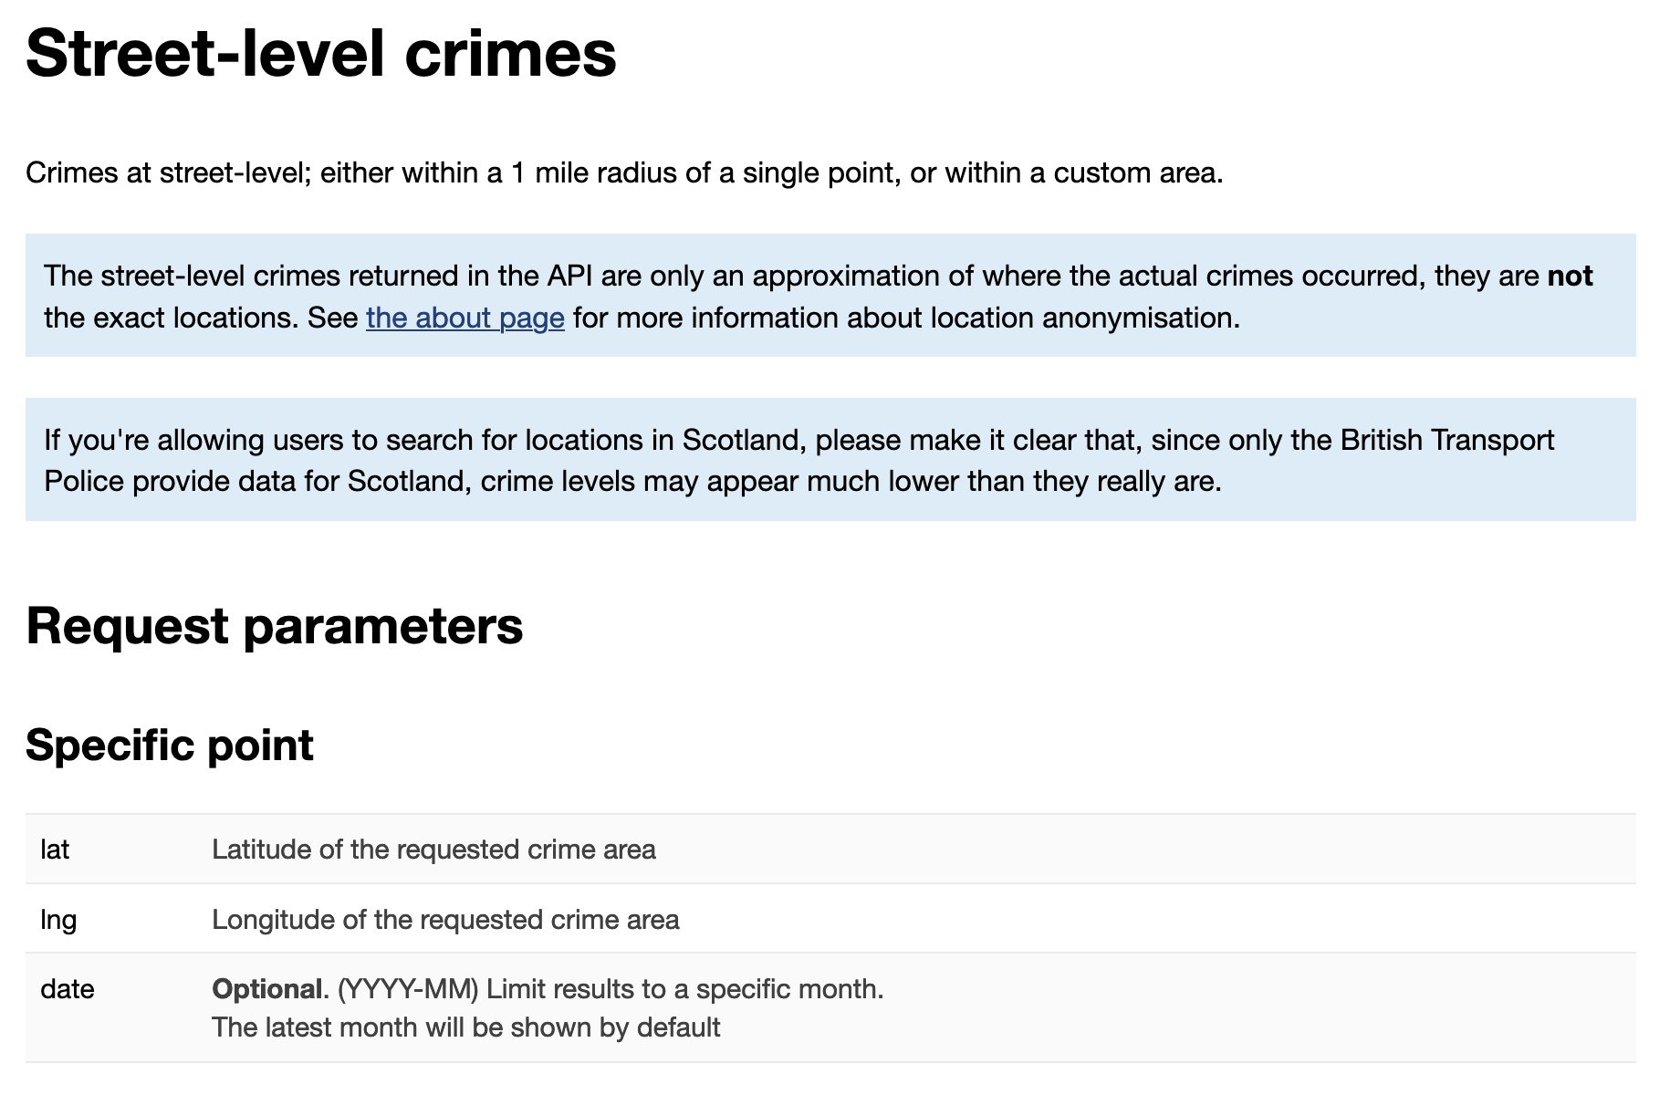
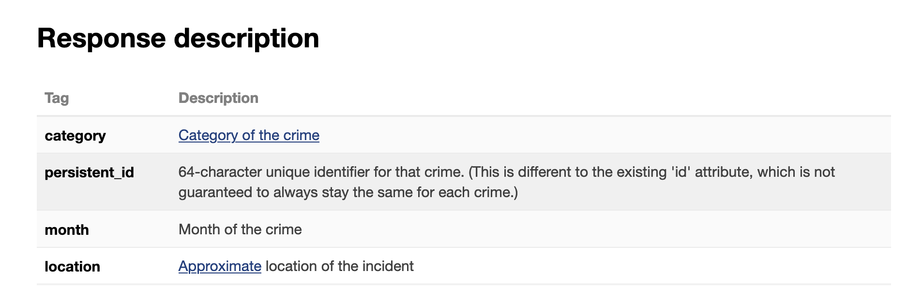
Public unlimited APIs
Public APIs tells how to structure a request to get (often JSON) formualted response.
You can consider this as a form of “grammar” between you and the service.
https://data.police.uk/docs/

Slide 6
Public unlimited APIs
Follows the GET/POST/PUT/DELETE request – response pattern we learned last week: https://data.police.uk/api/crimes-street/all-crime?lat=52.629729&lng=-1.131592&date=2017-01

Slide 7
Public APIs requiring authentication
Sometimes APIs try to limit how many requests you can do.
Several methods exists for this, among the most simple is to give you a spesific API key to make a request, identifying you as the person making the request.
Different APIs may vary on how this is done; for example the authentication may be in request headers or as payload.
https://holidays.abstractapi.com/v1/?api_key=72eab5e4254245f9a9a72e9e2a08cb71&country=US&year=2020&month=12&day=25

Slide 8
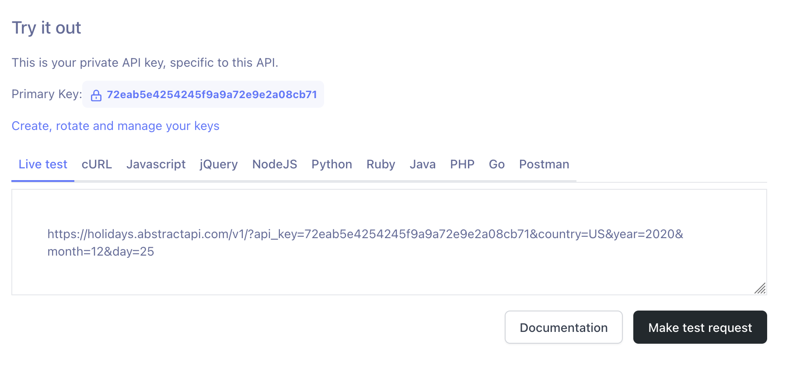
Public APIs requiring authentication

Slide 9
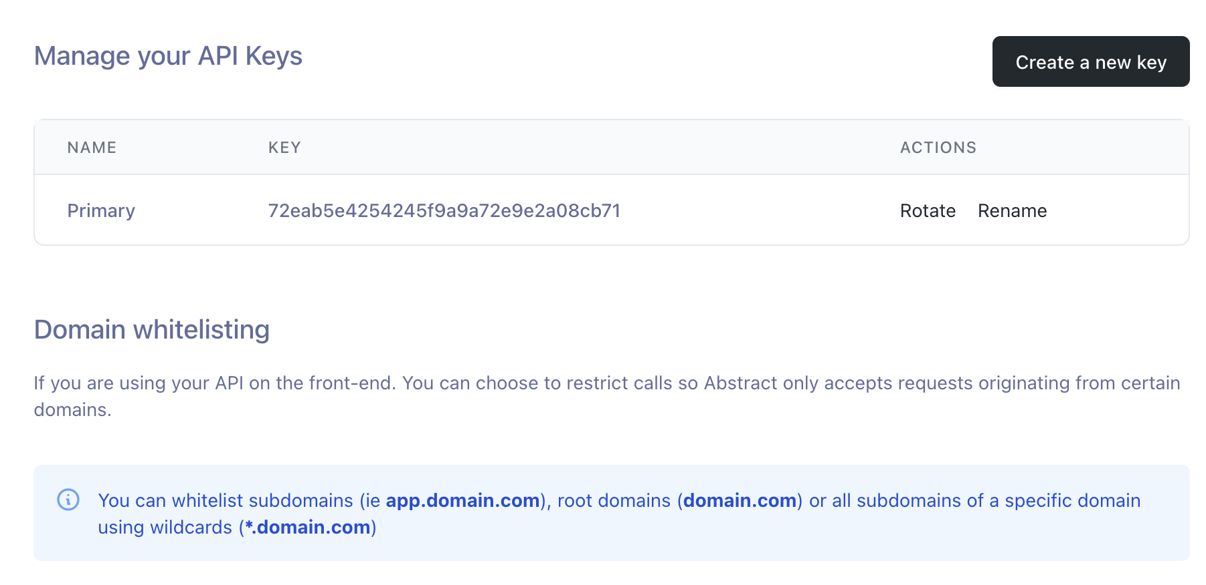
Public APIs requiring authentication

Slide 10
Public APIs with OAuth
In some services, you work with users’ personal data or on behalf of the user. Therefore, just a service level API key is not sufficient, as it does not contain permission to delegate tasks from the user.
One might use users username and password, but let’s not do so.
Instead, open authorization process allow for a permission from the user as well as identification of which service is using the data.

Slide 11
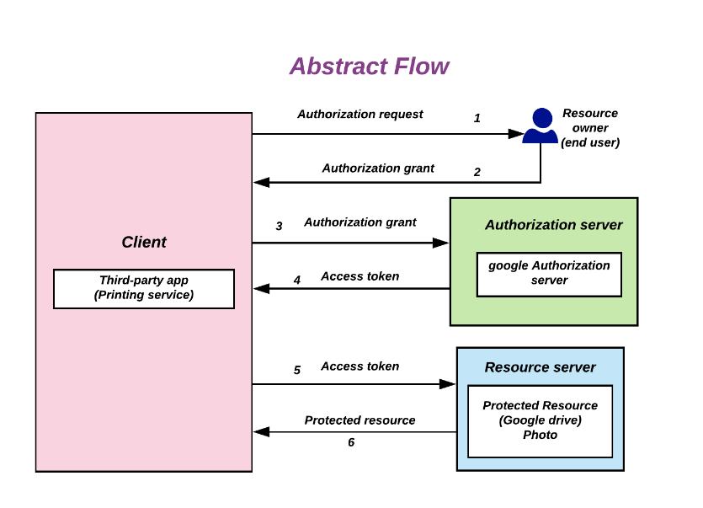
Public APIs with OAuth
Notes:
By Devansvd - Own work, CC BY-SA 4.0, https://commons.wikimedia.org/w/index.php?curid=109591026

Slide 12
API formats
REST - fixed endpoints, each returning a set of data
GraphQL - one flexible endpoint, you ask exactly for the data you need
Rate limiting

