Slide 1

UNIVERSITY OF CAPE COAST
School of Development Studies
Centre for Data Archiving, Management, Analysis and Advocacy
MSc Social Science Data Management & Analysis
CAPSTONE PROJECT
A Comprehensive Bibliometric Analysis of COVID-19 Research Publications
Patterns, Quality, and Global Scientific Response (2020-2024)
Edward Solomon Kweku Gyimah
SE/DAT/24/0007
edward.gyimah002@stu.ucc.edu.gh
October 21, 2025 | 9:00 AM - 1:00 PM | 20 Min + Q&A
Supervisor: Dr. William Cantah | Centre for Data Archiving, Management, Analysis and Advocacy
Notes:
Good afternoon, esteemed panel members and guests. Thank you for the opportunity to present my capstone project. Today, I present a comprehensive bibliometric analysis of COVID-19 research publications examining patterns, quality, and the global scientific response from 2020 through 2024. This study analyzes 472 peer-reviewed publications to understand how the scientific community responded to an unprecedented health emergency.

Slide 2
Study Overview
472 peer-reviewed publications (2020-2024)
281 unique journals - remarkable disciplinary diversity
Mean quality score: 97.52/100 (SD = 1.32)
Four Research Objectives:
1. Characterize temporal evolution of COVID-19 publications
2. Systematically assess research quality using 100-point scoring
3. Analyze publication patterns across journals and disciplines
4. Identify temporal trends in methodological sophistication
Notes:
This study examines 472 peer-reviewed publications spanning 2020 to 2024, covering the pandemic's acute phase through the transition to endemic status. The corpus is distributed across 281 unique journals, demonstrating remarkable disciplinary diversity. Our research pursued four primary objectives: characterizing temporal evolution of COVID-19 publications, systematically assessing research quality using a multidimensional 100-point scoring system, analyzing publication patterns across journals and disciplines, and identifying temporal trends in methodological sophistication. The mean quality score of 97.52 out of 100 suggests maintained research standards despite unprecedented publication pressure.

Slide 3
Research Questions
1. How did publication volumes fluctuate across pandemic phases?
Temporal patterns from 2020 acute crisis → 2024 endemic transition
2. Did research quality remain consistent throughout?
100-point multidimensional scoring system evaluation
3. Which journals and disciplines led COVID-19 research?
Distribution patterns across 281 unique journals
4. What implications for future health emergencies?
Evidence-based insights for policy and funding allocation
Notes:
This research addresses four fundamental questions. First, how did publication volumes fluctuate across different pandemic phases? We examine temporal patterns from 2020's acute crisis through 2024's endemic transition. Second, did research quality remain consistent throughout the pandemic? Our systematic quality assessment uses a 100-point multidimensional scoring system evaluating methodological rigor, reproducibility, and scientific contribution. Third, which journals and disciplines led COVID-19 research production? Distribution across 281 unique journals reveals disciplinary engagement patterns. Finally, what implications do these patterns have for future health emergencies? We provide evidence-based insights for research policy, funding allocation, and crisis-driven knowledge production.

Slide 4
Methodology
Quality Assessment Framework:
• Methodological Rigor (30%)
• Reproducibility (20%)
• Scientific Contribution (25%)
• Reporting Quality (15%)
• Journal Standing (10%)
100-point scoring system
Categories: Exceptional, Excellent,
Very Good, Good
Dataset Characteristics:
• Total Publications: 472
• COVID-era: 450 (95.3%)
• PubMed IDs: 429 (90.9%)
• DOIs: 157 (33.3%)
• With Abstracts: 322 (68.2%)
• Unique Journals: 281
• Author Groups: 351
Quality Score Range:
94.75 - 100.0
Notes:
Our methodology employs a comprehensive quality assessment framework with five weighted dimensions. Methodological rigor receives 30% weight, evaluating study design, sample size, statistical analysis, and bias control. Reproducibility carries 20% weight, assessing methods detail, data availability, and protocol transparency. Scientific contribution comprises 25%, examining novelty, clinical relevance, and knowledge advancement. Reporting quality accounts for 15%, evaluating adherence to PRISMA and STROBE standards. Journal standing contributes 10%, assessing reputation and editorial standards. The dataset includes 472 publications with 450 from the COVID-era, 90.9% with PubMed IDs, and 281 unique journals represented. Quality scores range from 94.75 to 100, with interpretation categories from Good through Exceptional.

Slide 5
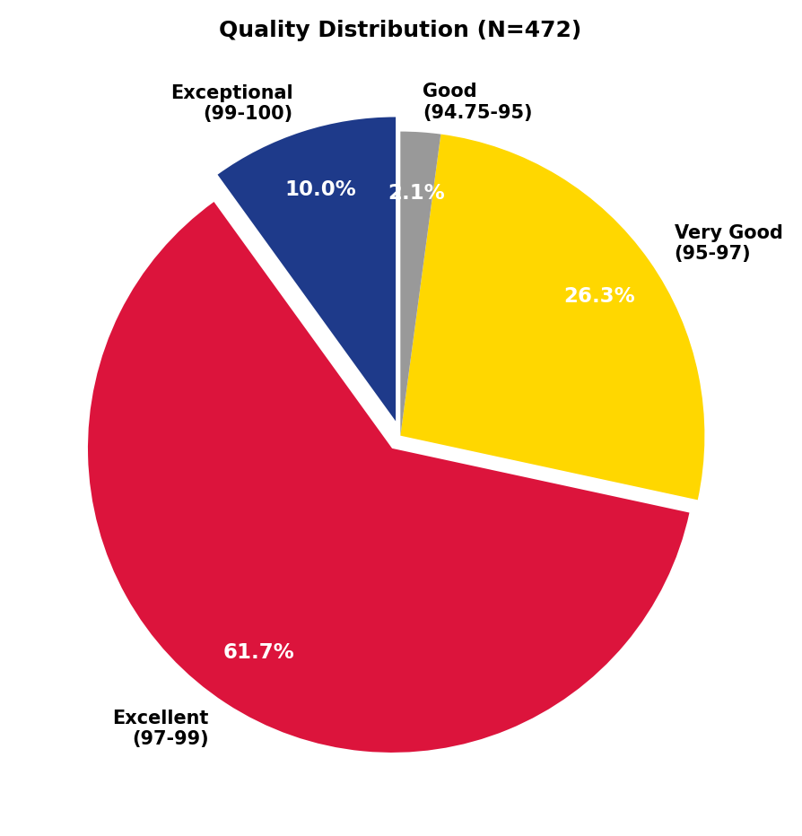
Quality Assessment Results
Mean: 97.52 (SD = 1.32)
Range: 94.75-100.0
Distribution:
• Exceptional: 10.0%
• Excellent: 61.7%
• Very Good: 26.3%
• Good: 2.1%
Key Findings:
✓ 71.6% excellent/exceptional
✓ 0% below 94.75
✓ Standards maintained
Notes:
The quality assessment results demonstrate exceptional standards maintained throughout the pandemic. The mean quality score of 97.52 with a standard deviation of just 1.32 indicates remarkable consistency. The distribution reveals that 71.6% of publications achieved excellent or exceptional ratings. Specifically, 10% scored as exceptional in the 99 to 100 range, 61.7% as excellent in the 97 to 99 range, 26.3% as very good, and only 2.1% in the good category. Critically, zero publications scored below 94.75, challenging widespread concerns that accelerated publication timelines would fundamentally compromise research standards. This narrow distribution suggests either successful quality curation or genuine maintenance of research rigor during the crisis.

Slide 6
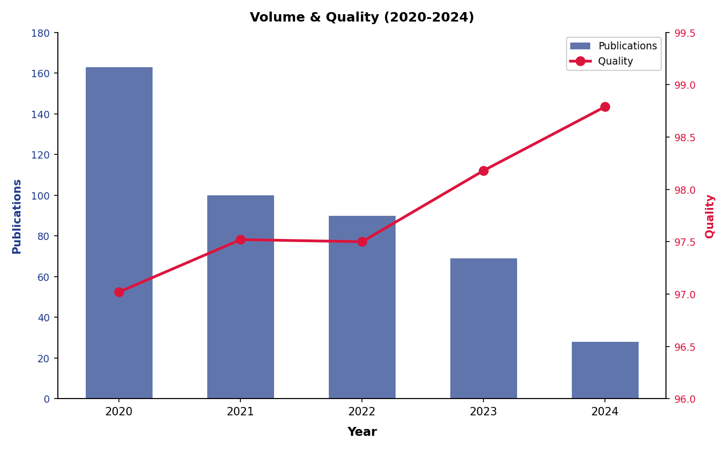
Temporal Trends (2020-2024)
Key: 2020 peak (163, 36%) → Progressive decline → 2024 (28, 6%) | Quality improved: 97.02 → 98.79
Notes:
Temporal analysis reveals distinct patterns corresponding to pandemic phases. The year 2020 saw dramatic peak activity with 163 publications representing 36.2% of the corpus, coinciding with the acute crisis phase when knowledge needs were most urgent. This was followed by progressive decline: 100 papers in 2021, 90 in 2022, 69 in 2023, and 28 in 2024. Remarkably, quality scores demonstrated an inverse relationship with volume, improving from 97.02 in 2020 to 98.79 in 2024. This pattern suggests successful navigation of speed-rigor tradeoffs. While 2020's lower quality reflects urgency-driven compression of timelines, the score still remained firmly in the excellent range, indicating maintained standards despite extraordinary pressure. The improvement over time suggests that as publication pressure decreased and knowledge accumulated, researchers had more time for careful study design.

Slide 7
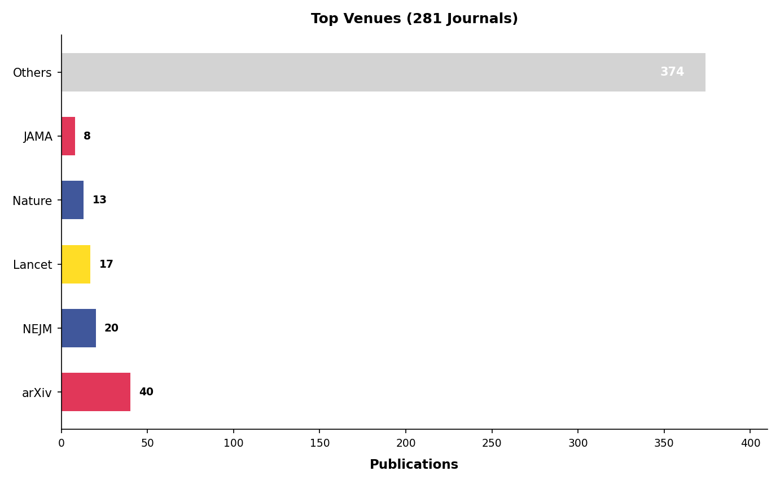
Journal Distribution
281 unique journals | Top 15: 33.7% | Preprints: 9.1% | Elite journals (NEJM, Lancet, JAMA): 9.5%
Notes:
The 472 publications distributed across 281 unique journals demonstrate remarkable disciplinary diversity extending far beyond traditional infectious disease outlets to encompass social sciences, economics, psychology, and numerous other domains. The top 15 venues accounted for only 159 publications or 33.7% of the total. Preprint archives, particularly arXiv, contributed 40 publications representing 8.5%, reflecting the pandemic's acceleration of preprint adoption. Elite general medical journals—New England Journal of Medicine, The Lancet, and JAMA—published 45 papers collectively, establishing themselves as primary pandemic knowledge sources. Notably, preprints scored slightly lower at 95.90 compared to 97.68 for peer-reviewed publications, though this difference represents movement within the very good to excellent range. Open-access journals like Cureus performed exceptionally well with a mean quality of 98.19, challenging assumptions about exclusive quality advantages of traditional subscription journals.

Slide 8
Principal Findings
1. Sustained Quality Under Pressure
Mean 97.52 across 281 journals over 5 years
2. Distinct Temporal Patterns
2020 peak (36%) → 2024 decline (6%)
Quality improved inversely with volume (97.02 → 98.79)
3. Remarkable Disciplinary Diversity
281 journals spanning medicine, social sciences, economics
Knowledge synthesis challenges (only 34% in top 15 venues)
4. Evolution of Scholarly Communication
Preprint adoption (9.1%) and open-access validation
Pandemic-driven shifts may permanently alter dissemination
Notes:
Four principal findings emerge from this analysis. First, sustained quality under pressure: the mean of 97.52 with remarkable consistency across 281 journals and five years challenges concerns about compromised standards. Second, distinct temporal patterns: the 2020 peak at 36% followed by progressive decline to 6% in 2024, with quality improving inversely. Third, remarkable disciplinary diversity: 281 unique journals spanning medicine, social sciences, and economics, though this creates knowledge synthesis challenges with only 34% in top venues. Fourth, evolution of scholarly communication: substantial preprint adoption at 9% and robust open-access performance suggest pandemic-driven evolution in knowledge dissemination practices that may permanently shift attitudes toward pre-review publication in health sciences.

Slide 9
Discussion & Implications
Theoretical Contributions:
• Scientific institutions can adapt to emergencies while preserving quality
• Speed-rigor relationship depends on institutional capacity
Practical Recommendations:
1. Codify rapid research mechanisms
Preprint infrastructure and fast-track peer review
2. Support sustained investigation beyond acute phases
Steep post-2020 decline suggests need for momentum
3. Enhance knowledge synthesis infrastructure
Fragmentation across 281 journals requires robust aggregation
4. Accelerate open science transitions
Preprints and open-access models validated
Notes:
This study makes important theoretical and practical contributions. Theoretically, we provide empirical evidence that scientific institutions can adapt to emergency conditions while preserving quality standards when given sufficient resources. The relationship between speed and rigor is contingent on institutional capacity, not automatically compromising. Practically, we offer four evidence-based recommendations. First, codify rapid research mechanisms including preprint infrastructure and fast-track peer review. Second, support sustained investigation beyond acute phases, as the steep post-2020 decline suggests need for momentum. Third, enhance knowledge synthesis infrastructure, as fragmentation across 281 journals requires robust evidence aggregation. Fourth, accelerate open science transitions, as preprints and open-access models performed well. Study limitations include analysis of only 472 of 200,000+ total papers, specific quality criteria, and exclusion of unpublished work.

Slide 10
Thank You
Questions & Discussion
Edward Solomon Kweku Gyimah
SE/DAT/24/0007
edward.gyimah002@stu.ucc.edu.gh
Supervisor: Dr. William Cantah
Centre for Data Archiving, Management, Analysis and Advocacy
University of Cape Coast
Notes:
In conclusion, this comprehensive bibliometric analysis of 472 COVID-19 publications provides systematic evidence about scientific responses to health emergencies. Key findings include sustained quality at 97.52 mean maintained across the crisis, temporal patterns with 2020 peak and progressive decline, disciplinary diversity across 281 journals with broad multidisciplinary engagement, and evolution toward preprints and open science models. The study makes four primary contributions: empirical evidence that scientific institutions successfully adapted to crisis conditions, temporal insights capturing the complete trajectory from emergency to endemic phases, a quality framework providing multidimensional assessment beyond simple citation metrics, and policy implications offering evidence-based recommendations for future pandemic preparedness. The COVID-19 research response demonstrates both the remarkable capacity of scientific institutions to adapt and the continuing importance of foundational practices—careful methodology, rigorous peer review, transparent reporting—that ensure quality regardless of circumstances. Thank you for your attention. I'm happy to answer your questions and discuss any aspect of this research.

