Slide 1

Capstone 1
Sales Tracking System for TractorTEK
Presented by: Eskinder Abebe
Date 03/10/2022

Slide 2
About the app
The application is used to enter weekly sales data by TractorTEK sales team.
Python as a front-end programming language
MySQL RDBMS for the backend

Slide 3
Data migration
How did I do the migration
Transform the data using excel power query and formulas(Unpivot, add and remove column)
Prepare CSV files based on the tables to be created in the DB
Load the data using pandas using Jupyter notebook as a tool

Slide 4
Web App UI – Data Entry Functionality
Consists of three pages
Home page It will welcome and direct what to do
Add Sales entry page this contains the form to enter the form
Delete page used to delete an entry from the sales order table

Slide 5
Sales Dashboard, and Analysis Findings​
Dashboard on an excel file
Sales Data by Region
Sales Data by Salesperson
Top Rankin Salesperson by period
Sales by category
Analysis Findings
Clement, Beverly is the best salesperson
Most sales happen in NW region
Company sales more S70 SKID STREED LOADER than every other products

Slide 6
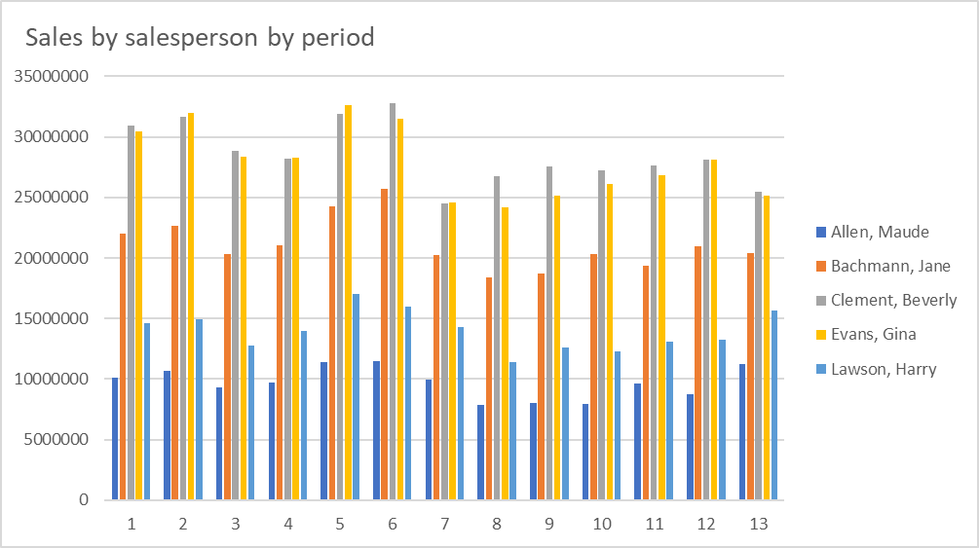
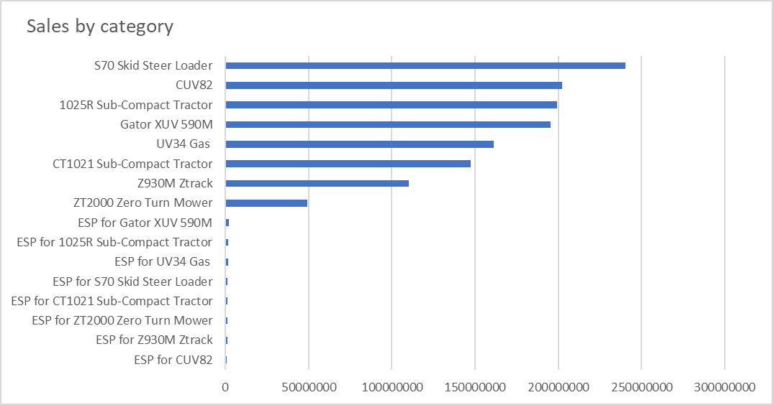
Some charts from the excel
This Subtitle is Arial in Light Orange

Slide 7
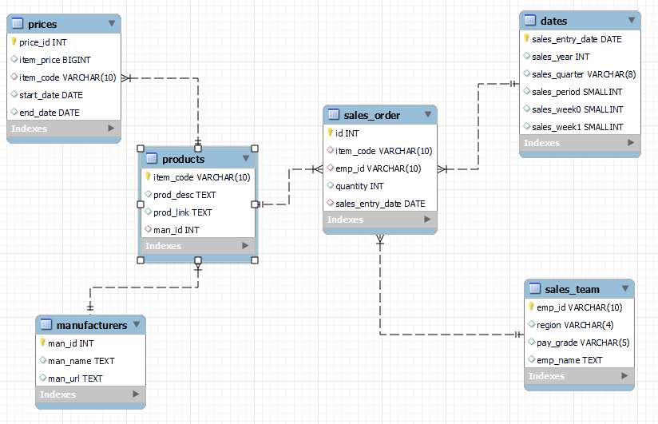
Back end – Database Design​
Tables and Views
There are
Six tables
One materialized view – product_price_dim
One view – Sales_dataset

Slide 8
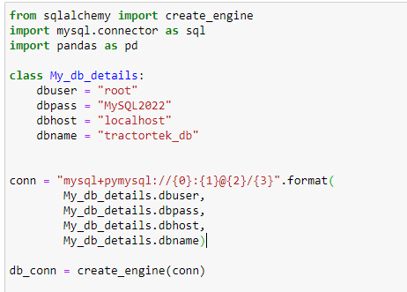
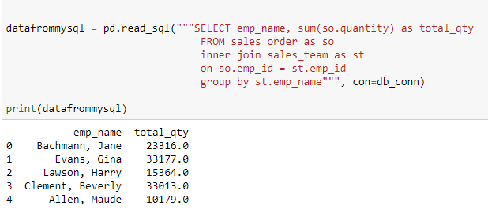
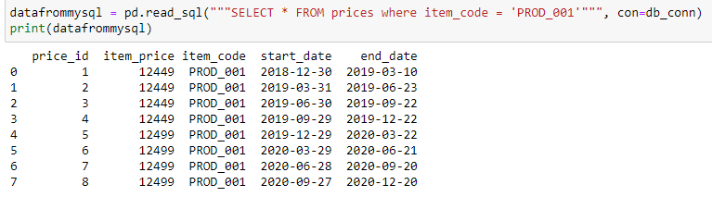
Testing the DB connection from Jupyter notebook by returning some query results
This is
a chart

Slide 9
Thank you again!

