Slide 1

Capstone 1
Sales Tracking System for TractorTEK
Presented by: Eskinder Abebe
Date 03/10/2022

Slide 2
Capstone 1 Instructions
Student guide for planning your presentation
Suggested order of components to demo:
Web App UI – Data Entry Functionality​
Sales Dashboard, and Analysis Findings​
Back end – Database Design​
Focal points should be: ​
Design choices & justifications​
Value to the customer
Slides & flow
Title Slide
One slide with the name of your solution, a few screenshots, and your picture
Use this slide to very briefly introduce your app, providing a summary of how it works.
[Live Demo]
Appendix
Any supporting materials such as diagrams, that you may refer to during Q&A

Slide 3
Instructions
How to use this template
There are many layout options you can use for each of your slides
Slides 5-13 are layout templates. They state the font colors and styles to use.
Suggest copying and pasting the slide you want and then modifying
Slide 14 is a divider if you wanted to have sections to your presentation
After you are done creating your presentation, delete any unused slides

Slide 4
TEKsystems Slide Templates

Slide 5
Web App UI – Data Entry Functionality
Consists of three pages
Home page It will welcome and direct what to do
Add Sales entry page this contains the form to enter the form
Delete page used to delete an entry from the sales order table

Slide 6
Sales Dashboard, and Analysis Findings​
Dashboard on an excel file
Sales Data by Region
Sales Data by Salesperson
Top Rankin Salesperson by period
Sales by category
Analysis Findings
Clement, Beverly is the best salesperson
Most sales happen in NW region
Company sales more S70 SKID STREED LOADER than every other products

Slide 7
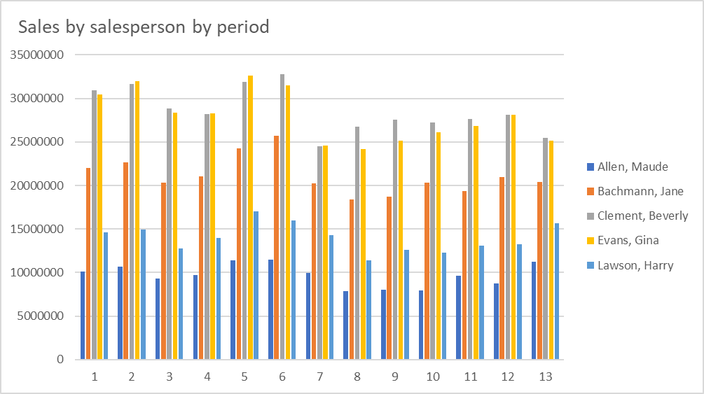
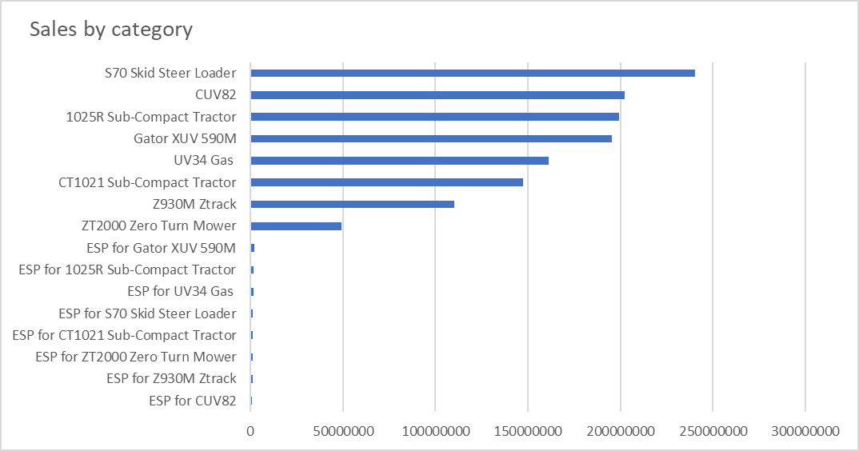
Some charts from the excel
This Subtitle is Arial in Light Orange

Slide 8
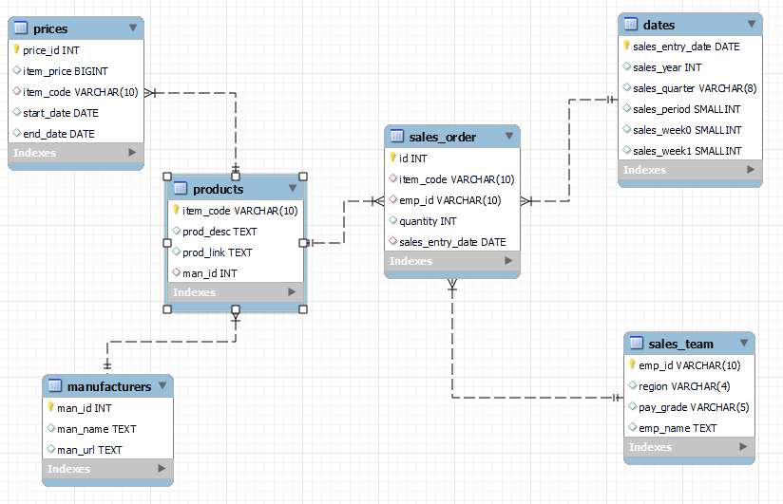
Back end – Database Design​
Tables and Views
There are
Six tables
One materialized view – product_price_dim
One view – Sales_dataset

Slide 9
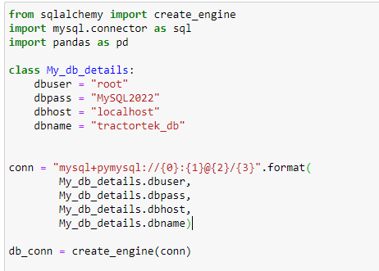
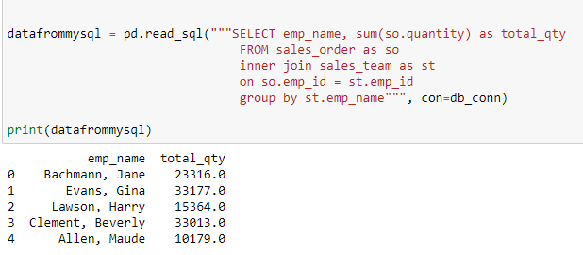
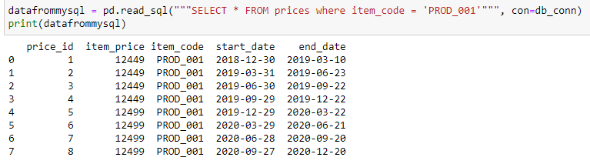
Testing the DB connection from Jupyter notebook by returning some query results
This is
a chart

Slide 10

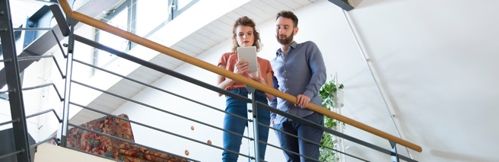
This Headline is Arial Regular in Dark Blue
This Subtitle is Arial in Light Orange
This slide is a two content option with imagery. To create the blue effect, click on the image, select the picture properties and drop the transparency to the desired opacity.
Et alique prorenim ipsa sum etur? Qui consed most aut quia is voloria voluptatio beror sam, sites vollant, teceaque volorep erchil maximolupta sit, quo tem quunt rem quaeres ciiscia tenimo mo verecus, quis ut aliaess

Slide 11

This Headline is Arial Regular in Dark Blue
This Subtitle is Arial in Light Orange
Et alique prorenim ipsa sum etur? Qui consed most aut quia is voloria voluptatio beror sam, sites vollant, teceaque volorep erchil maximolupta sit, quo tem quunt rem quaeres ciiscia tenimo mo verecus, quis ut aliaess
Et alique prorenim ipsa sum etur? Qui consed most aut quia is voloria voluptatio beror sam, sites vollant, teceaque volorep erchil maximolupta sit, quo tem quunt rem quaeres ciiscia tenimo mo verecus, quis ut aliaess
Et alique prorenim ipsa sum etur? Qui consed most aut quia is voloria voluptatio beror sam, sites vollant, teceaque volorep erchil maximolupta sit, quo tem quunt rem quaeres ciiscia tenimo mo verecus, quis ut aliaess
vollant, teceaque volorep erchil maximolupta sit, quo tem quunt rem quaeres ciiscia tenimo mo verecus, quis ut aliaess

Slide 12
This Headline is Arial Regular in Dark Blue
This Subtitle is Arial in Light Orange
TABLE TITLE HERE
Subhead | Subhead | Subhead
Body copy | Body copy | Body copy
Body copy | Body copy | Body copy
Body copy | Body copy | Body copy
Body copy | Body copy | Body copy
Body copy | Body copy | Body copy
Body copy | Body copy | Body copy

Slide 13
Divider Slide for Presentation use only
This Subtitle is Arial in Medium Blue

