Slide 1
Introduction to Python: Day 2
Revised 2016 – George Ryall
Revised 2017 – Adrian Coveney

Slide 2
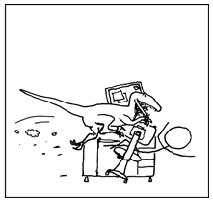
Refresher
Variables
Strings and integers
Input
Functions
Comparisons
Conditionals
While loop
Boolean operators

Slide 3
Refresher
Variables
Strings and integers
Input
Functions
Comparisons
Conditionals
While loop
Boolean operators
x = 5
y = 7
z = x + y
print(x)

Slide 4
Refresher
Variables
Strings and integers
Input
Functions
Comparisons
Conditionals
While loop
Boolean operators
x = int(input())
y = str(x)

Slide 5
Refresher
Variables
Strings and integers
Input
Functions
Comparisons
Conditionals
While loop
Boolean operators
print(“What is your name?”)
name = input()
print(“Hello ” + name)

Slide 6
Refresher
Variables
Strings and integers
Input
Functions
Comparisons
Conditionals
While loop
Boolean operators
def greeting(name):
print(“Welcome ” + name)
greeting(“Dom”)
greeting(“Steven”)
greeting(“Lauren”)

Slide 7
Refresher
Variables
Strings and integers
Input
Functions
Comparisons
Conditionals
While loop
Boolean operators
== equals
> greater than
< less than
!= not equal

Slide 8
Refresher
print("Please input x")
x = int(input())
if (x > 5):
print("x is more than five")
elif (x < 5):
print("x is less than five")
else:
print("x equals five")
Variables
Strings and int.
Input
Functions
Comparisons
Conditionals
While loop
Boolean operators

Slide 9
Refresher
Variables
Strings and int.
Input
Functions
Comparisons
Conditionals
while loop
Boolean operators
import random
numrolls = 0
while (numrolls < 4):
roll = random.randint(1,6)
print(roll)
numrolls = numrolls + 1

Slide 10
Refresher
Variables
Strings and int.
Input
Functions
Comparisons
Conditionals
while loop
Boolean operators
and
or
not

Slide 11
More about functions
We can use functions to do calculations:
def atm(initialBalance):
print("How much do you want to withdraw?")
withdrawl = input()
finalBalance = initialBalance - int(withdrawl)
print("inside fn " + str(finalBalance))
return finalBalance
balance = 100
balance = atm(balance)
print("outside fn " + str(balance))

Slide 12
Exercise 1
Add to your guess.py game by writing a function which performs a mathematical operation on your guess.

Slide 13
Global and local variables
You can also use global variables to make variables inside functions accessible in the main body of your code (but this is usually not a good idea!):
def temperature(celsius):
global fahrenheit
fahrenheit = celsius*9/5 + 32
print("Please input a temperature in Celsius")
celsius = float(input())
temperature(celsius)
print("That is " + str(fahrenheit) + " in Fahrenheit")

Slide 14
Lists
Lists are collections of values, so we can use lists to store many variables
Lists are indexed from zero
colours = [“red”, “green”, “blue”]
print(colours[0])
print(colours[1])
print(colours[2])

Slide 15
Lists
We can use lists to store many variables
Lists are indexed from zero
colours[0] = “purple”
colours[1] = “orange”
colours[2] = “yellow”
print(colours[1])

Slide 16
Lists
You can add lists together: concatenation
coloursA = [“purple”, “red”]
coloursB = [“orange”, “blue”]
colours = coloursA + coloursB
print(colours)
You can add strings to list using append
coloursB.append(“green”)
print(coloursB)

Slide 17
Exercise 2 - other tools
Experiment with these methods to see what they do
list.reverse() – for lists
str.upper() – for strings
str.lower() – for strings
str.split() – for strings

Slide 18
for loops
for loops are used when you want to repeat a block of code a certain number of times
We can loop over integers
for i in range(0,5):
print(i)

Slide 19
for loops
for loops are used when you want to repeat a block of code a certain number of times
We can loop over lists
for i in [“red”, “green”, “blue”]:
print(i)

Slide 20
for loops
for loops are used when you want to repeat a block of code a certain number of times
We can loop over the characters in a string
for i in “Hello”:
print(i)

Slide 21
Exercise 3
Write a while loop that fulfils the same function as a for loop

Slide 22
Tuples
Tuples are like lists, but we use () not []
Tuples cannot be modified
Exampletuple = (42, ‘star wars’, ‘hitchhiker’)
Print(Exampletuple[0])

Slide 23
Dictionaries
Dictionaries are collections of values
Dictionaries are indexed with keys
Keys must be an immutable data type (e.g. a string, number, or tuple) and are unique within the dictionary
Values can be any data type
newdict={“key0”:“smile”, 1: “Dr Who”, “2”:43}
print(newdict[“key0”])
print(newdict[1])
print(newdict[“2”])

Slide 24
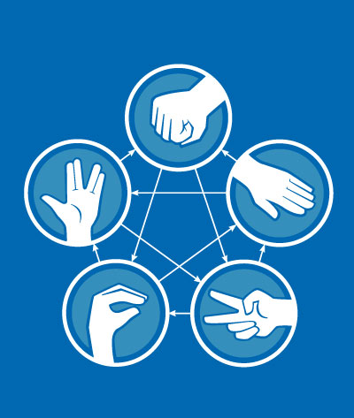
Dragon Realm
Flowcharts
Flowcharts are a useful way of mapping out your code

Slide 25
Exercise 4
Write a text adventure game. Your player can choose which cave to go into. In each cave there’s a dragon – the player must beat the dragon at a game or be eaten
Guess the number
Anagrams
Write your name backwards
Rock paper scissors lizard Spock
Hangman
Noughts and crosses

Slide 26
Rock Paper Scissors Lizard Spock
Scissors cuts Paper
Paper covers Rock
Rock crushes Lizard
Lizard poisons Spock
Spock smashes Scissors
Scissors decapitates Lizard
Lizard eats Paper
Paper disproves Spock
Spock vaporizes Rock
Rock crushes Scissors

