Slide 1



BinderAnn: Automated Reification of Source Annotations for Monadic EDSLs
AGUSTÍN MISTA, ALEJANDRO RUSSO
CHALMERS UNIVERSITY OF TECHNOLOGY

Slide 2
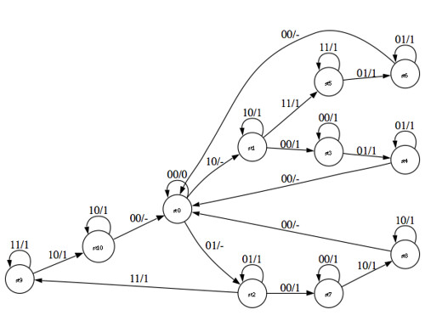
Example: an EDSL for generating graph code
Notes:
Visualizing data is very important
Graph plotting libraries are ugly

Slide 3
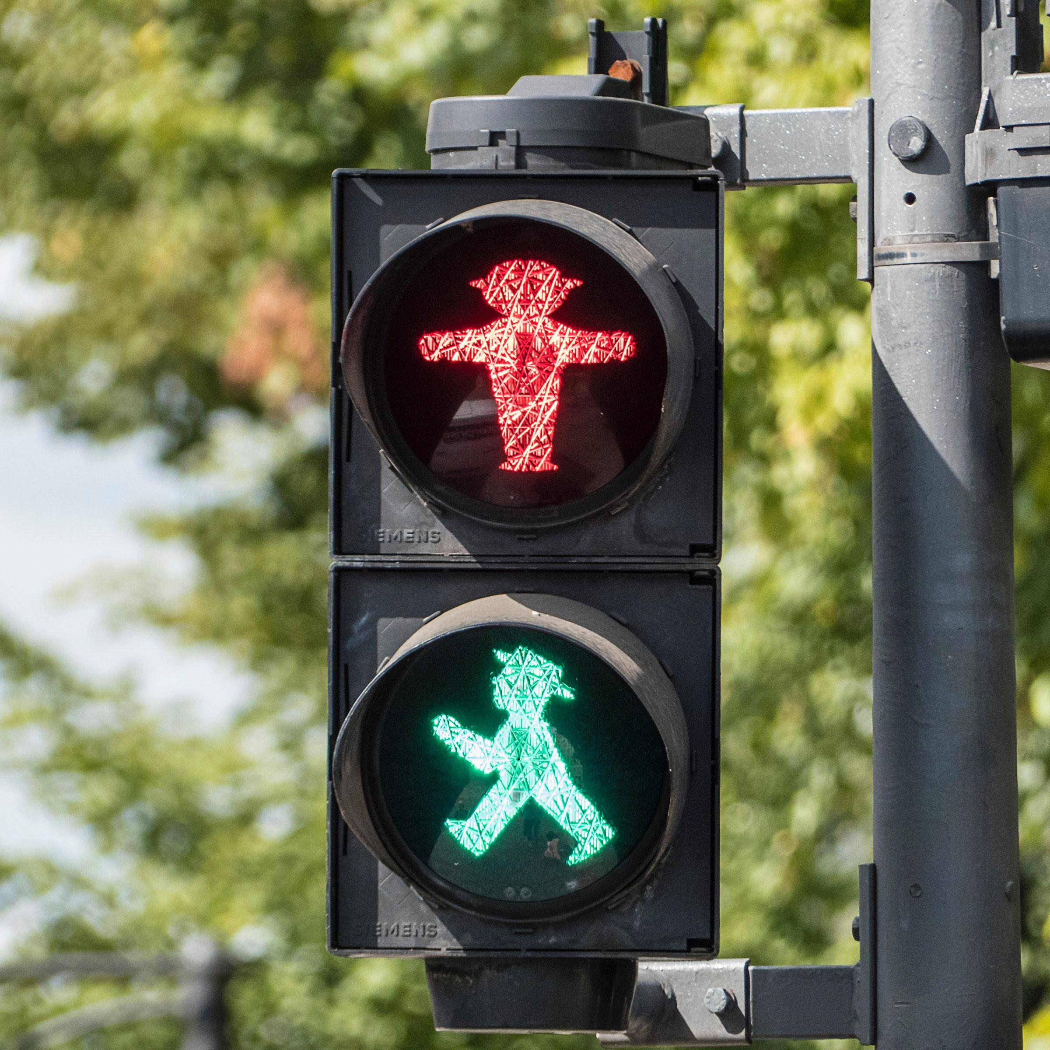
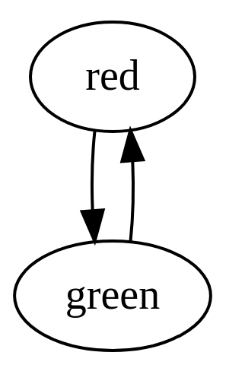
Example: an EDSL for generating graph code
Notes:
FSM

Slide 4
Example: an EDSL for generating graph code
Haskell code
Generated code
semaphore = do
green <- node
red <- node
green --> red
red --> green
digraph G {
n0; n1;
n0 -> n1;
n1 -> n0;
}
Notes:
Sequentially generated names

Slide 5
1) The name binding problem
Haskell code
Generated code
semaphore = do
green <- node
red <- node
green --> red
red --> green
digraph G {
n0; n1;
n0 -> n1;
n1 -> n0;
}

Slide 6
1) The name binding problem
Haskell code
Generated code
semaphore = do
green <- node “green”
red <- node “red”
green --> red
red --> green
digraph G {
n0; n1;
n0 -> n1;
n1 -> n0;
}

Slide 7
1) The name binding problem
Haskell code
Generated code
semaphore = do
green <- node “green”
red <- node “red”
green --> red
red --> green
digraph G {
green; red;
green -> red;
red -> green;
}

Slide 8
2) The error reporting problem
Haskell code
Generated code
semaphore = do
green <- node
red <- node
green --> red
red --> green
digraph G {
n0; n1;
n0 -> n1;
n1 -> n0;
}

Slide 9
2) The error reporting problem
Haskell code
Generated code
semaphore = do
green <- node
red <- node
green --> red
red --> green
red --> green
digraph G {
n0; n1;
n0 -> n1;
n1 -> n0;
}
Error:
there is a multi-edge somewhere (n0-->n1)

Slide 10
2) The error reporting problem
Haskell code
Generated code
semaphore = do
green <- node “green”
red <- node “red”
green --> red
red --> green
red --> green
digraph G {
green; red;
green -> red;
red -> green;
}
Error:
edge (red-->green) has multiple definitions

Slide 11
2) The error reporting problem
Haskell code
Generated code
semaphore = do
green <- node “green”
red <- node “red”
green --> red
red --> green
red --> green
digraph G {
green; red;
green -> red;
red -> green;
}
Error at Main.hs(7:3):
edge (red-->green) already defined @Main.hs(6:3)

Slide 12

TEMPLATE HASKELL
®

Slide 13

GHC
PLUGINS

Slide 14


Parsed
source plugins
since
GHC 8.6.1
Renamed
renamer plugins
Type-checked
type checker plugins
Core
core plugins

Slide 15

Source annotations
Just “foo”
Main.hs
… |
42| do foo <- bar
43| baz
… |
(42,5,“Main.hs”)
Nothing
(43,5,“Main.hs”)
data SrcInfo = Info
(Maybe String)
(Maybe )
Loc
type Loc = (Int, Int, FilePath)

Slide 16
Source transformation
semaphore = do
green <- node
red <- node
green --> red
red --> green

Slide 17
Source transformation
semaphore = do
green <- node
Info (Just “green”) (Just (3,3,“Main.hs”))
red <- node
Info (Just “red”) (Just (4,3,“Main.hs”))
green --> red
Info Nothing (Just (5,3,“Main.hs”))
red --> green
Info Nothing (Just (6,3,“Main.hs”))

Slide 18
Source transformation
semaphore = do
green <- node `annotateM`
Info (Just “green”) (Just (3,3,“Main.hs”))
red <- node `annotateM`
Info (Just “red”) (Just (4,3,“Main.hs”))
green --> red `annotateM`
Info Nothing (Just (5,3,“Main.hs”))
red --> green `annotateM`
Info Nothing (Just (6,3,“Main.hs”))

Slide 19
annotateM ::
Monad m
=> m a
-> SrcInfo
-> m a
effect-full annotations
effect-free annotations
class AnnotatedM m a
class Annotated a

Slide 20
Demo

Slide 21
Much more in the paper
More usage examples!
Tuning annotation granularity
Limitations
What about non-monadic EDSLs?
Source Annotations vs. QuasiQuoters
http://github.com/OctopiChalmers/BinderAnn
http://github.com/OctopiChalmers/BinderAnn-examples
http://github.com/OctopiChalmers/PropProver

Slide 22
Thank you!

Slide 23
Haskell code w/QQs
semaphore = [graph|
green <- node
red <- node
green --> red
red --> green
|]
graph :: String -> Q Exp

Slide 24
instance {-# OVERLAPPABLE #-} AnnotatedM a where
twice :: Monad m => m a -> m (a,a)
twice ma = do
a <- ma
a’ <- ma
return (a, a’)

Slide 25
INCOHERENT
instance {-# OVERLAPPABLE #-} AnnotatedM a where
twice :: Monad m => m a -> m (a,a)
twice ma = do
a <- ma
a’ <- ma
return (a, a’)

Slide 26
Now suppose that, in some client module, we are searching for an instance of the target constraint (C ty1 .. tyn). The search works like this:
Find all instances \(I\) that match the target constraint; that is, the target constraint is a substitution instance of \(I\). These instance declarations are the candidates.
If no candidates remain, the search fails
Eliminate any candidate \(IX\) for which there is another candidate \(IY\) such that both of the following hold:
\(IY\) is strictly more specific than \(IX\). That is, \(IY\) is a substitution instance of \(IX\) but not vice versa.
Either \(IX\) is overlappable, or \(IY\) is overlapping. (This “either/or” design, rather than a “both/and” design, allow a client to deliberately override an instance from a library, without requiring a change to the library.)
If all the remaining candidates are incoherent, the search succeeds, returning an arbitrary surviving candidate.
If more than one non-incoherent candidate remains, the search fails.
Otherwise there is exactly one non-incoherent candidate; call it the “prime candidate”.
Now find all instances, or in-scope given constraints, that unify with the target constraint, but do not match it. Such non-candidate instances might match when the target constraint is further instantiated. If all of them are incoherent top-level instances, the search succeeds, returning the prime candidate. Otherwise the search fails.
https://downloads.haskell.org/~ghc/latest/docs/html/users_guide/glasgow_exts.html#instance-overlap

Slide 27
Effect-free and Effect-full annotations
node :: Graph Node
(-->) :: Node -> Node -> Graph Edge
class Annotated a where
(… -> m a)
instance Annotated Node
instance Annotated Edge

Slide 28
Effect-free and Effect-full annotations
node :: Graph Node
(-->) :: Node -> Node -> Graph Edge
class AnnotatedM m a where
(… -> m a)
instance AnnotatedM Graph Node
instance AnnotatedM Graph Edge

Slide 29
Effect-free and Effect-full annotations
(… -> m a)
class Annotated a where
class AnnotatedM m a where
(… -> m a)
node :: Graph Node
(-->) :: Node -> Node -> Graph Edge
instance AnnotatedM Graph Node
instance AnnotatedM Graph Edge

Slide 30
Effect-free annotations
(… -> m a)
class Annotated a where
data Node = Node {
… -- extra stuff
info :: Maybe SrcInfo
}
node :: Graph Node
instance Annotated Node
(-->) :: Node -> Node -> Graph Edge
instance Annotated Edge

Slide 31
Effect-full annotations
(… -> m a)
class AnnotatedM m a where
~ Int
node :: Graph NodeId
type Graph = State GraphSt
data GraphSt = GraphSt {
… -- extra stuff
info :: Map NodeId SrcInfo
}
instance AnnotatedM Graph NodeId
(-->) :: NodeId -> NodeId -> Graph EdgeId
instance AnnotatedM Graph EdgeId

Slide 32
annotateM ::
Monad m
=> m a
-> SrcInfo
-> m a

Slide 33

annotateM must:
be fully polymorphic
to ensure type safe transformation
support different behaviors depending on the concrete type
Our approach:
* Annotations type class with default trivial instance (failsafe)
* Several overlapping more concrete ones (desired behavior)

Slide 34
Effect-free annotations
(… -> m a)
class Annotated a where
annotate :: a -> SrcInfo -> a
annotateM :: (Monad m, Annotated a)
=> m a -> SrcInfo -> m a
annotateM ma info = (`annotate` info) <$> ma
instance Annotated a where
annotate a _ = a

Slide 35

Effect-free annotations
(… -> m a)
node :: Graph Node
data Node = Node { … -- extra stuff
, name :: Maybe String
, loc :: Maybe Loc
}
instance Annotated Node where
annotate aNode (Info nm l) =
aNode { name = nm, loc = l }

Slide 36
Effect-free annotations
(… -> m a)
(-->) :: Node -> Node -> Graph Edge
instance Annotated Edge where …

Slide 37
Effect-full annotations
(… -> m a)
node :: Graph NodeId
newtype NodeId = NodeId Int
type Graph a = State GraphState a
data GraphState = GraphState
{ … -- extra stuff
, names :: Map Id (Maybe String)
, locs :: Map Id (Maybe Loc)
}

Slide 38
Effect-full annotations
(… -> m a)
instance AnnotatedM Graph NodeId where
annotateM mid (Info nm l) = do
id <- mid
modify $ \st ->
st { names = insert id nm (names st)
, locs = insert id l (locs st) }
return id

Slide 39
Effect-full annotations
(… -> m a)
(-->) :: NodeId -> NodeId -> Graph EdgeId
instance AnnotatedM Graph EdgeId where …

