Slide 1
Team Information
Name | ID | Grade
اسلام خالد السيد احمد | 201900137
اسراء سعيد هاشم | 201900128
استبرق محمد صبحي | 201900125
اسلام حامد احمد حامد | 201900135
اسلام خالد محمد سعيد | 201900139
امنيه جاد حسني جاد | 201900173
اميره علاء الدين عبد الله | 201900182
امال خالد السيد خليل | 201900171

Slide 2
ABSTRACT
Brain tumor classification is a crucial task to evaluate the tumors and make a treatment decision according to their classes. There are many imaging techniques used to detect brain tumors. However, MRI is commonly used due to its superior image quality and the fact of relying on no ionizing radiation. Deep learning (DL) is a subfield of machine learning and recently showed a remarkable performance, especially in classification and segmentation problems. In this paper, a DL model based on a convolutional neural network is proposed to classify different brain tumor types using two publicly available datasets. The former one classifies tumors into (meningioma, glioma, and pituitary tumor). The other one differentiates between the three glioma grades (Grade II, Grade III, and Grade IV). The datasets include 233 and 73 patients with a total of 3064 and 516 images on T1-weighted contrast-enhanced images for the first and second datasets, respectively. The proposed network structure achieves a significant performance with the best overall accuracy of 96.13% and 98.7%, respectively, for the two studies. The results indicate the ability of the model for brain tumor multi-classification purposes.

Slide 3
Published By
HOSSAM H. SULTAN , NANCY M. SALEM , AND WALID AL-ATABANY Department of Biomedical Engineering, Faculty of Engineering, Helwan University, Cairo 11792, Egypt Corresponding author: Hossam H. Sultan (hossam.sultan@h-eng.helwan.edu.eg)

Slide 4
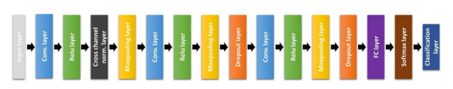
Architecture Used In Paper
Multi-Classification of Brain Tumor Images Using Deep Neural Network

Slide 5
Dataset Used In the Architecture:
Brain Tumor dataset consists of 7020 Samples 512x512 divided into 4 classes ( glioma – meningioma – notumor – pituitary ) 68% for training and 32% for validation.

Slide 6
Implementation Details:
We used the Datagenerator for the preprocessing with Rescaling of 1.0/255. , Color mode :grayscale, Target size(128,128).
Splitted the dataset into 68% Training 32 Validation.
Built the model with the Sequential method consists of 12 Layers ( 3 Conv2D , 1 BatchNormalization , 3 MaxPool2D, 2 Dropout, 1 Flatten , 2 NN )
Filters (8,16,32)
Kernel_size (5,3,2)
Strides (2)
Pool Size (2,2)
Dropout (0.25 , 0.5)
Padding (same)

Slide 7
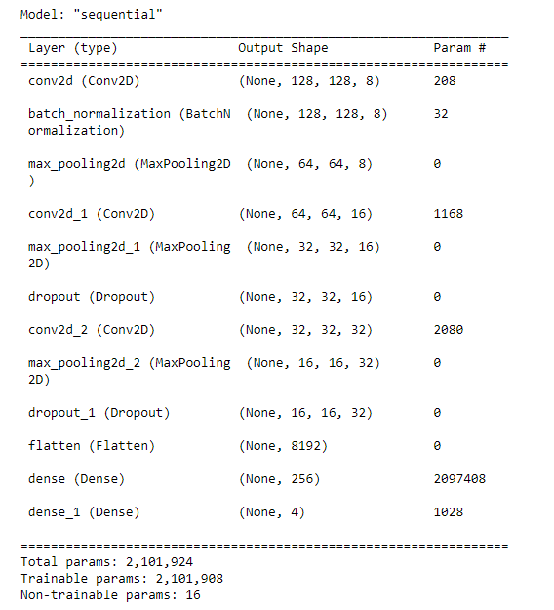
Implementation Details:

Slide 8
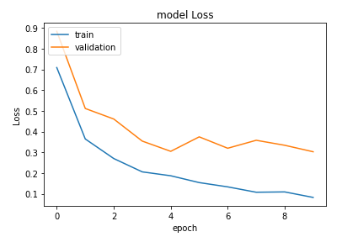
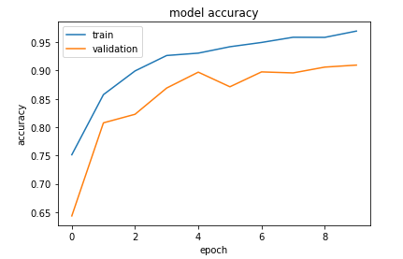
Model results and visualization:

Slide 9
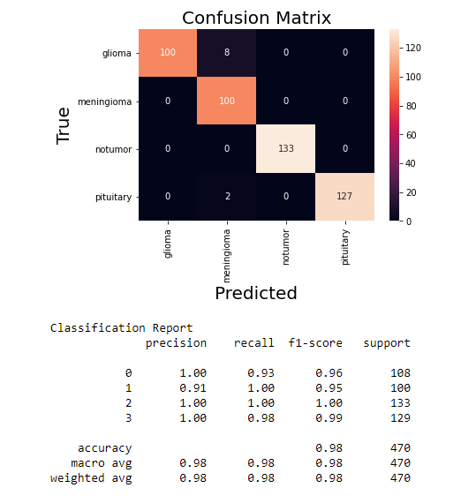
Confusion Matrix

Slide 10
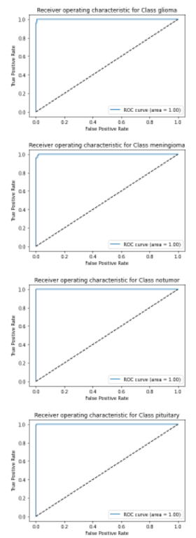
Roc Curv

