Slide 1

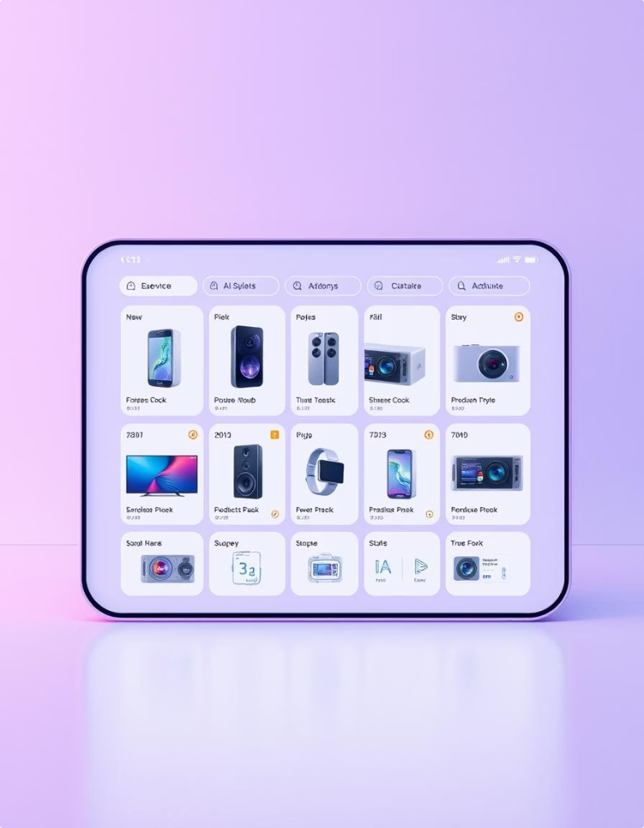
Nextronica: Revolutionizing E-commerce for Electronics
Welcome to Nextronica, an innovative e-commerce platform designed to streamline the shopping experience for electronics. Our mission is to connect users with a diverse range of products from various sellers, ensuring transparency in pricing and a seamless path from browsing to checkout. This presentation will delve into the core functionalities, technical architecture, and the dedicated team behind Nextronica.

Slide 2





Meet the Nextronica Team
Eslam Hawas
Mohamed Said
Mariam Faried
Lead Developer
Frontend Developer
Frontend Developer
Jana Mourad
Halima Ramadan
Mostafa Mohdy
Backend Developer
Backend Developer
Backend Developer
The Nextronica project is driven by a talented team of computer science professionals. Our backend development is spearheaded by Mostafa Mohdy, alongside Eslam Hawas, Jana Mourad, and Halima Ramadan, ensuring robust and scalable server-side operations. On the frontend, Mohamed Said and Mariam Faried are crafting an intuitive and engaging user interface, working collaboratively to bring a high-quality product to life.

Slide 3
Nextronica Platform Overview
Product Browsing
Transparent Pricing
Personalized Cart
Users can explore a wide array of electronic products sourced from multiple sellers, providing a diverse selection to meet various needs and preferences.
Each product displays a clear price that includes Nextronica’s profit margin and any current promotions offered by the admin for a specific provider at a specific product , ensuring full transparency for the user.
Users have the flexibility to select the best product options and add them to their personal shopping cart. This cart persists across sessions, allowing for a convenient and continuous shopping journey until final checkout.
Nextronica is designed to offer a comprehensive and user-friendly experience for electronics shopping. Our platform aggregates products from various sellers, presenting them with clear, all-inclusive pricing. This approach simplifies the decision-making process for users, who can then easily manage their selections within a persistent shopping cart, ready for checkout at their convenience.

Slide 4
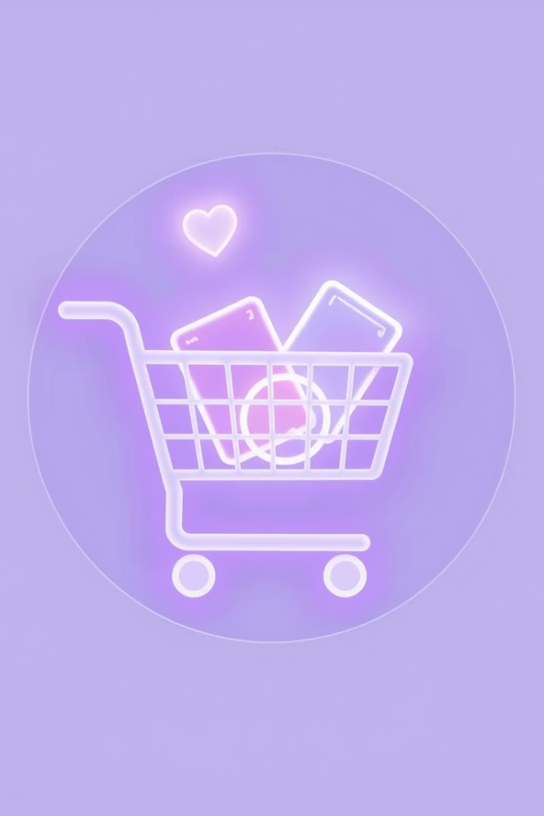



Seamless User Flow & Persistent Cart System
Add Items
Effortlessly add desired products to your shopping cart.
Manage Cart
Update quantities or remove items with ease.
Cart Persistence
Leave the app and return to find your cart exactly as you left it, ready for continued shopping.
The Nextronica user experience is centered around convenience and continuity. Our robust cart system allows users to freely add, remove, and modify items in their cart. Crucially, the cart state is persistently saved, meaning users can exit the application and return later to find their selections intact. This ensures a truly seamless and uninterrupted shopping experience, from initial browsing to the final checkout.

Slide 5





Order Creation & Provider Interaction Workflow
Quantity Validation
System verifies product availability and quantities.
Alternate Provider Search
If out of stock, system automatically searches for other providers.
Order & Transaction Generation
New order created, transactions set to 'Pending'.
Provider Notification
Email sent to provider for order-item confirmation.
Status Update
Transaction status changes to 'Accepted' upon provider confirmation.
When a user initiates checkout, Nextronica’s system performs a rigorous validation of product quantities to ensure availability. In cases where an item is out of stock, the system intelligently seeks out alternate providers for the same product, guaranteeing fulfillment. Once validated, an order is generated with associated 'Pending' transactions. Providers are then promptly notified via email to confirm the order-item. Upon their acceptance, the transaction status is updated to 'Accepted', enabling real-time tracking and financial management for the admin team.

Slide 6
Payment, Delivery & Profit Distribution Model
1
Order Confirmation
2
Trackable Delivery
Users receive email notifications as soon as their order is confirmed and dispatched.
Each order is assigned a unique ID for seamless tracking, providing real-time updates on its journey.
3
Cash on Delivery
4
Dynamic Profit Calculation
Payments are conveniently collected upon delivery, offering flexibility and trust to our customers.
Nextronica manages payment collection and precisely calculates each provider’s share and the platform’s profit margin on a per-product basis, ensuring fair and accurate distribution.
Following order confirmation, users are immediately notified via email, confirming their purchase is en route. All orders are assigned a unique Order ID, enabling easy tracking of delivery progress. Nextronica operates on a Cash on Delivery (COD) model, simplifying the payment process for customers. Upon collection, Nextronica meticulously calculates the profit margin for each individual product, rather than the entire order, ensuring precise and transparent distribution of funds to providers.

Slide 7
Core Technologies Driving Nextronica
Backend Frameworks
Frontend Technologies
Node.js with Express.js
React.js
Nest.js
Redux
Java with Spring Boot
Communication
Database
Nodemailer (for Email Service)
MySQL
RESTful APIs (for API Architecture)
Nextronica's robust architecture is built upon a foundation of cutting-edge technologies. For the backend, we leverage the power of Node.js with both Express.js and Nest.js, alongside Java with Spring Boot, ensuring high performance and scalability. The frontend delivers a responsive and dynamic user experience, powered by React.js and Redux. All data is managed efficiently using MySQL. Communication is seamlessly handled through RESTful APIs, and critical functionalities like authentication and cart persistence are secured with JWT. Nodemailer integrates our email services for essential notifications.

Slide 8
Key Takeaways & Future Outlook
2
1
1
Backend Languages
Seamless Flow
Transparency
Node.js and Java provide robust and scalable solutions.
Persistent cart and automated order processing ensure a smooth user experience.
Dynamic profit calculation and clear pricing for users and providers.
Nextronica is poised to redefine the electronics e-commerce landscape with its powerful technological stack and user-centric design. By combining the flexibility of Node.js and the stability of Java in our backend, we ensure a highly scalable and reliable platform. The seamless user flow, from persistent cart management to automated order processing and provider interaction, guarantees an unparalleled shopping journey. Our commitment to transparency, through dynamic profit calculation and clear pricing, fosters trust with both users and sellers. Moving forward, Nextronica aims to continuously innovate, enhance features, and expand its reach, solidifying its position as a leading platform in the electronics market.

