Slide 1
DESIGN OF (15:11) Hamming Code Encoder & Decoder Using VERILOG HDL
Supervised by Dr. Mohamed Hamdy Merzban

Slide 2
Team Members :
• Eslam Hussein Mohamed (ECE)
• Abdelrahman Hassan Ahmed (ECE)
• Mohamed Gamal Mohamed (ECE)
• Abdelrahman Badr Abdeltwab (ECE)
• El shafai Amer Ali (CSE)

Slide 3
Outlines :
Introduction .
Parity Concept .
Algorithm of Hamming.
Hamming Code Encoder .
Hamming Code Decoder .
Simulation Results .

Slide 4
Introduction :
Coding theory is concerned with reliability of communication over noisy channels.
Error correcting codes are used in a wide range of communication systems from deep space communication.
Hamming code is a set of error-correction codes that can be used to detect and correct a one bit error that can occur when computer data is moved or stored.
Hamming code is named for R. W. Hamming of Bell Labs.
Like other error-correction code, Hamming code makes use of the concept of parity bits, which are bits that are added to data so that the validity of the data can be checked when it is read or after it has been received in a data transmission. Using more than one parity bit, an error-correction code can not only identify a single bit error in the data unit, but also its location in the data unit.

Slide 5
Communication System Block diagram
At Transmitter
Hamming encoder
Serial input data
At Receiver
Hamming decoder
Serial output data

Slide 6
Parity Concept :
Parity bit is a bit appended to a data of binary bits to ensure that the total number of 1’s in the data is even or odd. Parity bits are used for error detection. There are two types of parity bits:
Even parity bit:
In the case of even parity, for a given set of bits, the number of 1’s are counted. If that count is odd, the parity bit value is set to 1, making the total count of occurrences of 1’s an even number. If the total number of 1’s in a given set of bits is already even, the parity bit’s value is 0.
Odd Parity bit :
In the case of odd parity, for a given set of bits, the number of 1’s are counted. If that count is even, the parity bit value is set to 1, making the total count of occurrences of 1’s an odd number. If the total number of 1’s in a given set of bits is already odd, the parity bit’s value is 0.
Parity may detect an error but can’t correct that error so it can’t be used as an error detection& correction method instead we use hamming code algorithm.

Slide 7
Algorithm of Hamming
Write the bit positions starting from 1 to 15 in binary form .
All the bit positions in 15 bit codeword that are a power of 2 are marked as parity bits (1, 2, 4, 8).
All the other bit positions are marked as data bits.
Each data bit is included in a unique set of parity bits, as determined its bit position in binary form.
Parity bit 1 covers the bits positions (1, 2, 4 , 5, 7, 9, 11).
Parity bit 2 covers the bits positions (1, 3, 4 , 6, 7, 10 11).
Parity bit 3 covers the bits positions (2, 3, 4 , 8, 9, 10, 11).
Parity bit 4 covers the bits positions (5, 6, 7 , 8, 9, 10, 11).
Each parity bit covers all bits where the bitwise XOR bit positions specified in previously.

Slide 8
Hamming Code Encoder :
Design Schematic
Counter
Clk_B
REST
Control Unit
Counter enable
Device Enable
4
Counter output
Clock Divider
Clk_B
Clk
Shift enable
REST
Write enable
Clk_A
Hamming encoder (11:15)
Shift Register A
11
15
Shift Register B
Serial input
Serial output

Slide 9
2. Principle of operation
The hamming encoder datapath consists of :
Shift Register A :
Is the first component of the hamming encoder datapath and its function is to convert the serial input bit streams into parallel words at rate “11MBits/Sec” .
Its shift_enable signal is always active and its write_enable signal is always low and it works at a clock equals to “11MHZ” .
Hamming encoder :
It is a combinational logic circuit that takes an input message of 11bits from the serial parallel converter, adds four parity bits then arrange the 15 output bits into a codeword based on hamming matrix.

Slide 10

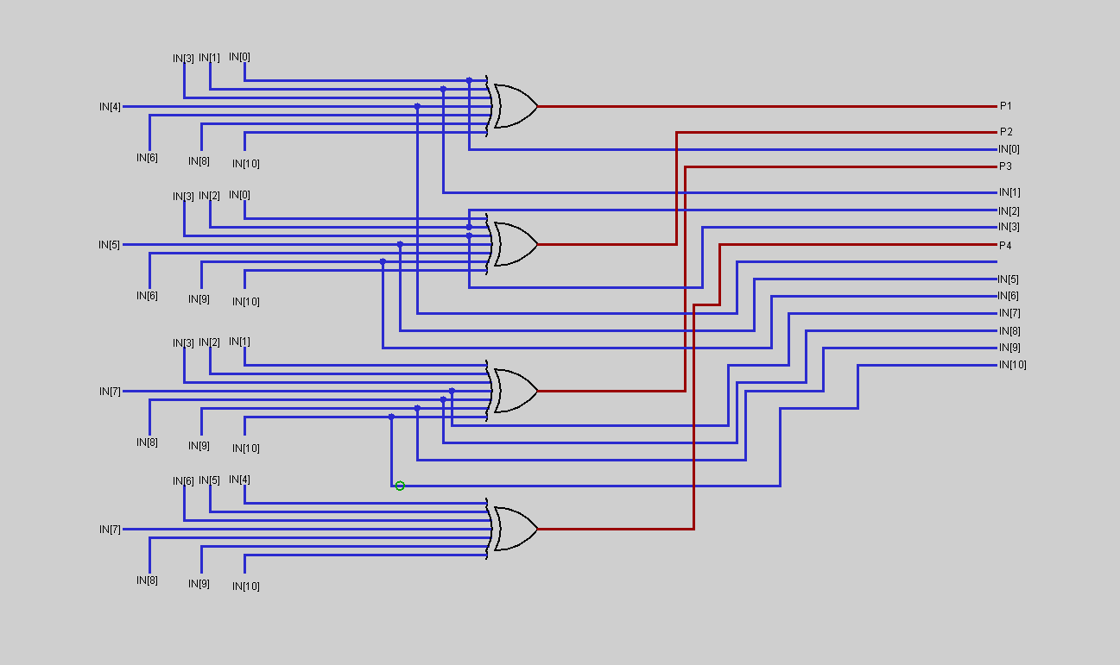

Slide 11
Shift Register B :
It converts the 15 output bits from the hamming encoder into serial output bit stream at rate “15MBits/Sec” .
Its shift_enable signal and its write_enable signal are controlled by the control unit and it works at a clock equals to “15MHZ”.
Control Unit:
It drives the pervious shift register through three control signals ( write enable , shift enable , counter enable signal )
Its inputs are : { 15MHZ clock , the counter output , Device enable signal , Rest signals } .
Its outputs are : { write enable signal , counter enable signal , shift enable signals } .
There are two states to be controlled
#WRITE:
COUNTER_EN is active
WRITE_EN is active
#SHIFT:
SHIFT_EN is active
COUNTER_EN is active
<14
WRITE
SHIFT
=14

Slide 12
Hamming Code Decoder :
Design Schematic
Counter
Clk_D
REST
Control Unit
Counter enable
Device Enable
4
Counter output
Clock Divider
Clk_D
Clk
Shift enable
REST
Write enable
Clk_C
Hamming decoder (15:11)
Shift Register C
15
11
Shift Register D
Encoder output
Serial output

Slide 13
2. Principle of operation
The hamming encoder datapath consists of :
Shift Register C :
Is the first component of the hamming decoder datapath and its function is to convert the serial input bit streams into parallel words at rate “15MBits/Sec” .
Its shift_enable signal is always active and its write_enable signal is always low and it works at a clock equals to “15MHZ” .
Hamming dncoder :
It is a combinational logic circuit that takes an input codeword of 15bits from the serial parallel converter, corrects them if there is an error in one bite in the codeword bits then removes the parity bits to produce the original message which consist of 11 bits corrected.
The following logic circuit diagram shows how it works:
XOR GATE
Parity remover
15 bits codeword
11 bits original message
15 bits corrected data
Check Bit Generator
decoder
15 bits codeword

Slide 14
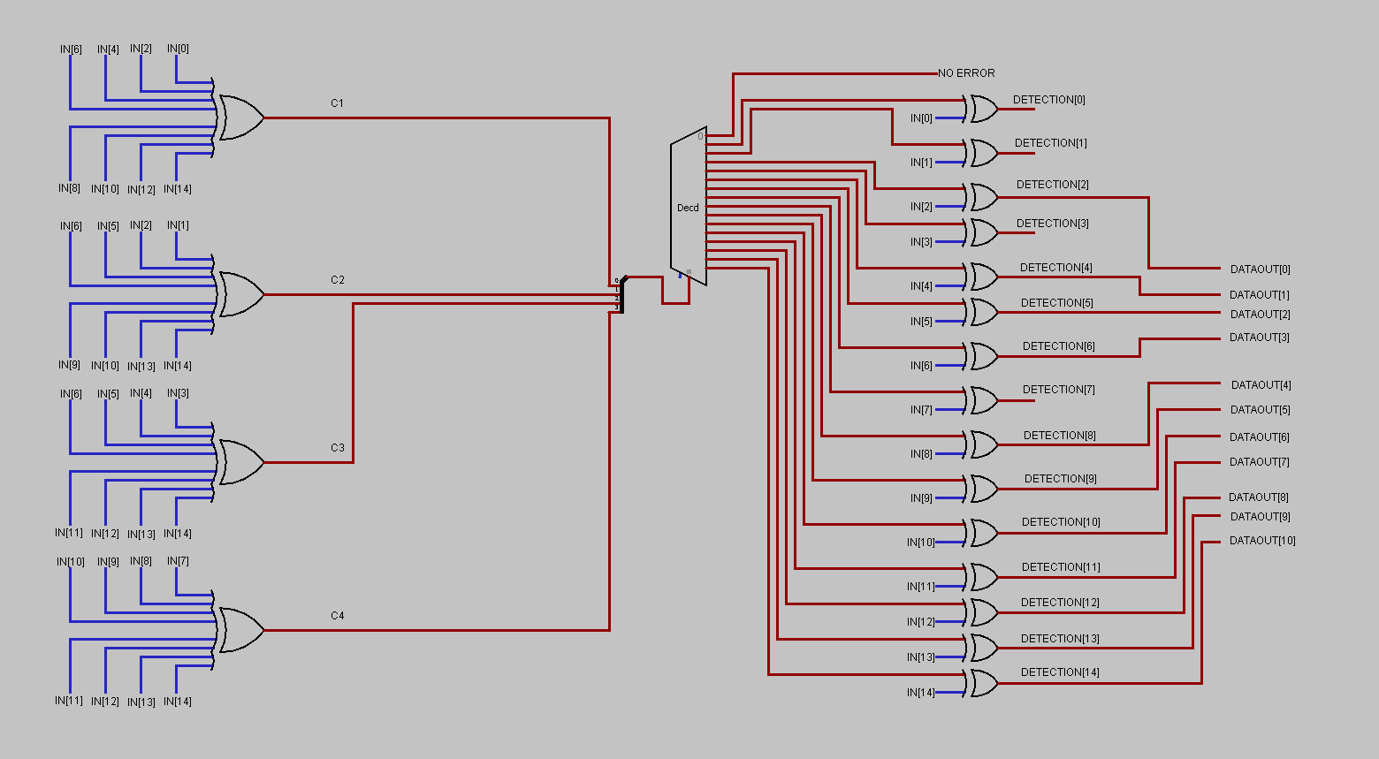

Slide 15
Shift Register D :
It converts the 11 output bits from the hamming encoder into serial output bit stream at rate “11MBits/Sec” .
Its shift_enable signal and its write_enable signal are controlled by the control unit and it works at a clock equals to “11MHZ”.
Control Unit:
It drives the pervious shift register through three control signals ( write enable , shift enable , counter enable signal )
Its inputs are : { 11MHZ clock , the counter output , Device enable signal , Rest signals } .
Its outputs are : { write enable signal , counter enable signal , shift enable signals } .
There are two states to be controlled
#WRITE:
COUNTER_EN is active
WRITE_EN is active
#SHIFT:
SHIFT_EN is active
COUNTER_EN is active
<10
WRITE
SHIFT
=10

Slide 16
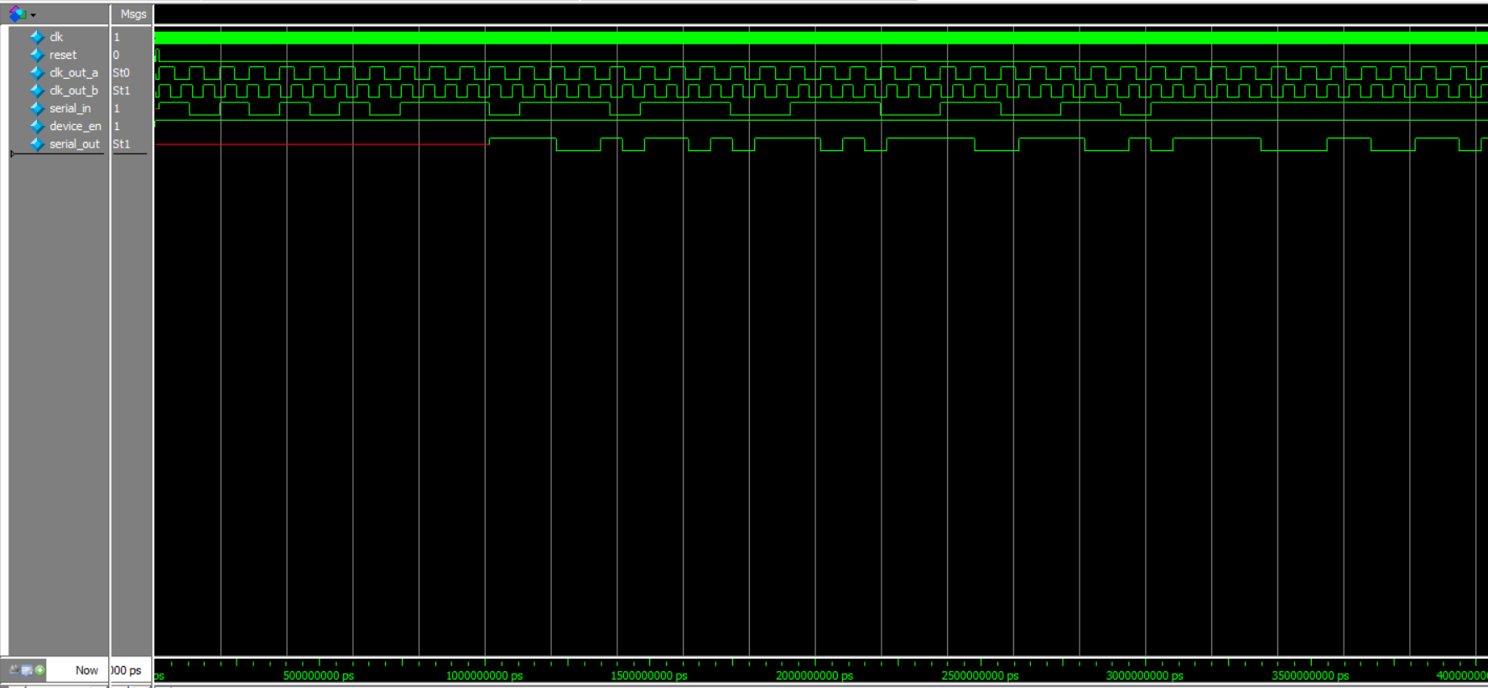
Simulation Results:
HAMMING_ENCODER_TESTBENCH

Slide 17
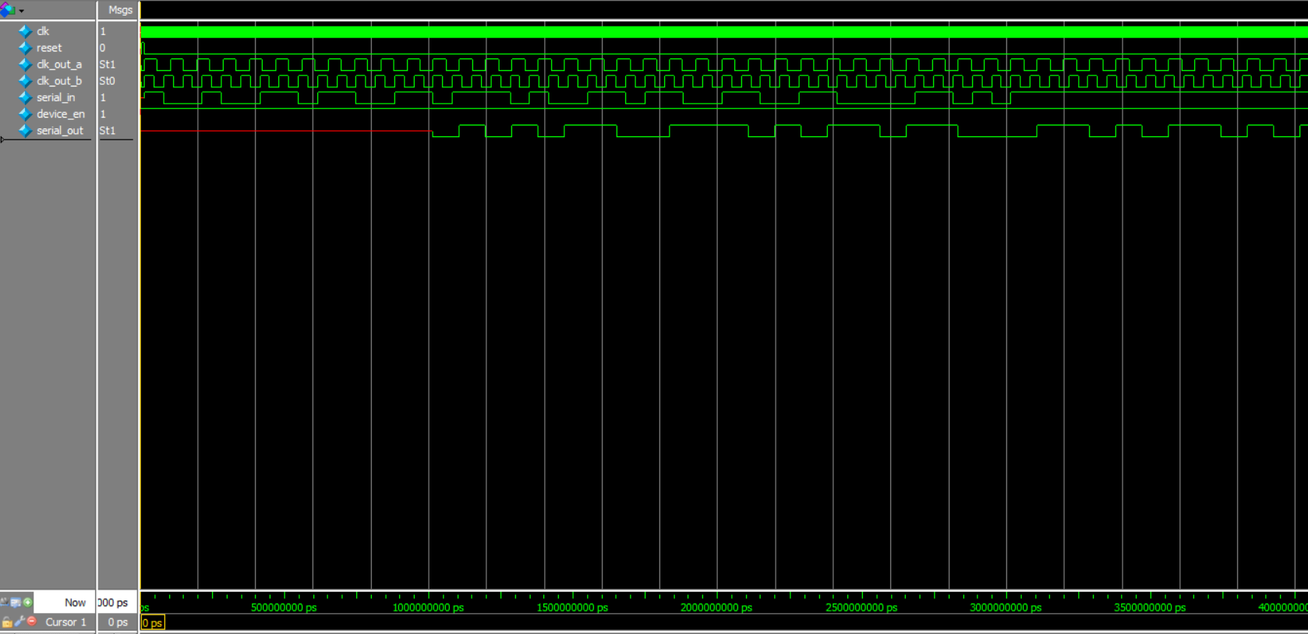
HAMMING_DECODER_TESTBENCH

Slide 18
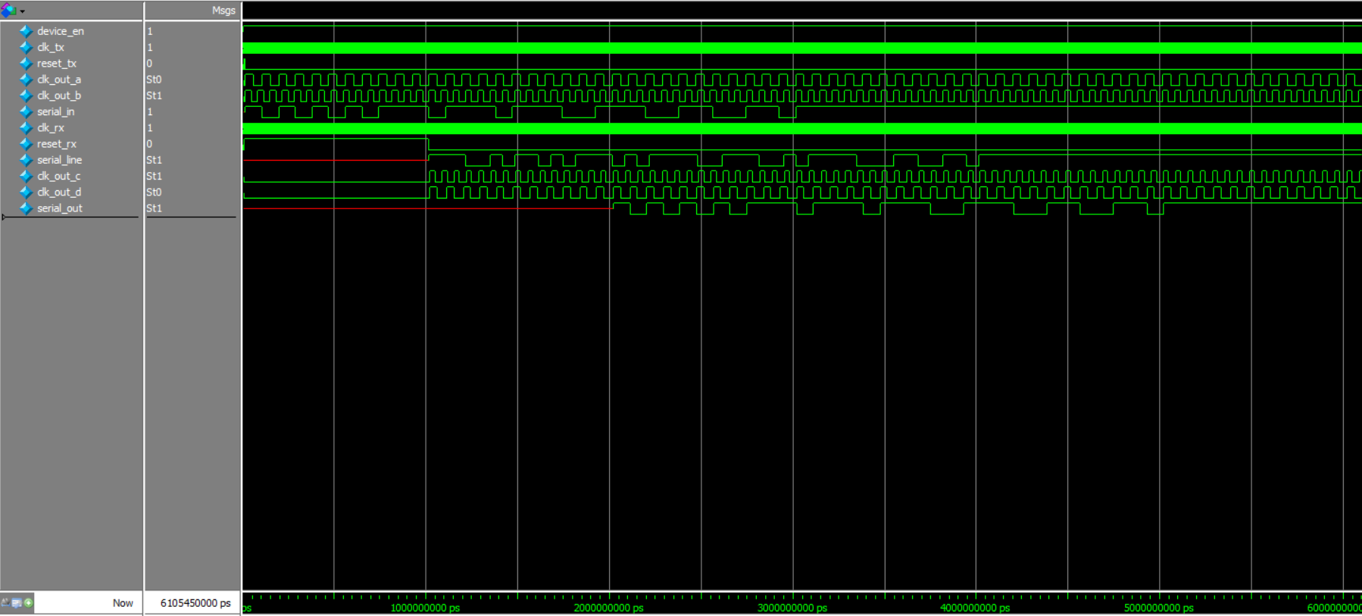
HAMMING_ENCODER & DECODER_TESTBENCH

Slide 19
Thank YÖU /

