Slide 1
Module Code: 7150CEM - Data Science Project - 2526JANMAY Student ID: 16342938 Coventry University

Slide 2
title
“Explainable and Constraint-Aware Machine Learning for Robust Vehicle Fuel Consumption Prediction”

Slide 3
AGENDA
Dataset Construction
Physics-Motivated Features
Exploratory Data Analysis (EDA)

Slide 4
Data construction

Slide 5
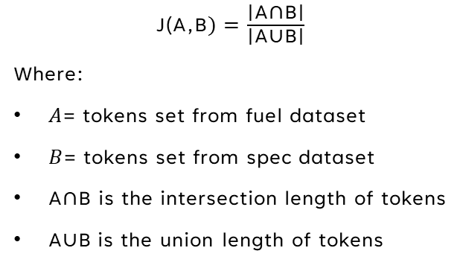

Joining Strategy Overview
Text Normalisation
Token-Based similarity (Jaccard Similarity)
Overall joining workflow
$$\text{Final} \text{merged} \text{dataset}\text{ ↓}\text{Quality} \text{control}\text{ ↓}\text{Best} \text{match} \text{selection}\text{ ↓}\text{Token}\text{−}\text{based} \text{similarity}\text{ ↓}\text{Tokenisation}\text{ ↓}\text{Text} \text{Normalisation}\text{ ↓}\text{Raw} \text{datasets}$$
Reduce formatting differences by:
Case standardisation
Token standardisation(e.g., “4 door” → “4dr”, “sport utility vehicle” → “suv”)
Noise removal (Remove marketing or non-informative words such as technology, package, or special characters)
$\text{J}\text{(}\text{A}\text{,}\text{B})=$ $\frac{\text{∣}\text{A}\text{∩}\text{B}\text{∣}}{\text{∣}\text{A}\text{∪}\text{B}\text{∣}}$
Where:
$A$= tokens set from fuel dataset
$B$= tokens set from spec dataset
$\text{A}\text{∩}\text{B}$ is the intersection length of tokens
A∪B is the union length of tokens
Best Match selection
Quality Control (QC)
Best match rules:
Highest similarity score
Tie Resolution (if scores are equal):
Stronger tokens ➔ model name, class,..etc
Longer intersection ➔ more shared tokens
Shorter union ➔ fewer unmatched tokens.
QC procedures:
Vehicle make consistency check
Intersection length verification
Tie case review
Random sample validation

Slide 6
Joining Pipeline(function) logic - Examples
Raw Data
Fuzzy Join statistics
Ex#1
Fuel Dataset | Specification Dataset
Model: CSX | MODEL: CSX 4DR SEDAN FWD /TECH PACKAGE
Vehicle class: Compact
Engine size: 2.0
Cylinders: 4
Tokens: {2.0, csx, v4} | Tokens: {sedan, csx, 4dr, fwd}
Ties | Similarity ratio | Join intersection
0 | 0.166667 | {'csx'}
Ex#2
Fuel Dataset | Specification Dataset
Model: 4Runner 4WD | MODEL: 4RUNNER 4DR SUV 4WD LIMITED V6
Vehicle class: Sport utility vehicle: Standard
Engine size: 4.0
Cylinders: 6
Tokens: {'suv', '4runner', '4.0', '4wd', 'v6'} | Tokens: {'4runner', '4wd', 'v6', 'suv', '4dr', 'limited'}
Ties | Similarity ratio | Join intersection
1 | 0.571429 | {'suv', '4wd', 'v6', '4runner'}
Ex#3
Fuel Dataset | Specification Dataset
Model: TL AWD | MODEL: TL 4 DR SEDAN SH-AWD/SH-AWD TECHNOLOGY
Vehicle class: Mid-size
Engine size: 3.7
Cylinders: 6
Tokens: {'tl', 'awd', '3.7', 'v6’} | Tokens: {'tl', 'awd', 'sedan', 'nology', '4dr'}
Ties | Similarity ratio | Join intersection
0 | 0.28571 | {'tl', 'awd'}

Slide 7
Exploratory Data Analysis (EDA)
Missing Values Analysis
Outliers Analysis
Feature Relationships:
Correlation Heatmap
Multicollinearity Analysis
4. Categorical Variable Exploration

Slide 8
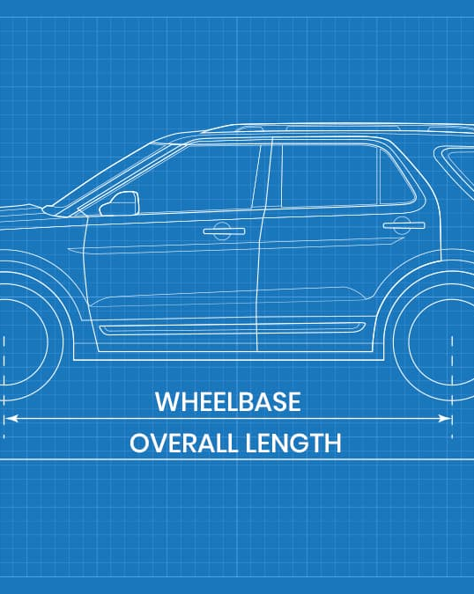
Dataset summary
Years covered: 2011–2023
Vehicle records: (11097)
Feature categories:
Mechanical features ➔ influence vehicle power generation
[engine_size_l, cylinders, transmission, fuel_type]
Vehicle geometry features ➔ influence vehicle aerodynamics
[overall_length, overall_width, overall_height, wheelbase, front_overhang, rear_overhang, track_width_front, track_width_rear, roof_width, side_glass_height, body_side_height]
Mass-related features ➔ influence vehicle rolling resistance and inertia
[curb_weight, weight_distribution]
Fuel consumption features ➔ prediction targets
[city_l_per_100_km, highway_l_per_100_km]

Slide 9
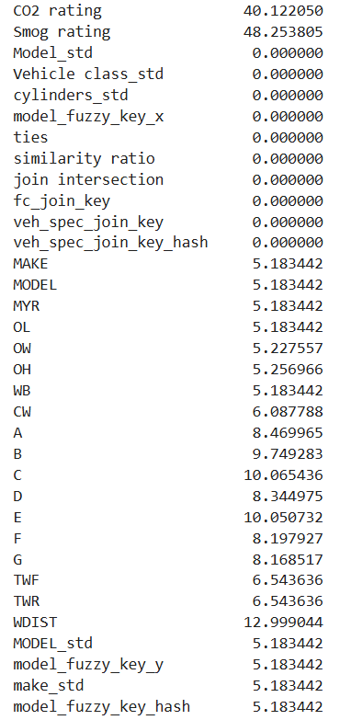
Missing values analysis
Handling strategy
CO₂ rating & Smog rating:
40% to 48% missing values
Mechanically derived from fuel consumption
Dropped to avoid redundancy
Unmatched fuel records:
~5% of fuel consumption records had no matching vehicle specifications
Incomplete vehicle specifications:
~6% up to 12% of records are missing geometry or mass variables
Removed from the dataset

Slide 10
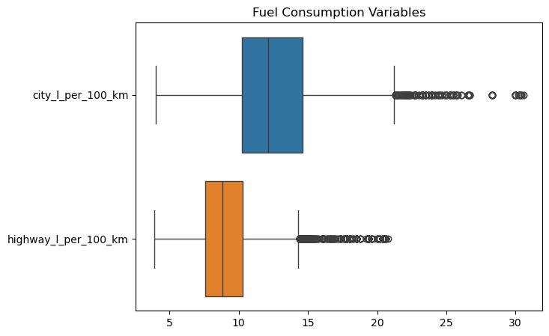
Outliers analysis
366 statistical outliers detected in fuel consumption boxplots
Correspond to vehicles with genuinely high fuel consumption
Action: Retained

Slide 11
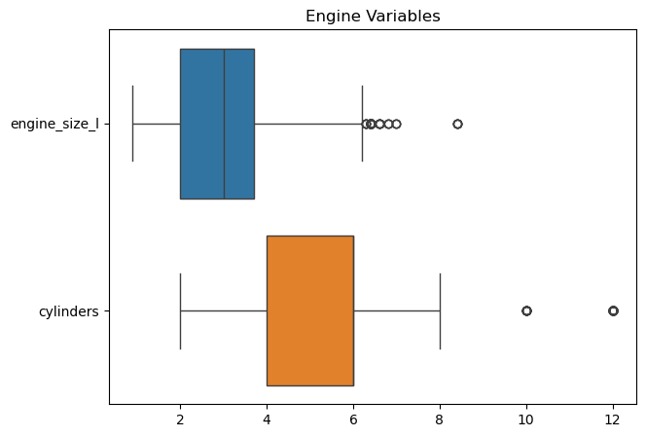
Outliers analysis
373 engine size and 76 cylinder outliers detected
Verified as valid engine specifications
Action: Retained

Slide 12
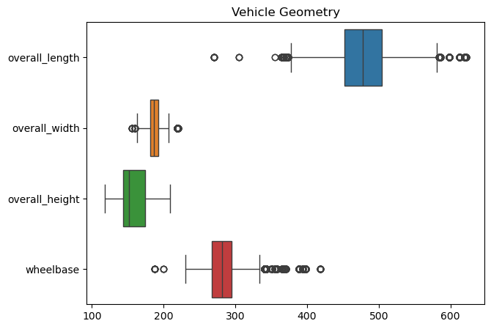
Outliers analysis
557 upper and 1,925 lower outliers identified
Upper: Pickup trucks, SUVs, Vans
Lower: Compact, Subcompact, Mid-size, Small vehicles
Action: Retained

Slide 13
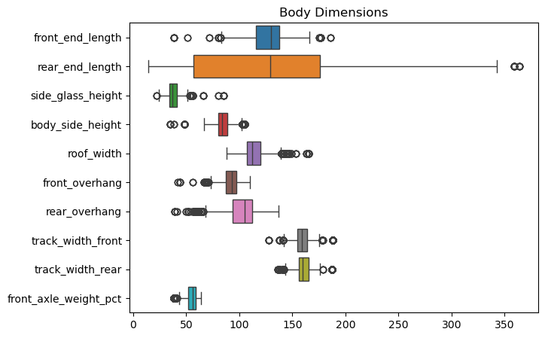
Outliers analysis
Outliers consistent with expected vehicle class differences
Action: Retained

Slide 14
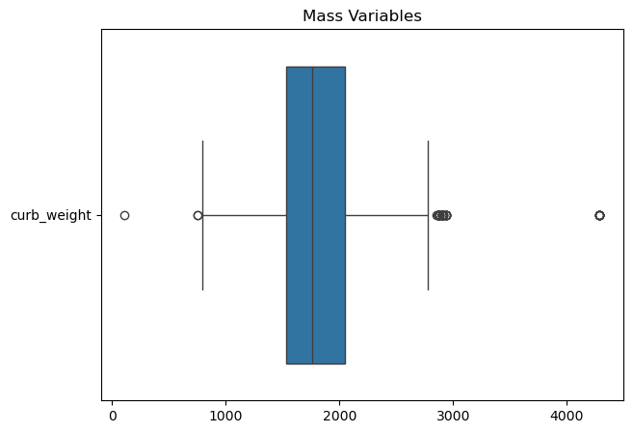
Outliers analysis
Crub_weight:
Smart Fortwo (~750–790 kg): valid lightweight vehicles → Retained
Kia Carnival (109 kg): clear data error → Removed (1 record)
Volkswagen Atlas Cross Sport (4288): unit inconsistency (likely lbs) → Removed (9 records)

Slide 15
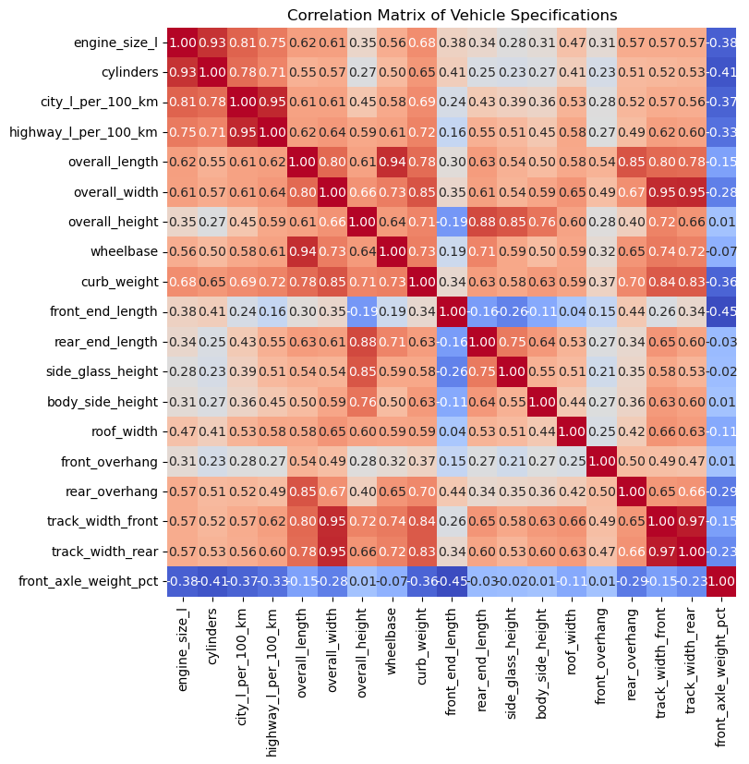
Correlation Heatmap
Multicollinearity Handling & Feature Selection
Highly correlated variables ≥ 0.85 were examined to avoid redundant predictors.
track_width_front vs. track_width_rear (0.97)
city_l_per_100_km vs. highway_l_per_100_km (0.95)
overall_length vs. wheelbase (0.94)
engine_size_l vs. cylinders (0.93)
overall_height vs. side_glass_height (0.85)

Slide 16
Numeric Feature Selection:
Mechanical features ➔
Retained: [engine_size_l, transmission, fuel_type]
Dropped: [cylinders]
Vehicle geometry features
Retained: [overall_length, overall_width, overall_height, front_overhang, rear_overhang, track_width_front, roof_width]
Dropped: [track_width_rear, side_glass_height, body_side_height]
Mass-related features
Retained: [curb_weight, weight_distribution]
Fuel consumption features
Retained: [city_l_per_100_km, highway_l_per_100_km]

Slide 17
Categorical variables
Excluded Variables (identifiers)
Retain categorical Variables
Model year
Make
Model
Transmission
Fuel Type
Vehicle Class

Slide 18
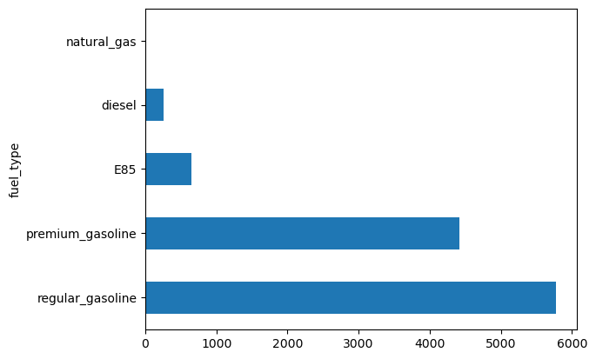
Fuel Type variable
regular_gasoline 5781
premium_gasoline 4419
E85 643
diesel 253
natural_gas 1

Slide 19
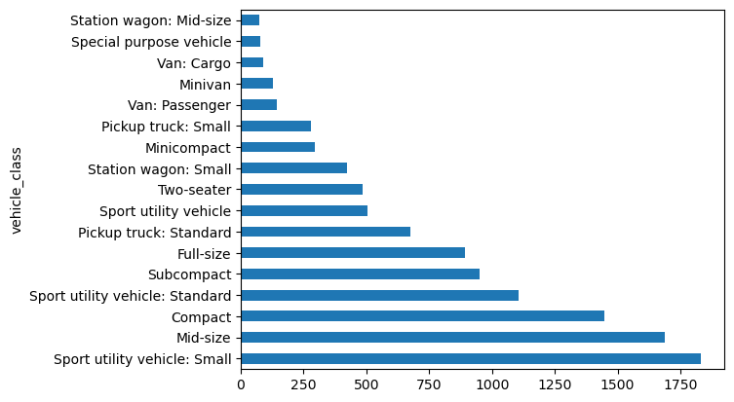

vehicle_class variable
Sport utility vehicle: Small 1833
Mid-size 1689
Compact 1446
Sport utility vehicle: Standard 1107
Subcompact 952
Full-size 893
Pickup truck: Standard 676
Sport utility vehicle 503
Two-seater 485
Station wagon: Small 423
Minicompact 295
Pickup truck: Small 281
Van: Passenger 145
Minivan 129
Van: Cargo 88
Special purpose vehicle 79
Station wagon: Mid-size 73

Slide 20
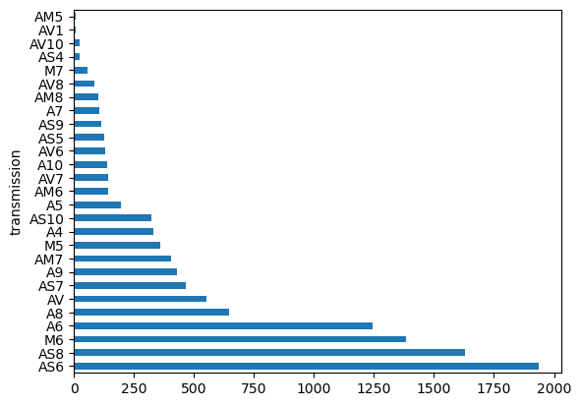
Transmission variable
AS6 1935
AS8 1629
M6 1385
A6 1244
A8 648
AV 550
AS7 464
A9 428
AM7 403
M5 360
A4 329
AS10 324
A5 194
AM6 144
AV7 143
A10 140
AV6 129
AS5 126
AS9 113
A7 105
AM8 100
AV8 86
M7 58
AS4 23
AV10 23
AV1 8
AM5 6

Slide 21
Physics-Motivated Features

Slide 22
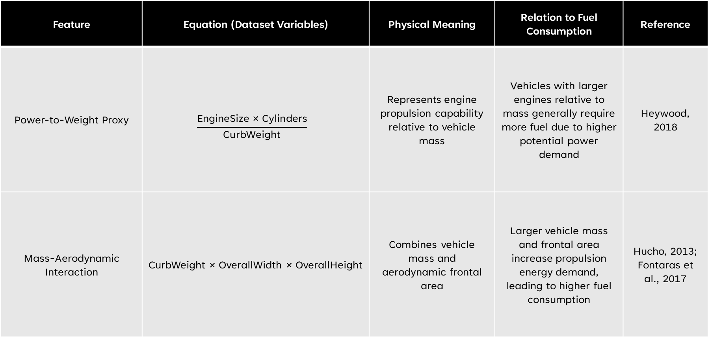
Feature | Equation (Dataset Variables) | Physical Meaning | Relation to Fuel Consumption | Reference
Power-to-Weight Proxy | $$\frac{\text{EngineSize}\text{ × }\text{Cylinders}}{\text{CurbWeight}}$$ | Represents engine propulsion capability relative to vehicle mass | Vehicles with larger engines relative to mass generally require more fuel due to higher potential power demand | Heywood, 2018
Mass-Aerodynamic Interaction | CurbWeight × OverallWidth × OverallHeight | Combines vehicle mass and aerodynamic frontal area | Larger vehicle mass and frontal area increase propulsion energy demand, leading to higher fuel consumption | Hucho, 2013; Fontaras et al., 2017

Slide 23
References
Heywood, J. B. (2018). Heywood, J. B. (2018). Internal combustion engine fundamentals (Second edition.).
Hucho, W. H. (2013). Hucho, W.-H. (2013). Aerodynamics of Road Vehicles: From Fluid Mechanics to Vehicle Engineering. Butterworth-Heinemann.
Fontaras et al. (2017). Fontaras, G., Zacharof, N.-G., & Ciuffo, B. (2017). Fuel consumption and CO2 emissions from passenger cars in Europe – Laboratory versus real-world emissions. Progress in Energy and Combustion Science, 60, 97–131. https://doi.org/10.1016/j.pecs.2016.12.004

Slide 24
THANK YOU
Eslam Abuelella
Student ID: 16342938
Coventry University
Email: abuelellae@uni.coventry.ac.uk

