Slide 1

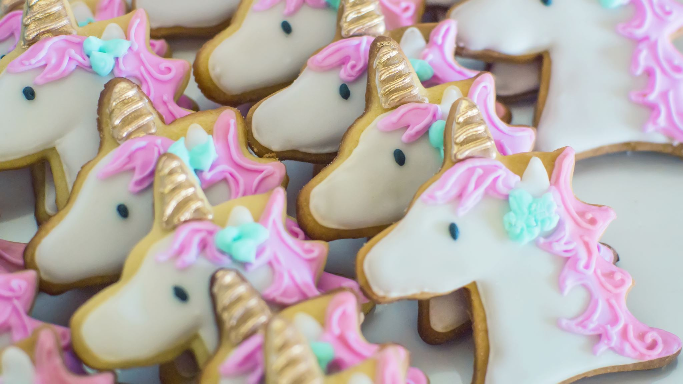
HTTP cookies manager
By eslam lotfy

Slide 2
Scenario
Open: https://the-internet.herokuapp.com/login
Enter credentials: Enter tomsmith for the username and SuperSecretPassword! for the password
Click Login button
Validate secure page is open successfully & Validate Text “Welcome to the Secure Area. When you are done click logout below.”

Slide 3
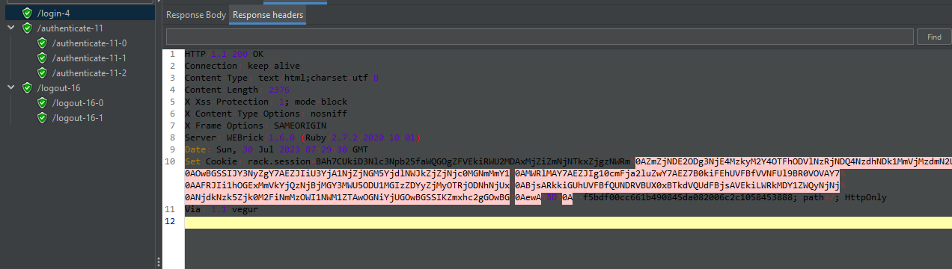
Login page [ request ]

Slide 4
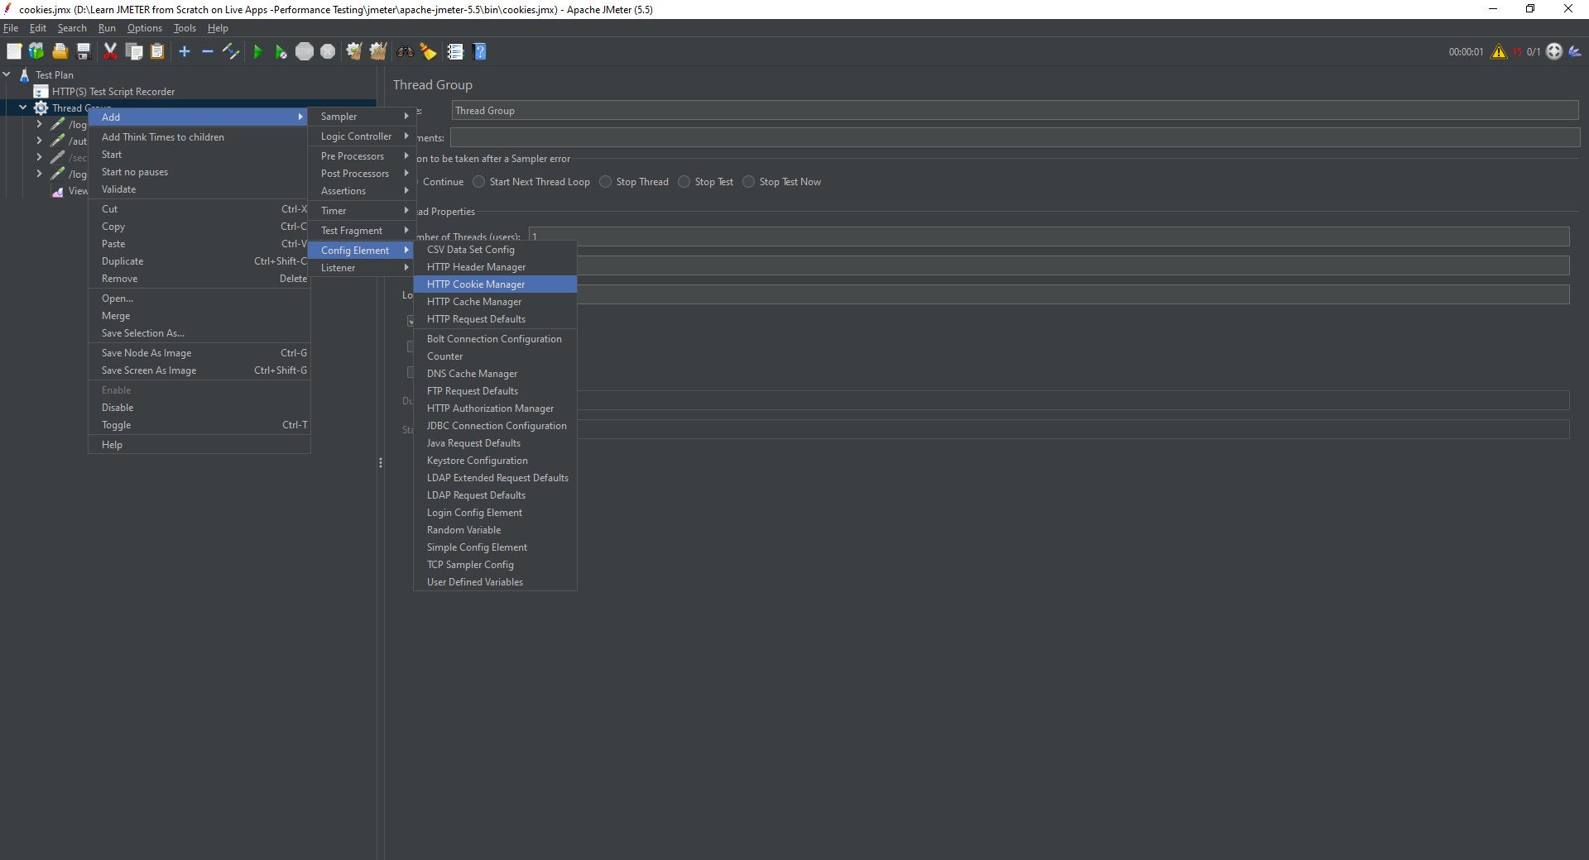
Adding HTTP cookies manager

Slide 5
Usages
Before adding cookies
https://the-internet.herokuapp.com/authenticate
GET data:
[no cookies]
After adding cookies
https://the-internet.herokuapp.com/authenticate
GET data:
Cookie Data:
rack.session=BAh7CUkiD3Nlc3Npb25faWQGOgZFVEkiRWRhMDU2OTY1MGM0YzY4YTNlZTYy%0AYjgzNTViYTQwMmU0ZGY0YzIzZWU3YTZjMzU1YzMwMWE4MzA1ZTM3NTI4ZjgG%0AOwBGSSIJY3NyZgY7AEZJIiVhNzVlYjhmMzJiZWRmYzFhNWE2MzhmYjRjZTEw%0AY2E3NwY7AEZJIg10cmFja2luZwY7AEZ7B0kiFEhUVFBfVVNFUl9BR0VOVAY7%0AAFRJIi1jNjhmNDk4ZjRjYTBjYTkxODdhNWJhMzI1MDAzNjYwMGI1MzYxNWFi%0ABjsARkkiGUhUVFBfQUNDRVBUX0xBTkdVQUdFBjsAVEkiLWRkMDY1ZWQyNjNj%0ANjdkNzk5Zjk0M2FiNmMzOWI1NWM1ZTAwOGNiYjUGOwBGSSIKZmxhc2gGOwBG%0AewA%3D%0A--c0926fde88ae6f9b5964b9042b1155a016ceae88

Slide 6
Notes definition
Cookies are important to identify yours
Cookies stored in the browser
JMeter does not like a browser to save cookies JMeter acts as a browser

