Slide 1


Containers and Virtualization
Hagar Abdelsamad 18/10/2022

Slide 2
AGENDA
1
What are Testing Challenges ?
2
What is Docker and Container?
3
Containers Vs Machine virtualization
4
Features of Docker
5
Docker Components
6
Live Demo

Slide 3
What are Testing Challenges ?
1
Tests start growing
2
Parallelization (reduce time)
3
VM’s are heavy and costly to maintain
4
Agents are costly

Slide 4

What is Docker and Container?
What is Docker?
Docker is an open-source standalone application that helps its users in developing, deploying, monitoring, and running applications in a Docker Container with all their dependencies.
It is installed on your OS (windows, Linux, Mac,...)
An application running in a container is isolated from the rest of the system and from other containers.

Slide 5
What is Docker and Container?
What is Container?
Containers are the building blocks of the software that allow you to package only the things you need for your application or service without creating a whole
operating system.
This means they are faster and more lightweight.
Containers also give you control over your environment because you can specify exactly what you want each container to look like by using blueprints called Images

Slide 6
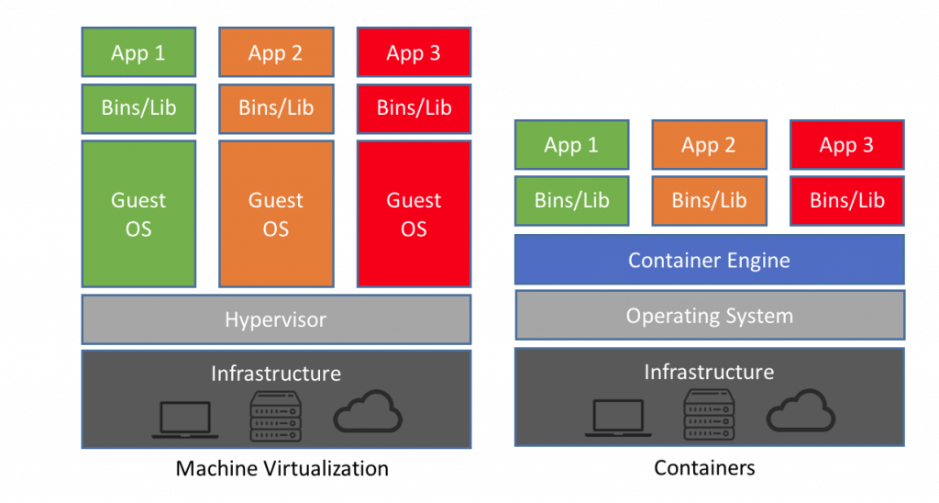
Containers Vs Machine virtualization
Containers Vs Virtualization

Slide 7
Docker Containers have the following benefits:
1
Light-weight
2
Applications run in isolation
3
Easily portable and highly secure
4
Occupies less space
5
Short boot-up time

Slide 8
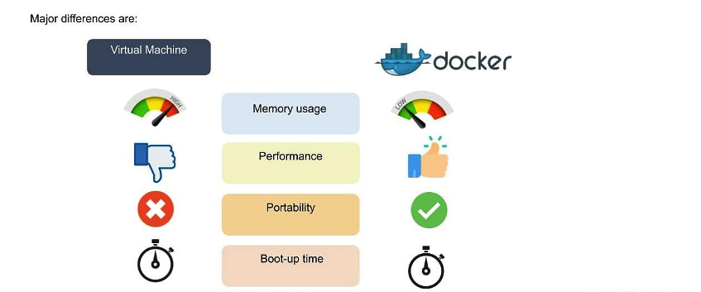
Containers Vs Machine virtualization
Containers Vs Virtualization

Slide 9
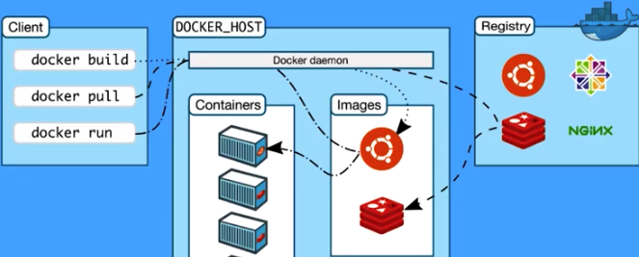
Component of Docker
1
Docker image
2
Docker container
3
Docker Registry
4
Docker client
5
Docker Daemon
6
Namespace

Slide 10

Live Demo

Slide 11


THANK YOU

