Slide 1
Test Automation Framework

Slide 2
Outline
Framework Definition
Framework Benefits
Automation Framework types
Linear Framework
Modular Framework
Data Driven Testing Framework
Behaviour Driven Tetsing Framework
Hybrid Testing Framework

Slide 3
What ?
A set of guidelines which when followed during automation scripting produces beneficial outcomes
Guidelines like coding standards, test-data handling, etc...

Slide 4
Why ?
Improved test efficiency
Lower maintenance costs
Minimal manual intervention
Maximum test coverage
Reusability of code

Slide 5
Types of Automation FRamework
Linear Automation Framework
Modular Driven Framework
Behavior Driven framework
Data Driven Framework
Hybrid Testing Framework
Keyword-Driven Framework
Library architecture Framework

Slide 6
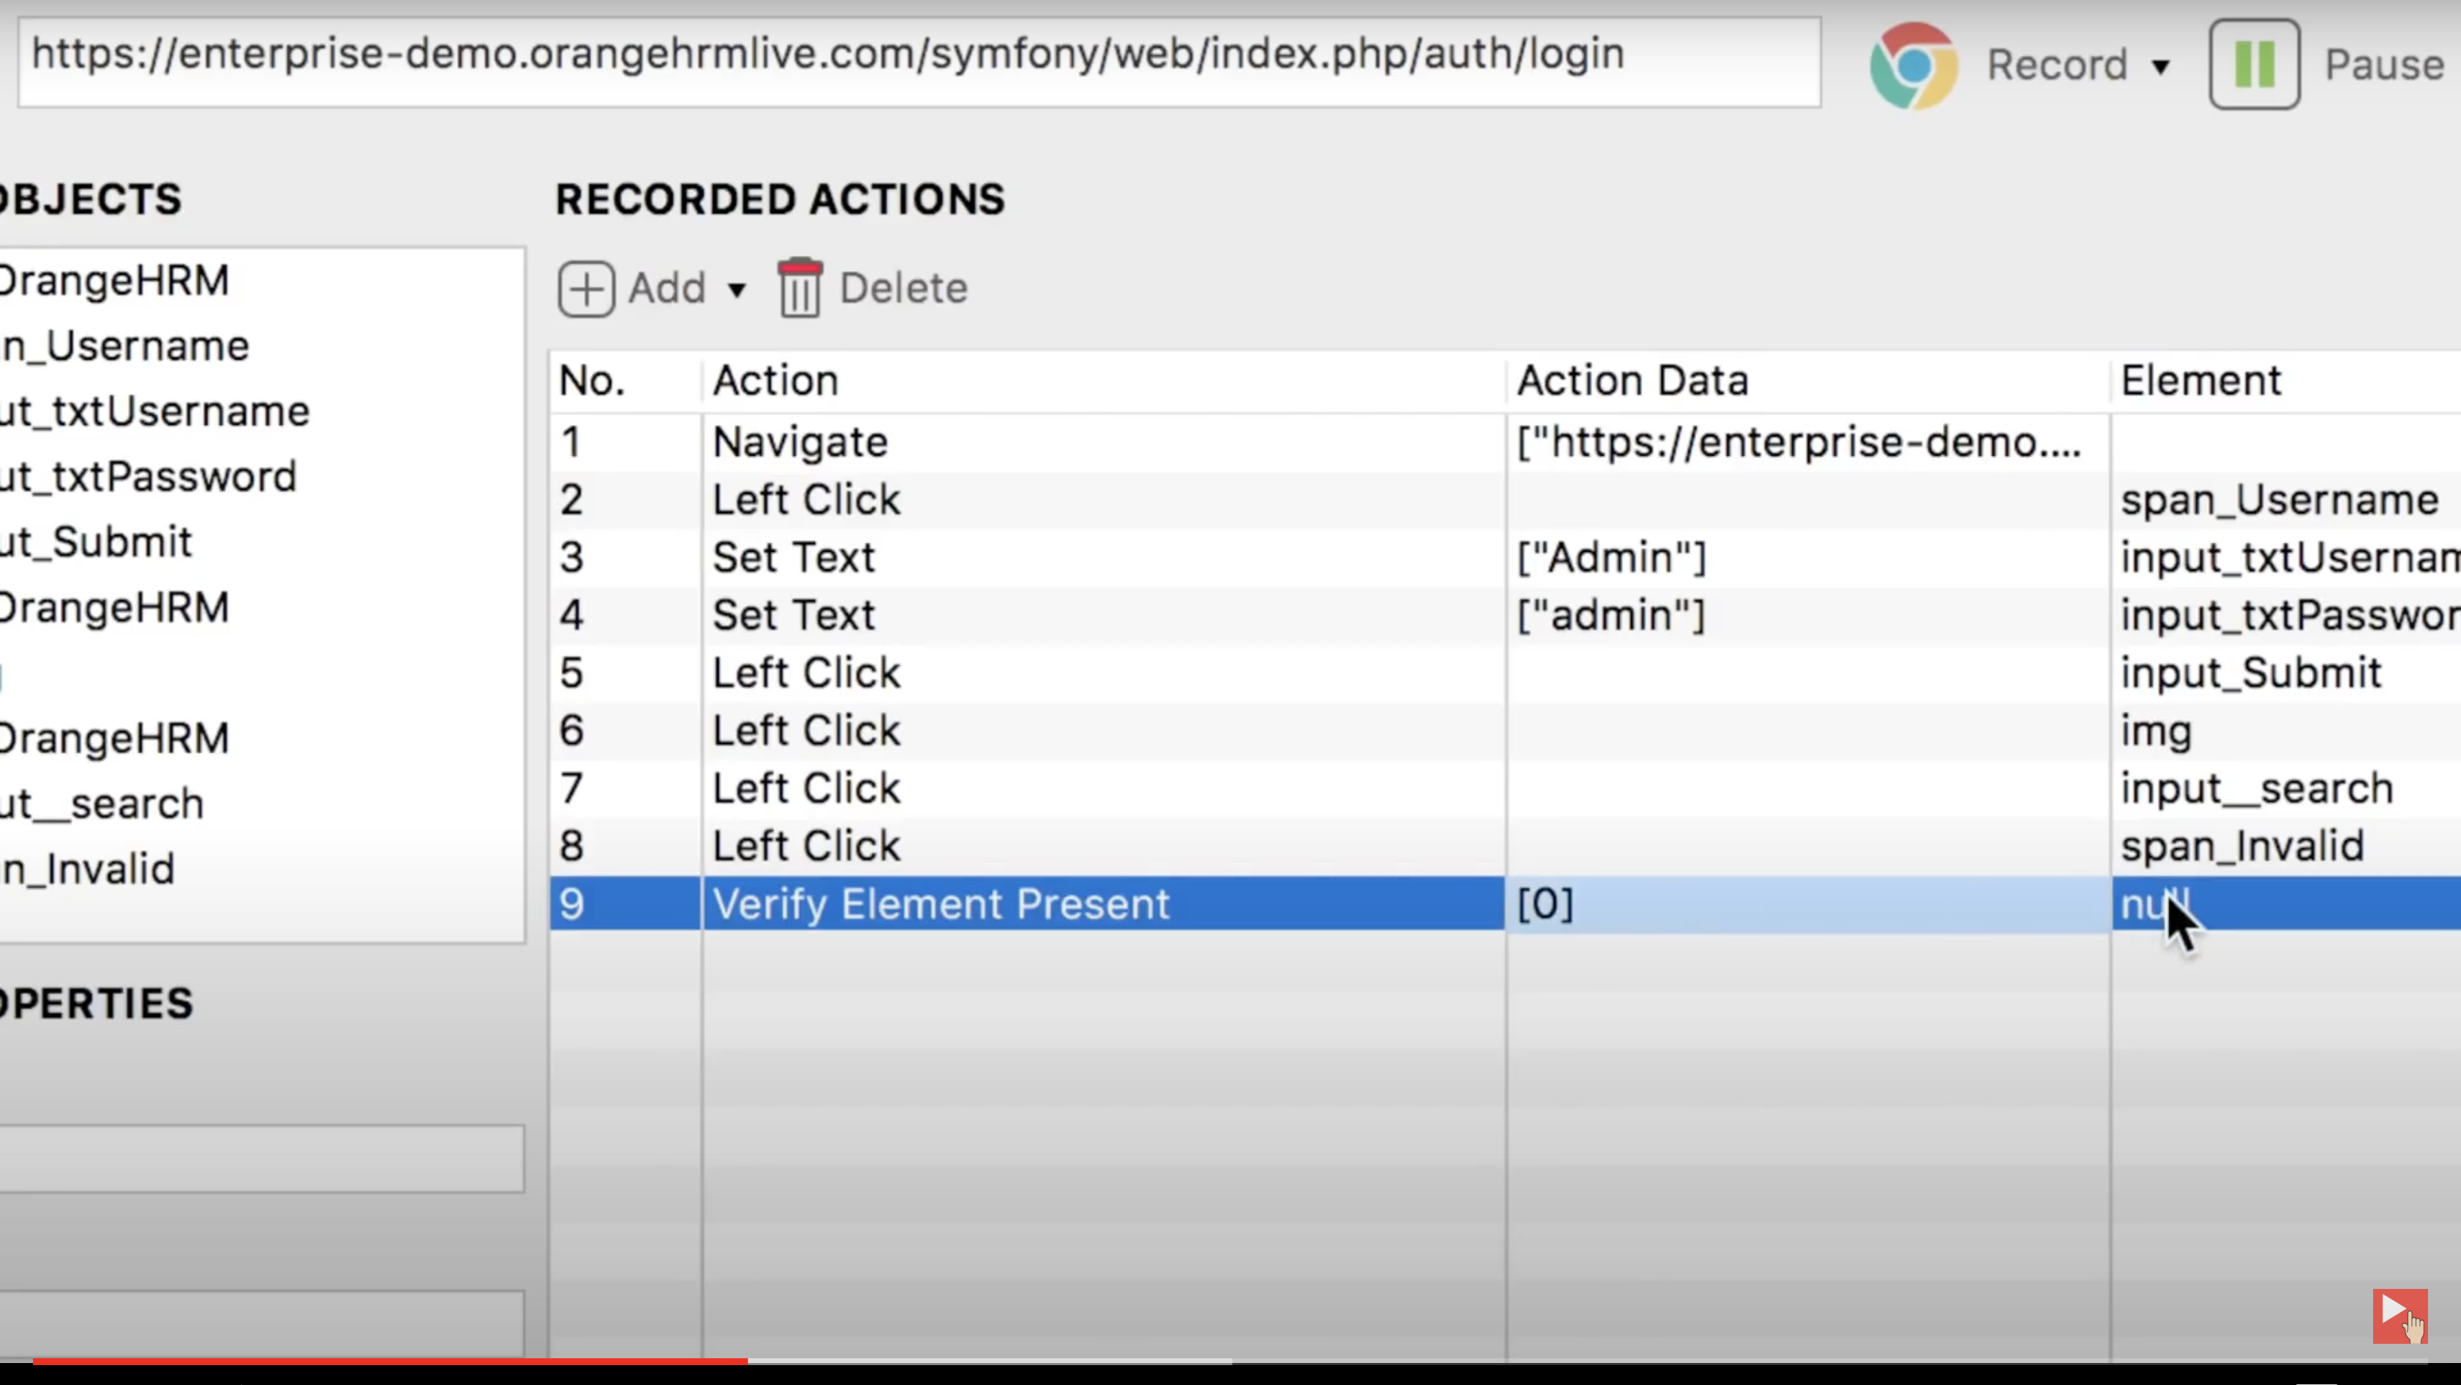
Linear Framework
Record and play back
QA Record Scenario
Tool Extract Elements , Actions and Data and generate test script.
QA Replays recorded test case.

Slide 7
Linear Framework
Tools:
Selenium IDE
Katalon
Pros | Cons
No custom code = Need for Experties Easiness Minimum Time | Non re-usable components Maintenance.

Slide 8
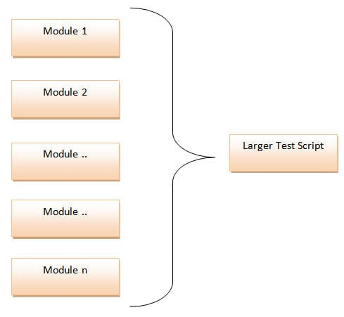
Modular Driven Framework
Break down the app to smaller modules
Create test case for each module seperately
Integrate code units in one/different modules to generate one test scripts

Slide 9
Modular Driven Framework
Modularity Pros and Cons
Pros | Cons
Easy Maintenance Scalable | 1- More time consumed on flow analysis 2- programming skills is required

Slide 10
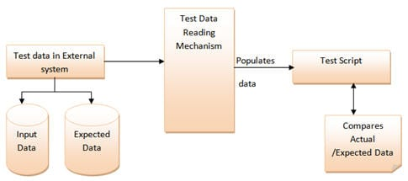
Data Driven Testing (DDT)
Read Data from external source
Load data into object and use it in Test scripts
Example of sources : Text file, CSV , ODBC , etc,,

Slide 11
Data Driven Testing (DDT)
Pros | Cons
Reduece the number of test scripts needed to cover the possible combination of inputs Change in data does not change in code Increase maintainability | 1. Requires programming proficiency.

Slide 12
Behaviour Driven (BDD)
Design Test case in English
Define Tests with “ Action , Data , Output”
Tools :
Cucumber
JBehave

Slide 13
Behaviour Driven (BDD)
Keywords :
Feature: High-level description of a feature
Scenario: Business situation..
Given: Precondition.
When: Action done by an actor.
Then: Outcome.
Example :
Feature : Active user Profiles.
Scenario: Navigate to my profile
Given: User is logged in
When: User clicked on my profile picture
Then: User is Navigated to profile page

Slide 14
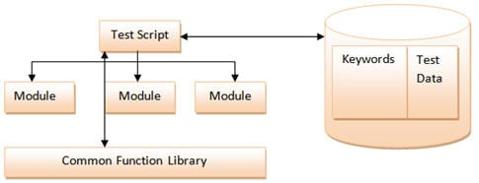
Hybrid Framework
Combination of Set of framework togeather to get best results.
Use different framework advantages
Mitigate weakness of others.

Slide 15
Questions ?

