Slide 1
Modern Car Rental System
Architecture, Flows, and Visuals

Slide 2
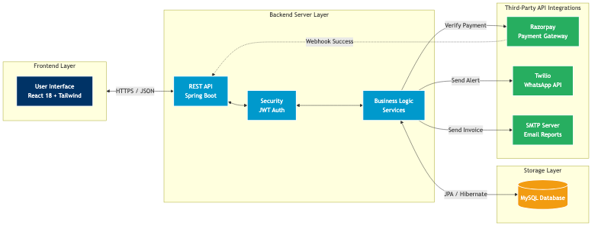
1. Overall System Architecture

Slide 3
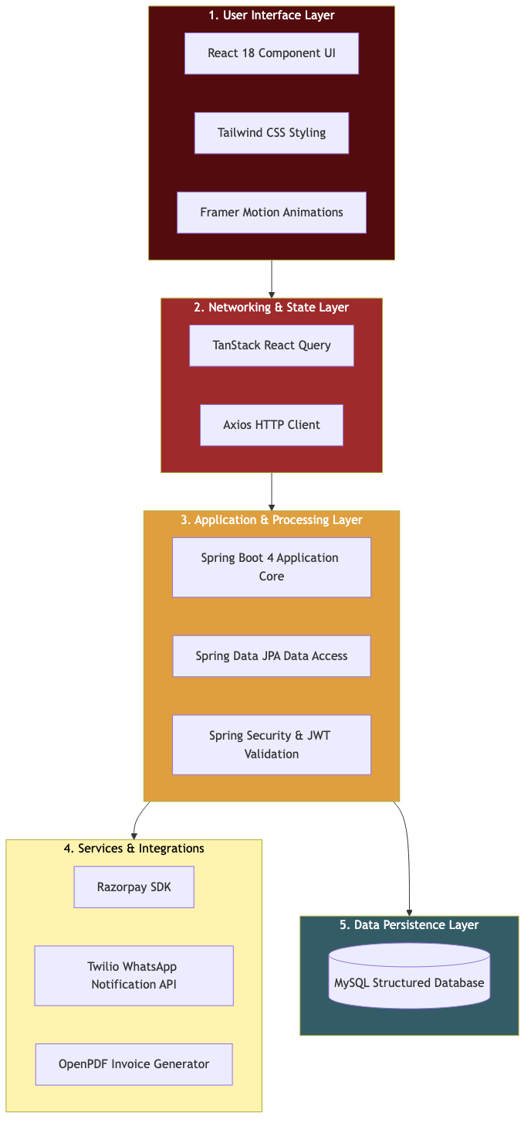
2. Technology Stack Overview

Slide 4
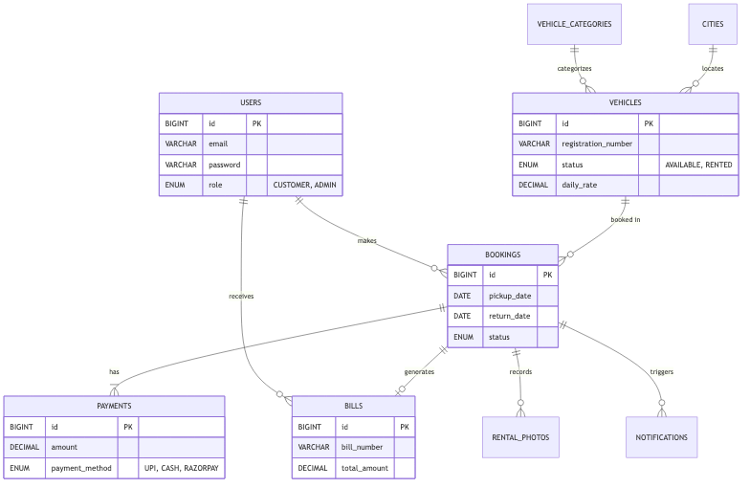
3. Entity-Relationship (ER) Diagram

Slide 5
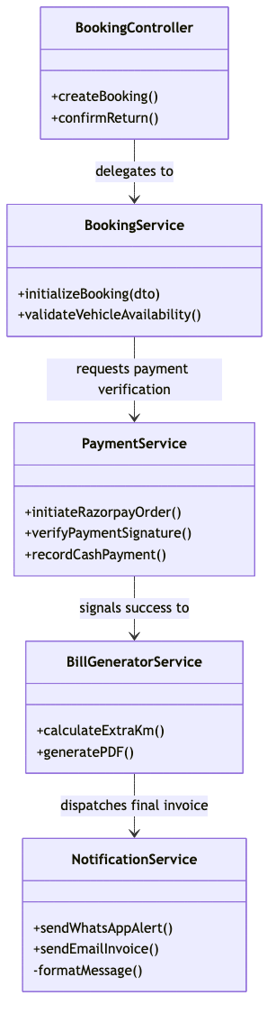
4. Service Class Diagram

Slide 6
Application UI: Home Display
PASTE SCREENSHOT HERE:
Take a screenshot of the main React frontend (Vehicle Listing)

Slide 7
Application UI: Booking Flow
PASTE SCREENSHOT HERE:
Take a screenshot of the Booking & Razorpay Payment Modal

Slide 8
Application UI: Admin Dashboard
PASTE SCREENSHOT HERE:
Take a screenshot of the Admin Dashboard showing Revenue/Reports

Slide 9
Real-world Alert: WhatsApp Message
PASTE SCREENSHOT HERE:
Take a screenshot of the Twilio WhatsApp confirmation message

