Slide 1



Embedded computing
UDOO – Single-board and microcontroller
Master ATIAM - Informatique
Philippe Esling (esling@ircam.fr)
Maître de conférences – UPMC
Equipe représentations musicales (IRCAM, Paris)

Slide 2
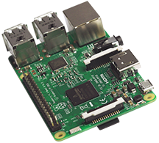
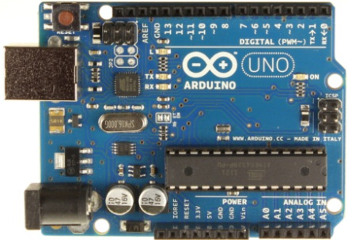
Single-Board Computer vs. Microcontroller
Raspberry Pi
Single-Board Computer
Arduino UNO
Microcontroller (MCU)

Slide 3
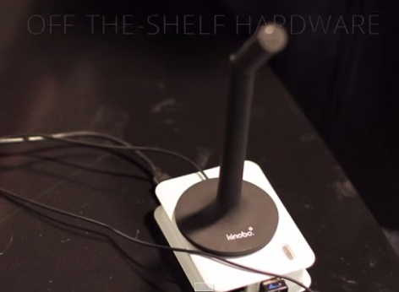
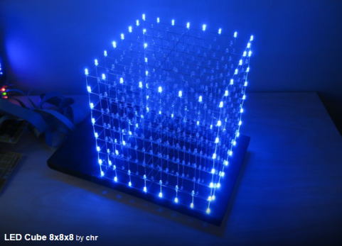

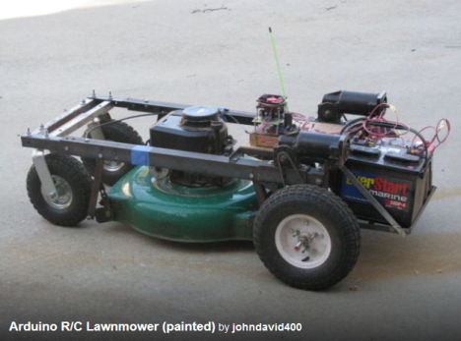
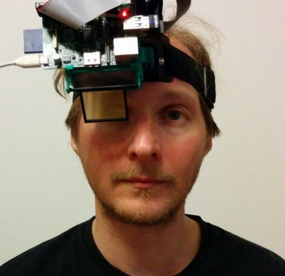
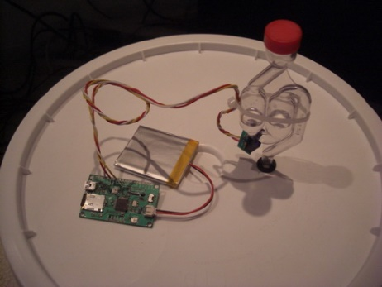
What can you do with this ?
Jasper – Voice Controller powered by Rpi https://jasperproject.github.io
LED Cube - http://www.instructables.com/id/Led-Cube-8x8x8/
Flamethrower Jack-O-Lantern - http://www.instructables.com/id/Flamethrowing-Jack-O-Lantern/
Arduino RC- Lawnmower http://www.instructables.com/id/Arduino-RC-Lawnmower/
Fermentation Monitoring - https://www.sparkfun.com/tutorials/131
Raspberry Eye - https://hackaday.io/project/865-raspberry-eye

Slide 4
Why so popular?
They are cheap
They sense and manipulate the physical world
GPIO pins (reading values/sending instructions)
GPIO = General Purpose Input/Output

Slide 5
Internet of Things (IoT)
Connection of embedded computing devices
Home Automation
Augmented Reality
Connecting non-computer devices
Home Entertainment
Aquariums
… your fridge ?!
Etc.

Slide 6
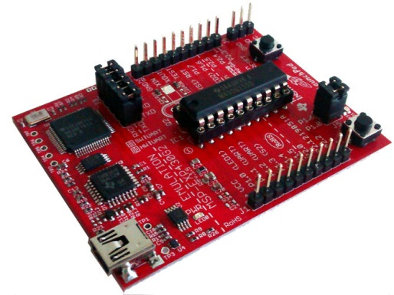
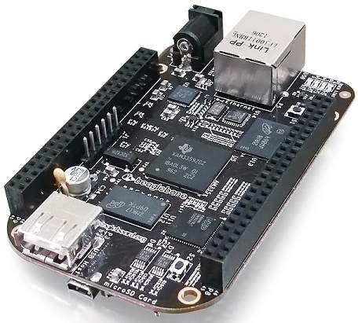
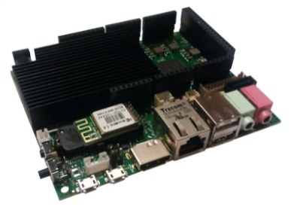
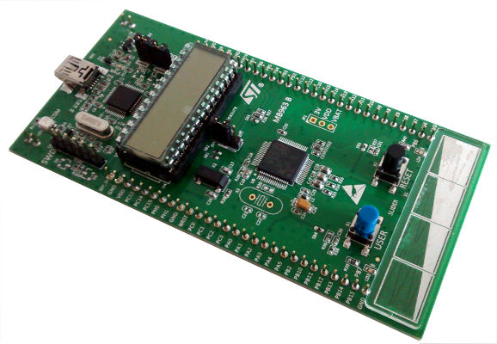
Single-Board Computer vs. Microcontroller What is the difference?
Single-board Computers
Microcontrollers

Slide 7

Single-Board Computer vs. Microcontroller Defining Features
Raspberry Pi
Single-board computer
Lots of processing power
Operating system (Linux, Android)
Monitor Connection
Cheap, “weak” computer
Microcontroller
Devoted to having GPIO pins
Low power, quick boot
Very cheap
Arduino

Slide 8
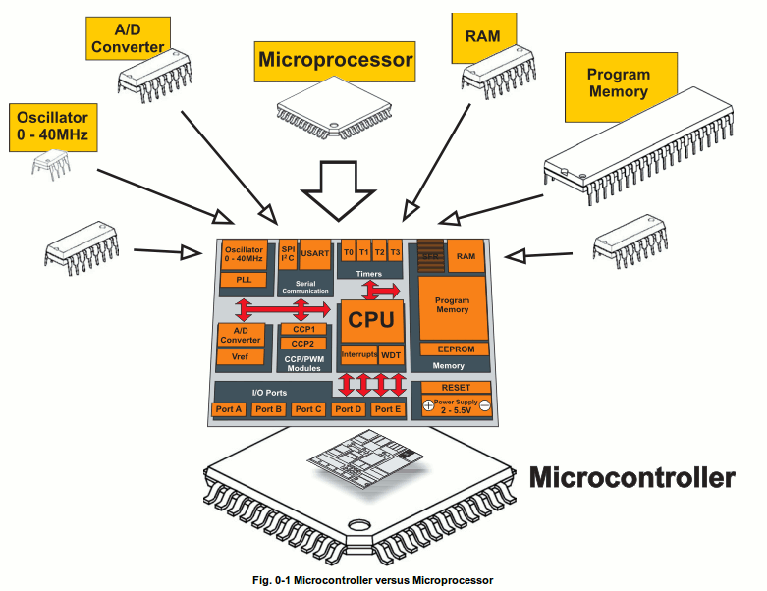
Micro-controller ?
A single chip has to emulate a small computer
Processor, memory, and input/output

Slide 9

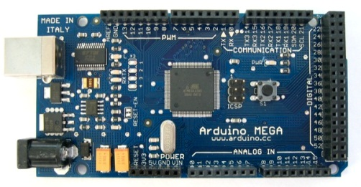
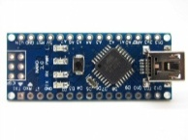
Microcontrollers Arduino
 | Arduino Uno | Arduino Mega2560 | Arduino Nano (ATmega328)
Microcontroller | ATmega328 | ATmega2560 | ATmega328
Flash Memory | 32KB | 256KB | 32KB
Clock Speed | 16MHz | 16MHz | 16 MHz
RAM | 2KB | 8KB | 1KB
Price (approx, USD) | $24.95here | $45.95 here | $34.99 here
Digital I/O Pins | 14 | 54 | 14
http://arduino.cc/

Slide 10
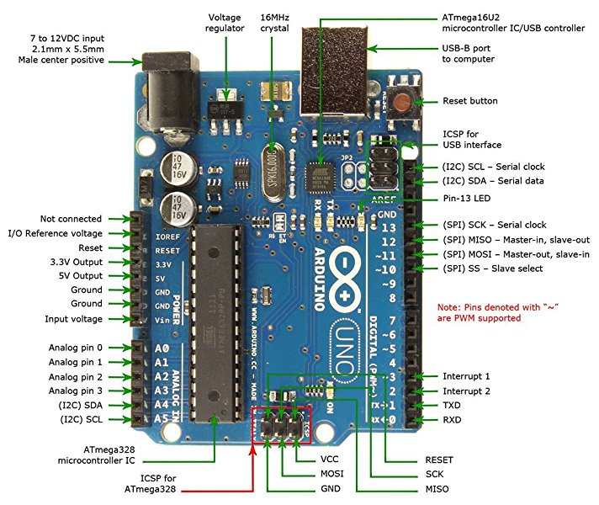
Arduino Microcontroller

Slide 11
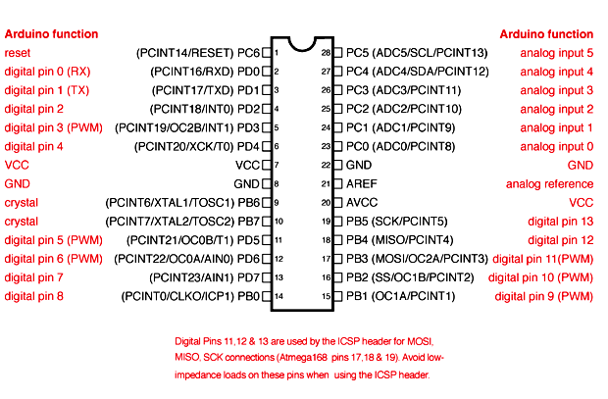
Arduino Microcontroller
GPIO Pins !

Slide 12
How do we use this ?
Working with these devices requires
Programming
Electronics

Slide 13
First Challenge Programming – Simplifying Aspects
Pre-written Libraries
Code Examples
https://github.com/
Community help (Forums, StackExchange)
Free online courses
Search for “MIT Arduino Course”
Programming courses on:
Khan Academy
Coursera
Udacity

Slide 14
Second Challenge Electronics – the hard part
Difficult to get started
Easy to make mistakes
Some mistakes cannot be undone
Often needs additional equipment:
Soldering Iron
Voltmeter
Oscilloscope

Slide 15
Electronics Simplifying Aspects
Starter Packs and Kits
Contain a minimum number of electronic components that you may need
Microcontroller Attachments
Shields (for Arduino)
Motor shields, sensor shields
Capes (for Beagleboard)
BoosterPacks (TI LaunchPad)
Notes:
-Simplify things for beginners and prototyping
-Somewhat pricey
-You would not use it for the final product, because it has components that you don’t need

Slide 16
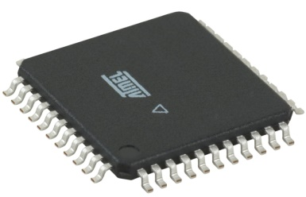
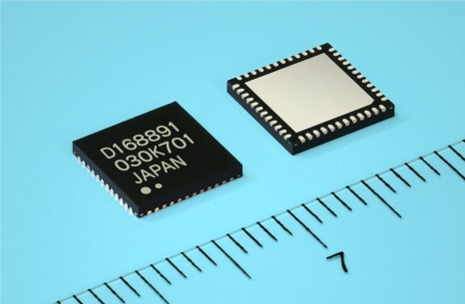
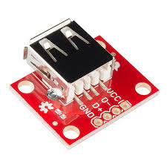
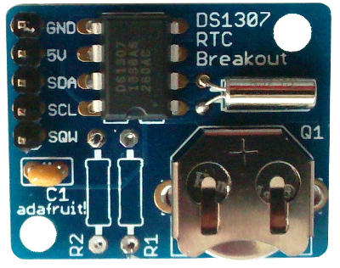
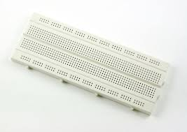
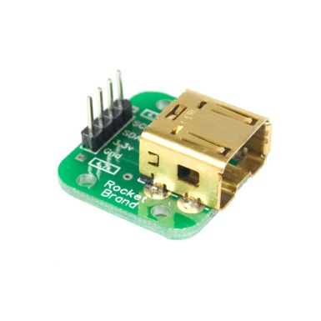
Electronics Simplifying Aspects
A lot of electronics come like this:
Solution: Breakout boards: pre-soldered breadboard-ready electronics:
Source:
http://elecshop.blog.com/files/2014/01/313-44-TQFP.jpg
http://www.renesas.com/media/press/news/2010/20101006.jpg

Slide 17

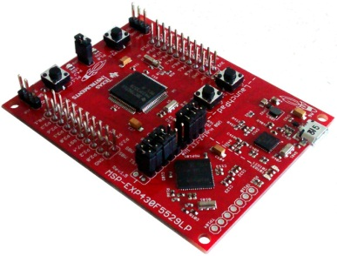
Microcontroller Expansion Boards features
Communication Cable Attachments
Programmer
Buttons
Power Supply Connectors
Pin connectors
On-board Sensors
(accelerometers, real-time clocks, temperature sensors)

Slide 18
How to use Arduino ?
Download & install the Arduino environment (IDE)
Connect the board to your computer via the USB cable
Launch the Arduino IDE
Select your board
Select your serial port
Open the blink example
Upload the program

Slide 19
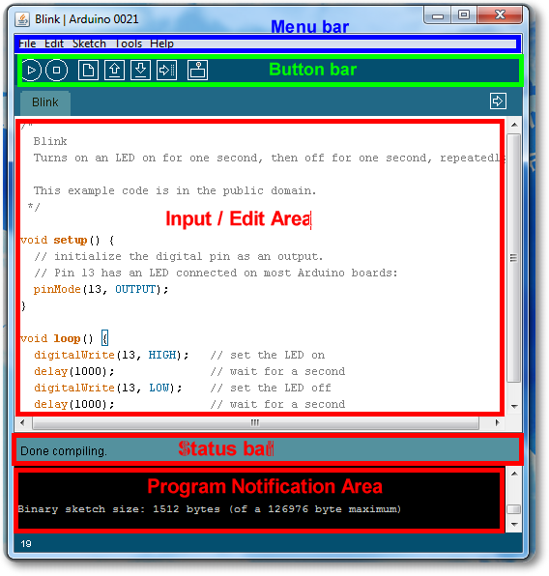
Arduino IDE

Slide 20
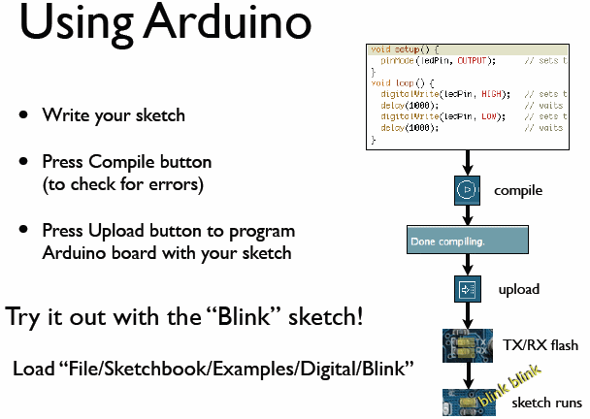
???
Profit
todbot.com/blog/bionicarduino

Slide 21
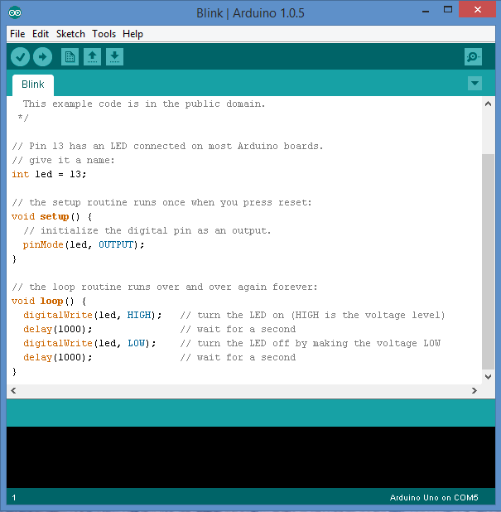
Microcontrollers Arduino IDE - Programming
http://arduino.cc/

Slide 22
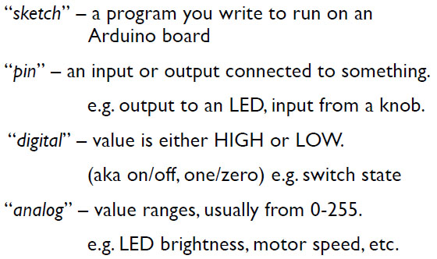
Arduino terminology

Slide 23
Bare minimum code
void setup() { // put your setup code here, to run once:
}
void loop() { // put your main code here, to run infinitely:
}

Slide 24
Bare minimum code
setup :
Called only when Arduino is powered on or reset
Used to initialize variables and pin modes
loop :
Runs continuously till the device is powered off.
Main logic of the code goes here.
A form of while(True) for micro-controller

Slide 25
Digital I/0
pinMode(pin, mode)
Sets pin to either INPUT or OUTPUT
digitalRead(pin)
Reads HIGH or LOW from a pin
digitalWrite(pin, value)
Writes HIGH or LOW to a pin

Slide 26
PinMode
A pin can be set as input or output
(All I/O pins can serve both mode)
pinMode function.
pinMode(13, OUTPUT);
// sets pin 13 as output pin
pinMode(13, INPUT);
// sets pin 13 as input pin

Slide 27
Reading/writing digital values
digitalWrite(13, LOW);
// Makes the output voltage on pin 13 , 0V
digitalWrite(13, HIGH);
// Makes the output voltage on pin 13 , 5V
int buttonState = digitalRead(2);
// reads the value of pin 2 in buttonState

Slide 28
Analog to Digital (ADC) Conversion
Analog ?
Continuous range of voltage values
Based on electrical in/outs
Why convert to digital ?
Because our microcontroller only understands digital.

Slide 29
ADC in Arduino
The Arduino Uno board contains pins for ADC
10-bit analog to digital converter
Map input voltages between 0 and 5 volts into integer values between 0 and 1023

Slide 30
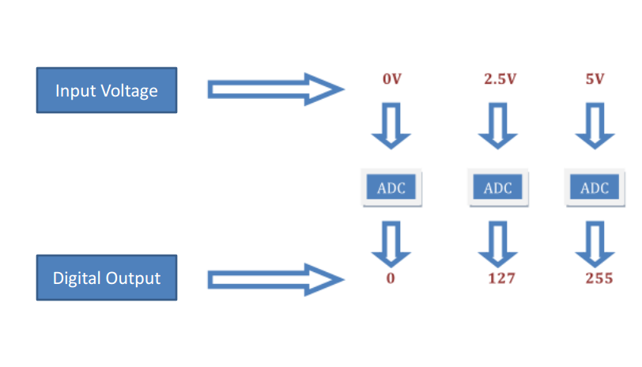
Analog Value to Digital ?

Slide 31
Digital? Analog?
Digital has two values: on and off
Analog has many (infinite) values
Computers don’t really do analog, they quantize
Remember the analog input pins---here’s how they work
todbot.com/blog/bionicarduino

Slide 32
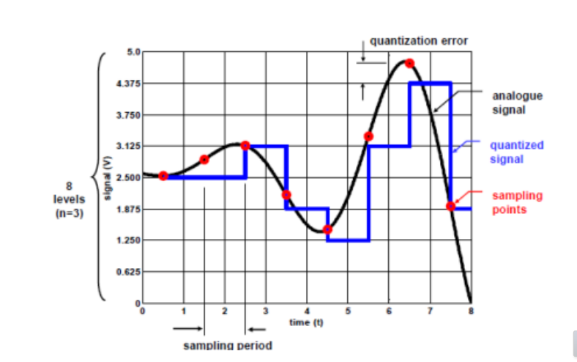
Signal quantization

Slide 33
Reading/Writing Analog Values
analogRead(A0); // used to read the analog value from the pin A0
analogWrite(2,128);

Slide 34
ADC Example
// These constants won't change. They're used to give names to the pins used: const int analogInPin = A0; // Analog input pin that the potentiometer is attached to const int analogOutPin = 9; // Analog output pin that the LED is attached to int sensorValue = 0; // value read from the pot int outputValue = 0; // value output to the PWM (analog out) void setup() { // initialize serial communications at 9600 bps: Serial.begin(9600); } void loop() { // read the analog in value: sensorValue = analogRead(analogInPin); // map it to the range of the analog out: outputValue = map(sensorValue, 0, 1023, 0, 255); // change the analog out value: analogWrite(analogOutPin, outputValue); // print the results to the serial monitor: Serial.print("sensor = " ); Serial.print(sensorValue); Serial.print("\t output = "); Serial.println(outputValue); // wait 2 milliseconds before the next loop for the analog-to-digital converter to settle delay(2); }

Slide 35
Arduino Timing
delay(ms)
Pauses for a few milliseconds
delayMicroseconds(us)
Pauses for a few microseconds
More commands: arduino.cc/en/Reference/HomePage

Slide 36

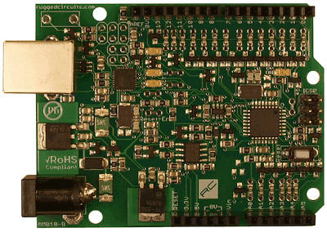
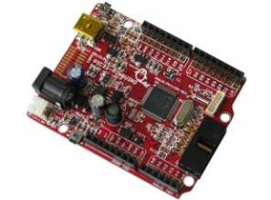
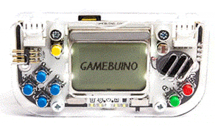
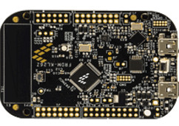
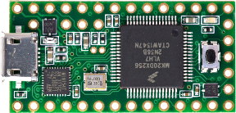
Microcontrollers Thousands Others
Some of these had limited production runs or have been discontinued.
Beetle
Ruggeduino
Pinguino PIC32
Freescale Freedom
Teensy
Gamebuino
Beetle: http://www.dfrobot.com/wiki/index.php/Beetle_SKU:DFR0282
Nanode: http://www.nanode.eu/
Pinguino PIC32: https://www.olimex.com/Products/Duino/PIC32/PIC32-PINGUINO/open-source-hardware
Ruggeduino: http://www.ruggedcircuits.com/ruggeduino/
Gamebuino: http://gamebuino.com/
Freescale Freedom: http://www.freescale.com/webapp/sps/site/overview.jsp?code=FREDEVPLA
Teensy: https://www.pjrc.com/teensy/

Slide 37
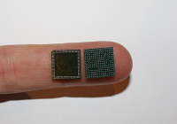
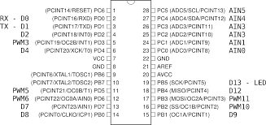
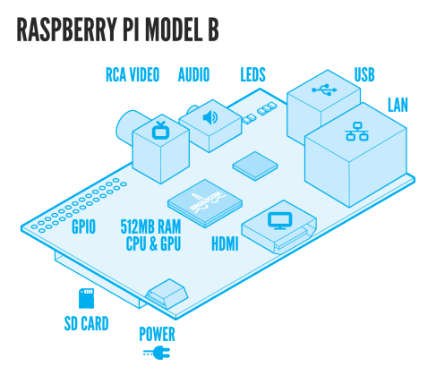
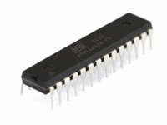
Single-Board Computer vs. Microcontroller Examples of Embedded Systems
Broadcom BCM2835
CPU, GPU, RAM
Storage
ATMega328
CPU, RAM, Storage
Image Source
http://pixshark.com/raspberry-pi-model-b-schematic.htm
http://images.studica.com/images/product/arduino/9a9b5c9e479e1a5b237b41a173d34dcfimage472x354_72_200x.gif

Slide 38
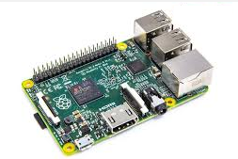
Single-Board Computers Raspberry Pi
 | Raspberry Pi Model B | Raspberry Pi 2
Processor | ARM1176JZF-S core | Quad-core ARM7
Flash Memory | None | None
Clock Speed | 700 MHz | 800 MHz
RAM | 512MB | 1 GB
Price (approx, USD) | $39.95 | $35.00
Other Features | 2x USB ports 26x GPIO pins | 4x USB2.0 40x GPIO pins
http://www.raspberrypi.org/
Image Source: http://www.techradar.com/news/computing-components/peripherals/raspberry-pi-2-outed-with-faster-cpu-double-ram-and-windows-10-support-1283075

Slide 39
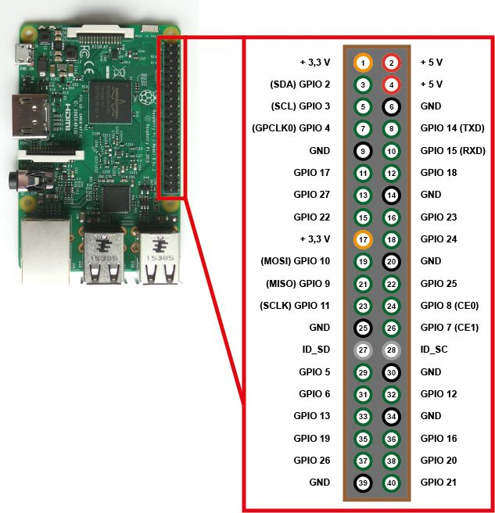
Raspberry Pi ?

Slide 40
Raspberry Pi ?
But also …
Powerful CPU
Screen display
Audio (sometimes)
Ethernet / WiFi

Slide 41
Raspberry Pi ?
But also …
Powerful CPU
Screen display
Audio (sometimes)
Ethernet / WiFi
And most importantly
External storage
Operating system (Linux)
Computing / RAM power
Ease of use/debug

Slide 42
Single-Board Computers
Properties
Processor Speed (Ghz, Multiple core)
RAM (speed of RAM)
Video Card (Home entertainment)
On-board storage (FLASH)
Hard-drive storage
GPIO pins
Features
Audio jack
IR remote
Blue tooth
Other connectors

Slide 43
Single-Board Computer vs. Microcontroller
Raspberry Pi
Single-Board Computer
Arduino UNO
Microcontroller (MCU)

Slide 44
Single-Board Computer vs. Microcontroller
Raspberry Pi
Single-Board Computer
Arduino UNO
Microcontroller (MCU)

Slide 45

Single-Board Computer vs. Microcontroller
UDOO
Single-Board Computer
+ Arduino Microcontroller (MCU) !

Slide 46
Single-Board Computers UDOO
 | UDOO Quad
Processor | Quad-core 1GHz
Flash Memory | None (SATA connector)
RAM | 1 GB DDR3
Other Features | 2x USB port WiFi Module 76 x GPIO pins Analog Audio and Mic
Price (approx, USD) | $135.00
http://www.udoo.org/

Slide 47
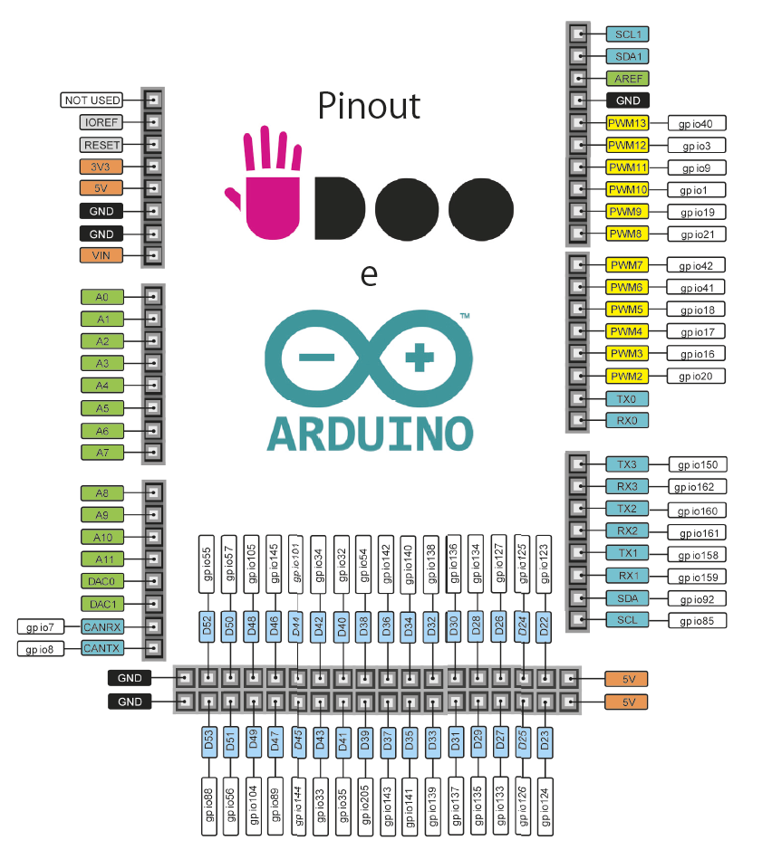
UDOO

Slide 48
UDOO
POWER

Slide 49
UDOO
POWER
ANALOG
IN/OUT

Slide 50
UDOO
POWER
ANALOG
IN/OUT
DIGITAL
IN/OUT

Slide 51
UDOO
POWER
PWM
Pulse Width
Modulation
ANALOG
IN/OUT
DIGITAL
IN/OUT

Slide 52
UDOO - PureData
PureData has a special distribution for UDOO
You can find pre-compiled versions for it or compile it
This PureData version can use two objects
Find more informations and tutorials at
https://www.udoo.org/forum/threads/guide-compile-pure-data-extended-on-udoo.478/
[gpio] allows a direct interaction with pins
[comport] is a serial data transfer extern (interact with Arduino code)
https://github.com/irllabs/Udoo

Slide 53
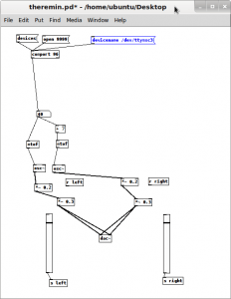
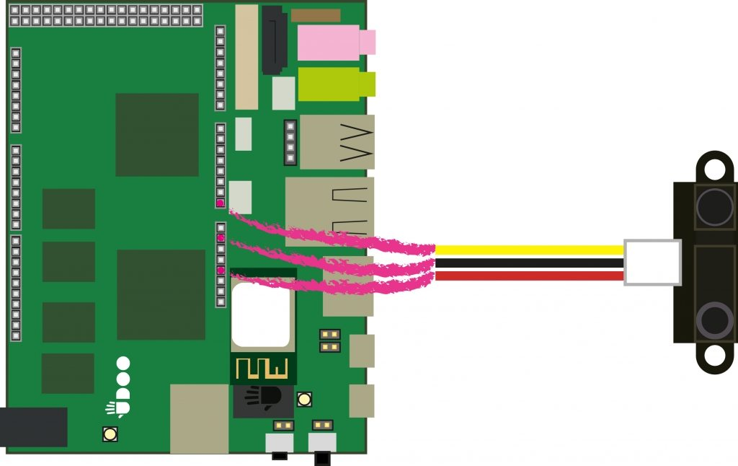
UDOO – PD
Project - Theremin of light

Slide 54
UDOO – PD
Project - Theremin of light
int IRpin = A0;
int distance = 0; int msg = 0;
void setup() { Serial.begin(115200); }
void loop()
{
distance = analogRead(IRpin);
if (distance < 100) { distance = 100; }
else if (distance > 900){ distance = 900; }
msg = map(distance, 100, 900, 0, 255); Serial.write(msg);
}

