Slide 1



Music Machine Learning
XIII – Pytorch
Master ATIAM - Informatique
Philippe Esling (esling@ircam.fr)
Maître de conférences – UPMC
Equipe représentations musicales (IRCAM, Paris)

Slide 2



Deep learning frameworks
Modern tools make it easy to implement neural networks
Often used components
Linear, convolution, recurrent layers etc.
Many frameworks available: Torch (2002), Theano (2011), Caffe (2014), TensorFlow (2015), PyTorch (2016)
eras

Slide 3
Which framework to choose ?
Research, flexibility and being happy in life ?
Deployment (mobile, web)

Slide 4
Which framework to choose ?
Research, flexibility and being happy in life ?
Deployment (mobile, web)
Are you a senile 82 years old drunk person ?
eras

Slide 5
Pytorch
Fast tensor computation (like numpy) with strong GPU support
Deep learning research platform that provides maximum flexibility and speed
Dynamic graphs and automatic differentiation

Slide 6

Developers

Slide 7
Outlines
Basic concepts
Write a model
Classification of MNIST dataset
Convolutional model

Slide 8
Basic Concepts
torch.Tensor
similar to numpy.array
nn.Parameter
contain Parameters and define functions on input Variables
nn.Module
contain Parameters and define functions on input Variables
autograd.Variable
wraps a Tensor and enables auto differentiation
autograd.Function
operate on Variables, implements forward and backward

Slide 9
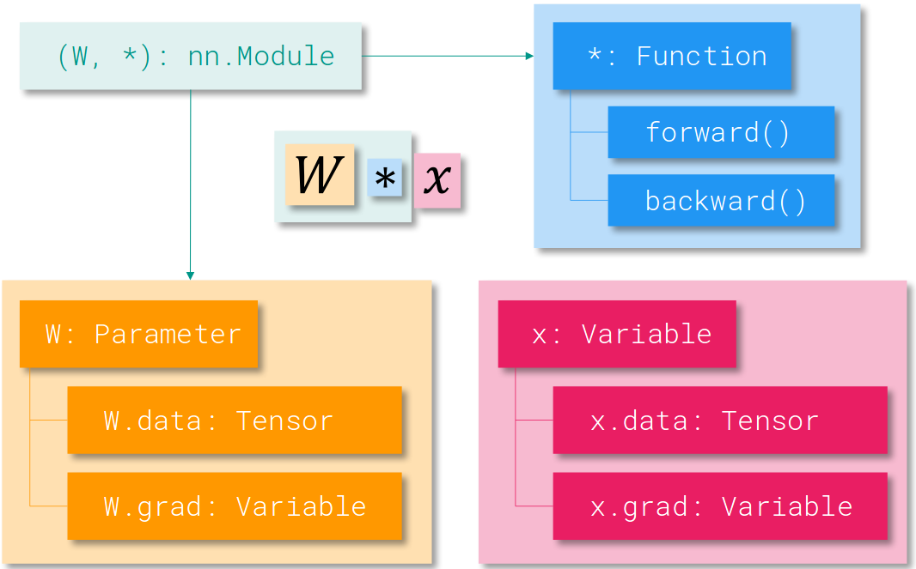
Basic Concepts

Slide 10
Basic Concepts
import torch x = torch.rand(10, 5) y = torch.rand(10,5) z = x * y

Slide 11
Basic Concepts
import torch x = torch.rand(10, 5) y = torch.rand(10,5) z = x * y
import torch x = torch.ones(5,5) b = x.numpy()

Slide 12
Basic Concepts
import torch x = torch.rand(10, 5) y = torch.rand(10,5) z = x * y
import torch x = torch.ones(5,5) b = x.numpy()
import torch import numpy as np a = np.ones(5) x = torch.from_numpy(a)

Slide 13
Basic Concepts
import torch x = torch.rand(10, 5) y = torch.rand(10,5) z = x * y
import torch x = torch.ones(5,5) b = x.numpy()
import torch import numpy as np a = np.ones(5) x = torch.from_numpy(a)
import torch x= torch.rand(100,100) x = x.cuda()
One single operation to go to GPU computing ☺

Slide 14
Basic Concepts
# IN PLACE ADD
y.add_(x)
print(y)
y = torch.rand(5, 3)
print(x + y)
print(torch.add(x, y))
import torch x = torch.rand(10, 5) y = torch.rand(10,5) z = x * y
import torch x = torch.ones(5,5) b = x.numpy()
import torch import numpy as np a = np.ones(5) x = torch.from_numpy(a)
import torch x= torch.rand(100,100) x = x.cuda()
One single operation to go to GPU computing ☺

Slide 15
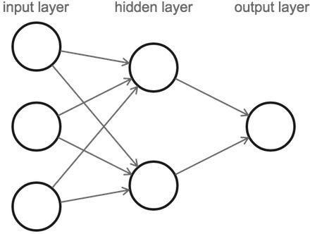
Creating a network (gran’ma way)
PyTorch allows to write models in one line
import torch.nn as nn
﻿model = nn.Sequential
(
nn.Linear(input_dim, hidden_dim),
nn.ReLU(True),
nn.Linear(hidden_dim, output_dim),
nn.Softmax()
)
x = torch.rand(16, input_dim)
model(x)
Low amount of control but easily implemented

Slide 16
Network definition
More flexible and controllable definition
Object-oriented through nn.Module
class TwoLayerNet(torch.nn.Module): def __init__(self, D_in, H, D_out): super(TwoLayerNet, self).__init__() self.linear1 = nn.Linear(D_in, H) self.linear2 = nn.Linear(H, D_out) self.relu = nn.ReLU(inplace=True) def forward(self, x): h_relu = self.linear1(x) h_relu = self.relu(h_relu) y_pred = self.linear2(h_relu)
ypred = nn.functional.softmax(y_pred) return y_pred

Slide 17
Network definition
More flexible and controllable definition
Object-oriented through nn.Module
class TwoLayerNet(torch.nn.Module): def __init__(self, D_in, H, D_out): super(TwoLayerNet, self).__init__() self.linear1 = nn.Linear(D_in, H) self.linear2 = nn.Linear(H, D_out) self.relu = nn.ReLU(inplace=True) def forward(self, x): h_relu = self.linear1(x) h_relu = self.relu(h_relu) y_pred = self.linear2(h_relu)
ypred = nn.functional.softmax(y_pred) return y_pred
Operations can be layers
Or directly functions to apply
(when no parameters involved)

Slide 18
Example of a residual network
class ResBlock(nn.Module):
def __init__(self, dim, dim_res=32):
super().__init__()
self.block = nn.Sequential(
nn.Conv2d(dim, dim_res, 3, 1, 1),
nn.ReLU(True),
nn.Conv2d(dim_res, dim, 1),
nn.ReLU(True)
)
def forward(self, x):
return x + self.block(x)
Mixing modules and direct operations !
Modules are themselves usable in more complex models !
nn.Sequential(
ResBlock(64, 32),
ResBlock(64, 32),
)

Slide 19
Optimizing the Network
# Have some data
N, D_in, H, D_out = 64, 1000, 100, 10
# Create a network model = TwoLayerNet(D_in, H, D_out)
# Select an adequate loss loss_fn = torch.nn.MSELoss(size_average=False)
# Create an optimizer (here stochastic gradient descent) optimizer = torch.optim.SGD(model.parameters(), lr=1e-4) for epoch in range(500): # Forward pass: Compute predicted y by passing x to the model y_pred = model(x) # Zero gradients (cumulative). optimizer.zero_grad()
# Backward pass: loss.backward()
# Apply your optimization (gradient descent)
optimizer.step()

Slide 20
Optimizing the Network
# Have some data
N, D_in, H, D_out = 64, 1000, 100, 10
# Create a network model = TwoLayerNet(D_in, H, D_out)
# Select an adequate loss loss_fn = torch.nn.MSELoss(size_average=False)
# Create an optimizer (here stochastic gradient descent) optimizer = torch.optim.SGD(model.parameters(), lr=1e-4) for epoch in range(500): # Forward pass: Compute predicted y by passing x to the model y_pred = model(x) # Zero gradients (cumulative). optimizer.zero_grad()
# Backward pass: loss.backward()
# Apply your optimization (gradient descent)
optimizer.step()

Slide 21
Optimizing the Network
# Have some data
N, D_in, H, D_out = 64, 1000, 100, 10
# Create a network model = TwoLayerNet(D_in, H, D_out)
# Select an adequate loss loss_fn = torch.nn.MSELoss(size_average=False)
# Create an optimizer (here stochastic gradient descent) optimizer = torch.optim.SGD(model.parameters(), lr=1e-4) for epoch in range(500): # Forward pass: Compute predicted y by passing x to the model y_pred = model(x); loss = loss_fn(y, y_pred) # Zero gradients (cumulative). optimizer.zero_grad()
# Backward pass: loss.backward()
# Apply your optimization (gradient descent)
optimizer.step()

Slide 22
Optimizing the Network
# Have some data
N, D_in, H, D_out = 64, 1000, 100, 10
# Create a network model = TwoLayerNet(D_in, H, D_out)
# Select an adequate loss loss_fn = torch.nn.MSELoss(size_average=False)
# Create an optimizer (here stochastic gradient descent) optimizer = torch.optim.SGD(model.parameters(), lr=1e-4) for epoch in range(500): # Forward pass: Compute predicted y by passing x to the model y_pred = model(x); loss = loss_fn(y, y_pred) # Zero gradients (cumulative). optimizer.zero_grad()
# Backward pass: loss.backward()
# Apply your optimization (gradient descent)
optimizer.step()

Slide 23
Details on losses
A loss function takes a (output, target) pair of inputs,
Computes the prediction error made by the network
A simple loss: nn.MSELoss (mean-squared)
output = net(input)
target = torch.randn(10) # a dummy target, for example
criterion = nn.MSELoss()
loss = criterion(output, target)
print(loss)

Slide 24
Details on losses
A loss function takes a (output, target) pair of inputs,
Computes the prediction error made by the network
A simple loss: nn.MSELoss (mean-squared)
output = net(input)
target = torch.randn(10) # a dummy target, for example
criterion = nn.MSELoss()
loss = criterion(output, target)
print(loss)
Flashback time

Slide 25
Network definition #3

Slide 26

Network definition #3
THE REAL DEAL

Slide 27
Gradients
Variables wrap a tensor and saves a history
Used for automatic differentiation
import torch from torch.autograd.variable import Variable x = Variable(torch.ones((2, 2)), requires_grad=True) y = x + 2 z = y * y * 3 out = z.mean() out.backward() print(x.grad)

Slide 28
Gradients
Variables wrap a tensor and saves a history
Used for automatic differentiation
import torch from torch.autograd.variable import Variable x = Variable(torch.ones((2, 2)), requires_grad=True) y = x + 2 z = y * y * 3 out = z.mean() out.backward() print(x.grad)

Slide 29
Gradients
Variables wrap a tensor and saves a history
Used for automatic differentiation
import torch from torch.autograd.variable import Variable x = Variable(torch.ones((2, 2)), requires_grad=True) y = x + 2 z = y * y * 3 out = z.mean() out.backward() print(x.grad)

Slide 30
Gradients
Variables wrap a tensor and saves a history
Used for automatic differentiation
import torch from torch.autograd.variable import Variable x = Variable(torch.ones((2, 2)), requires_grad=True) y = x + 2 z = y * y * 3 out = z.mean() out.backward() print(x.grad)

Slide 31
Gradients
Variables wrap a tensor and saves a history
Used for automatic differentiation
import torch from torch.autograd.variable import Variable x = Variable(torch.ones((2, 2)), requires_grad=True) y = x + 2 z = y * y * 3 out = z.mean() out.backward() print(x.grad)
This operation goes through the whole differentiation graph

Slide 32
Gradients
NOTE = Since Pytorch 0.4
All tensors are Variables
Variables wrap a tensor and saves a history
Used for automatic differentiation
import torch from torch.autograd.variable import Variable x = Variable(torch.ones((2, 2)), requires_grad=True) y = x + 2 z = y * y * 3 out = z.mean() out.backward() print(x.grad)
This operation goes through the whole differentiation graph

Slide 33
Network definition
Implementing [Yang et. al 2016]
Attention layer on

Slide 34
Network definition
Implementing [Yang et. al 2016]
Attention layer on

Slide 35
Network definition
Affine transform
Implementing [Yang et. al 2016]
Attention layer on

Slide 36
Network definition
Affine transform
Implementing [Yang et. al 2016]
Attention layer on
Softmax

Slide 37
Network definition
Affine transform
Implementing [Yang et. al 2016]
Attention layer on
Softmax
Trainable matrix

Slide 38
Network definition
Affine transform
Implementing [Yang et. al 2016]
Attention layer on
Softmax
# Chord-level attention layer
class ChordLevelAttention(nn.Module):
def __init__(self, n_hidden):
super(ChordLevelAttention, self).__init__()
self.mlp = nn.Linear(n_hidden, n_hidden)
self.u_w = nn.Parameter(torch.rand(n_hidden))
def forward(self, X):
# get the hidden representation of the sequence
u_it = F.tanh(self.mlp(X))
# get attention weights for each timestep
alpha = F.softmax(torch.matmul(u_it, self.u_w), dim=1)
# get the weighted sum of the sequence
out = torch.sum(torch.matmul(alpha, X), dim=1)
return out, alpha
Trainable matrix

Slide 39
Network definition
Affine transform
Implementing [Yang et. al 2016]
Attention layer on
Softmax
# Chord-level attention layer
class ChordLevelAttention(nn.Module):
def __init__(self, n_hidden):
super(ChordLevelAttention, self).__init__()
self.mlp = nn.Linear(n_hidden, n_hidden)
self.u_w = nn.Parameter(torch.rand(n_hidden))
def forward(self, X):
# get the hidden representation of the sequence
u_it = F.tanh(self.mlp(X))
# get attention weights for each timestep
alpha = F.softmax(torch.matmul(u_it, self.u_w), dim=1)
# get the weighted sum of the sequence
out = torch.sum(torch.matmul(alpha, X), dim=1)
return out, alpha
Trainable matrix

Slide 40
Network definition
Affine transform
1
Implementing [Yang et. al 2016]
Attention layer on
Softmax
# Chord-level attention layer
class ChordLevelAttention(nn.Module):
def __init__(self, n_hidden):
super(ChordLevelAttention, self).__init__()
self.mlp = nn.Linear(n_hidden, n_hidden)
self.u_w = nn.Parameter(torch.rand(n_hidden))
def forward(self, X):
# get the hidden representation of the sequence
u_it = F.tanh(self.mlp(X))
# get attention weights for each timestep
alpha = F.softmax(torch.matmul(u_it, self.u_w), dim=1)
# get the weighted sum of the sequence
out = torch.sum(torch.matmul(alpha, X), dim=1)
return out, alpha
Trainable matrix
1

Slide 41
Network definition
Affine transform
1
Implementing [Yang et. al 2016]
Attention layer on
Softmax
2
# Chord-level attention layer
class ChordLevelAttention(nn.Module):
def __init__(self, n_hidden):
super(ChordLevelAttention, self).__init__()
self.mlp = nn.Linear(n_hidden, n_hidden)
self.u_w = nn.Parameter(torch.rand(n_hidden))
def forward(self, X):
# get the hidden representation of the sequence
u_it = F.tanh(self.mlp(X))
# get attention weights for each timestep
alpha = F.softmax(torch.matmul(u_it, self.u_w), dim=1)
# get the weighted sum of the sequence
out = torch.sum(torch.matmul(alpha, X), dim=1)
return out, alpha
Trainable matrix
1
2

Slide 42
Network definition
Affine transform
1
Implementing [Yang et. al 2016]
Attention layer on
Softmax
2
# Chord-level attention layer
class ChordLevelAttention(nn.Module):
def __init__(self, n_hidden):
super(ChordLevelAttention, self).__init__()
self.mlp = nn.Linear(n_hidden, n_hidden)
self.u_w = nn.Parameter(torch.rand(n_hidden))
def forward(self, X):
# get the hidden representation of the sequence
u_it = F.tanh(self.mlp(X))
# get attention weights for each timestep
alpha = F.softmax(torch.matmul(u_it, self.u_w), dim=1)
# get the weighted sum of the sequence
out = torch.sum(torch.matmul(alpha, X), dim=1)
return out, alpha
3
Trainable matrix
1
2
3

Slide 43
Network definition
Affine transform
1
Implementing [Yang et. al 2016]
Attention layer on
Softmax
2
# Chord-level attention layer
class ChordLevelAttention(nn.Module):
def __init__(self, n_hidden):
super(ChordLevelAttention, self).__init__()
self.mlp = nn.Linear(n_hidden, n_hidden)
self.u_w = nn.Parameter(torch.rand(n_hidden))
def forward(self, X):
# get the hidden representation of the sequence
u_it = F.tanh(self.mlp(X))
# get attention weights for each timestep
alpha = F.softmax(torch.matmul(u_it, self.u_w), dim=1)
# get the weighted sum of the sequence
out = torch.sum(torch.matmul(alpha, X), dim=1)
return out, alpha
3
Trainable matrix
1
2
3
And Pytorch handles all derivations and gradients !

Slide 44
So what about data ?
Using torchvision extremely easy to load known datasets.
Example on MNIST (that we will use)
import torchvision
import torchvision.transforms as transforms
# Use transform to Tensors of normalized range [-1, 1].
transform = transforms.Compose(
[transforms.ToTensor(),
transforms.Normalize((0.5, 0.5, 0.5), (0.5, 0.5, 0.5))])
trainset = torchvision.datasets.MNIST(root='./data', train=True, download=True, transform=transform)
trainloader = torch.utils.data.DataLoader(trainset, batch_size=4, shuffle=True, num_workers=2)
for i, data in enumerate(trainloader, 0):
# get the inputs
inputs, labels = data

Slide 45
Writing your own dataset
﻿# Simplest Pytorch Audio dataset object ever
class AudioDataset(Dataset):
def __init__(self, datadir):
self.data_files = sorted(glob.glob(datadir + '/*'))
def __getitem__(self, idx):
try :
audio_file, sr = librosa.core.load(self.data_files[idx])
loaded_file = librosa.feature.melspectrogram(audio_file, sr)
loaded_file = torch.from_numpy(np.log1p(np.flipud(loaded_file)))
return loaded_file, 0
except :
return torch.Tensor(1), 0
def __len__(self):
return len(self.data_files)

Slide 46
Things to remember

Slide 47
Things to remember
Evaluate generalization on a separate test set
Beware of bad splits ! (cf. blue door / GTZAN)
Is your neural network a horse ? (Clever Hans)
Check your input data thoroughly (normalization !)
Address the characteristics of your data
Select your loss function accordingly
Always wonder about regularization
Dropout, BatchNorm, Augmentations
Start by solving simple toy problems
Good test = can you overfit on a small set ?

Slide 48
Things to remember
Evaluate generalization on a separate test set
Beware of bad splits ! (cf. blue door / GTZAN)
Is your neural network a horse ? (Clever Hans)
Check your input data thoroughly (normalization !)
Address the characteristics of your data
Select your loss function accordingly
Always wonder about regularization
Dropout, BatchNorm, Augmentations
Start by solving simple toy problems
Good test = can you overfit on a small set ?

Slide 49
Things to remember
Evaluate generalization on a separate test set
Beware of bad splits ! (cf. blue door / GTZAN)
Is your neural network a horse ? (Clever Hans)
Check your input data thoroughly (normalization !)
Address the characteristics of your data
Select your loss function accordingly
Always wonder about regularization
Dropout, BatchNorm, Augmentations
Start by solving simple toy problems
Good test = can you overfit on a small set ?

Slide 50
Things to remember
Evaluate generalization on a separate test set
Beware of bad splits ! (cf. blue door / GTZAN)
Is your neural network a horse ? (Clever Hans)
Check your input data thoroughly (normalization !)
Address the characteristics of your data
Select your loss function accordingly
Always wonder about regularization
Dropout, BatchNorm, Augmentations
Start by solving simple toy problems
Good test = can you overfit on a small set ?

Slide 51
Things to remember
Evaluate generalization on a separate test set
Beware of bad splits ! (cf. blue door / GTZAN)
Is your neural network a horse ? (Clever Hans)
Check your input data thoroughly (normalization !)
Address the characteristics of your data
Select your loss function accordingly
Always wonder about regularization
Dropout, BatchNorm, Augmentations
Start by solving simple toy problems
Good test = can you overfit on a small set ?

Slide 52
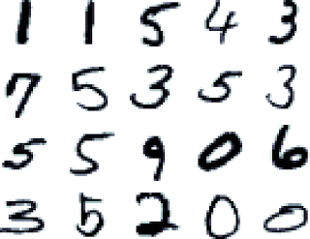
Classifying Handwritten Digits
Input Image
Conv 5x5, 1/10
MaxPool 2x2 + RELU
Conv 5x5, 10/20
MaxPool 2x2 + RELU
Conv 5x5, 10/20
Dropout , p = 0.5
Linear, 320/50
Linear, 50/10
Softmax

Slide 53
Convolutional layers
kernel_size
Input
Output
out_channels x
kernel_size
in_channels
out_channels (equals the number of convolutional filters for this layer)
in_channels (e.g. 3 for RGB inputs)

Slide 54
Classifying Handwritten Digits
Input Image
Conv 5x5, 1/10
MaxPool 2x2 + RELU
Conv 5x5, 10/20
MaxPool 2x2 + RELU
Conv 5x5, 10/20
Dropout , p = 0.5
Linear, 320/50
MNIST Dataset
Linear, 50/10
Softmax

Slide 55

If you are bored ?
Perform some funky neural transfer with Pytorch
https://pytorch.org/tutorials/advanced/neural_style_tutorial.html

