Slide 1
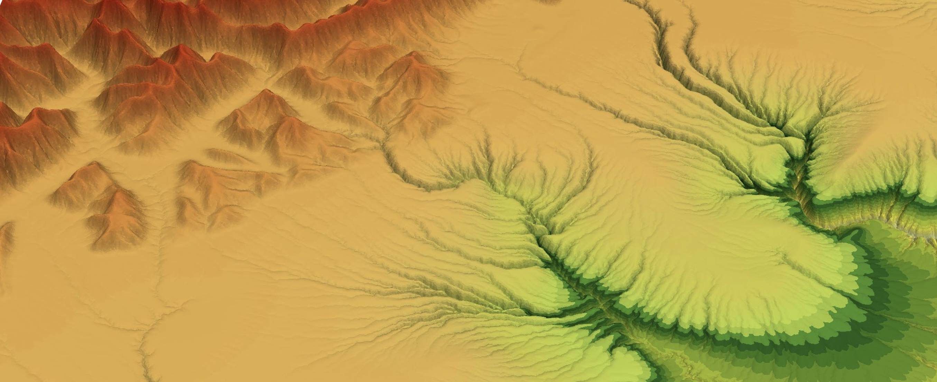

Modelling worksheet
https://github.com/badlands-model/badlands

Slide 2
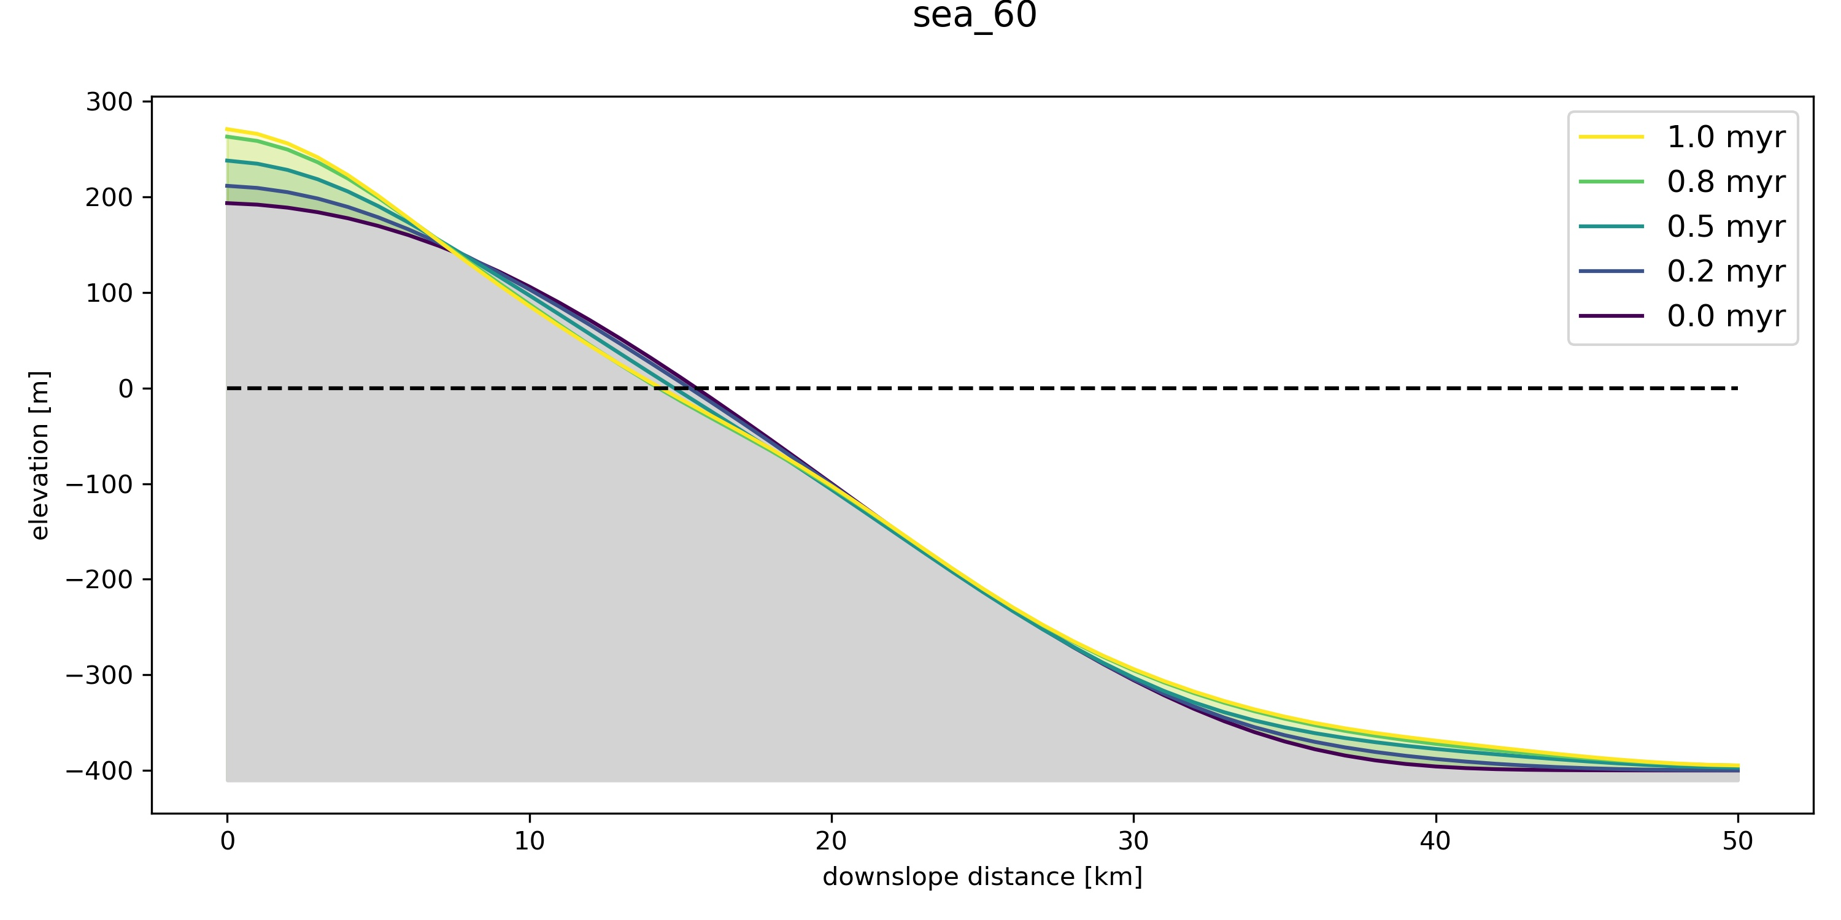
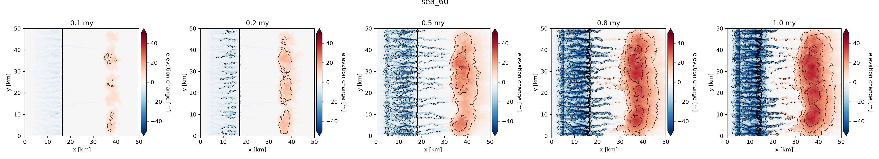
Guide
Run a model in the notebook and generate some maps and sections
Download the maps and sections from the ‘figures’ folder in the notebook, or take a screenshot of them directly
Insert these figures into the PowerPoint and use them to answer each question

Slide 3
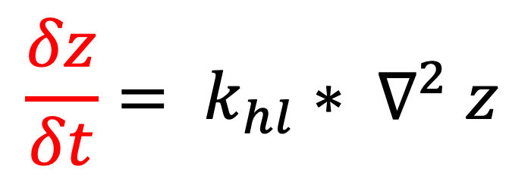
Tip for answering the questions
The underlying equations that drive the models are:
Increasing slope angle, relief, drainage area, uplift, and precipitation = more erosion
Change in elevation
through time
Erosion rate
$$\frac{δz}{δt}= k_{hl}{∗ ∇}^{2}z$$
E = K * A ^{m} * S ^{n}
Erodibility
Drainage area
(discharge e.g. precipitation)
Slope
Elevation
Diffusion

Slide 4
Q1) Initial conditions
Where is erosion and deposition concentrated?
..
Why are erosion and deposition concentrated in these locations?
..
How does erosion and deposition change through time?
..

Slide 5
Q2) Initial topography
Trying changing the steepness of the initial topography (by changing the amplitude or the period of the surface)
How has this affected erosion and deposition compared to the experiment with a lower initial slope?
..
Why has changing the steepness affected patterns of erosion and deposition?
..

Slide 6
Q3) Uplift rates
Trying changing the uplift rate
How has this affected erosion and deposition compared to the previous experiment?
..
Why has changing the uplift rate affected patterns of erosion and deposition?
..

Slide 7
Q4) Sea-level
Trying changing the magnitude of sea-level change rate
How has this affected where erosion and deposition occurs compared to the previous experiment?
..
Why would changing the sea-level affect patterns of erosion and deposition? Is erosion different on land compared to the sea?
..

Slide 8
Q5) Problems?
What is the problem with these equations?
For example, what is the problem with the K (erodibility) parameter? What controls erodibility?
..

