Slide 1
SlyterLisp:
Lisp to JavaScript Interpreter
ERIC SLYTER
CS3160 – FINAL PROJECT

Slide 2
Purpose
Write an interpreter that translates a user-input Lisp expression into JavaScript, runs it, and returns the exact same result that you would see from Dr. Racket
Goals:
  Successfully run most of the solutions for HW #1
  Learn more about JavaScript

Slide 3
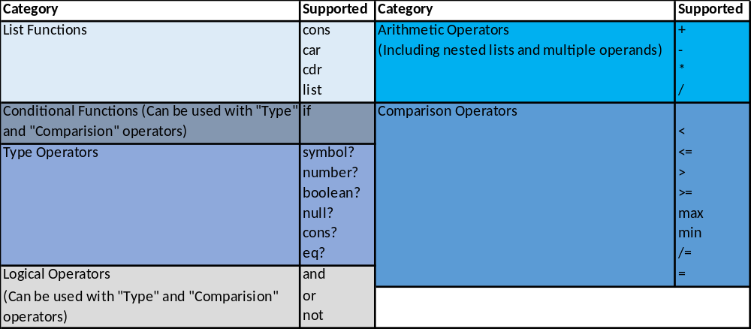
Supported Functionality
- Subset of Lisp Language

Slide 4
Overall Interpreter Design
Parsing: An input “program” or expression is received in the form of a character sequence, it is verified and then translated into an internal representation such as an Abstract Syntax Tree (AST). Parsing occurs in two steps:
  Lexical Analysis – The input character string is broken up into tokens.
  Syntactic Analysis – the tokens are assembled into an AST that reflects the nested structure of statements and expressions in the program.
Execution/Evaluation: This part of the interpreter takes the parsed output as input and evaluates the program using the semantic rules of the language.

Slide 5
Parsing: Lexical Analysis
generate_tokens function takes the string representation of a Lisp expression provided by the user:
  (cons? (car '((2 3) 7 (7 3))))
Splits the string on whitespace and stores the result in token_array:
  [(,cons?,(,car,',(,(,2,3,),7,(,7,3,),),),)]

Slide 6
Parsing: Syntactic Analysis
generate_AST function takes the “token_array”:
  [(,cons?,(,car,',(,(,2,3,),7,(,7,3,),),),)]
and recurses through the token_array to create an AST. This is returned in an array called list:
  [cons?[2,3],7,[7,3]]
Leaves us with a nested array containing just ‘operators’ and ‘atoms’

Slide 7
Evaluation:
The ‘Evaluation’ function is a wrapper function that calls other evaluation functions based on the first element (x[0]) of the AST array:
EvalList(x)
AST
GenList(x)
car, cdr, cons
list
EvalCond(x)
if
Evaluation(x)
EvalType(x)
symbol?, number?, bool?, cons?, null? eq?
<, <=, >, >=, /=, max, min
and, or, not
EvalCompare(x)
+, -, *, /
EvalLog(x)
EvalArith(x)

Slide 8
EvalList(x) example:
Lisp Expression: (car (cons 5 (cons ‘abc (cons 17 ‘()))))
[car [cons 5 [cons 'abc [cons 17 ‘ []]]]]
[cons 5 [cons ‘abc [cons 17 ‘ []]]]
x[0] is car
x[1] is everything else
return car(EvalList(x[1],returnList)
x[0] is cons
x[1] is atom push onto returnList
x[2] is everything else
return EvalList(x[2],returnList)
returnList is:
[5]

Slide 9
EvalList(x) example:
[cons ‘abc [cons 17 ‘ []]]
[cons 17 ‘ []]]]
x[0] is cons
x[1] is atom push onto returnList
x[2] is everything else
return EvalList(x[2],returnList)
returnList is:
[5,’abc]
x[2] is a single quote. Ignore it and:
return EvalList(x[3],returnList)
returnList is: [5,’abc, 17]
On the next call, since x[3] is [], returnList is just returned
Now we can finish with our car(5 ‘abc 17)
Result is: 5
x[0] is cons
x[1] is atom push onto returnList

Slide 10
EvalArith(x) example:
x[0] is +
[2 3 4 [* 4 5] 6]
[ + 2 3 4 [* 4 5] 6]
EvalArith(2) + EvalArith(3) + EvalArith(4) + EvalArith([* 4 5]) + EvalArith(6)
20
Return 2
Return 3
Return 4
x[0] is *
[* 4 5]
Return 6
20
Result:
2 + 3 + 4 + 20 + 6 = 35
EvalArith(4) * EvalArith(5)
Return 4
Return 5

Slide 11
Demo

