Slide 1
esm-master
Download, configure and compile

Slide 2
Download esm-master
`git clone https//gitlab.dkrz.de/esm-tools/esm-master.git`
No installation required,
configuration happens automatically

Slide 3
Configure esm-master
The first time you use esm-master, you will be asked for your account names on ollie / mistral.
The results are saved to esm-master.conf. You can edit that file later, or call
`make conf-esm-master`
to restart the configuration dialog.

Slide 4
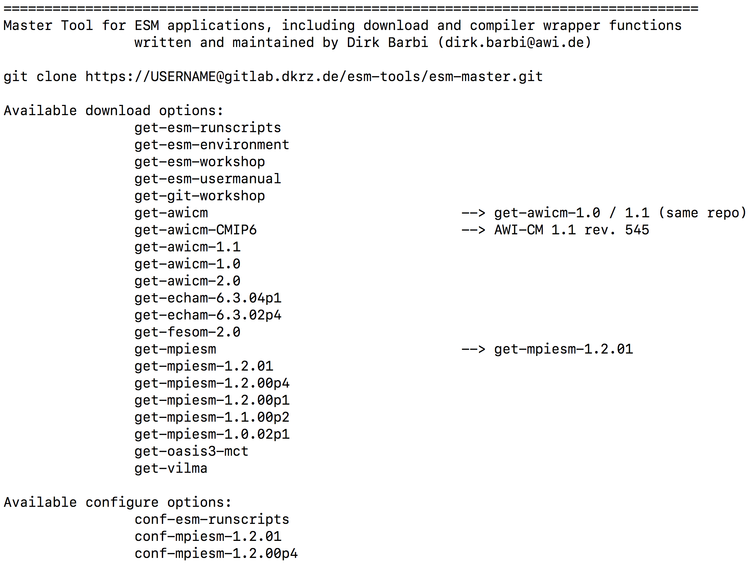
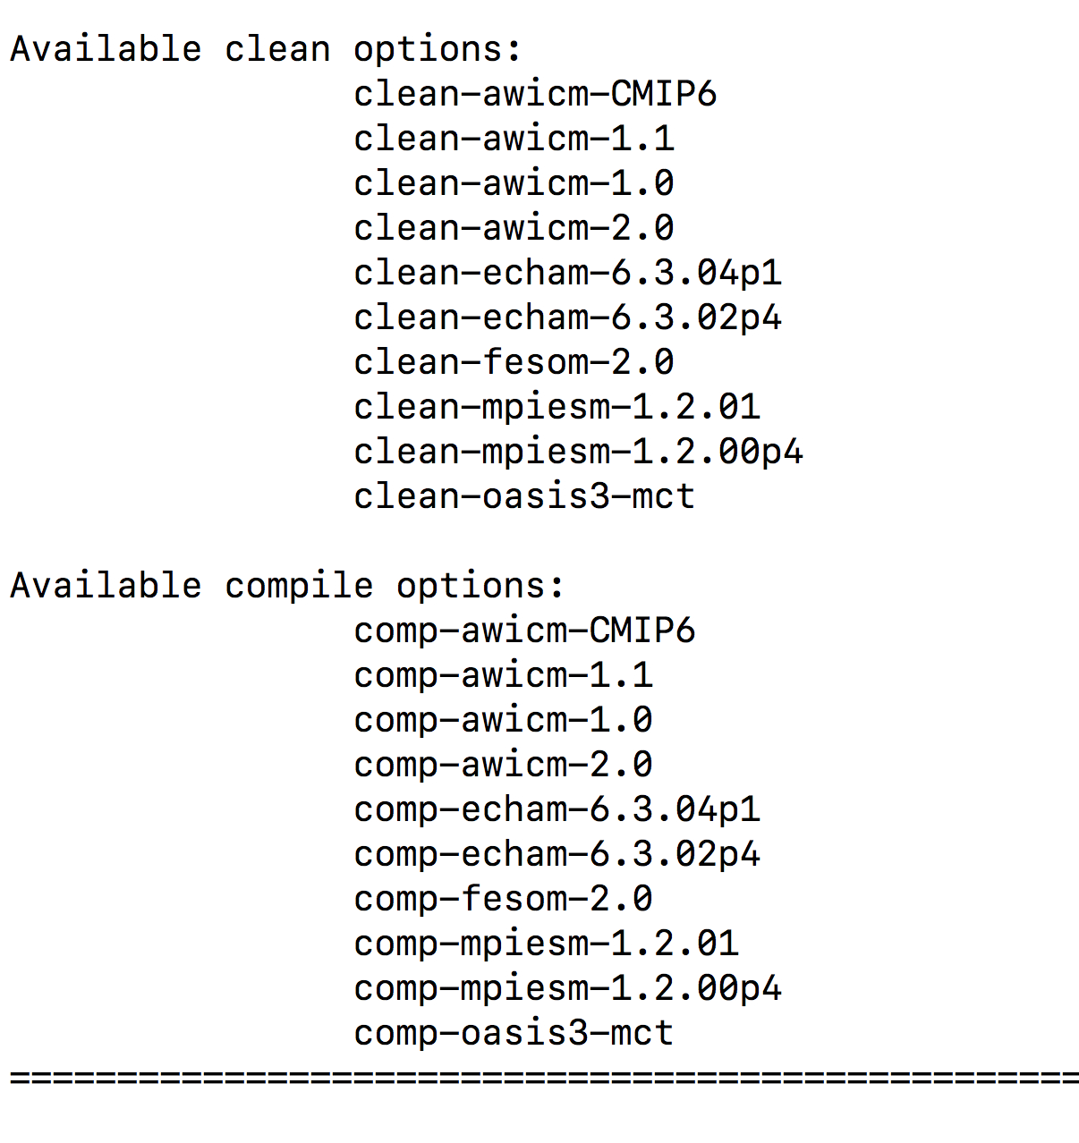
List of available targets
Type
`make`
to see what esm-master can do for you:

Slide 5
Use esm-master to download stuff…
`make get-stuff-version`
will download the named version of software tool "stuff " using svn or git, if the user has access to the repository of "stuff ".
The tool does not replace the permission of the owner of the repository!

Slide 6
…to configure stuff…
'make conf-stuff-version'
Some models require configuration before compiling, e.g. mpiesm.
The tools esm-master and esm-runscripts also can be configured, and by default will be by 'make get-‘. In this case,
calling 'make conf-‘ will restart the configuration steps.

Slide 7
…to compile stuff…
'make comp-stuff-version'
esm-master will trigger the models‘ own compile systems, rather than replace them. If present, the environment setting will be read from
esm-environment
(advised); if not, model defined settings will be used.
Compiled models are registered in esm-master.conf.

Slide 8
…and to clean stuff.
'make clean-stuff-version'
esm-master will trigger the models‘ own compile systems, rather than replace them. If present, the environment setting will be read from
esm-environment
(advised); if not, model defined settings will be used.

Slide 9
Metarepositories
esm-master can assemble an ESM from seperate component repositories, e.g. awicm-2.0.
This happens invisible to the user.

Slide 10
Learn more:
Check out the documentation, available by typing
'make get-esm-usermanual'
or
'git clone https://gitlab.dkrz.de/esm-tools/esm-usermanual.git'

Slide 11
More to come:
Support for more models (oifs, nemo, RecoM, …)
make update-…
database keeping track of what you compiled / ran with which versions of the esm-tools
any ideas from your side (Please let me know, dirk.barbi@awi.de, -1561)

