Slide 1

Infrastructure for Earth System
Modelling
ESM User Workshop May 2019

Slide 2
Agenda
01
What are the ESM-Tools?
A unified infrastructure for ESM modelling
02
Who benefits?
The Tools are designed to simplify the work of modelers, model developers, software supporters and HPC admins.
03
How are the ESM-Tools developed?
Developed within the ESM project, the Tools have more than 30 authors from 6 institutes. Main development is done at AWI.
04
How can I get the ESM-Tools?
ESM-Tools can be obtained for free, it is open source under GPL.

Slide 3
What are the ESM-Tools?
Models
Coupled Setups
The Tools provide an easy and standardized way to obtain, configure and compile model components. As of May 2019, we support 10 independent components, including 4 ocean, 2 atmosphere, 1 ice sheet, 1 BGC, 1 GIA model and a coupler, all organized under version control.
M
C
Out of the mentioned models, a variety of coupled systems can be combined. A graphical interface helps choosing the wanted components. Among the supported combinations are MPIESM, AWICM (1 and 2), FESOM-OIFS and FOCI-OIFS.
MODELS
HARDWARE
COUPLED SETUPS
DATA
Hardware
H
D
Data
Currently the Tools are running on 6 HPC systems, holding the machine specifications in a central place that can be used by the models during compile and run time, leaving more time for the user to focus on scientific questions.
  The life cycle of model data has become increasingly important. The tools try to help – by referring to standardized input data pools, managing model output and restarts, and functionality for tar-balling and archiving data. CMOR support is planned.

Slide 4
Obtaining models
esm-master
run
make comp-
Compile your models with a simple one-liner, independent of the model or HPC system
make conf-
Adapt the software to the hardware you are using
make get-
Choose from 10 components and numerous coupled setups
to obtain the model you want
compile
configure
obtain

Slide 5
Running Simulations
esm-runscripts
Small runscripts
Focus on your simulation, defaults are pre-defined. Typically around 40 lines, similar for all models.
Input / Forcing Data
The Tools organize the data, recognizing standard data pools on the machines.
Runtime Functionality
A lot of nice stuff – restarts, monitoring, iterative coupling,
Output Data
Model Output is automatically sorted and postprocessed, even tarred and archived.
Reproducibility / Documentation
Simulation folders contain (almost) everything, and a ton of log files provide all the information to re-run or continue a simulation.

Slide 6
Who benefits from the Tools?
1st
System Admins
3rd
Modellers
Standardized Compile and Runtime Environments means fewer needed software packages. Deploy optimal machine settings or new modules easily.
Run your simulations in an easy and unified way, independent of the model and hardware. Have lots of functions with a few lines of runscript.
2nd
Model developers
4th
Model supporters
Organize your developments, deploy them on different machines. Co-work with other institutes on the same code.
Solve problems once, not over and over again. Deploy bugfixes / new hardware configurations quickly to all users. Same experiment layout also means less context switching.

Slide 7
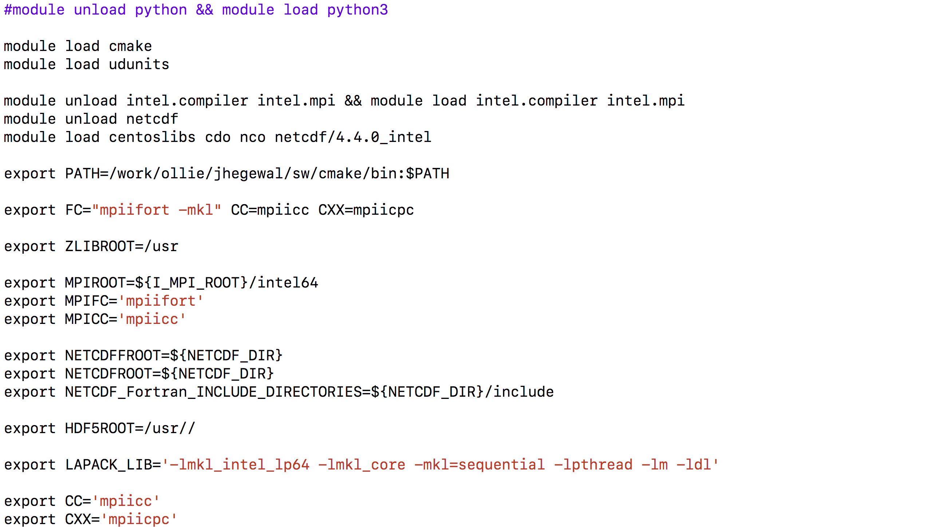
System Admins
A group of users all use the same configuration file – solve problems once, and deploy the solution quickly.
Provide an “optimal” standard configuration to your users.
Get less requests for additional tools / packages or incompatible combinations.
Get a reduced ’.sad’ – runscript only containing the information needed by the batch system. (WIP)

Slide 8
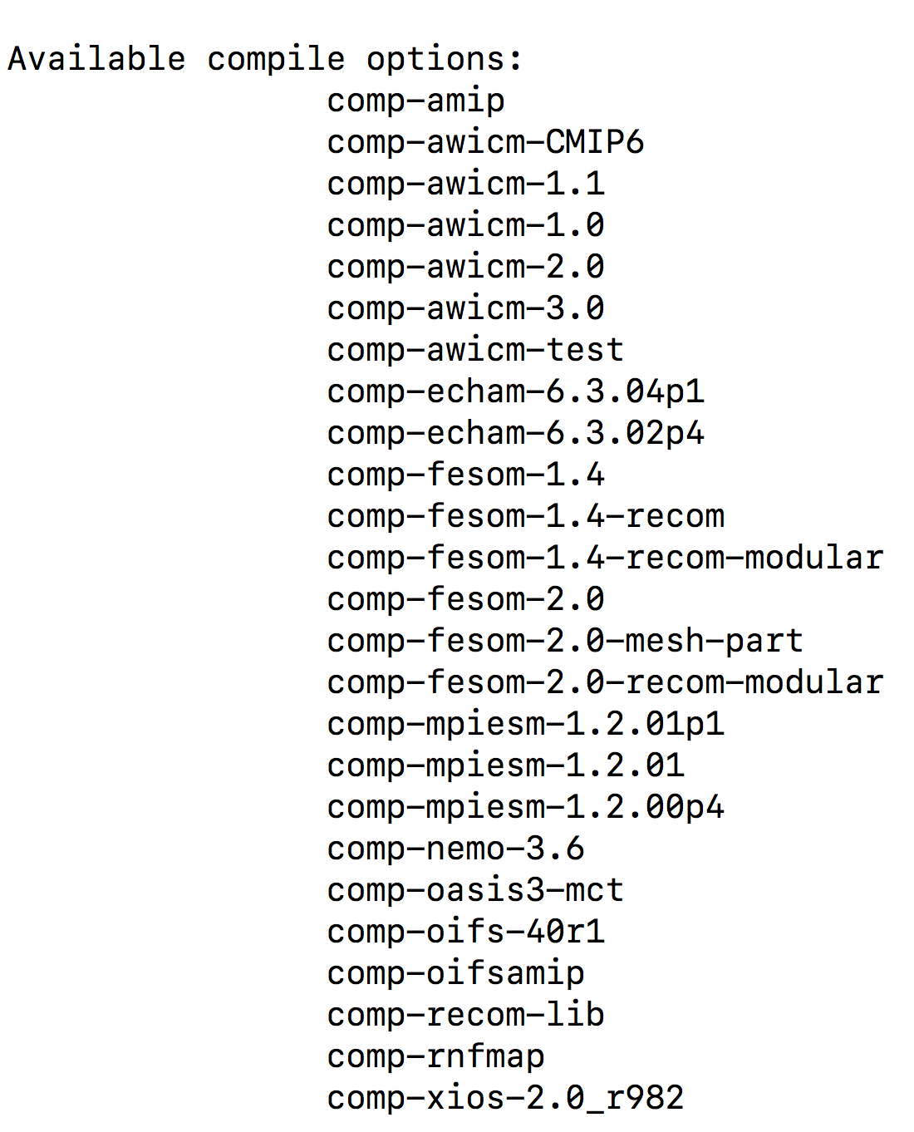
Model Developers
Concentrate more on your model, and less on the technical side
The ESM-Tools provide standard configurations for a number of HPC systems. Chances are good that you can compile and run your development on these out of the box.
Get your developments to the users
New standard versions of your codes can be distributed with esm-master.
Runscripts with a ton of functions for a new model - without coding
All you need in a runscript is already there. You can just go and use it.

Slide 9
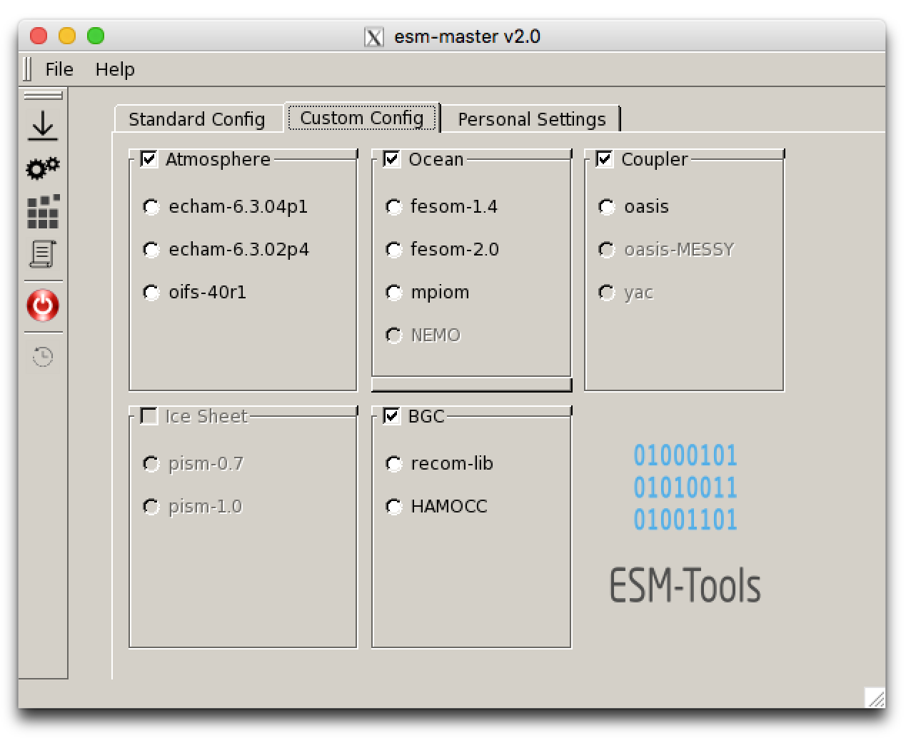
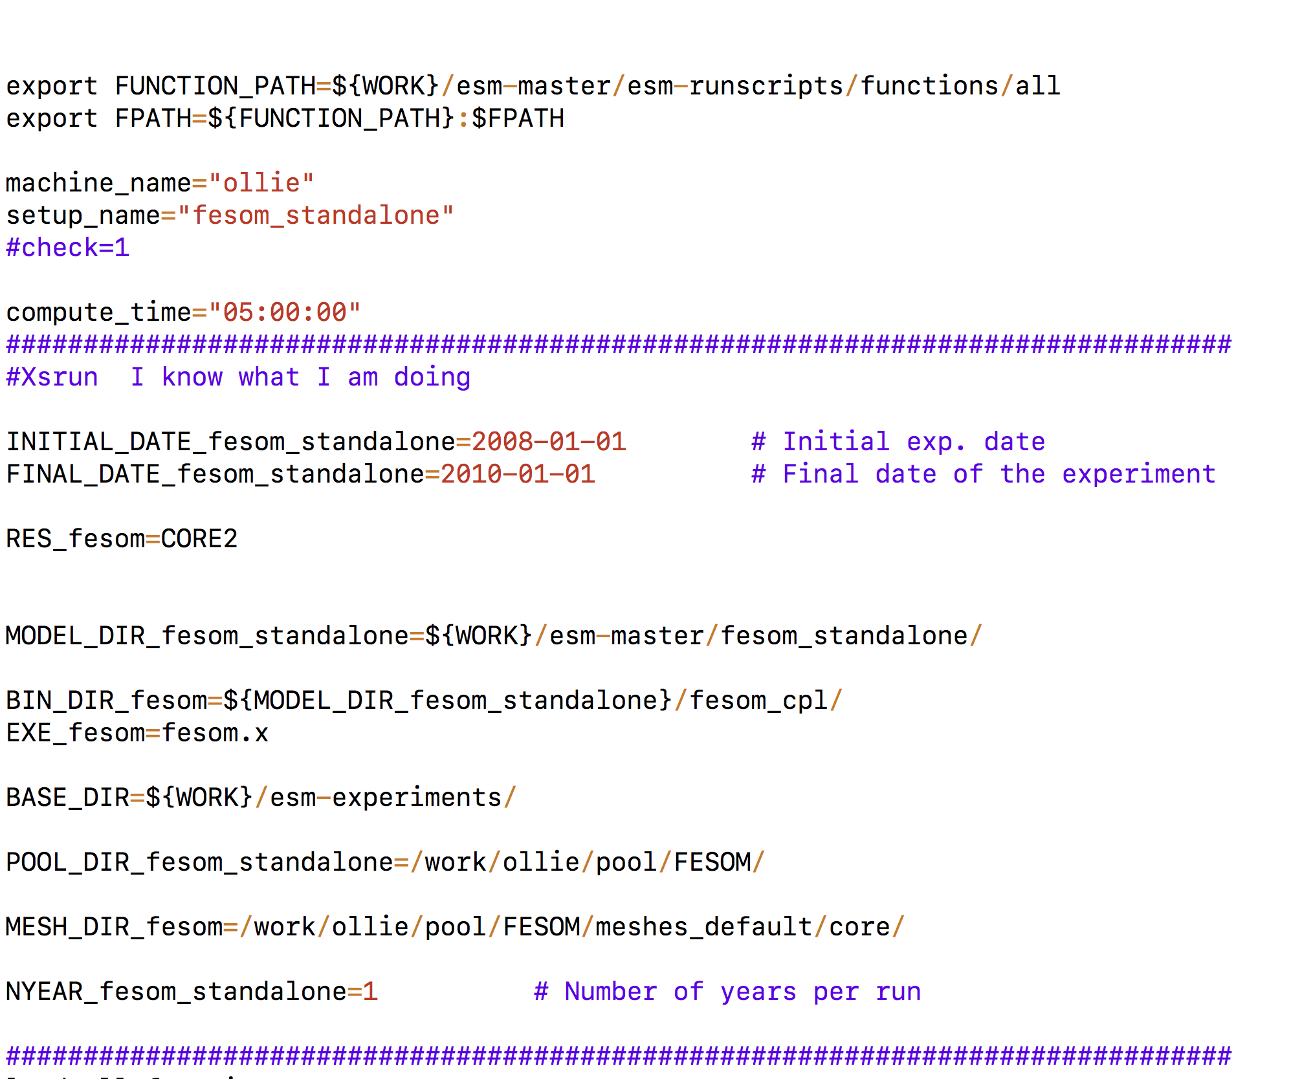
Modellers
Easy access to a huge variety of model components and coupled setups
Start running simulations quickly. With a steep learning curve.
New colleague, about to work with an unknown model? Maybe even new to programming, shell scripting, HPC?
Changing to a new model (system), maybe for intercomparison, or exchanging one implementation of a model with a different one?
Changing to a different HPC system?
Getting lost in too many simulations, and needing an automatic way to ”document” them?
Short (but do-it-all) runscripts, almost independent of the model and hardware you use

Slide 10
Model Support
One environment configuration
If anything goes wrong with the environment, you know where to look.
One runscript
Effectively people can use the same runscript for a variety of models, so no need to work through a new one each time. Plus ESM-Tools support.
Automatic testing
You can know about problems before your users do, and also where it might come from.
Deploy solutions
Once a problem is fixed, the solution can be picked up by all users directly.

Slide 11

Kiel
ESM-Tools distribution
GEOMAR : NEMO / FOCI-OIFS
CAU: Metos3D
Bremerhaven
AWI : ESM-Tools, FESOM, REcoM,
AWICM, PISM
Potsdam
AWI : Echam / ICON
GFZ: VILMA
Supported machines:
AWI: ollie
JSC: juwels, jureca
HLRN: blogin, glogin
DKRZ: mistral
Bonn
Uni Bonn : MESSY / EMACS
Oberpfaffenhofen
DLR : MESSY / EMACS

Slide 12
Timeline
01/2017
05/2017
08/2017
04/2018
09/2018
10/2018
03/2019
09/2019
First steps
Concept:
ESM-Tools
Release 1
Release 2
“easy-scripts”
as self-defense against a chaos of user scripts
1st release of core functionality
10 model components /
6 HPC systems /
30 authors /
1300 commits
Growing beyond the “easy-scripts”, integration of esm-interfaces
1st external partners
Release 3
ESM@HGF
1st ESM@HGF coupling meeting
New code base (python), extended GUI, web interface prototype, ICON, YAC, …
Kickoff meeting of the Helmholtz ESM project
GEOMAR / NEMO-OIFS
prototype and concept widely accepted by the ESM project members

Slide 13

Development strategy
ESM-Tools TEAM@AWI
Model Developers
Nadine Wieters, Dirk Barbi, Luisa Cristini
(Paul Gierz)
New colleague (position is open for applications) starting in summer ‘19.
All component models are available in VCS repositories, most of them in modular_esm. Frequent communication ensures that the versions are up-to-date. Regular tagging.
gitlab.dkrz.de/modular_esm
gitlab.dkrz.de/esm-tools
Model Users
System Admins and Supporters
Reporting problems using the issue tracking system of gitlab helps us to provide quick solutions.
Contribute changes in the machine settings and bugfixes back to the Tools to deploy them.

Slide 14
How can I get the ESM-Tools?
https://gitlab.dkrz.de/esm-tools
(https://gitlab.awi.de/esm-tools)
Contact us:
info@esm-tools.net
0471/4831-1561 /
www.esm-tools.net
twitter.com/ToolsESM

Slide 15

Get the Tools

Slide 16
Getting the esm-tools
Suggested workflow (1)
download / configure esm-master
download esm-environment
download esm-runscripts
( optional:
download esm-usermanual )
download your model / setup
Suggested workflow (2)
download esm-tools installer
download your model / setup
run installer

Slide 17
Download esm-master
git clone https://gitlab.dkrz.de/esm-tools/esm-master.git
(git clone https://gitlab.awi.de/esm-tools/esm-master.git)

Slide 18
Configure esm-master
In the esm-master folder, type
make
and answer the questions that pop up. The configuration is written to a file called
esm-master.conf
which can be edited by hand. If it is messed up, remove it, or run
make conf-esm-master

Slide 19
Download esm-environment
In the esm-master folder, type:
make get-esm-environment
(Same as:
git clone https://gitlab.dkrz.de/esm-tools/esm-environment.git )

Slide 20
Download esm-runscripts
In the esm-master folder, type:
make get-esm-runscripts
(Same as:
git clone https://gitlab.dkrz.de/esm-tools/esm-runscripts.git
cd esm-runscripts/functions
./set_links
cd ../.. )

Slide 21
Download esm-usermanual
In the esm-master folder, type:
make get-esm-usermanual
(Same as:
git clone https://gitlab.dkrz.de/esm-tools/esm-usermanual.git )
Or:
Download the pdf from www.esm-tools.net

Slide 22
Shortcut 1:
After downloading and configuring esm-master, type:
make get-esm-tools
(Same as:
make get-esm-environment
make get-esm-runscripts
make get-esm-usermanual )

Slide 23
Shortcut 2:
Download and run the esm-tools installer:
git clone https://gitlab.dkrz.de/esm-tools/esm-tools.git
cd esm-tools
./install.sh
In this case, esm-master still needs to be configured!

Slide 24
Three ways to get the Tools
git clone https://gitlab.dkrz.de/esm-tools.de/esm-master.git
cd esm-master; make
make get-esm-environment
make get-esm-runscripts
make get-esm-usermanual
01
git clone https://gitlab.dkrz.de/esm-tools.de/esm-master.git
cd esm-master; make
make get-esm-tools
02
git clone https://gitlab.dkrz.de/esm-tools.de/esm-tools.git
cd esm-tools
./install.sh
Contents
03
Add Text Here

Slide 25
How can I get Information / Documentation?
www.esm-tools.net
https://gitlab.dkrz.de/esm-tools
Contact us:
info@esm-tools.net
0471/4831-1561 /
www.esm-tools.net
twitter.com/ToolsESM

