Slide 1

esm-runscripts
Overview

Slide 2
1st: Download esm-runscripts
Three possible ways:
git clone https://gitlab.dkrz.de/esm-tools.de/esm-master.git
cd esm-master; make
make get-esm-environment
make get-esm-runscripts
make get-esm-usermanual
01
git clone https://gitlab.dkrz.de/esm-tools.de/esm-master.git
cd esm-master; make
make get-esm-tools
02
git clone https://gitlab.dkrz.de/esm-tools.de/esm-tools.git
cd esm-tools
./install.sh
Contents
03
Add Text Here

Slide 3
esm-runscripts - folder layout
esm-runscripts
functions
namelists
runscripts
testing
all
echam
fesom
echam
fesom
awicm
6.302p4
6.304p1
ESM-Tools
PI-CTRL
HIST
PALEO
Model
Coupled setup
Model version
Scenario

Slide 4
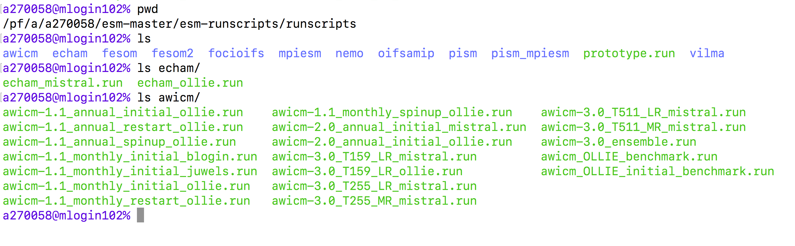
Subfolder: esm-runscripts/runscripts/awicm
The subfolder runscripts contains a collection of example runscripts, which have worked at some time at should in principle still be functional.
These need to be adapted, e.g. user defined paths, account information etc. need to be changed.
Best practice: Copy one of the runscripts somewhere else, and edit and run from there, not in this folder.

Slide 5
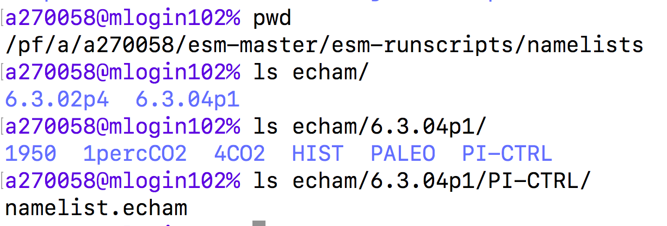
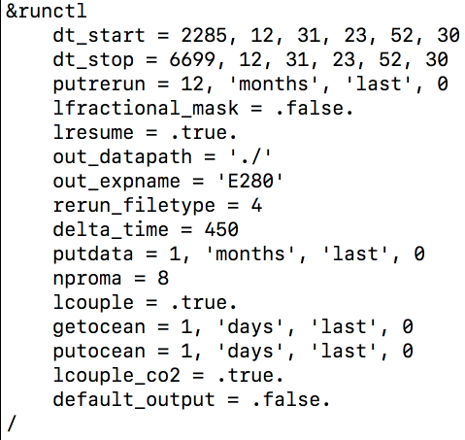
Subfolder: esm-runscripts/namelists/echam/6.304p1/PI-CTRL
Default namelists are sorted in a certain way:
model / version / scenario / resolution
(those that apply)
Namelists changes can be applied in a number of ways – by changing the default file, by defining a different namelist, or by defining changes directly from the runscript.
Best practice: Small changes from the runscript, bigger changes in a new file NOT in this folder.

Slide 6
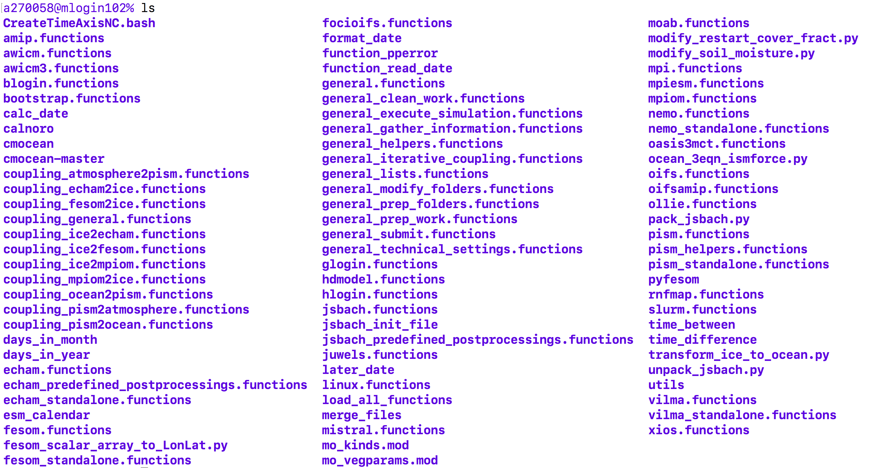
Subfolder: esm-runscripts/functions
esm-runscripts/functions contains dozens of SHELL and PYTHON functions, sorted into folders. A special folder is
all
that contains links to all functions. all is setup by the script set_links.sh – if something goes missing, it is save to remove
esm-runscripts/functions/all
and then call
./set_links.sh

Slide 7
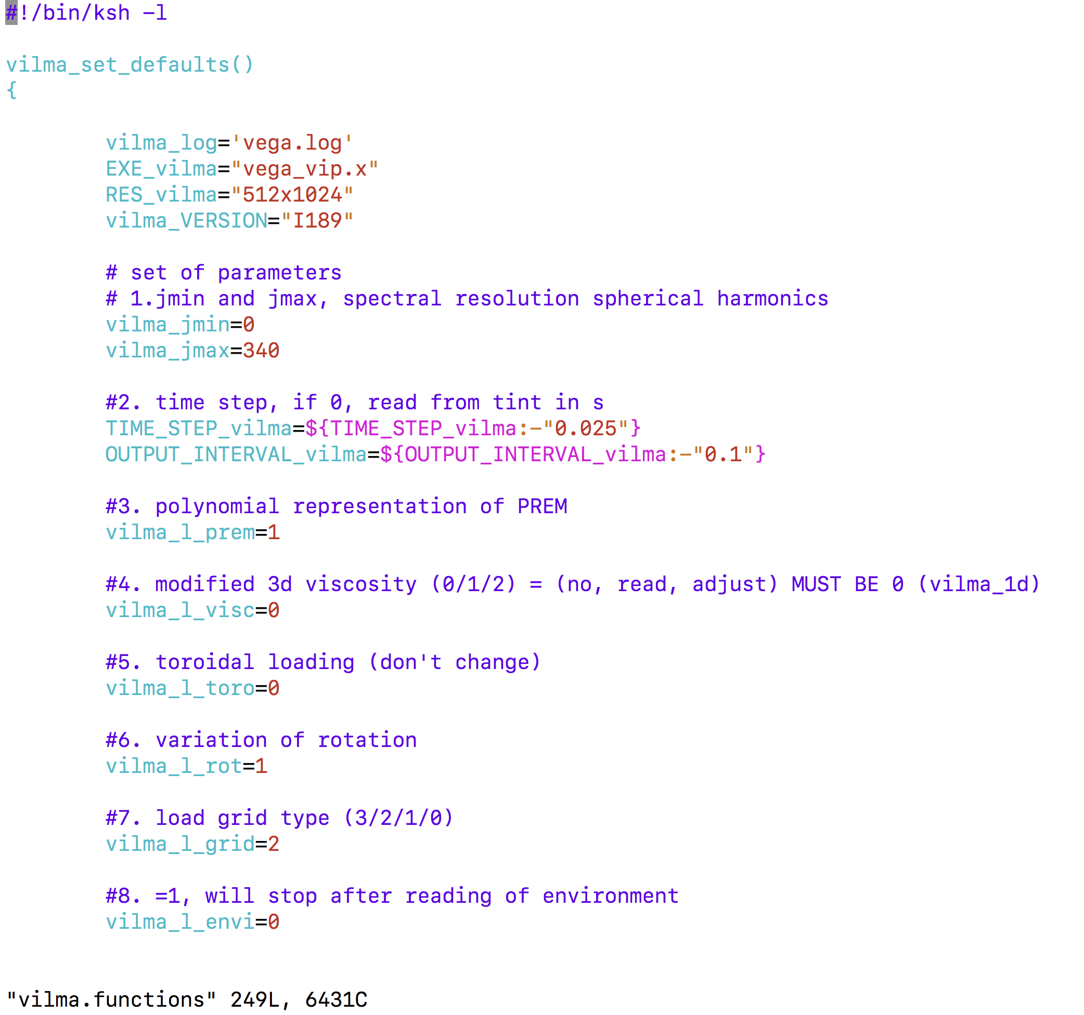
functions you can edit
You can / sometimes need to modify some of the functions. It is quite safe to edit model / setup / machine functions.
These are named in a certain way, e.g.:
echam_set_defaults
echam_prepare_forcings
echam_cleanup
These are called automatically from the general functions.
This will be much nicer once we release the python version.

Slide 8
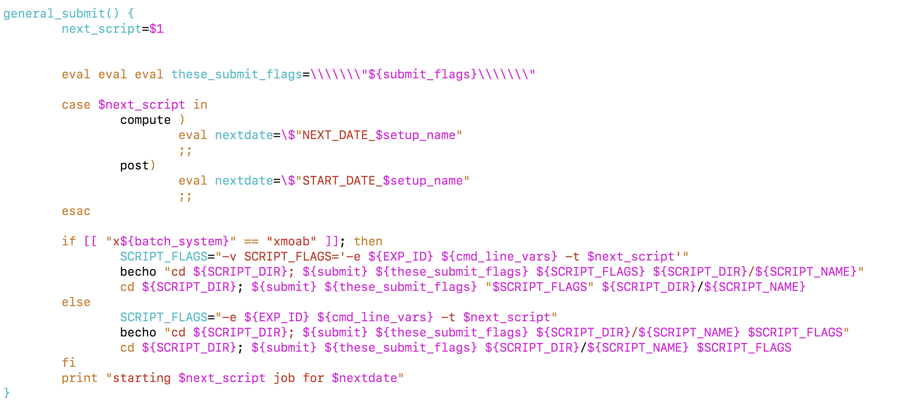
functions you shouldn’t edit
Some functions have grown for a long while,becoming more and more abstract and difficult to change. Especially, these are the ones starting with
general_*
Be prepared for total carnage if you try to change some of these.This is also why we recode this part in python.
Good news: No real reason to
touch these.

Slide 9
Adapt esm-runscripts
Changes that can potentially be helpful for other users should be commited back…
It‘s an OpenSource project after all!
Adaptations needed often
Runscripts: Copy one to the default scripts somewhere, and adapt paths and user information. Add details for your simulation
Namelists: Make small namelist changes from the runscript, bigger ones by copying one of the default namelists somewhere, editing them, and then referring to them from the runscript.
Adaptations needed rarely
Model / setup functions: E.g. defining a new scenario needs changes to the model functions
esm-environment: If the machine / your needs change, that should be done here.
No changes
If you need changes to the general functions – maybe ask us, info@esm-tools.net.

Slide 10
Basic runscript functionality
01
Prepare Input Data
Initial data, forcing data, config files (namelists) and executables are copied into distinct folders, you get a report about what isn’t found.
02
Apply changes
Namelist changes, restart file manipulations etc. are performed in the experiment folder, and documented.
03
Prepare work folder
Link the previously prepared files into the work folder. When launched as a ‘check’ the run will stop here, and report.
04
Execute and monitor
During the actual execution of the simulation, error and graphical monitoring can provide online information about your run.
05
Cleanup output and restart files
After successful ending of the simulation, restart files and output files are sorted and copied to the folder structure.
06
Asynchronous postprocessing
In separate jobs, postprocess your data. Default postprocessing methods are pre-defined. Tar and archive.
06
Data base registering
WIP: Register your work in a personal / project data base, let others know where to find model results.

Slide 11
First standard run
Example:
awicm-test

Slide 12
1st: Download esm-tools
Three possible ways:
git clone https://gitlab.dkrz.de/esm-tools.de/esm-master.git
cd esm-master; make
make get-esm-environment
make get-esm-runscripts
make get-esm-usermanual
01
git clone https://gitlab.dkrz.de/esm-tools.de/esm-master.git
cd esm-master; make
make get-esm-tools
02
git clone https://gitlab.dkrz.de/esm-tools.de/esm-tools.git
cd esm-tools
./install.sh
Contents
03
Add Text Here

Slide 13
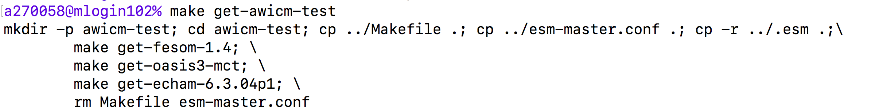
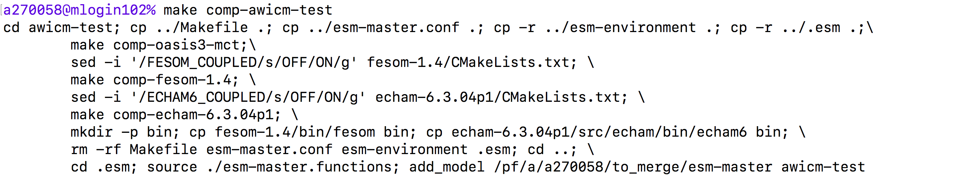
2nd: Download / configure / compile the model
From the esm-master folder, type:
make get-awicm-test
make comp-awicm-test

Slide 14
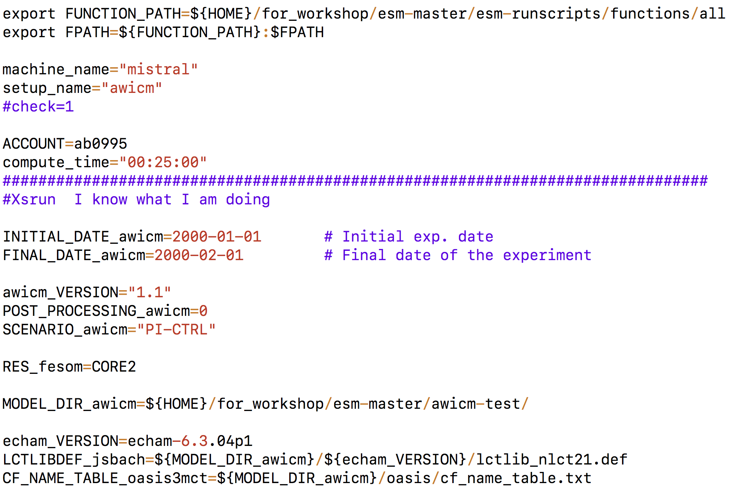
Pick a sample runscript
From the esm-runscripts/runscripts/ folder, pick an example script, and copy it to a save place to edit it later:
mkdir scripts; cd scripts
cp esm-runscripts/runscripts/awicm/awicm-1.1_monthly_initial_ollie.run awicm.run
There are plenty of runscripts available,
depending on the machine you are about
to use, whether you want monthly or yearly
restarts, initial or restart from a previous run…

Slide 15
Adapt the runscript
There are a couple of entries in the runscript you need to adapt:
FUNCTION_PATH: full path to esm-runscripts/functions/all
ACCOUNT: on some machines, an account (like ab0995 on mistral)
needs to be given
machine: name of the computer you want to use (ollie, mistral,…)
INITIAL_DATE_awicm: Start date of your simulation
FINAL_DATE_awicm: End date of your simulation
NYEAR_awicm: Number of years per restart (default: 1)
NMONTH_awicm: Number of months per restart (default: 0)
MODEL_DIR_awicm: full path to esm-master/awicm-CMIP6
BIN_DIR_awicm: full path to esm-master/awicm-CMIP6/bin
POOL_DIR_echam: full path to input/forcing data pool ECHAM
POOL_DIR_fesom: full path to input/forcing data pool FESOM
MESH_DIR_fesom: full path to FESOM meshes

Slide 16
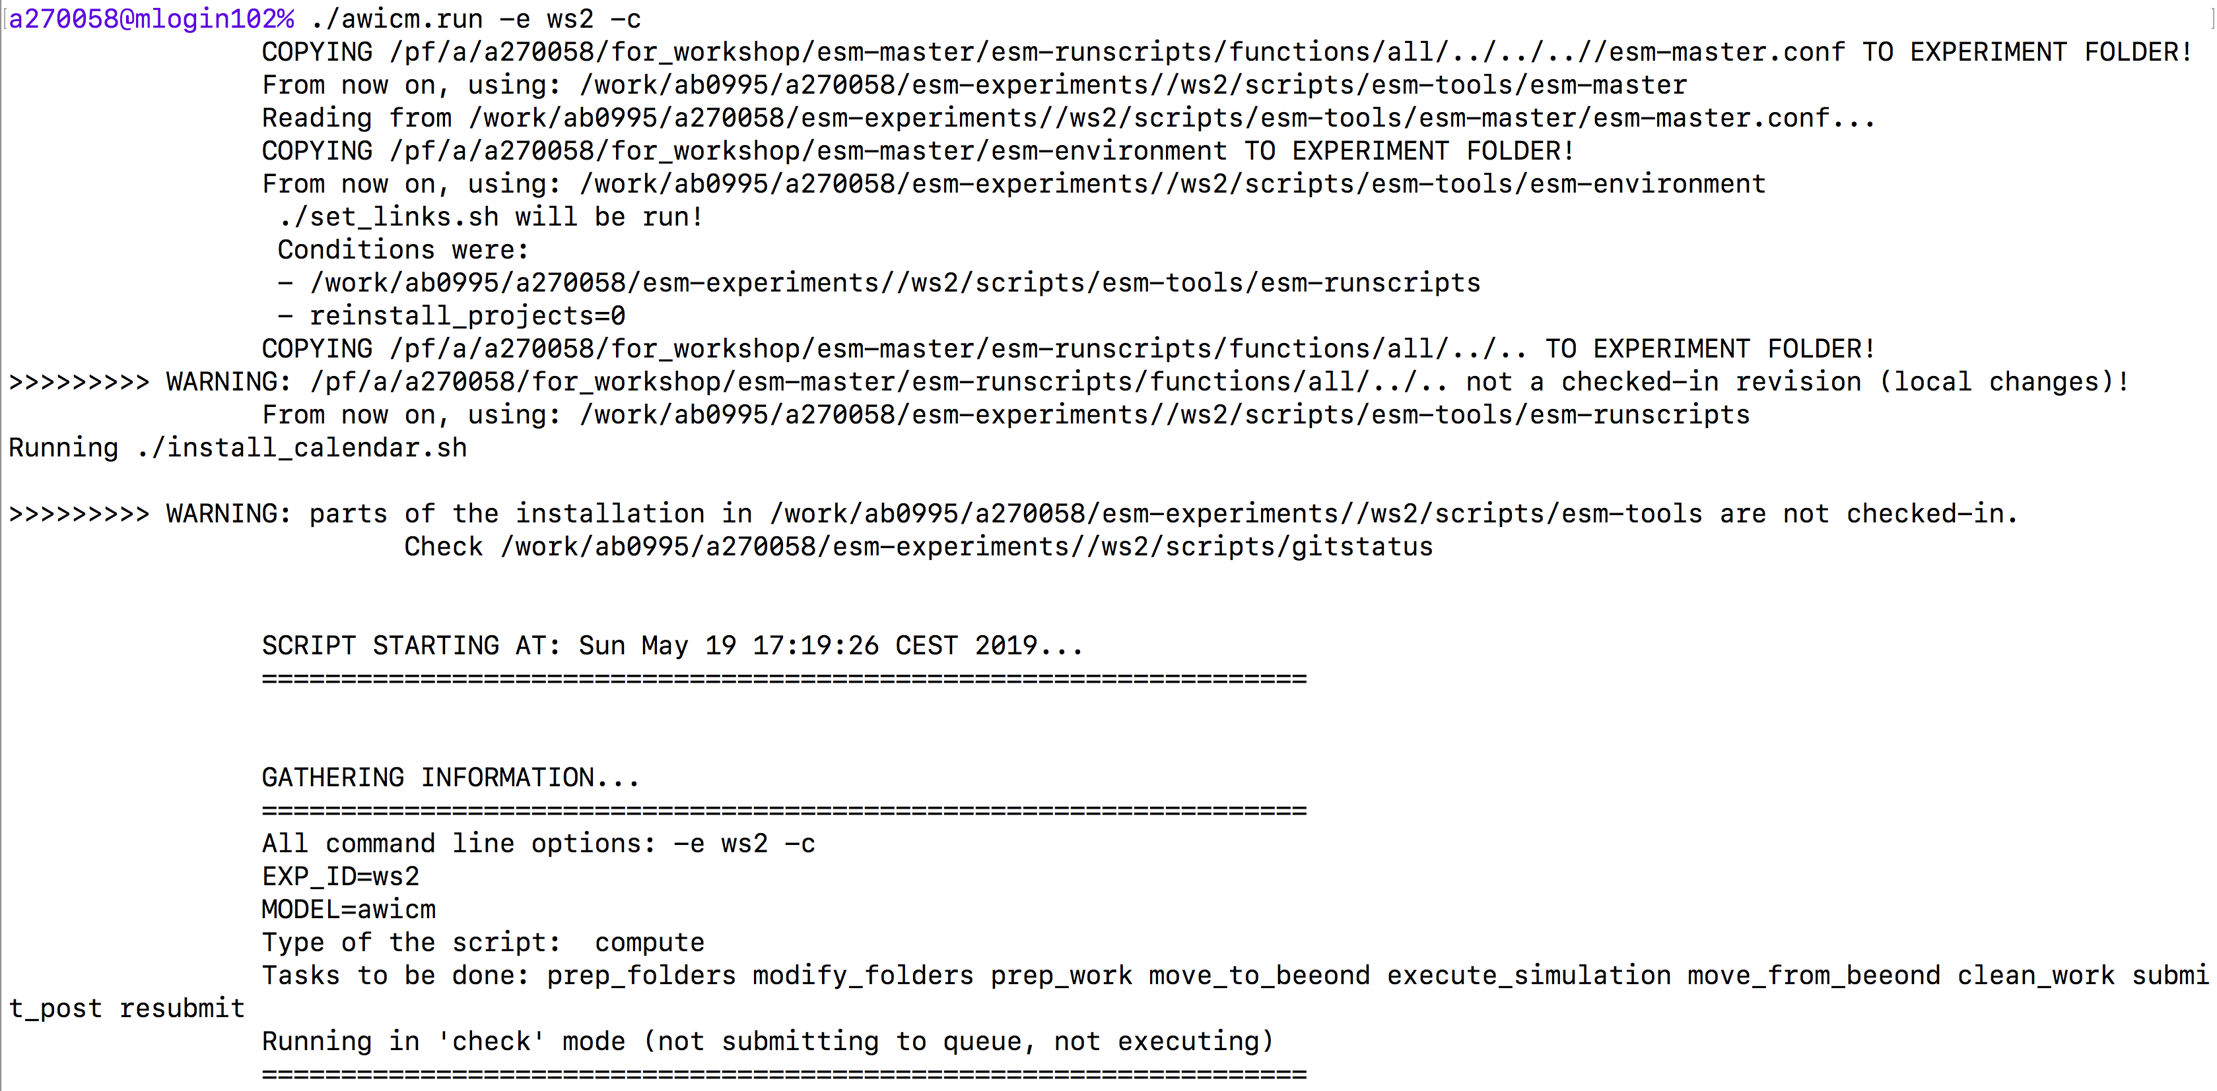
run a first check
Launch the runscript with:
./awicm.run –e mytest –c
This starts the run on the login node, doing everything but does not start the actual execution. Gives a report. Results go to
$BASE_DIR/$EXP_ID

Slide 17
Phases of the run
BASE_DIR
Prepare Files
Cleanup
Creates main exp folder and copies ESM-Tools to scripts (1st run only).
Files are copied to the experiment folders, the manipulated, then brought to work.
Take the written logs, output, restarts,… and sort them back to the folders
Collect
Execute
Resubmit
BASE_DIR
Prepare
Cleanup
Collect
Excecute Run
Resubmit
Information about the run, the needed data, calendar etc. is collected
The actual simulation
Submits Postprocessing and next run.

Slide 18
Experiment - folder layout
$BASE_DIR/$EXP_ID
scripts
log
input
forcing
restart
config
outdata
work
post_***
esm-tools
echam
oasis
awicm
fesom
Top Level for this experiment
Runscripts, main log files, date files
Model
Main work folder
Coupled setup
Maybe: One / more post folders
Data types (sorted)
Copy of the ESM-Tools

Slide 19
Main log files
01
scripts/$EXPID_compute_$JOBID.log
Standard output of the runscript / your job
02
scripts/$EXPID_$setup_name_compute.log
Main experiment tracking file, just the info
03
log/awicm/*.dump
“Dump” file containing a lot more output from the runscript, not easily readable
04
scripts/gitstatus (if exists) and scripts/esm-tools/*/gitstatus
Contains the information about the version of esm-tools you are using, also local changes
05
scripts/setup*.txt and forcing/awicm/setup*.txt (and other folders)
Keeps track about the files that were copied for use in your experiment
06
scripts/missing*.txt and forcing/awicm/missing*.txt (if exists)
Keeps track about files that should have been copied, but were not found.

Slide 20
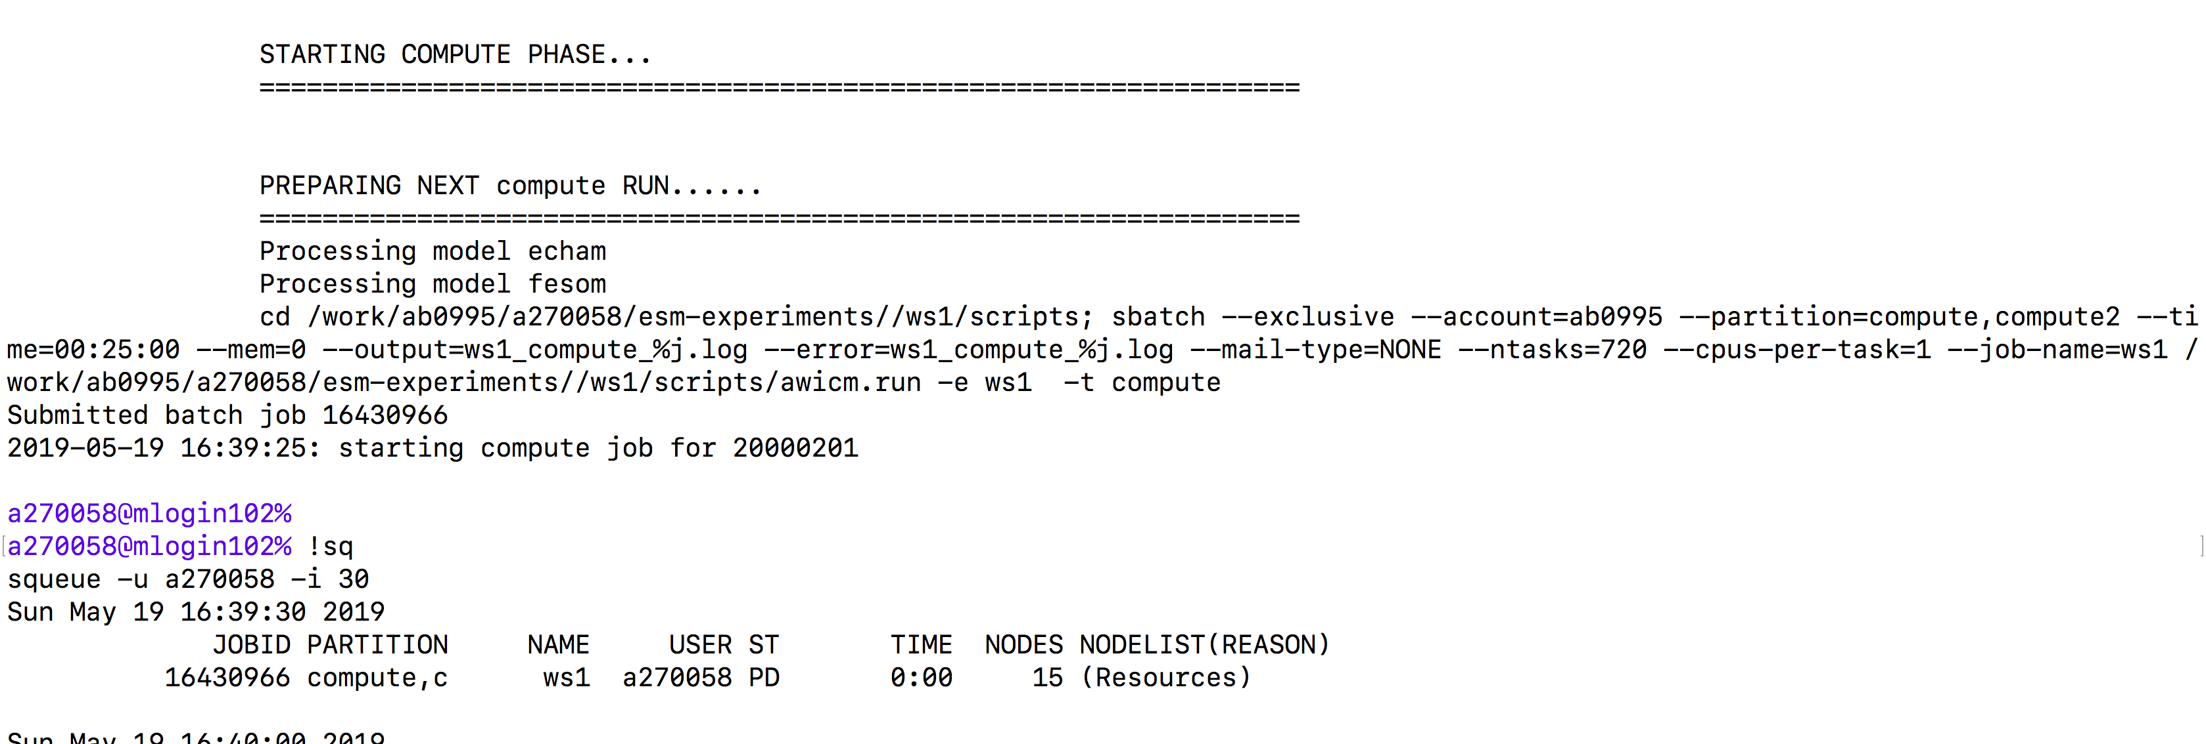
Start the actual simulation
Start your simulation with:
./awicm.run –e myrun
You will see less output than from the check. In the end, the job submits itself to the batch system.

Slide 21
Congratulations!

