Slide 1
ESM–TOOLS
An Overview
Mitarbeitertag June 14, 2018
Dirk Barbi, Nadine Wieters

Slide 2
ESM-Tools
Download, compile and run (all) your models in a standard way
Developed and maintained @AWI
You can find us at:
Dirk.Barbi@awi.de
Nadine.Wieters@awi.de
https://gitlab.dkrz.de/esm-tools

Slide 3
ESM-Tools - Overview
esm-master
Get the esm-tools; download, configure and compile your models
esm-environment
Collection of machine setting, can be used by esm-master / models to compile or esm-runscripts to run models
esm-runscripts
Unified and short runscripts for your models, supporting iterative coupling, hyperthreading, beeond, shortcuts for namelist changes
Implemented for:
FESOM 1.4 and 2.0
ECHAM 6.302 and 6.304
AWICM 1 and 2
MPIESM 1.2.00p4 and 1.2.01
PISM 1.0
PISM-MPIESM and PISM-AWICM
esm-usermanual
Documentation, How-to section, description of default settings
esm-workshop
Workshop on ESM-Tools:
June 18/19 2018,
Konferenzzimmer Kantinenturm
as well as the slides used for it (including this talk).

Slide 4
Suggested usage of the esm-tools
esm-master
esm-environment
esm-runscripts
esm-usermanual
esm-workshop

Slide 5
1. esm-master
Download, configure and compile your model

Slide 6
esm-master
Makefile-based tool to
download (e.g. make get-mpiesm-1.2.01)
configure (e.g. make conf-mpiesm-1.2.01)
compile (e.g. make comp-mpiesm-1.2.01)
Typing „make“ gives you a detailed list of available commands.
Also gives you access to
the other esm-tools,
the slides of the git-workshop, and
the slides of the esm-tools workshop.
Integration with esm-environment
If esm-environment exists in esm-master folder, all compiling is performed using the machine settings from there.
Integration with esm-runscripts
If esm-runscripts exists in esm-master folder, esm-master will generate a prototype runscript for the model after compiling it.
Get it from: https://gitlab.dkrz.de/esm-tools/esm-master

Slide 7
2. esm-environment
All the machine-relevant settings in one place

Slide 8
esm-environment
Collection of files containing the (optimal) settings for each machine, e.g. ollie.awi.de, mistral.dkrz.de, …
sets module files
sets environment variables
is by default used by esm-master to compile models
can be used by esm-runscripts to run simulations
Advantages:
Share optimal settings for (new/changed) machines easily
No contradicting settings between compilation and run
esm-environment is based on the cmake-build-system developed by Jan Hegewald for awicm.
Get it by using esm-master (make get-esm-environment),
or from: https://gitlab.dkrz.de/esm-tools/esm-environment

Slide 9
3. esm-runscripts
Run all your models with short, easy, and almost identical runscripts

Slide 10
esm-runscripts
Huge set of functions, containing the script blocks depending on
(machine)
operating system
batch system
coupled setup
component models
as well as a layer for general functionality.
Needed user input:
Models used
Resolution
Integration period
Defaults exist for:
Physical parameters
Slurm settings
Model Partitioning
All defaults can be overwritten easily!
Get it by using esm-master (make get-esm-runscripts),
or from: https://gitlab.dkrz.de/esm-tools/esm-runscripts

Slide 11
esm-runscripts – more than runscripts
Optimize
Choose hardware based options like hyperthreading, beeond etc. by setting simple flags, like
use_beeond=1
Organize
All data is automatically organized neatly in subfolders of the experiment folders,
e.g.
forcing/echam
(also init, output, restart, log, config, scripts)
Document
All relevant data (origin of input files, parameter settings, machine settings, namelist configurations, runscript itself etc.) are saved to log files nicely.

Slide 12
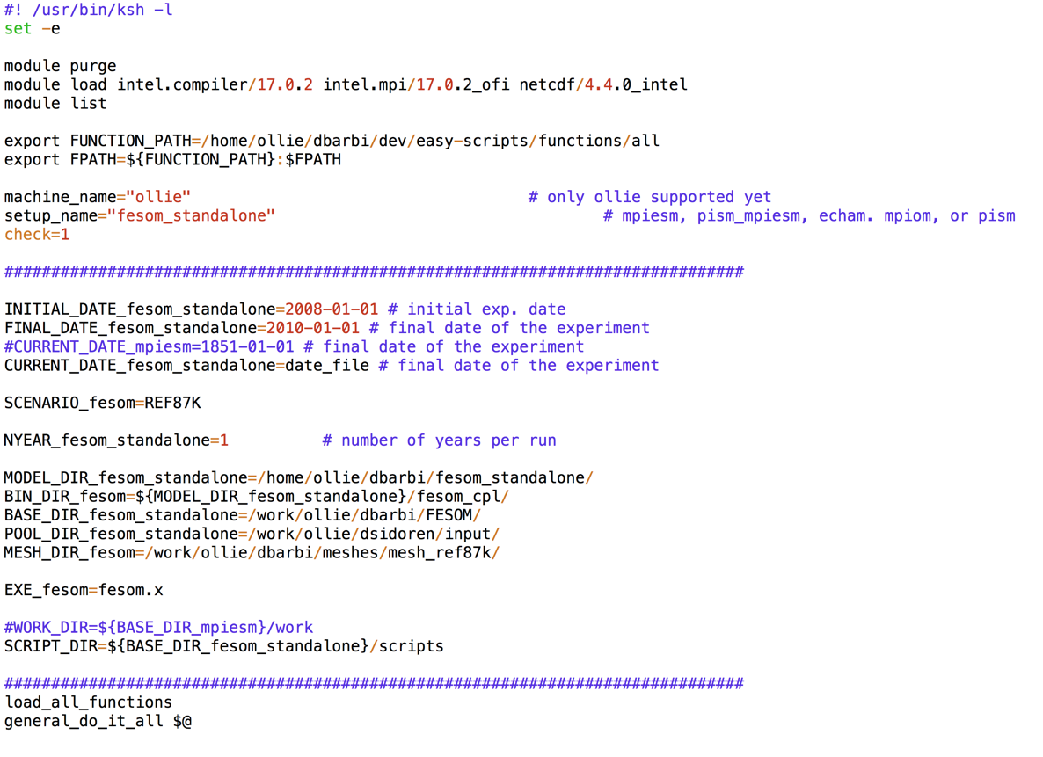
fesom-runscript?
That‘s all!

Slide 13
MODULARITY
As first step towards building a framework for Modular Earth System Modelling, the esm-runscripts are themselves implemented in a modular way.

Slide 14
esm-runscripts – main benefits
Get to a running simulation quickly
Combine two setups for offline coupling
Consider only the scientific side, not the technical side
Directly compare model runs from different models
Have all the functionality you want (or ask us for it)

Slide 15
No work is so much fun that you should do it twice.
(Someone.)

Slide 16
4. esm-usermanual
Documentation (really!)

Slide 17
esm-usermanual
Documentation of:
All feature available in the esm-tools
„How-to“ get started quickly
Default settings
Known issues
Open project – feel free to add content!
Get it from: https://gitlab.dkrz.de/esm-tools/esm-usermanual
Also check out the wiki-page: https://gitlab.dkrz.de/esm-tools/esm-runscripts/wikis/home

Slide 18
5. esm-workshop
Learn how to get, use and contribute to the esm-tools

Slide 19
esm-workshop
Day 1: Introduction to new users
Overview
Accessing the projects
„How-to“ get started quickly
Writing a runscripts
Hands-on session
Day 2: Invitation to contributors
Philosophy behind the tools
Coding standards
Available functions
FAQ / Missing features
The course will take place:
JUNE 18 / 19 2018, 9:30 -16:00
Konferenzzimmer Kantinenturm
Building E
Get the slides (including this presentation) from: https://gitlab.dkrz.de/esm-tools/esm-workshop

Slide 20
More to come…
esm-master
esm-environment
esm-runscripts
esm-usermanual
esm-workshop
🎨
esm-interfaces
esm-parser
esm-visualisation
esm-hgf-system

Slide 21
Thanks!
Any questions?
You can find us at:
Dirk.Barbi@awi.de
Nadine.Wieters@awi.de
https://gitlab.dkrz.de/esm-tools

Slide 22

Credits
More info on how to use this template at www.slidescarnival.com/help-use-presentation-template
This template is free to use under Creative Commons Attribution license. You can keep the Credits slide or mention SlidesCarnival and other resources used in a slide footer.

