Slide 1
esm-environment
All the machine settings in one place

Slide 2
Download esm-environment
'git clone https//gitlab.dkrz.de/esm-tools/esm-environment.git'
or with esm-master:
'make get-esm-environment'
No installation / configuration required.
esm-environment was originally based on the cmake-build-environment developed by Jan Hegewald for awicm.

Slide 3
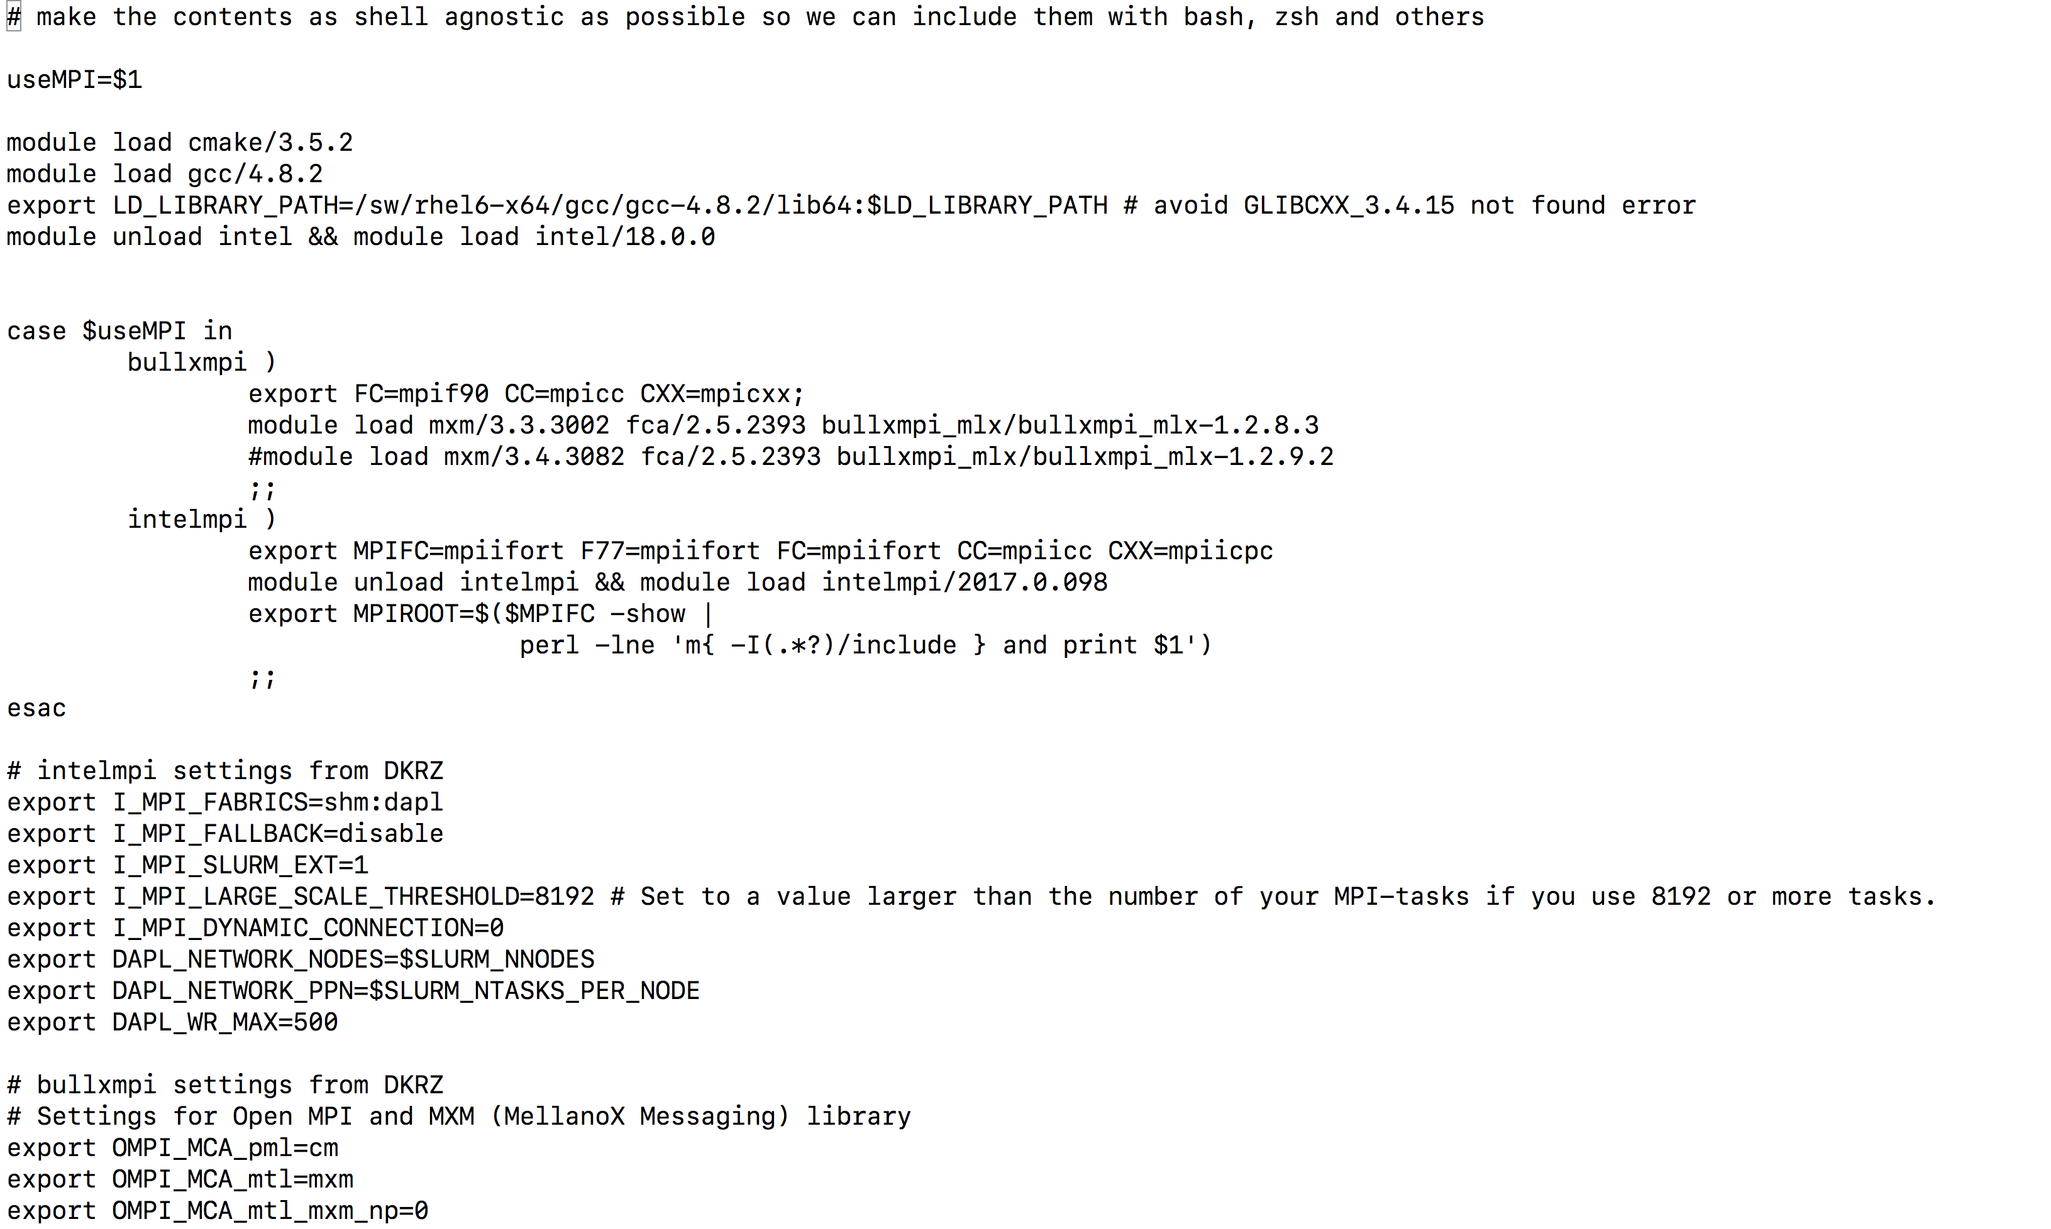
Machines supported:
ollie & mistral for all models
hlrn / hazelhen for awicm / fesom / echam

Slide 4
Integration with esm-tools:
With esm-master:
If esm-environment is present, esm-master compiles using these machine setting. If it is not present, esm-master will try to compile with model defined settings.
With esm-runscripts:
If esm-environment is present, esm-runscripts will set up runs according to these setting, if not, it will use some (probably not up-to-date) defaults.

Slide 5
Use esm-environment to compile without esm-master
Make tools of some models have been prepared to skip setting machine depending variables if that was already done by esm-environment (works for awicm, fesom, echam standalone).

Slide 6
Learn more:
Check out the documentation, available by typing
'make get-esm-usermanual'
or
'git clone https://gitlab.dkrz.de/esm-tools/esm-usermanual.git'

Slide 7
More to come:
Support for more machines (currently ollie and mistral for everything, hlrn/hlrs for awicm/fesom/echam)
Full integration on model side (mpiesm)
any ideas from your side (Please let me know, dirk.barbi@awi.de, -1561)

