Slide 1
esm-runscripts
Download, configure and compile

Slide 2
Download esm-runscripts
'git clone https//gitlab.dkrz.de/esm-tools/esm-runscripts.git'
or, with esm-master,
'make get-esm-runscripts'
Configuration happens automatically.
Force re-configuration by typing
'make conf-esm-runscripts'

Slide 3
conf-esm-runscripts
Creates example runscripts for all compiled models in the
esm-tools folder.
Each time a model is compiled, the corresponding runscript is generated, and can be found in
preconfigured-runscripts
You can find additional exampled in
esm-runscripts/runscripts

Slide 4
List of supported models
AWICM 1.0 / 1.1 and 2.0
MPIESM 1.2.00p4 and 1.2.01
FESOM (standalone) 1.4 and 2.0
ECHAM (standalone) 6.3.02p4 and 6.3.04p1
PISM (standalone)
PISM – AWICM and PISM – MPIESM

Slide 5
A first runscript
You need to provide:
setup_name (awicm)
awicm_VERSION (CMIP6)
machine (mistral)
ACCOUNT (ab0995)
INITIAL_DATE_awicm (1950-01-01)
FINAL_DATE_awicm (1951-12-31)
RES_fesom (CORE)
RES_echam (T63)
BASE_DIR (/work/ab0995/a270058/experiments)

Slide 6
First runscript - example

Slide 7
Important defaults
MESH_DIR_fesom=
SCENARIO_echam=HIST
POOL_DIR_echam=
POOL_DIR_fesom=
MODEL_DIR_awicm=
EXP_ID=test
proca_ and procb_ for each exectuable
LRESUME_echam=LRESUME_fesom
=LRESUME_oasis3mct=1

Slide 8
Some remarks
No batch system header in the script
check=0/1 to run a test without submitting the script / launching the executable

Slide 9
How to start a run
In the command line, run
'./name_of_your_script'
to start the simulation. Add '–h' to get a list of available command line options. Most importantly:
-c sets check=1 (don‘t submit script, don‘t run executable)
-e blabla overwrites the EXP_ID
-v "MYVAR=blabla" passes user definded var MYVAR to the script

Slide 10
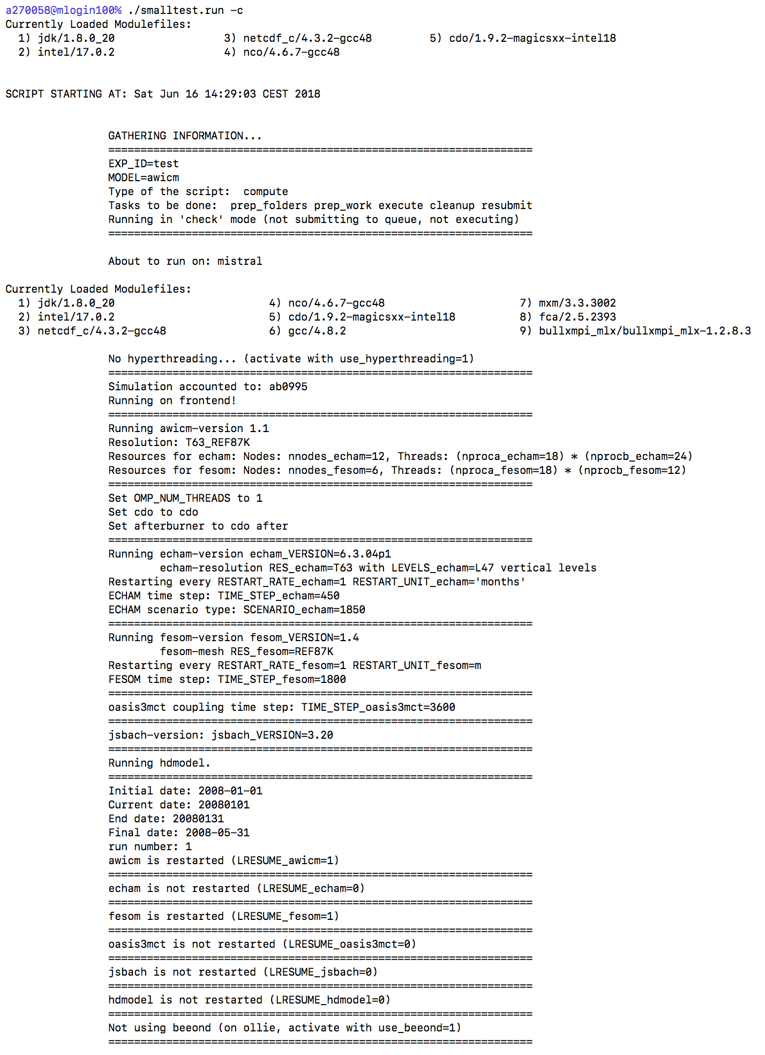
Let‘s 'check'!
Tons of output!
All information about defaults, used data, etc.

Slide 11
Stages of the runscript
Gather information
Prepare Data Folders
Modify Files
Prepare Work
Run Simulation
Cleanup
Resubmit
You can choose the stages you want!
(command line options -o, -x )

Slide 12
Where does the data go?
In your BASE_DIR, esm-runscripts create a large number of folder, sorted by data type (input, forcing, output, restart, config, log, scripts) and model name (echam, jsbach, fesom, oasis,…) similar to mpiesm.
All files are dealt with automatically.
In each folder, files named ‘setup‘ and ‘missing‘ document what has been done.
An overall ‘setup‘ can be found in the scripts folder.

Slide 13
Let‘s run a simulation!
Much less output!
All information about defaults, used data, etc.

Slide 14
Let‘s change something!
A Namelist parameter (e.g. iaero to 666 in namelist.echam):
‘radctl___iaero___nml_file=namelist.echam‘
‘radctl___iaero___nml_entry=666‘
alternatively:
‘echam_MYOWN_namelist_change=“namelist.echam radctl iaero 666“ ‘

Slide 15
Let‘s change something else!
The origin of a file (first way):
Run with –c, carefully read the output for the name of the
default variable you can change. E.g. if you want to take
the echam-executable from /path/to/exe/, you could set
BIN_DIR_echam= /path/to/exe/

Slide 16
Let‘s change something else!
The origin of a file (second version):
echam_DIFF_EXE_FILES=“/path/to/exe/echam6 echam6 warn“
warn/no_warning specifies whether scripts shall complain if file is not found.
This also overwrites defaults! Works always, also for additional files.

Slide 17
Learn more:
Check out the documentation, available by typing
'make get-esm-usermanual'
or
'git clone https://gitlab.dkrz.de/esm-tools/esm-usermanual.git'

Slide 18
More to come:
Support for more models (oifs, nemo, RecoM, …)
make update-…
log the revision numbers of all involved tools / models, save a copy of the used runscript-functions
any ideas from your side (Please let me know, dirk.barbi@awi.de, -1561)

