Slide 1



Deniz Ural
AWI, Climate Dynamics
Potsdam
Miguel Andrés-Martínez
AWI, Climate Dynamics
Bremerhaven
PalMod - ESM-Tools Workshop
DKRZ, 20-21 April, 2022

Slide 2



OUTLINE:
1
What are ESM-Tools?
Motivation & Aim
Advantages
Supported systems
Repository, Documentation, Community
2
Introduction to YAML
Basic YAML Syntax
Brief overview of ESM-Tools Extended YAML Syntax
3
Lets’s Get Started: (Hands-on introduction)
Install ESM-Tools and verify
Troubleshooting
Installed programs, command-line options
Brief overview of the folders and files

Slide 3
OUTLINE:
4
Run a model from scratch: A test case with FESOM
Briefing
Install FESOM and verify
Write our (very basic) first runscript
Check run and verify our settings.
esm_runscripts in more detail
Submit our simulation (Mistral, Levante)
Monitor and check our simulation
5
ESM-Tools extended YAML syntax & operations
Finished YAML config file
Declaring and accessing variables
Switches, adds, removes
Arithmetic, Math and calendar options
Namelist changes
YAML hierarchy

Slide 4
OUTLINE:
6
Introduction to Coupled Setups
Online vs Offline coupling
AWICM example
Oasis coupler and namcouple
7
Workflow Manager and Offline Coupling
TODO: Miguel’s part
Offline coupling → Miguel will show using Vilma
TODO

Slide 5
TODO: Runscripts and YAML files in more detail
Directory structure
YAML commands and common operations
Important conceps: config files, ...
Final part of day 1: Introduction to coupled setups
Overview: online vs offline coupling
Overview of sample YAMLs: AWI-ESM, model YAML inheritance
Important conceps: config files, ...
TODO
AWI-ESM 2 coupled system
Important Concepts slide:
Miguel will share on GitHub
Fesom restarts, branch-off experiment (Dirk’s slides), 2 day simulation and restart from finished simulation

Slide 6
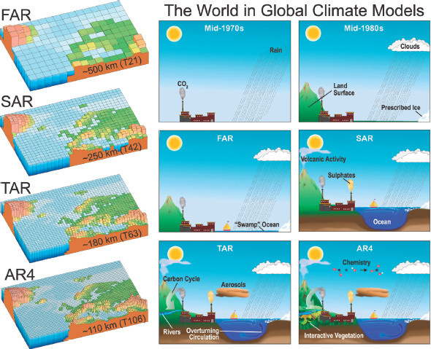
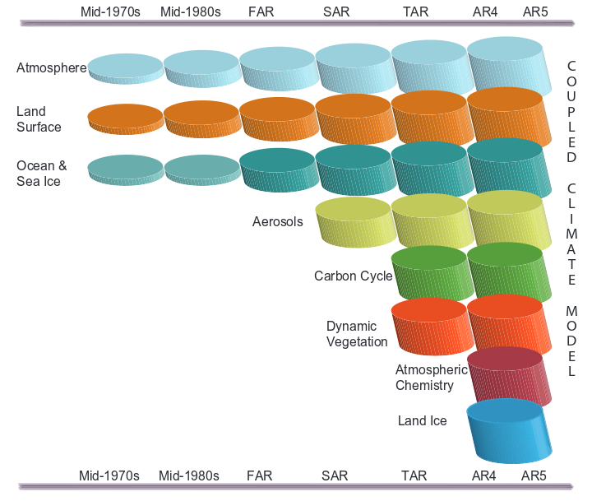
Fact: Models are getting more complicated
- Great for science but hard job for the modellers
IPCC Fifth Assessment Report, 2014

Slide 7
What are ESM-Tools?
1
Collection of programs to download, compile, configure, and run different Earth system models (ESM)
Standalone Atmosphere, Ocean, Geo-Biochemistry, Hydrology, Sea-Ice and
Ice-sheet models as well as coupled systems
Researchers should focus on science and less on technical details
Provide a common infrastructure for
Models and coupled systems
HPC environment
Setup and run model experiments
Consistent file / directory structure

Slide 8
Why do we need ESM-Tools?
1
Target audience: Earth System modellers working on HPC machines
ESM are complex softwares that require technical knowledge
Build is difficult:
Many different models & different build systems & different configurations
Different HPC and batch systems
Setup & Run are difficult:
Complex configurations & Couplings
Requires and generates many files
Requires a consistent directory structure, CMORization
Automatization: Repeating the same simulation multiple times
Reproducibility
Less technical demand → more time for science & research

Slide 9
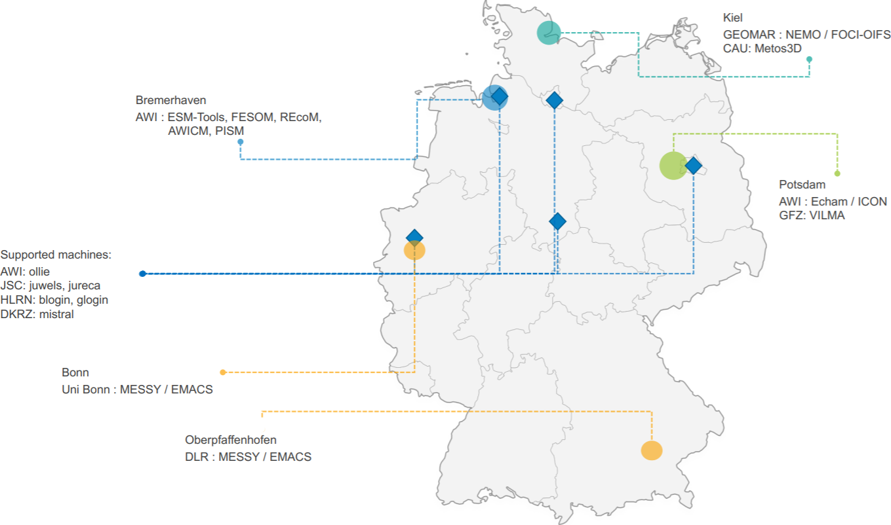
Supported Models & Couplings, Partners
1
Coupled Systems | Components
FOCI | VILMA
FOCI-OIFS | ICON
FESOM-REcoM | NEMO
AWIESM | REcoM
OIFSCL | AMIP
AWICM | debm
AWICM3 | FESOM
OIFSAMIP | scope
AWICMCR | xios
MPIESM | Echam
 | YAC
 | fesom_mesh_part
 | oasis3mct
 | rnfmap
 | MPIOM
 | PISM
 | nemobasemodel
 | OIFS

Slide 10
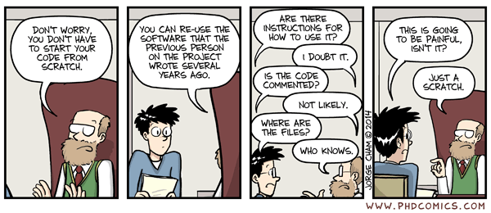
Need for the high-quality research software
BETTER
SOFTWARE
BETTER
RESEARCH
www.software.ac.uk
VS
Prof. Carole Goble
Software Sustainability Institute
https://ieeexplore.ieee.org/document/6886129
http://phdcomics.com/comics/archive/phd031214s.gif

Slide 11



VS
Old Workflow
ESM-Tools workflow
Obtain the model source code (usually a tar ball)
Build the model
configure
make
FAIL: Read the HPC documentation and repeat (libraries, compilers, modules, ...)
Prepare the data folders (input, boundary conditions, output, ...)
Setup the namelist for the models
Submit your job to the HPC system
Warning: environment mismatch
Resubmit / Iterative coupling
Move the data to the storage disk
Postprocessing of the results
Repeat the whole process for the next run or write a shell script for automatization.
Obtain and build the model code (from a repository)
Uniform environment for both installation and running
→ guaranteed integrity.
esm_master install-awicm-2.0
Prepare YAML based runscript
[OPTIONAL] Check if your run would run successfully:
esm_runscripts my_awicm_runscript.yaml -e my_first_test -c
Submit your job to the system:
esm_runscripts my_awicm_runscript.yaml -e my_first_test
Monitor your log files
Postprocess the results (esmviz, in progress)

Slide 12
VS
Old Workflow
ESM-Tools workflow
echam_prepare_forcing()
{
# forcing
if [[ "v$setup_name" = "vecham_standalone" ]]; then
case $SCENARIO_echam in
1850 | PI-CTRL*)
add_to ${echam_INPUT_DIR}/${RES_echam}/${RES_echam}${OCERES_echam}_piControl-LR_sst_1880-2379.nc unit.20
add_to ${echam_INPUT_DIR}/${RES_echam}/${RES_echam}${OCERES_echam}_piControl-LR_sic_1880-2379.nc unit.96
;;
HIST )
...
...
for ((yr = YR0_echam + -2; yr <= YRN_echam + 2; ++yr)); do
if [ $yr -le 1849 ] ; then
eval add_to ${echam_INPUT_DIR}/${RES_echam}/ozone/$ozonefile_1850 ozon$yr
elif [ $yr -le 2014 ] ; then
eval add_to ${echam_INPUT_DIR}/${RES_echam}/ozone/$ozonefile_hist ozon$yr
else
eval add_to ${echam_INPUT_DIR}/${RES_echam}/ozone/$ozonefile_scen ozon$yr
fi
if [ $yr -le 1849 ] ; then
add_to ${echam_INPUT_DIR}/${RES_echam}/volcano_aerosols/strat_aerosol_ir_${RES_echam}_1850.nc strat_aerosol_ir_${yr}.nc
add_to ${echam_INPUT_DIR}/${RES_echam}/volcano_aerosols/strat_aerosol_sw_${RES_echam}_1850.nc strat_aerosol_sw_${yr}.nc
elif [ $yr -le 2024 ] ; then
add_to ${echam_INPUT_DIR}/${RES_echam}/volcano_aerosols/strat_aerosol_ir_${RES_echam}_${yr}.nc strat_aerosol_ir_${yr}.nc
add_to ${echam_INPUT_DIR}/${RES_echam}/volcano_aerosols/strat_aerosol_sw_${RES_echam}_${yr}.nc strat_aerosol_sw_${yr}.nc
elif [ $yr -gt 2024 ] ; then
add_to ${echam_INPUT_DIR}/${RES_echam}/volcano_aerosols/strat_aerosol_ir_${RES_echam}_2024.nc strat_aerosol_ir_${yr}.nc
add_to ${echam_INPUT_DIR}/${RES_echam}/volcano_aerosols/strat_aerosol_sw_${RES_echam}_2024.nc
... and many more
general:
setup_name: "awicm"
compute_time: "00:15:00"
initial_date: "2000-01-01"
final_date: "2000-02-29"
base_dir: "/work/ollie/dural/sample_work_dir/"
nmonth: 1
nyear: 0
awicm:
version: "CMIP6"
postprocessing: false
scenario: "PI-CTRL"
model_dir: "/work/ollie/dbarbi/modelcodes/awicm-CMIP6/"
fesom:
pool_dir: "/work/ollie/pool/FESOM/"
mesh_dir: "/work/ollie/pool/FESOM/meshes_default/core/"
restart_rate: 1
restart_unit: "m"
restart_first: 1
further_reading:
- "fesom_output_control.yaml"

Slide 13
Advantages of ESM-Tools
1
Automation: minimal manual interaction Uniform, Data Integrity, Consistency → Reproducible Portability: across different supported HPCs Abstraction: configuration and operations are separated
Stateful: simulation configuration is stored

Slide 14




Technical reasons for using ESM-Tools
1
For Users
For Developers
(extended) YAML syntax is easy to read
Sample runscripts are already available
Well maintained
Issues on GitHub (and we will take care of them)
Updated regularly
Portable & Tested
Documentation (sphinx, readthedocs)
Workshops
Easier to read / write (compared to )
OOP, High level data structures
Easier to debug (via pdb, ipdb)
Configuration files are inherited
Hosted on GitHub & robust branching model
Open-source development is encouraged
[In progress] CI/CD, DevOps, Automated tests

Slide 15
Recap: Aim & Motivation
1
What ESM-Tools are / do
What ESM-Tools are / do not
A unified infrastructure for ESM modelling
Build the models without knowing the details of the HPC system
Provide easy to read/write YAML based configuration
Run your simulation as easy as possible
Generate a log documentation
Organize files / directories (eg. input, forcing, output, log, executables, ...)
One interface: standardize the modelling process for all of your models
One software to rule them all
A new model
A new programming language or DSL
Change the model code / build process
This slide can be omitted

Slide 16












ESM-Tools Ecosystem
2
esm_runscripts
esm_environment
esm_version_checker
esm_master
esm_rcfile
esm_tools
esm_workshop
esm_calendar
esm_parser
esm_archiving
esm_plugin_manager
esm_database

Slide 17

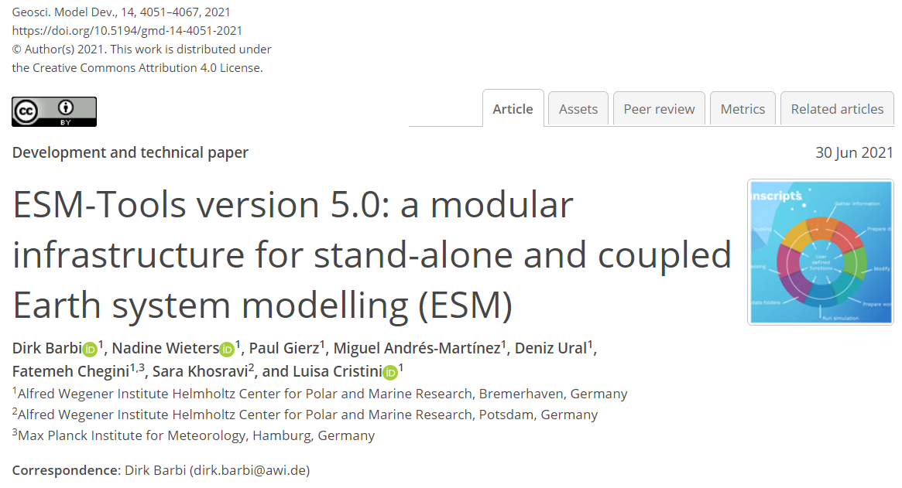




Contact & Community
1
https://github.com/esm-tools
- https://github.com/esm-tools/esm_tools/discussions
- https://github.com/esm-tools/esm_tools/issues
https://esm-tools.readthedocs.io
https://www.esm-tools.net
@ToolsEsm
ESMTools

Slide 18
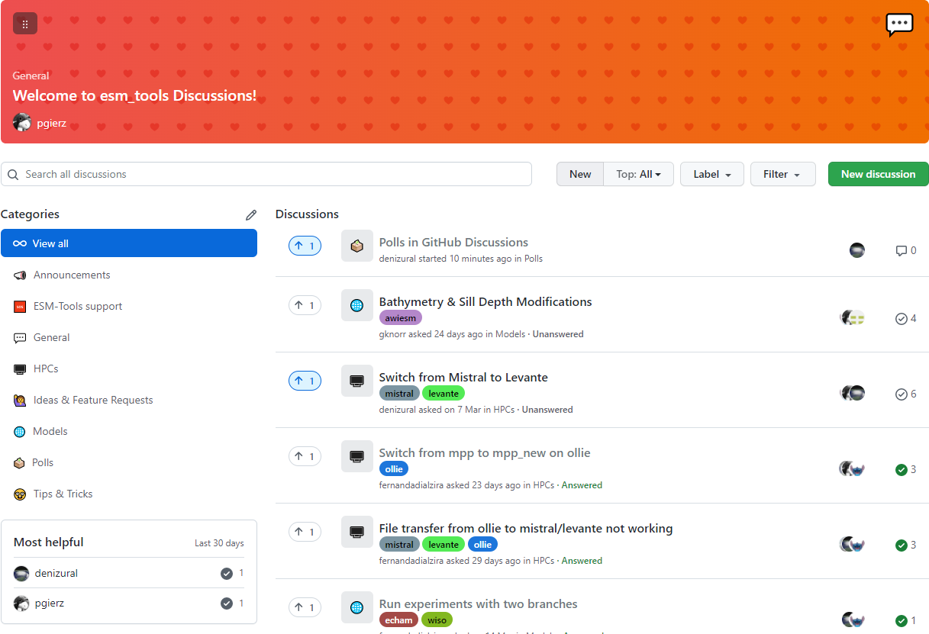
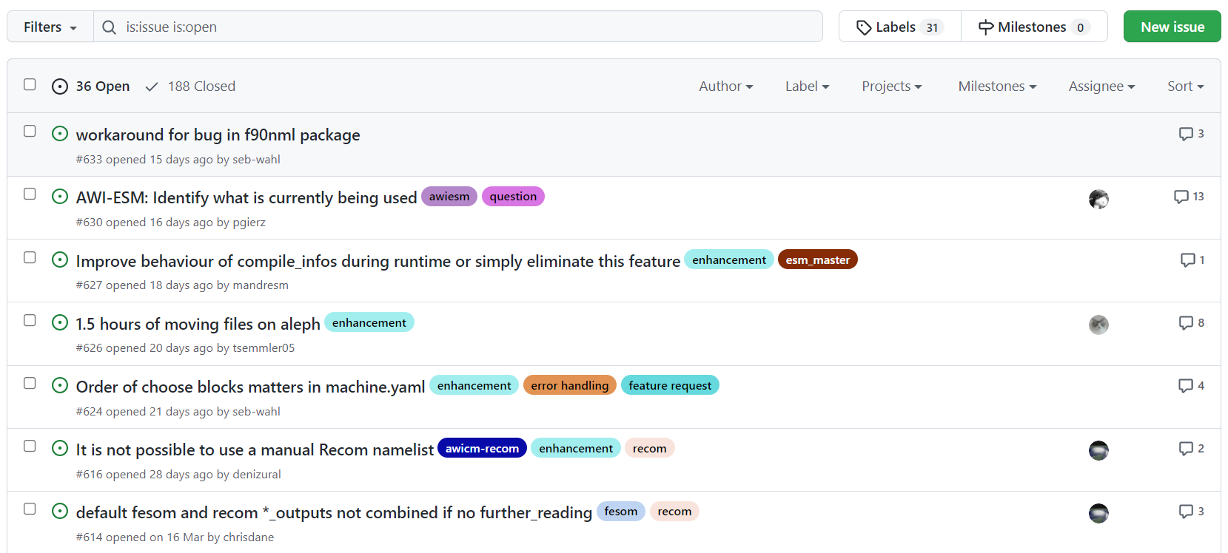
Community: Issues and Discussions
1
Open to everyone
Single platform
Searchable
Agile

Slide 19
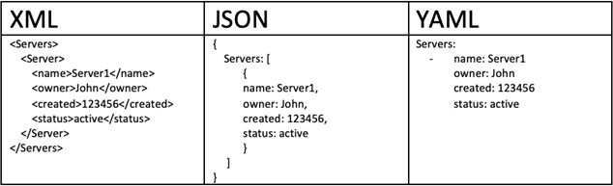
Introduction to YAML:
2
How to save the configuration and transfer it across different apps and machines
Serialization & Deserialization
Binary vs Text (human-readable)
Easy to read & write
3 standards exist: XML, JSON, YAML

Slide 20
Hands-on introduction:
# ===========================
# This is a sample YAML file
# ===========================
age: 18 # integer value
1: one # integer key
PalMod_Date: 2022-04-20 # date value
another_date: '2020-03-09' # note the quotes
golden_ratio: 1.6180339887 # float value
3.14159265359: pi # float key
# list: one item per line
shopping_lists:
- tofu
- beer
- apples
# inline lists
models: ["echam", "fesom", "pism"]
# dictionary, map
foo:
bar:
fizz:
buzz: 666
import yaml
fname = "data.yaml"
# choose a loader
loader = yaml.BaseLoader # basic loader
# loader = yaml.FullLoader # more advanced loader
# Opend and deserialize the YAML file
with open(fname, "rt") as yaml_file:
yaml_data = yaml.load(yaml_file, Loader=loader)
# Print the information about the deserialized data
print("Type of the loaded data is: ", type(yaml_data), "\n")
print("Contents of the YAML file:")
print("--------------------------")
print( yaml.dump(yaml_data, indent=4) )
print("\n")
# iterate over the items and print them
width = 40
for key, value in yaml_data.items():
print(f"{str(key):40} {type(key)}")
print(f"{str(value):40} {type(value)}")
print()
print()
print(yaml_data["PalMod_Date"])
print(yaml_data["foo"]["bar"]["fizz"]["buzz"])
print(yaml_data["models"][-1])

Slide 21
Hands-on introduction:
Output
Output (contd.)
data.yaml:
Type of the loaded data is: <class 'dict'>
Contents of the YAML file:
--------------------------
'1': one
'3.14159265359': pi
PalMod_Date: '2022-04-20'
age: '18'
another_date: '2020-03-09'
foo:
bar:
fizz:
buzz: '666'
golden_ratio: '1.6180339887'
models:
- echam
- fesom
- pism
shopping_lists:
- tofu
- beer
- apples
age <class 'str'>
18 <class 'str'>
1 <class 'str'>
one <class 'str'>
PalMod_Date <class 'str'>
2022-04-20 <class 'str'>
another_date <class 'str'>
2020-03-09 <class 'str'>
golden_ratio <class 'str'>
1.6180339887 <class 'str'>
3.14159265359 <class 'str'>
pi <class 'str'>
shopping_lists <class 'str'>
['tofu', 'beer', 'apples'] <class 'list'>
models <class 'str'>
['echam', 'fesom', 'pism'] <class 'list'>
foo <class 'str'>
{'bar': {'fizz': {'buzz': '666'}}} <class 'dict'>
2022-04-20
666
pism
age: 18
1: one
PalMod_Date: 2022-04-20
another_date: '2020-03-09'
golden_ratio: 1.6180339887
3.14159265359: pi
# list: one item per line
shopping_lists:
- tofu
- beer
- apples
# inline lists
models: ["echam", "fesom", "pism"]
# dictionary, map
foo:
bar:
fizz:
buzz: 666
?
Exercise: Change the loader to FullLoader and try again

Slide 22
ESM-Tools Extended YAML Syntax
2
We can only store data and configuration in a YAML file.
ESM-Tools extends this functionality by adding operations and commands
ESM-Tools programs (eg. esm_master, esm_runscripts) parse these commands
Language for Earth System Modelling
One language for all (supported) models and HPCs

Slide 23
ESM-Tools Extended YAML Syntax
2
# creating and accessing variables from different sections
ini_restart_dir: "${general.ini_restart_dir}/fesom/"
# choose_ blocks allow select-case (aka switch) statements
resolution: CORE2
choose_resolution:
CORE2:
nx: 126858
mesh_dir: "${pool_dir}/meshes/mesh_CORE2_final/"
nproc: 288
time_step: 450
GLOB:
nx: 830305
# maths and calendar operations
runtime: $(( ${end_date} - ${time_step}seconds ))
# adding and removing elements from lists and dicts
list1:
- element1
- element2
add_list1:
- element3
- element4
... and many more
# Changing Fortran namelists
namelist_changes:
namelist.echam:
runctl:
out_expname: ${general.expid}
dt_start:
- ${pseudo_start_date!year}
- ${pseudo_start_date!month}

