Slide 1
Hands-on Practice with FESOM 2
5
Briefing
Install FESOM and verify
Write our (very basic) first runscript
Check run and verify our settings.
Submit our simulation (Mistral, Levante)
Monitor and check our simulation

Slide 2

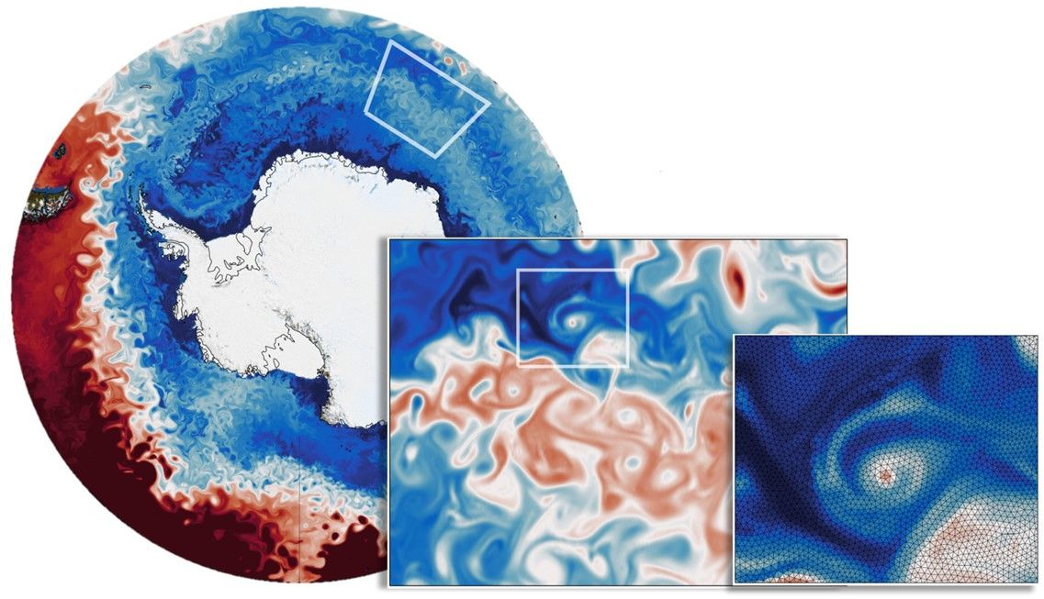
Short Briefing
5
FESOM (Finite-Element/volumE Sea ice-Ocean Model) is a multi-resolution sea ice-ocean model that solves the equations of motion on unstructured meshes.
FESOM is developed and supported at the Alfred Wegener Institute, Helmholtz Centre for Polar and Marine Research (AWI).
https://fesom.de/
The CORE II mesh was initially used for experiments designed according to CORE II protocol. Later it become a basis mesh for climate simulations with AWI-CM. Mesh resolution increased in equatorial and polar regions.

Slide 3


Installing FESOM2 using ESM-Tools
5
mkdir Workshop
cd Workshop/
git clone https://github.com/esm-tools/workshops.git
mkdir model_codes # models will be installed here
mkdir runscripts # runscripts will be stored here
cd model_codes/
esm_master install-fesom-2.1 --check # dryrun
esm_master install-fesom-2.1
TODO:
install Fesom & verify
check run
explanation of directories
run FESOM
monitor run
[HW] visualize output: pyfesom2
Please don’t install model codes or write runscripts inside the ESM-Tools repository.

Slide 4

Experiment directory structure
Folder Structure
4
General experiment folder
analysis/
bin/
config/
couple/
forcing/
input/
restart
run_DATE/
outdata/
unknown/

Slide 5
Experiment directory structure
Folder Structure
4
General experiment folder
analysis/
bin/
config/
couple/
forcing/
input/
restart
run_DATE/
outdata/
unknown/
Run folder
analysis/
bin/
config/
couple/
work/
input/
restart/
outdata/
unknown/
forcing/

Slide 6
Experiment directory structure
Folder Structure
4
General experiment folder
analysis/
bin/
config/
couple/
forcing/
input/
restart
run_DATE/
outdata/
unknown/
Run folder
analysis/
bin/
config/
couple/
work/
input/
restart/
outdata/
unknown/
forcing/
in the run folder:
Where the experiment run actually takes place.
Before the run: Edited namelists, restart files and binaries are copied here before the run start.
During the run: Output data and restarts are generated here by the model
After the run: the output and restarts are copied to the general directory
The copying of the files from work to the general directory is fully customizable using File Dictionaries
https://esm-tools.readthedocs.io/en/latest/yaml.html#file-dictionaries)
More details about the directory structure:
https://esm-tools.readthedocs.io/en/latest/esm_runscripts.html#experiment-directory-structure
work/

Slide 7



Experiment directory structure
Folder Structure
4
General experiment folder
analysis/
bin/
config/
couple/
forcing/
input/
restart
run_DATE/
outdata/
unknown/
restarts
Run folder
analysis/
bin/
config/
couple/
work/
input/
restart/
outdata/
unknown/
forcing/
namelists
binaries
esm_tools/namelists/
model_dir
(user runscript)

Slide 8

Experiment directory structure
Folder Structure
4
General experiment folder
analysis/
bin/
config/
couple/
forcing/
input/
restart
run_DATE/
outdata/
unknown/
output data
restarts
Run folder
analysis/
bin/
config/
couple/
work/
input/
restart/
outdata/
unknown/
forcing/
Which files to be moved / copied are specified in YAML configuration files (eg. model.yaml or setup.yaml)
The process is repeated for the next restart period (eg. run_DATE-NEW)

Slide 9


esm_runscripts -e tutorial fesom_run_initial_monthly.yaml --check --verbose
esm_runscripts: FESOM check run
5
Before we start:
Make a check run and have a look at the finished config YAML file
Verbose is optional but it gives you more output. It is better to redirect it to a file and view with a text editor
esm_runscripts -e tutorial fesom_run_initial_monthly.yaml --check –verbose &> check.log
Don’t forget to use --open-run if you don’t have use_venv: false in your general section. Otherwise a dialog prompt will open
Exercise: make a check run and look at the finished config file. Also observe directory structure

Slide 10
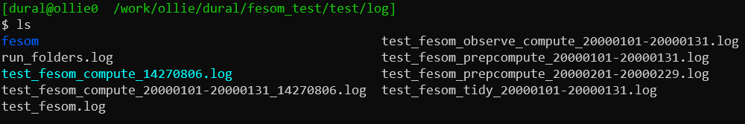
Hands-on Practice with FESOM
5
Now we can submit our run:
Just drop the --check
esm_runscripts -e tutorial fesom_run_initial_monthly.yaml
You can also use --update option to update the directory after the check run.
esm_runscripts -e tutorial fesom_run_initial_monthly.yaml --update
Exercise: Submit and Monitor your run. Watch (tail -f) the log files in exp_id/log/ director.y

