Slide 1
Let’s Get Started
3
Install ESM-Tools and verify
Troubleshooting
Installed programs, command-line options
Brief overview of the folders and files

Slide 2



Let’s Get Started: Installation
3
https://esm-tools.readthedocs.io
mkdir Software # or Programs
cd Software/
❸
❹
git clone https://github.com/esm-tools/esm_tools.git
❶
cd to your ${HOME} directory
❷
In your .bash_profile, .bashrc, .profile
❺
cd esm_tools
./install.sh
This will install ESM-Tools and all of the dependencies
export PATH=${PATH}:~/.local/bin
export LC_ALL=en_US.UTF-8
export LANG=en_US.UTF-8
❻
esm_tools --version
Verify the installation
module load git
module unload netcdf_c
module load python3/2021.01-gcc-9.1.0

Slide 3













esm environment
ESM-Tools Ecosystem
esm_runscripts
esm version checker
Coupled & Modular architecture
Main executables: esm_master
esm_master
esm_master
esm_rcfile
esm_runscripts
Significant change from R5 → R6
esm_parser
ESM-Tools
esm_workshop
Some of the tools will be obsolete
Well tested. Test coverage is increasing
esm_calendar
esm_database
esm_archiving
esm plugin manager
esm cleanup

Slide 4
esm_master: overview
3
ESM-Master downloads, builds (configure, compile, link), cleans, recomps models and setups.
You can think of ESM-Master as a package manager. Note: ESM-Tools has no right on any models or licences.
Build information is stored in <model>.yaml (setup.yaml) files. Eg. fesom.yaml, awicm.yaml
Ideally the models are version controlled and hosted in a remote repository but tarballs are also supported.
esm_master <operation>-<software>-<version>
esm_master --help (or –h) # get help
esm_master # shows all available targets (models, setups)
install and recomp are meta-commands.
install = get (+ conf) + (comp)
recomp = clean (+ conf) + comp
esm_master fesom # shows all available targets that include ‘fesom’

Slide 5
esm_runscripts --help
esm_runscripts: overview
3
esm_runscripts your_runscript.yaml –e name_of_your_experiment -v --open-run –c
Common Options:
-e | specifies the experiment name (test is the default name)
-v, --verbose | verbose mode on. Useful for getting more information
--open-run | run without a virtual environment. Or use use_venv: false in your runcript
-c, --check | dryrun or check mode. Prepares everything but does not submit the job. It is recommended to make a check run before submitting your job

Slide 6

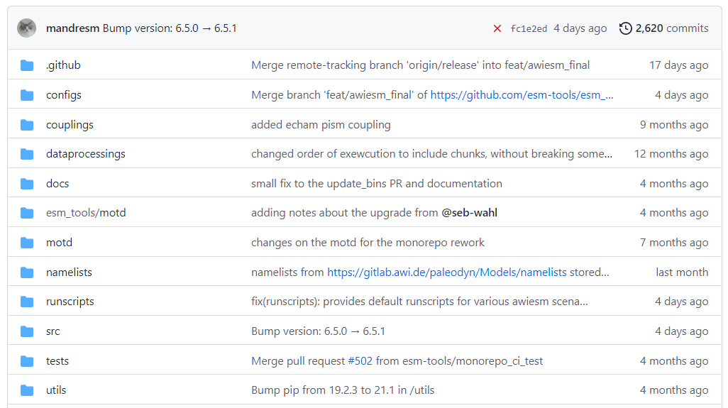
Quick Overview of YAML configs
3
https://github.com/esm-tools/esm_tools
- configs/machines/<machine>.yaml
- components/<model>/<model>.yaml
- setups/<setup>/<setup>.yaml
ESM-Master downloads, builds (configure, compile, link), cleans, recomps models and setups.

Slide 7
Miguel’s terminology slides
TODO:

Slide 8
ESM-Tools Executables
3
TODO:
TODO: show esm_master and esm_runscript command line options
- esm_master output

