Slide 1



Deniz Ural
AWI, Climate Dynamics
Potsdam
Dr. Miguel Andrés-Martínez
AWI, Climate Dynamics
Bremerhaven
TODO: update page number (last thing)
PalMod - ESM-Tools Workshop
DKRZ, 20-21 April, 2022
Notes:
This is for Deniz

Slide 2
AGENDA
Day 1
Day 2 (Hands-on)
12:00-12:30 | - | Lunch
12:30-13:00 | - | Introduction to the workshop and participants ESM-Tool introduction
13:00-13:15 | - | Introduction to YAML
13:15-14:15 | - | Hands-on introduction Build and run FESOM Build and run AWI-ESM-2.1
14:15-15:30 | - | ESM-Tools extended YAML syntax and hands-on exercises
15:30-16:00 | - | Coffee break
16:00-17:30 | - | Introduction to the workflow manager (offline coupling) and machine environments
09:00-10:45 | - | Working groups New models into ESM-Tools Offline coupling Levante
10:45-11:15 | - | Coffee break
11:15-12:45 | - | Working groups New models into ESM-Tools Offline coupling Levante
12:45-13:00 | - | Resume
13:00-14:00 | - | Lunch and adjourn
Notes:
Miguel

Slide 3



OUTLINE:
1
What are ESM-Tools?
Motivation & Aim
Advantages
Supported systems
Repository, Documentation, Community
2
Introduction to YAML
Basic YAML Syntax
Brief overview of ESM-Tools Extended YAML Syntax
3
Lets’s Get Started: (Hands-on introduction)
Install ESM-Tools and verify
Troubleshooting
Installed programs, command-line options
Brief overview of the folders and files
Notes:
Deniz

Slide 4
OUTLINE:
4
ESM-Tools Terminology
Overview
YAML Hierarchy
Configuration files
Runscripts
YAML Sections
Feature Variables
Compilation Scripts
.run files
5
Hands-on Practice with FESOM 2
Briefing
Install FESOM and verify
Write our (very basic) first runscript
Check run and verify our settings.
Submit our simulation
Monitor and check our simulation
Notes:
Deniz

Slide 5
OUTLINE:
6
ESM-Tools extended YAML syntax & operations (Hands-on session)
Finished YAML config file
Declaring and accessing variables
Switches, adds, removes
Arithmetic, Math and calendar options
Namelist changes
YAML hierarchy
7
Machine files and environment_changes
Relevant feature variables
environment_changes dictionaries
8
Workflow manager and offline coupling
Intro to the workflow manager
Workflow dictionary
VILMA-PISM
Notes:
Deniz

Slide 6
TODO: Runscripts and YAML files in more detail
+++ Directory structure
+++ YAML commands and common operations
Important conceps: config files, ...
Final part of day 1: Introduction to coupled setups
Overview: online vs offline coupling
Overview of sample YAMLs: AWI-ESM, model YAML inheritance
Important conceps: config files, ...
TODO:
These were some notes. Maybe we can remove these
AWI-ESM 2 coupled system
Important Concepts slide:
Miguel will share on GitHub
Fesom restarts, branch-off experiment (Dirk’s slides), 2 day simulation and restart from finished simulation

Slide 7

Before we start:
https://github.com/esm-tools/workshops
Presentations, runscripts, exercises, ...
https://github.com/esm-tools
https://github.com/esm-tools/esm_tools/discussions

Slide 8
ESM-Tools development history
Period | Developments | Team
pre-2019 | First version of the tools written in ksh with to support AWI couple setups | Dirk Barbi Nadine Wieters Luisa Cristini
Tools development phase
Summer 2019-Spring 2020 | Version 3.1: Translating all the functionality to Python More modular and generalized Separation of concerns (functionality in Python, model-specific in yaml) Support for AWI coupled systems and FOCI (GEOMAR) | Dirk Barbi Paul Gierz Nadine Wieters Luisa Cristini Sebastian Wahl
Tools development phase
Spring 2020-Spring 2021 | Version 4.0 (April 2020): finishing off most of the Python functionality Version 5.0 (December 2020): new models and features - AWI-ESM-2 (ECHAM6 + FESOM2) - FOCI (ECHAM6 + NEMO4) and FOCI-OpenIFS (OpenIFS43 + NEMO4) - AWI-CM-3 (OpenIFS43 + FESOM2) | Dirk Barbi Paul Gierz Miguel Andres Deniz Ural Nadine Wieters Luisa Cristini Sebastian Wahl
Tools development phase
Notes:
Miguel

Slide 9
ESM-Tools development history
Period | Developments | Team
Spring 2021 – end 2021 | Version 6.0: - Workflow manager and offline coupling - VILMA-PISM - Stability - Focus on the end user - All packages in one single repository - CI, automatic testing - Production runs | Dirk Barbi Miguel Andres Deniz Ural Paul Gierz Sebastian Wahl Jan Streffing
Stability and user-friendliness
2022 | Stability Clean the Python code (refactorizations) -> adding transparency to the “blackbox” Encourage advance users to contribute Community building | Miguel Andres Paul Gierz Deniz Ural Sebastian Wahl Jan Streffing
Stability and advance user friendly
Notes:
Miguel

Slide 10
What are ESM-Tools?
1
Motivation & Aim
Advantages
Supported systems
Repository, Documentation, Community

Slide 11
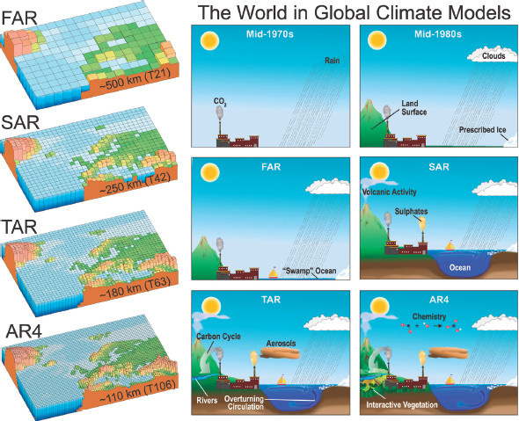
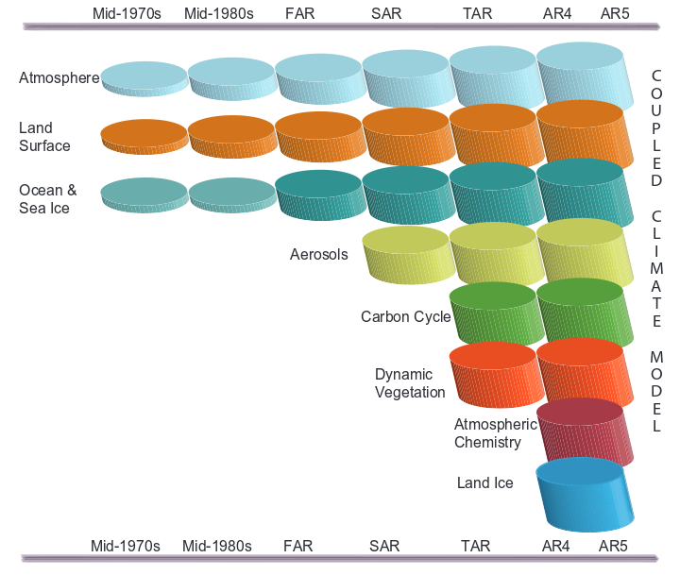
Fact: Models are getting more complicated
- Great for science but hard job for the modellers
IPCC Fifth Assessment Report, 2014
Notes:
Deniz

Slide 12
What are ESM-Tools?
1
Collection of programs to download, compile, configure, and run different Earth system models (ESM)
Standalone Atmosphere, Ocean, Geo-Biochemistry, Hydrology, Sea-Ice and
Ice-sheet models as well as coupled systems
Researchers should focus on science and less on technical details
Provide a common infrastructure for
Models and coupled systems
HPC environment
Setup and run model experiments
Consistent file / directory structure
Notes:
Deniz

Slide 13
Why do we need ESM-Tools?
1
Target audience: Earth System modellers working on HPC machines
ESM are complex softwares that require technical knowledge
Build is difficult:
Many different models & different build systems & different configurations
Different HPC and batch systems
Setup & Run are difficult:
Complex configurations & Couplings
Requires and generates many files
Requires a consistent directory structure, CMORization
Automatization: Repeating the same simulation multiple times
Reproducibility
Less technical demand → more time for science & research
Notes:
Miguel

Slide 14
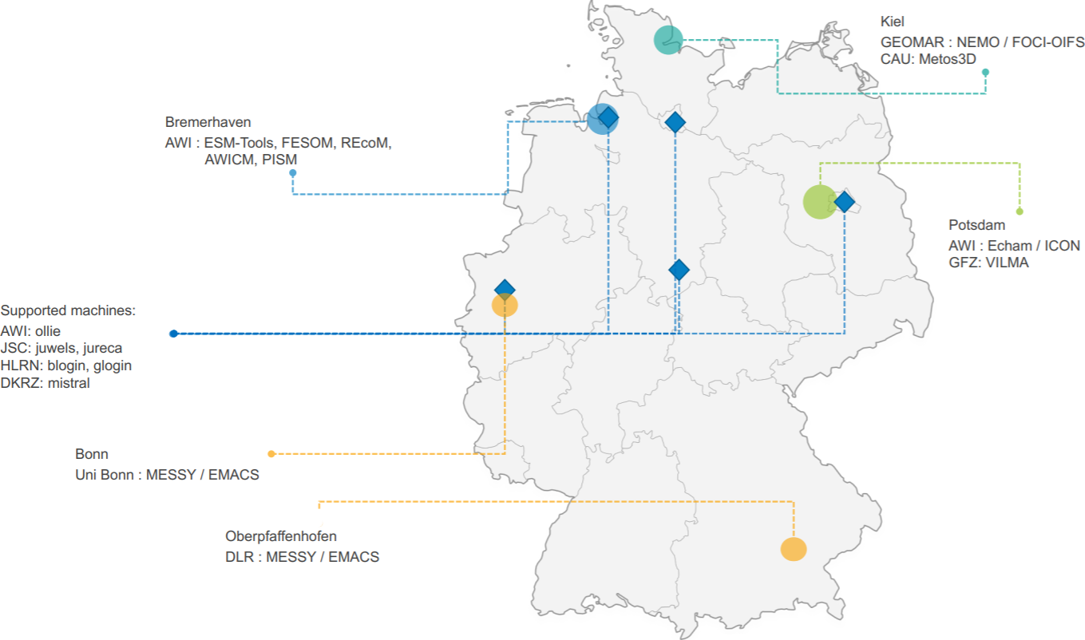
Supported Models & Couplings, Partners
1
Coupled Systems | Components
FOCI | VILMA
FOCI-OIFS | ICON
FESOM-REcoM | NEMO
AWIESM | REcoM
OIFSCL | AMIP
AWICM | debm
AWICM3 | FESOM
OIFSAMIP | scope
AWICMCR | xios
MPIESM | Echam
 | YAC
 | fesom_mesh_part
 | oasis3mct
 | rnfmap
 | MPIOM
 | PISM
 | nemobasemodel
 | OIFS
Notes:
Miguel

Slide 15
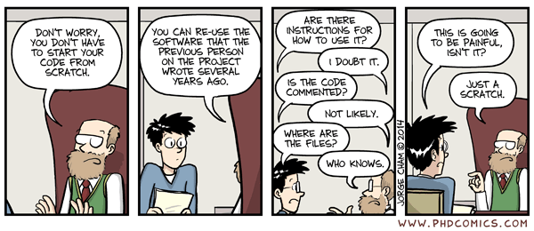
Need for the high-quality research software
BETTER
SOFTWARE
BETTER
RESEARCH
www.software.ac.uk
VS
Prof. Carole Goble
Software Sustainability Institute
https://ieeexplore.ieee.org/document/6886129
http://phdcomics.com/comics/archive/phd031214s.gif
Notes:
Deniz

Slide 16



VS
Old Workflow
ESM-Tools workflow
Obtain the model source code (usually a tar ball)
Build the model
configure
make
FAIL: Read the HPC documentation and repeat (libraries, compilers, modules, ...)
Prepare the data folders (input, boundary conditions, output, ...)
Setup the namelist for the models
Submit your job to the HPC system
Warning: environment mismatch
Resubmit / Iterative coupling
Move the data to the storage disk
Postprocessing of the results
Repeat the whole process for the next run or write a shell script for automatization.
Obtain and build the model code (from a repository)
Uniform environment for both installation and running
→ guaranteed integrity.
esm_master install-awicm-2.0
Prepare YAML based runscript
[OPTIONAL] Check if your run would run successfully:
esm_runscripts my_awicm_runscript.yaml -e my_first_test -c
Submit your job to the system:
esm_runscripts my_awicm_runscript.yaml -e my_first_test
Monitor your log files
Postprocess the results (esmviz, in progress)
Notes:
Deniz

Slide 17
VS
Old Workflow
ESM-Tools workflow
echam_prepare_forcing()
{
# forcing
if [[ "v$setup_name" = "vecham_standalone" ]]; then
case $SCENARIO_echam in
1850 | PI-CTRL*)
add_to ${echam_INPUT_DIR}/${RES_echam}/${RES_echam}${OCERES_echam}_piControl-LR_sst_1880-2379.nc unit.20
add_to ${echam_INPUT_DIR}/${RES_echam}/${RES_echam}${OCERES_echam}_piControl-LR_sic_1880-2379.nc unit.96
;;
HIST )
...
...
for ((yr = YR0_echam + -2; yr <= YRN_echam + 2; ++yr)); do
if [ $yr -le 1849 ] ; then
eval add_to ${echam_INPUT_DIR}/${RES_echam}/ozone/$ozonefile_1850 ozon$yr
elif [ $yr -le 2014 ] ; then
eval add_to ${echam_INPUT_DIR}/${RES_echam}/ozone/$ozonefile_hist ozon$yr
else
eval add_to ${echam_INPUT_DIR}/${RES_echam}/ozone/$ozonefile_scen ozon$yr
fi
if [ $yr -le 1849 ] ; then
add_to ${echam_INPUT_DIR}/${RES_echam}/volcano_aerosols/strat_aerosol_ir_${RES_echam}_1850.nc strat_aerosol_ir_${yr}.nc
add_to ${echam_INPUT_DIR}/${RES_echam}/volcano_aerosols/strat_aerosol_sw_${RES_echam}_1850.nc strat_aerosol_sw_${yr}.nc
elif [ $yr -le 2024 ] ; then
add_to ${echam_INPUT_DIR}/${RES_echam}/volcano_aerosols/strat_aerosol_ir_${RES_echam}_${yr}.nc strat_aerosol_ir_${yr}.nc
add_to ${echam_INPUT_DIR}/${RES_echam}/volcano_aerosols/strat_aerosol_sw_${RES_echam}_${yr}.nc strat_aerosol_sw_${yr}.nc
elif [ $yr -gt 2024 ] ; then
add_to ${echam_INPUT_DIR}/${RES_echam}/volcano_aerosols/strat_aerosol_ir_${RES_echam}_2024.nc strat_aerosol_ir_${yr}.nc
add_to ${echam_INPUT_DIR}/${RES_echam}/volcano_aerosols/strat_aerosol_sw_${RES_echam}_2024.nc
... and many more
general:
setup_name: "awicm"
compute_time: "00:15:00"
initial_date: "2000-01-01"
final_date: "2000-02-29"
base_dir: "/work/ollie/dural/sample_work_dir/"
nmonth: 1
nyear: 0
awicm:
version: "CMIP6"
postprocessing: false
scenario: "PI-CTRL"
model_dir: "/work/ollie/dbarbi/modelcodes/awicm-CMIP6/"
fesom:
pool_dir: "/work/ollie/pool/FESOM/"
mesh_dir: "/work/ollie/pool/FESOM/meshes_default/core/"
restart_rate: 1
restart_unit: "m"
restart_first: 1
further_reading:
- "fesom_output_control.yaml"
Notes:
Deniz

Slide 18
Advantages of ESM-Tools
1
Automation: minimal manual interaction Uniform (same structure), Data Integrity → Reproducible Portability: across different supported HPCs Abstraction: configuration (YAML) and operations (Python) are separated
Stateful: simulation configuration is stored
Modular & Extendable: easy to implement a new model and coupled setup or user plugins
Notes:
Deniz

Slide 19
Who benefits from ESM-Tools
1
System Admins
Modellers
Standardized Compile and Runtime Environments means fewer needed software packages. Deploy optimal machine settings or new modules easily.
Run your simulations in an easy and unified way, independent of the model and hardware. Have lots of functions with a few lines of runscript.
Model developers
Model supporters
Organize your developments, deploy them on different machines. Co-work with other institutes on the same code.
Solve problems once, not over and over again. Deploy bugfixes / new hardware configurations quickly to all users. Same experiment layout also means less context switching.
Notes:
Miguel

Slide 20




Technical reasons for using ESM-Tools
1
For Users
For Developers
(extended) YAML syntax is easy to read
Sample runscripts are already available
Well maintained
Issues on GitHub (and we will take care of them)
Updated regularly
Portable & Tested
Documentation (sphinx, readthedocs)
Workshops
Easier to read / write (compared to )
OOP, High level data structures
Easier to debug (via pdb, ipdb)
Configuration files are inherited
Hosted on GitHub & robust branching model
Open-source development is encouraged
[In progress] CI/CD, DevOps, Automated tests
Notes:
Miguel

Slide 21
Recap: Aim & Motivation
1
What ESM-Tools are / do
What ESM-Tools are / do not
A unified infrastructure for ESM modelling
Build the models without knowing the details of the HPC system
great for education, new colleagues
Run your simulation as easy as possible
One interface: standardize the modelling process for all of your models
One software to rule them all
Provide easy to read/write YAML based configuration
Generate a log documentation, easy monitoring
Organize files & directories (eg. input, forcing, output, log, executables, ...), archieve or clean your simulations.
A new model
A new coupler
A new imperative programming language
Change the model code / build process
Notes:
Deniz

Slide 22

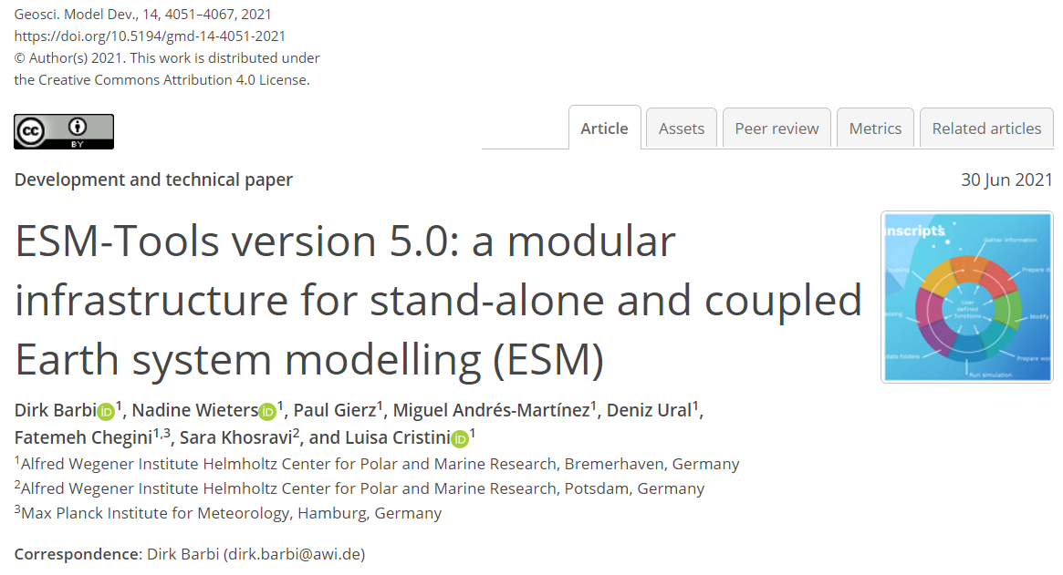




Contact & Community
1
https://github.com/esm-tools
https://github.com/esm-tools/esm_tools/discussions
https://github.com/esm-tools/esm_tools/issues
https://esm-tools.readthedocs.io
https://www.esm-tools.net
https://gmd.copernicus.org/articles/14/4051/2021/
@ToolsEsm
Barbi et. al., GMD (2021): https://doi.org/10.5194/gmd-14-4051-2021
Zenodo: https://doi.org/10.5281/zenodo.5787476
ESMTools
Notes:
Deniz

Slide 23
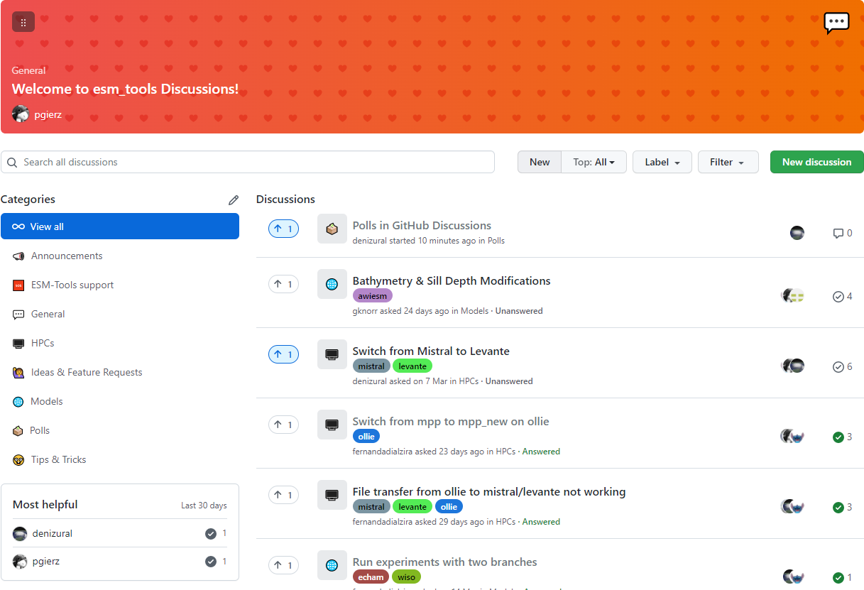
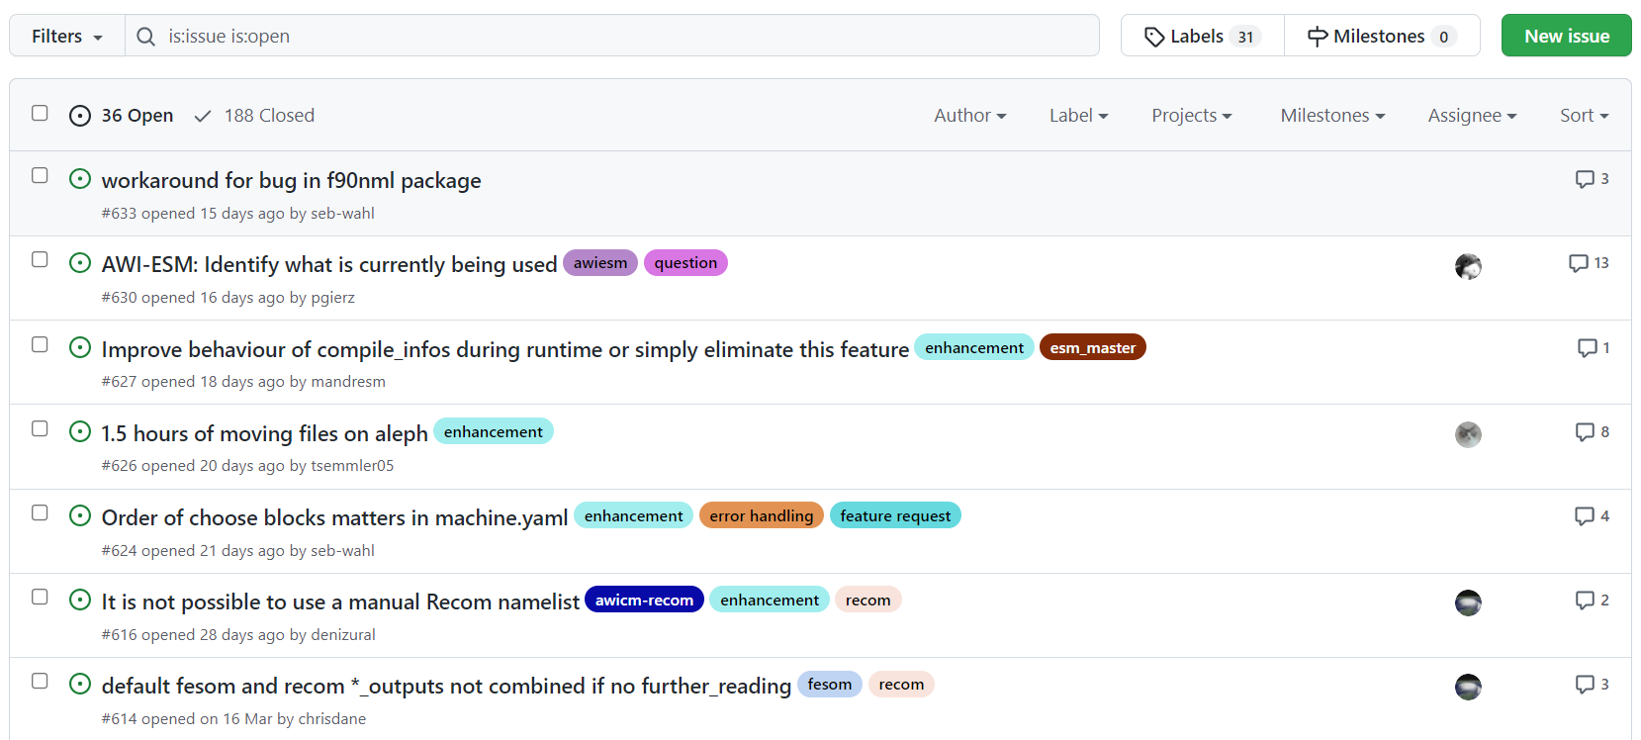
Community: Issues and Discussions
1
Open to everyone
Single platform
Searchable
Agile
Notes:
Deniz

