Slide 1
Socket Programming
By: Erik Macik, Spring 2022

Slide 2
What are Sockets?
Simple points of network communication between 2 machines.
Sockets can be used to send and receive information (Text, objects, other data). Through input and output streams.
Sockets listen and send information through the host machine’s IP address and port.
Most languages and platforms have a built in Socket library.

Slide 3
Ip addresses and Ports
Internet Protocol (IP) – Uniquely identifies a device on the internet or on a local network.
More about IP addresses
Port – A logical communication endpoint managed by the device’s operating system. Ports are identified by port numbers.
Common reserved ports – A ConnectException will be thrown if you try to use a port that is in use.

Slide 4
Creating a Socket Connection in Java
SERVER creates a new ServerSocket on an open port.
SERVER calls ServerSocket.accept(). At this point, the server pauses and is waiting for a connection on the accept method…
CLIENT creates a new socket with the IP and port of the server socket. The client automatically connects to the server socket.
SERVER’s ServerSocket.accept() method returns a Socket once the client connects.

Slide 5
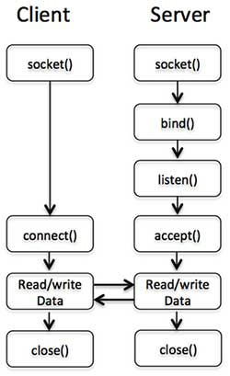
Creating a General Socket Connection
This diagram is a conceptual flow. Some steps (bind(), listen(), and connect()) execute in the background.
bind() – attach to a specific port
listen() – mark the socket as one that will accept some data
accept() – wait for a client socket connection

Slide 6
Socket Classes and methods to know
ServerSocket
Constructor, accept()
Socket
Constructor, getInputStream(), getOutputStream()
DataOutputStream
Constructor, writeUTF()
DataInputStream
Constructor, readUTF()

Slide 7
Sending and receiving information
Socket A and B are connected. A wants to send to B.
A creates a DataOutputStream with it’s socket’s OutputStream.
B creates a DataInputStream with it’s socket’s InputStream.
A sends to B by writing to the DataOutputStream (writeUTF(), writeDouble(), writeChar(), etc.)
B receives from A by reading from the DataInputStream (readUTF(), readDouble(), readChar(), etc.)

Slide 8
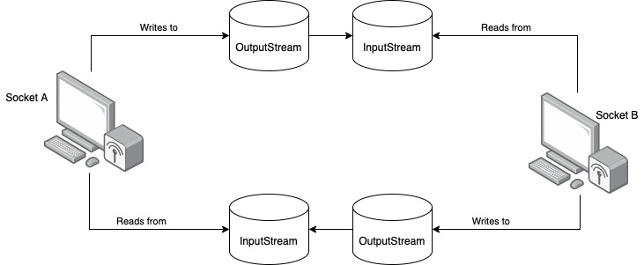
Sending and Receiving Information

Slide 9
Exercise: Socket Group Chat
GOAL: Create a class group chat that operates over socket connections.
Erik’s computer will act as the SERVER responsible for receiving and displaying messages from CLIENTS.
Your computer will act as a CLIENT sending messages to the SERVER.

Slide 10
Message Server with Multiple Clients
MessageServer waits for new clients to connect. Each time a client connects, a new EchoThread is created with the new socket connection.
The MessageClient sends the name of the user to its EchoThread. The EchoThread saves the user name.
Each EchoThread continuously receives and prints messages from its MessageClient.
Follow the code in MessageServer.java and EchoThread.java and the diagram on the following slide for a more detailed look at these steps.

Slide 11
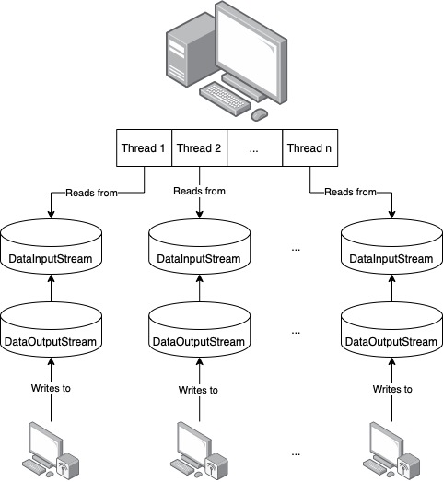
Message Server with multiple Clients

Slide 12
YOUR TASK: Complete the Message Client
Read and understand MessageServer.java and EchoThread.java by reading the code and JavaDoc for each method and attribute. Know the goal of each class, attribute, and method.
Read and understand MessageClientForStudents.java by reading the code and JavaDoc for each method and attribute. Know the goal of each attribute and method.
Add the Socket, DataOutputStream, and user name attributes to MessageClientForStudents.java.
Complete the methods in MessageClientForStudents.java.
Complete the constructor MessageClientForStudents()
Complete setClientName()
Complete startClient()
Complete the main method.

Slide 13
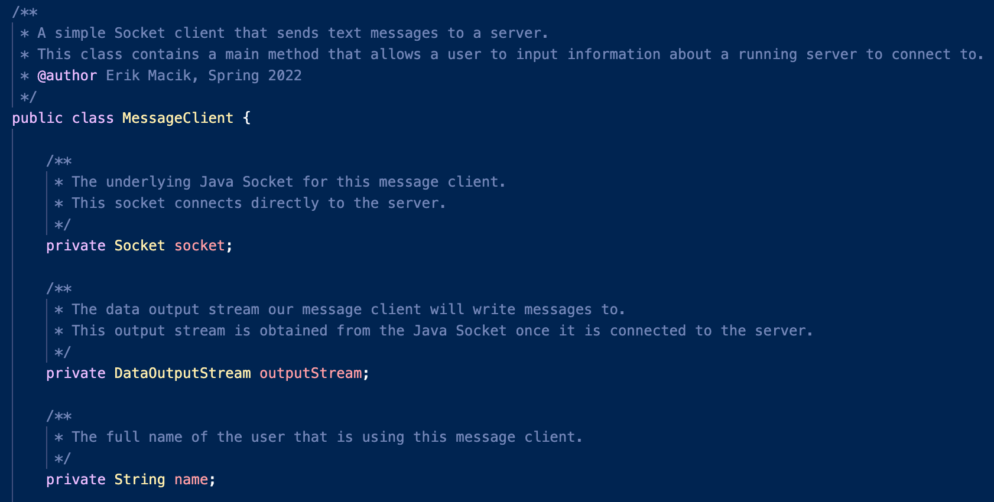
Step 3 – Attributes

Slide 14
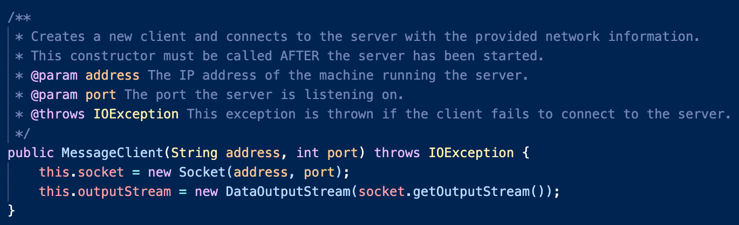
4A – Constructor

Slide 15
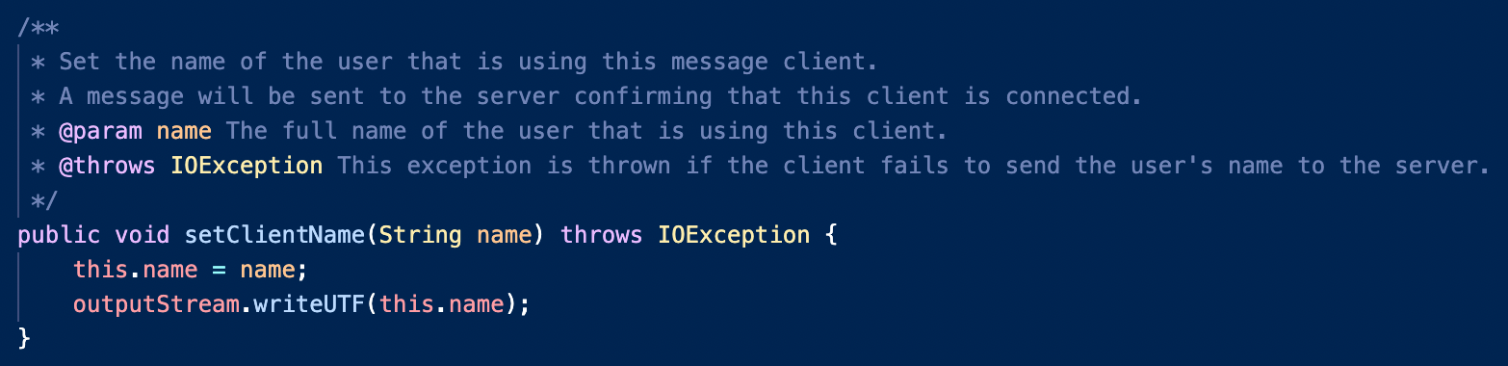
4B - set Client Name

Slide 16
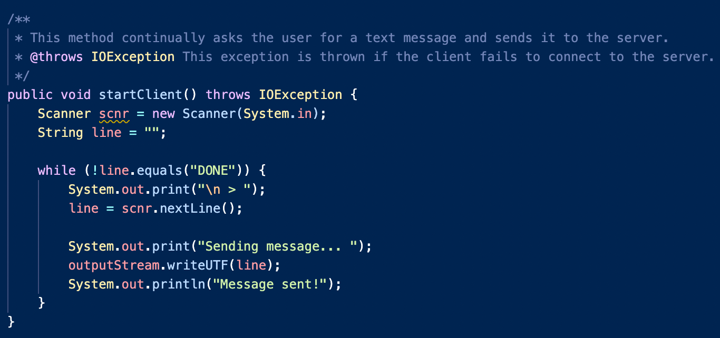
4C – start client

Slide 17
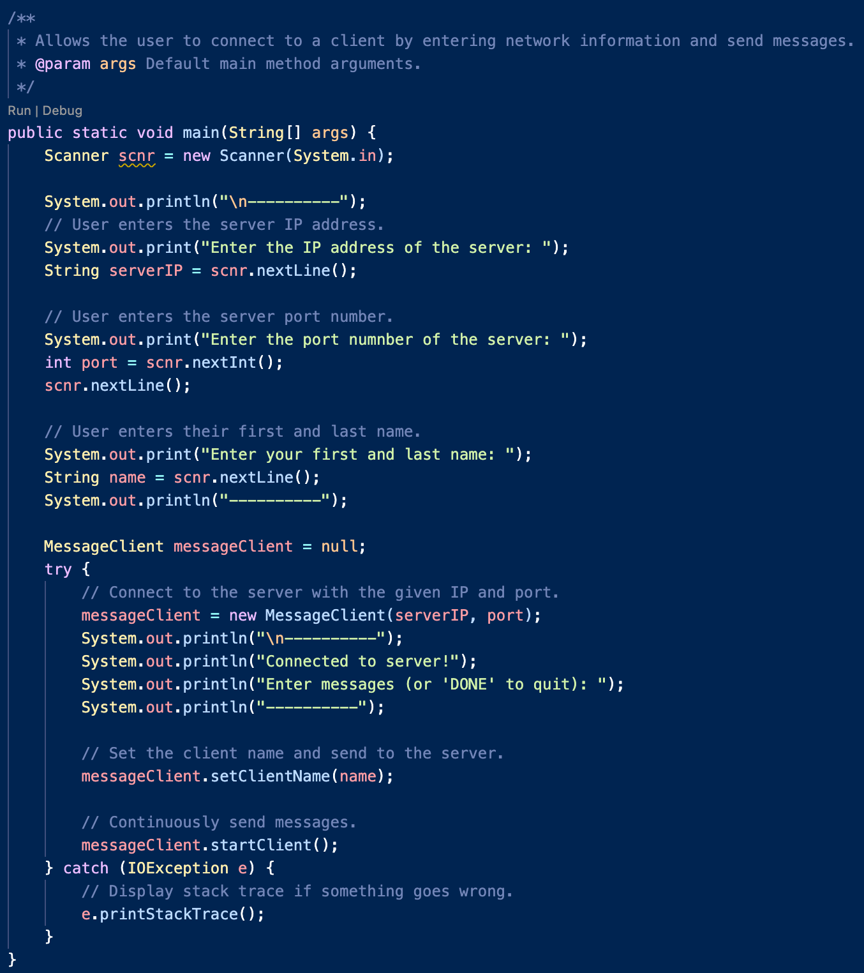
4D - main

