Slide 1
Intel Ivy Bridge
Ali Esmaeili
Isfahan University of Technology

Slide 2
Overview
Compromises needed
Think big make small
Tick Tock model
22 nm Technology and importance
Graphics
Cache and Memory
Interrupt
Screen Panel
Other features and Next generation

Slide 3
Compromises needed
Computing needs to be engaged in human ways
Computing should be consistent regardless of the device
Computing with custom preferences
Computing should be secure

Slide 4
Think big make small
Core i3, i5, i7 cpus are based on sandy bridge architecture (32 nm)
Penryn, Nehalem, Westmere, Sandy Bridge, Ivy Bridge (22nm)
Ivy bridge is still Core i3, i5, i7
Put in more transistors into the chip
Sandy bridge has at most 1.16 billion transistors the new Ivy bridge 1.4 billion

Slide 5
Tick Tock Model
Tock : new architecture on existing processor technology
Tick: take that architecture and make it compatible to the new processor technology while it changes

Slide 6
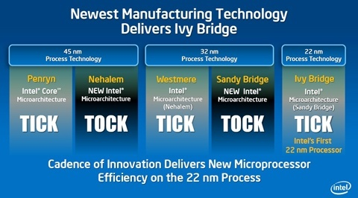
Tick Tock Model

Slide 7
22nm 3-D transistors
Reduce Power Consumption
Reduce Heat Production (good for laptops)
Same performance in 22nm and 32nm able to do with half the power
In the same voltage 37% more performance at a transistor level
Restrictions are on the sizes been used (how the die is made)

Slide 8
22nm 3-D transistors
Optimization for string operations
Float 16 (single precision when saving, double precision on calculations)
New random number generator (previous number generators were pseudo random)
The new random number generator is high quality and has a high bit rate (moving of a mouse or a custom set of keystrokes on keyboard)

Slide 9
Importance
These chips are put on LGA1155 sockets which are compatible to Sandy Bridge as well
Gigabyte has Announced 6 series ready to support Ivy Bridge via bios upgrade
Ivy bridge = Sandy Bridge -> 22nm

Slide 10
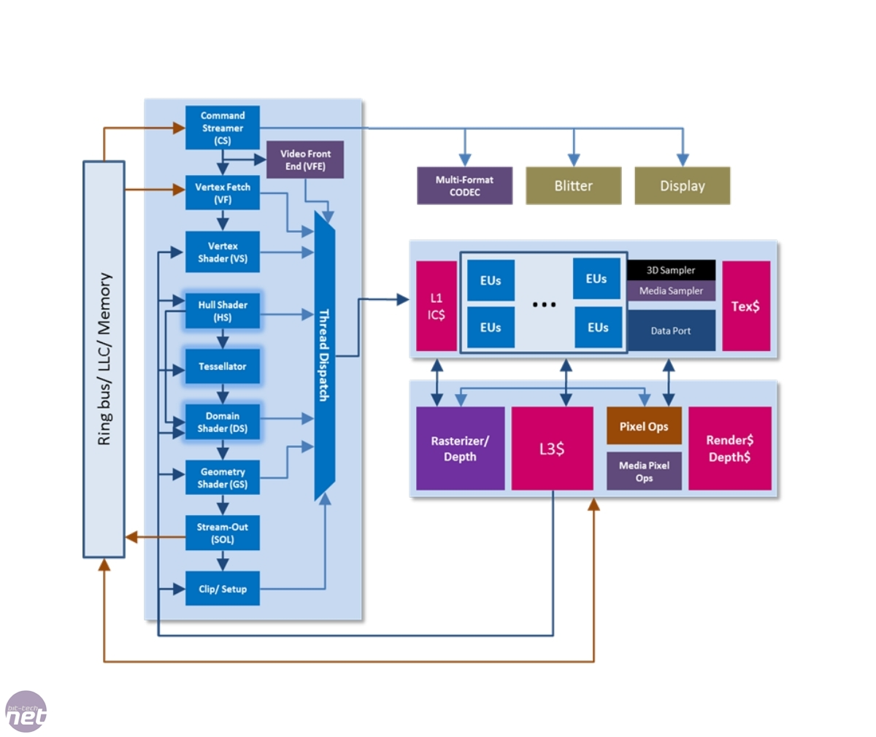
Graphics Architecture

Slide 11
Graphics
Rendering: The process of generating an image from a model or scene
Scene
Geometry
Viewpoint
Lighting
Shading

Slide 12
Shader
Simple program that describe the characteristic of a vertex or a pixel
Types of Shaders:
Pixel Shader
Compute color or other attributes of each pixel
Vertex Shader
Transform each vertex 3D position in virtual space to 2D coordinate to appear on the screen
Geometry Shader
Generate new primitives, such as point, lines and etc

Slide 13
Graphics
Supports OpenCL 1.1 DirectX 11, OpenGL 3.1
Three display outputs
More execution units
Either 8 or 16 depending on the GPU
6 or 12 On Sandy Bridge
L3$ lowers bandwidth need from ring architecture therefore less energy spent
60% more graphics performance

Slide 14
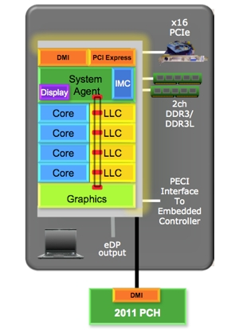
Cache and Memory
Cache used is same as Sandy bridge
Introduction of DDR3L Memory with 1.35V
Due to power gating the DDR channel, when there is no use, it is shut down
Max Frequency: 2133 MHz -> 2800MHz
Notes:
Integrated

Slide 15
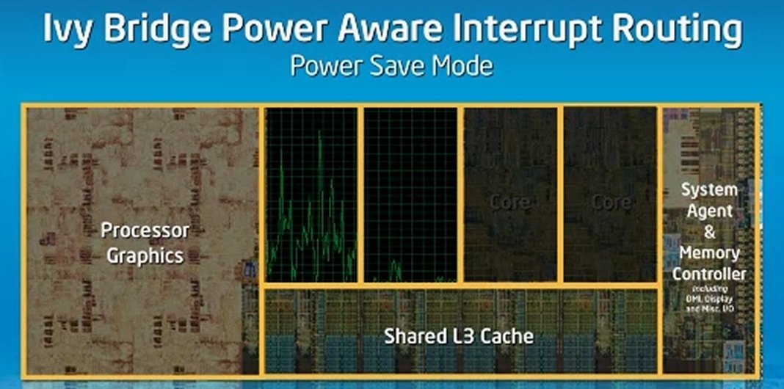
Ivy bridge Power Aware Interrupt Routing

Slide 16
Ivy bridge Power Aware Interrupt Routing
Based on the concept of interrupts
USB gives about 3000 interrupts per second
Core’s are usually sleeping especially core 0
Interrupts causes the cpu to wake up and execute the ISR
This causes more power usage
Why wake up a slept core?
Run interrupt on core which is awake

Slide 17
Screen Panel
LVDS Panel
eDP v1.3 Panel (Panel Self Refresh)
Frame buffer in TCON can maintain the display image without receiving video data from GPU
This allows the GPU to enter a low power state
Allowing the GPU to power down saves significant power
Doesn’t wake cpu up 60 times a second
The power usage difference is about 500 mwatts

Slide 18
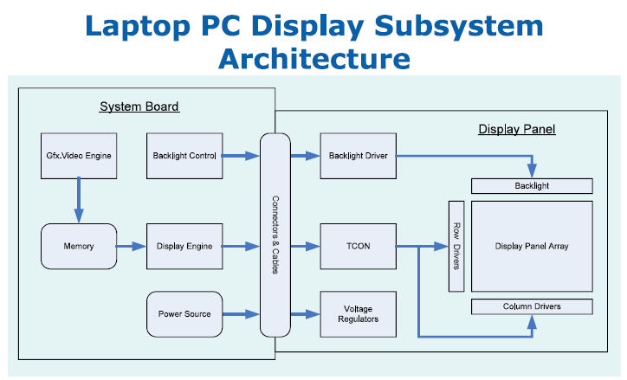
LVDS Panel

Slide 19
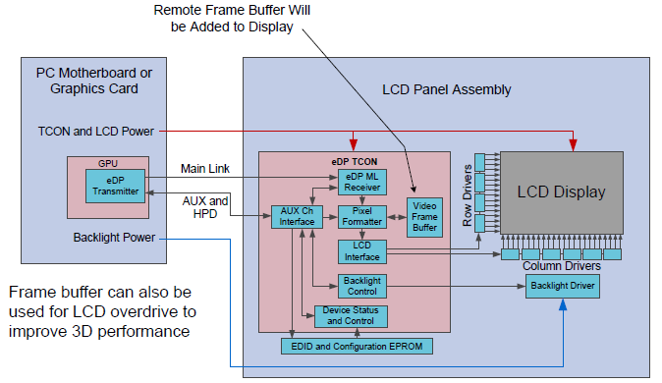
eDP 1.3 Panel

Slide 20
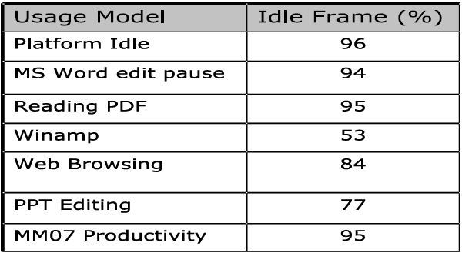
Idle frame statistics

Slide 21
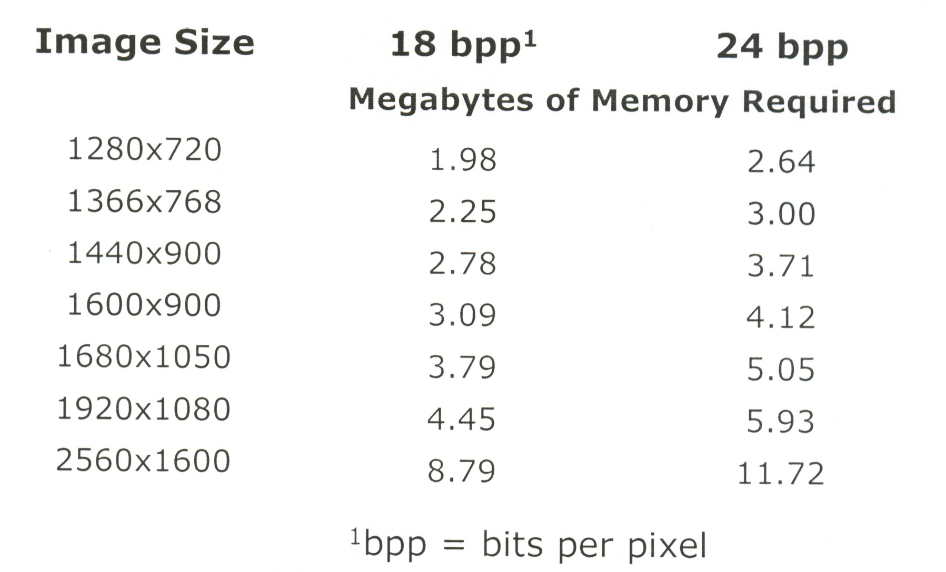
Frame buffer size with no compression

Slide 22
Other Features
Support for USB3.0
Add a third party chip to give USB 3.0 support
Ivy bridge has a default chipset for USB 3.0
Thunderbolt
PCI Express and DisplayPort into a serial data interface (20Gbit/s)
Provide support for most chipsets (Northbridge, Southbridge)
P67
Z68
Introduce new chipsets
Head77
Z77

Slide 23
Other Features
Cpu performance is increased by about 8-10%
Integrated GPU
Ideal for laptop and ultraportables
These chips are going to run windows 8 (enhanced touch capabilities)
Threading and usage of processor cores have been changed

Slide 24
Hybrid boot
Leverages Hibernate technology to reduce boot time
Improvements in hibernate stack to parallelize compression and I/O
Hybrid Boot is the default boot for windows 8
Boot time less than 10 seconds
1/3 boot time is for the bios
2/3 boot time is for the OS

Slide 25
Haswell
Next generation: Haswell 22nm
Ultra lifetime battery and ultra performance
24 hour runtime
10 days of connected standby
Haswell is been worked on for years
Availible in 2013
Haswell will complete the Ultrabook revolution

Slide 26
Thank you for your attention
Q&A

